Slide 1
Healthy Behaviors, Healthy Kids: Nutrition, Physical Activity, and Sleep in the Out-of-School Setting
Julia Richards Krapfl, MS
Center for Advocacy & Outreach
All Kids Healthy Outreach Program
Healthy Kids Clinic

Slide 2
Healthy Behaviors, Healthy Kids
What should kids eat?
What’s important in child nutrition?
Physical Activity and Sleep
Effects of lack of N/PA/S
Screen Time
Factors affecting N/PA/S
Role of the caregiver

Slide 3
What Kids Should Eat

Slide 4
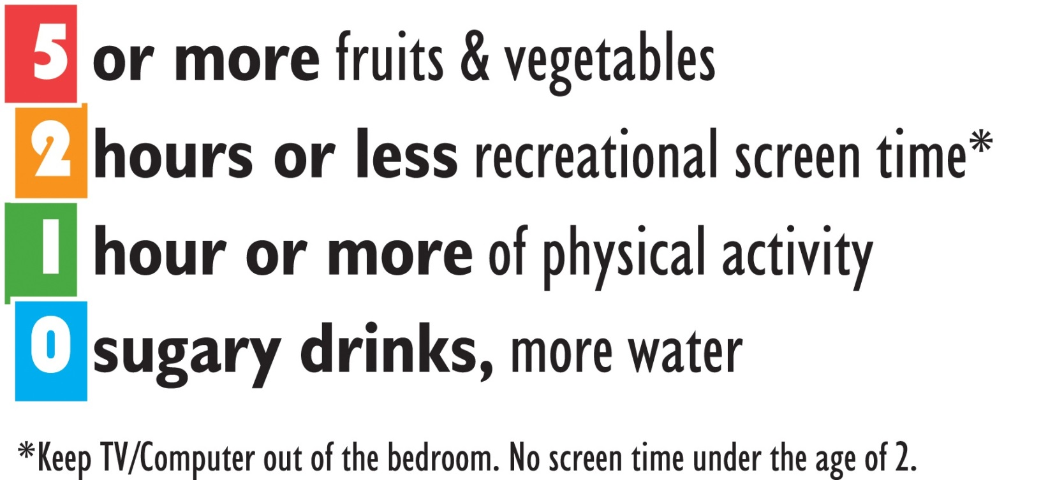

Slide 5
Nutrition Basics
Macro Nutrients
Carbohydrate Source of energy
Sugars and Starches
Body breaks them down into glucose to feed cells
Grains, fruits and vegetables, dairy, beans
Protein Used to build and repair muscle
Hair and skin
Helps us feel full longer
Fat Source of energy
Used to store vitamins and minerals
Essential for hormone production
Protection for organs

Slide 6
Nutrition Basics
Serving Sizes
Fruit ½ cup
Vegetables ½ cup
Grains 1 ounce equivalent (1 slice bread, 1 cup cereal, ½ cup cooked rice/pasta/cereal, 5 whole wheat crackers, 3 cups popcorn, 1 pancake, ½ English muffin)
Protein 1 ounce equivalent (1 ounce meat/poultry/fish, ¼ cup cooked beans, 1 egg, 1 tablespoon peanut butter, ½ ounce nuts/seeds)
Dairy 1 cup milk (1 ½ ounces hard cheese, 2 cups cottage cheese, 1 cup yogurt, 2 ounces processed cheese)

Slide 7
What Kids Should Eat
Example 1:
Female Age 11 4’8” 86 lbs
Moderately active over 60 min/day
6th Grade
Calories: 2000/day
Same child with 30-60 min moderate activity: 1800 calories
Same child with less than 30 min moderate activity: 1600 calories

Slide 8
Nutrition for Kids

Slide 9
What Kids Should Eat
Example 2:
Female Age 15 5’6” 142 lbs
Moderately active over 60 min/day
9th Grade
Calories: 2600/day
Same child with 30-60 min moderate activity: 2200 calories
Same child with less than 30 min moderate activity: 2000 calories

Slide 10
Nutrition for Kids

Slide 11
What Kids Should Eat
 | 1600 cals | 2000 cals | 2600 cals
Fruits | 1 ½ cups | 2 cups | 2 cups
Veggies | 2 cups | 2 ½ cups | 2 ½ cups
Grains | 5 ounces | 6 ounces | 9 ounces
Proteins | 5 ounces | 5 ½ ounces | 6 ½ ounces
Dairy | 3 cups | 3 cups | 3 cups
Added Sugar | 20-40g 5-8 tsp | 20-40 g 5-8 tsp | 20-40 g 5-8 tsp
Added sugars: 12 oz can Coke 39 g/9.33 tsp
1 cup Chocolate milk 13 g/3.25 tsp

Slide 12
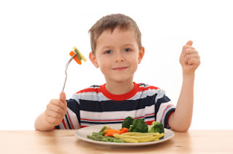
What’s Important
Look for nutrition
100 calories does not equal nutrition
May not have added sugars, but also may not have fiber, protein, vitamins, etc.
Less sugar and less artificial sweetener
More F&V
Meals
Snacks
Encourage tasting
14 or more exposures before kids will try it
Multiple colors
Whole Grains: What’s the difference?
Whole vs refined
Fiber

Slide 13
What’s Important
Balanced eating
Include food from all food groups
Different nutrients from different food groups
Substitutions
Avoid overeating and not eating enough
Need enough fuel for body to perform vital functions
Nutrition, not just calories

Slide 14
Is it really “Just One Time?”
Classroom birthday treats including teacher’s birthday = 27
Birthday parties for themselves, 2 friends, 2 parents, 2 sisters, 3 cousins, and 2 other relatives = 12
Classroom parties, Fun Night, Field Day = 5
Treats after softball and basketball games and 4-H meetings = 24
County Fair and State Fair = 6 days
Halloween candy = 14 days
Christmas candy and cookies = 14 days
Holiday gatherings = 3
Valentine’s Day gifts and classroom exchange candy= 7 days
Easter gifts and candy = 7 days
Total = 119 days
Not included: random sleepovers and playdates, making cookies at home, trips for frozen yogurt, visits to Grandma’s house, concession stand purchases, parades, rewards for immunizations and good grades, and items like chips, regular pizza, and hot dogs.

Slide 15
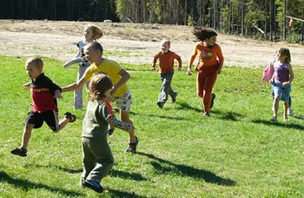
Physical Activity
How much 60 minutes
Types of physical activity Cardiovascular
Strength
Flexibility
Why important Prevent chronic diseases
Control weight
Cardiovascular benefits
Improve sleep
Relieve stress
Increased energy

Slide 16
Physical Activity
Accurate picture of how much physical activity they are getting
 | 11 yr old | 15 yr old
PE | 40 min every other day | 40 min every other day
Dance/Sport | 3 days/week 5.5 hours total | 4 days/week (3 2x/day) 16.25 hours
Other Activities | Horseback riding 2-4 hours/week | Horseback riding 2-4 hours/week
Play/Practice at Home | 5-10 hours/week | 3-6 hours/week
How “active” is their activity?

Slide 17
What’s Important
Physical Activity
Active Education: Growing Evidence on Physical Activity and Academic Performance Active Living Research, Research Brief, January 2015.
Children engaged in regular physical activity performed better on standardized tests than those who were sedentary.
Improved attention and memory-both crucial to learning
Brain imaging shows that children who participate in physical activity have increased neural firing than those who were sedentary.

Slide 18
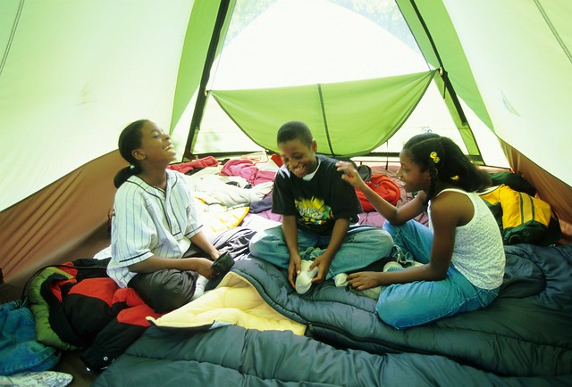
Sleep
How much Ages 6-13 9-11 hours
Times 8:00/9:00pm 6:00/7:00am
Why important? Sleep is when our bodies repair themselves
Important to attention and memory
Improved behavior
Better emotional stability

Slide 19
Effects of Inadequate Nutrition
Health Lacking essential macro and micro nutrients can lead to health problems: early puberty, certain cancers, osteoporosis, bone and liver problems, Type 2 Diabetes, gallstones
Energy imbalance-can lead to weight gain
Attention Difficulty focusing, especially with high-sugar foods
Learning Poor memory
Difficulty retaining information
Behavior Poor impulse control
Easily distracted
Poor decision-making

Slide 20
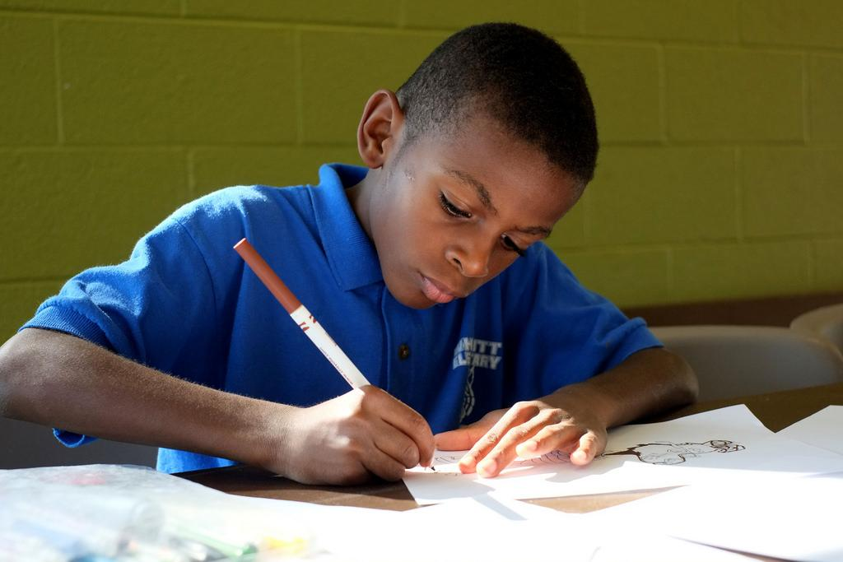
Effects of Inadequate Nutrition
How this looks in the school/out-of-school setting
Inability to focus on or finish homework, play game
Impulsive, easily distracted
Irritable, mood swings
Difficulty controlling emotions
Tired, low energy

Slide 21
Effects of Lack of Physical Activity
Health Risk of health problems-bone and cardiovascular illnesses
Energy imbalance
Increase risk of injury with physical activity
Tire easily
Sleep problems
Attention Difficulty focusing
Learning Difficulty with memory
Behavior Lack of energy
Restless
Mental Health Evidence suggesting regular activity can improve mood and some mental health symptoms
How this looks in the school/out-of-school setting

Slide 22
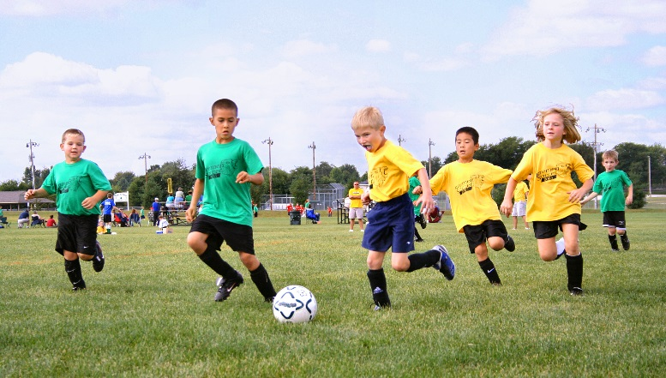
Effects of Lack of Physical Activity
How this looks in the school/out-of-school setting
Child may have trouble sitting still
Child may have low energy and not want to participate in physical activity
Difficulty with attention and memory

Slide 23
Effects of Lack of Sleep
Health Increased risk for various health concerns
Overeating
Tired, lack of energy
Unable to recover from illness
Attention Difficulty focusing
Falling asleep
Learning Inability to retain information (memory)
Behavior Irritable
Impulsive
Poor decision making

Slide 24
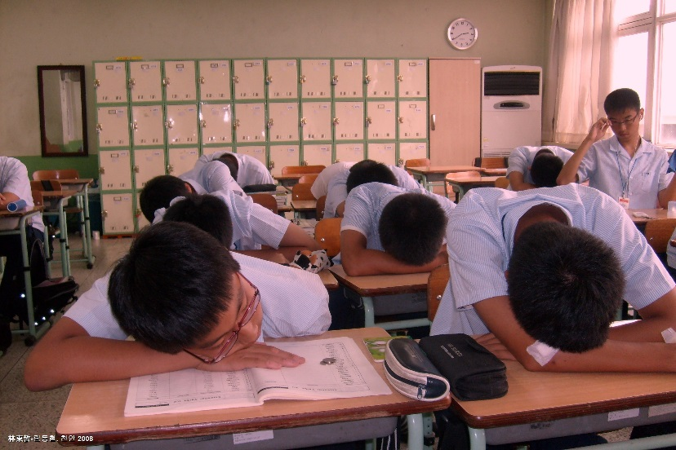
Effects of Lack of Sleep
How this looks in the school/out-of-school setting
Falling asleep
Lack of interest in participating in activities
Low-energy
Depressed mood

Slide 25
Screen Time
What it is Any time spent on a screen that is not for educational purposes
Cell phones, tablets (Ipad), TV, movies, video games
What is recommended 2 hours or less
Break up into 30 minute segments
Health Sedentary
Over or undereating
Difficulty falling asleep
Attention Difficulty focusing
Learning Memory attention
Behavior Impulsive
Upset when screen-time is limited

Slide 26
Screen Time
How this looks in the out-of-school setting
Lack of interest in participating in non-screen activities
Short attention span
Irritable with being limited on screen-time
Sneaking in devices
All of the lack of PA/Sleep symptoms

Slide 27
Factors Influencing Nutrition, Physical Activity, and Sleep
Food insecurity
Misinformation
Parents work schedules
Caregivers
Home environment
Appropriate sleeping space
Unregulated screen time

Slide 28
Your Role in Promoting Health Behaviors
Food insecurity Provide education, provide healthy snacks, list of resources, backpack program, grants
Misinformation Educate yourself, provide evidence-based curriculum on health
You are the example What you eat, drink, do
Talk about what you ate, did, etc.
Provide quiet space for kids who need a break
Limit screen time Out-of-school is a place for homework and fun activities

Slide 29
Resources
Academy of Nutrition and Dietetics EatRight.org
Midwest Dairy midwestdairy.com
Spend Smart. Eat Smart. App and website spendsmart.extension.iastate.edu
American Academy of Pediatrics Healthychildren.org
5210 Let’s Go! Let’sGo.org
Central Iowa 5210 unitedwaydm.org/5210

Slide 30
Resources
Fuel up to Play 60 www.fueluptoplay60.com
Alliance for a Healthier Generation www.healthiergeneration.org
Team Nutrition www.fns.usda.gov/tn/ and https://www.educateiowa.gov/sites/files/ed/documents/Indoor%20Recess%20101_0.pdf
Live Healthy Iowa Kids www.livehealthyiowakids.org
CATCH www.catchinfo.org
Kids’ Activities Blog http://kidsactivitiesblog.com/25870/physical-fitness

Slide 31
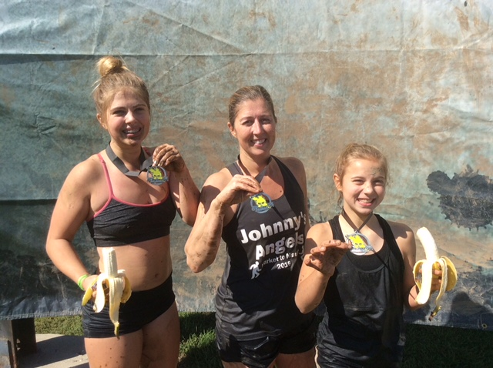
Thank You!
Julia Richards Krapfl
Julia.Richardskrapfl@unitypoint.org
515-241-3317
www.blankchildrens.org/allkidshealthy

