Slide 1

Iowa 21st CCLC Local Evaluation Form 2021-2022
October2022
R&R Educational Consulting

Slide 2
Changes for
2021-2022
Sections | What Changed
General Information | Title Reformatted – Only Cohorts 12-16
Introduction/Executive Summary | No Changes
Demographic Data | Attendance Tables reflect new APR Requirements. Removed Number of Centers in Partnership Table.
GPRA Measures | All new – Five GPRA Measures in total.
Local Objectives | Five Objectives per cohort. No objectives that mirror GPRA Measures.
Anecdotal Data | No Changes
Sustainability Plans | Discussion of original plan. No need to copy and paste entire plan.
Summary and Recommendations | URL should pull up evaluation without requiring download.

Slide 3
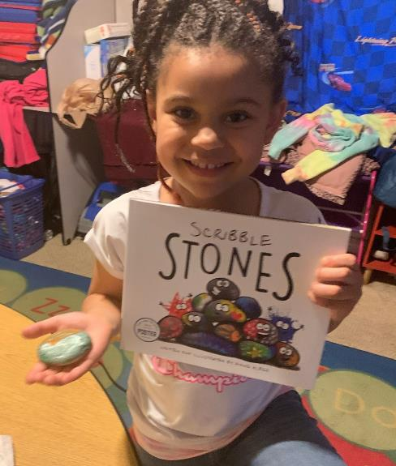
General Information
ORGANIZATION NOT name of Program
Only Cohorts 12-16

Slide 4
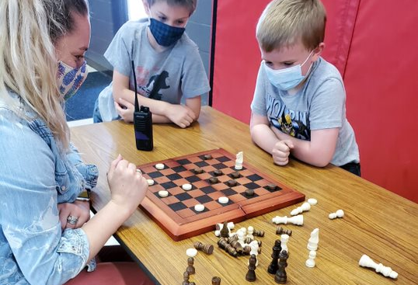
Introduction/Executive Summary
Include Required Elements
Hit the high spots
(Brag)

Slide 5

Demographic Data
Separate Tables for School Year and Summer of 2021

Slide 6
Attendance Tables
Reflects APR Data
Totals by row
Totals by column

Slide 7
Attendance Tables
Total Attendance

Slide 8
Attendance Tables
Total Attendance

Slide 9
Attendance Tables
Total Attendance

Slide 10
Attendance Tables
Total Attendance

Slide 11
Attendance Tables

Slide 12
Partnership Table
Use these (Numbers Only, comma separated)
Total Dollar Value
Three Types ONLY

Slide 13
Parent Involvement

Slide 14
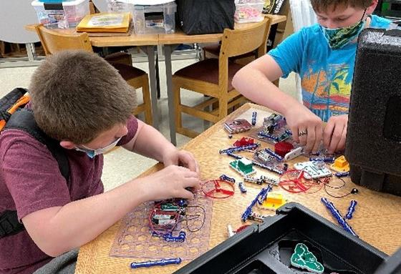
GPRA Measures

Slide 15
GPRA Measures
Tables mirror APR Tables. DO NOT CHANGE.
Current School Year reference = 2021-2022 School Year
If you have no data for any measure, you MUST explain.

Slide 16
GPRA Measure 1A Reading Progress
Same as APR
New attendance rules.
Percentage row not in APR.
Percentage of students in grades 4-8 participating in 21st CCLC programming during the school year and/or summer who demonstrate growth in reading and/or language arts on State Assessments.

Slide 17
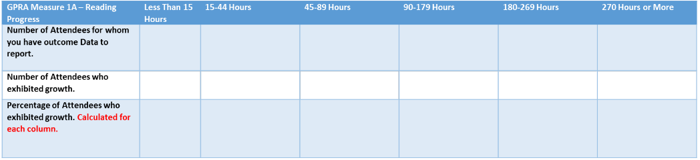
GPRA Measure 1A Reading Progress Example
The percentage is calculated by dividing the Green row amounts by the Purple row amounts and multiplying the result by 100. Then round the answer to zero decimal points.
Example. For Less than 15 hours.
3 divided by 10 equals .30
.30 times 100 equals 30%.
(3/10)*100=30%

Slide 18
GPRA Measure 1B Math Progress
Same as APR
New attendance rules.
Percentage row not in APR.
Percentage of students in grades 4-8 participating in 21st CCLC programming during the school year and/or summer who demonstrate growth in mathematics on State Assessments.

Slide 19
GPRA Measure 2 Academic Achievement GPA
Same as APR
Grade Point Average Determination
A = 4 points
B = 3 points
C = 2 points
D = 1 Point
F = 0 points
Total GPA = the average of all GPA Points
New attendance rules.
Percentage row not in APR.
Percentage of students in grades 7-8 and 10-12 attending 21st CCLC programming during the school year and/or summer with a prior-year unweighted Grade Point Average (GPA) of less than 3.0 who demonstrated an improved GPA.
Unweighted GPA does not adjust GPA for honors and/or other extra GPA point items.

Slide 20
GPRA Measure 3 School Day Attendance
Same as APR
New attendance rules.
Percentage row not in APR.
Percentage of students in grades 1-12 participating in 21st CCLC during the school year who had a school day attendance rate at or below 90% in the prior school year and demonstrated an improved attendance rate in the current school year.

Slide 21
GPRA Measure 4 Behavior
Same as APR
New attendance rules.
Percentage row not in APR.
Percentage of students in grades 1-12 attending 21st CCLC programming during the school year and/or summer who experienced a decrease in in-school suspensions compared to the previous school year.

Slide 22
GPRA Measure 5 Teacher Survey
Same as APR
New attendance rules.
Percentage row not in APR.
Percentage of students in grades 1-5 participating in 21st CCLC programming in the school year and/or summer who demonstrated an improvement in teacher-reported engagement in learning.

Slide 23
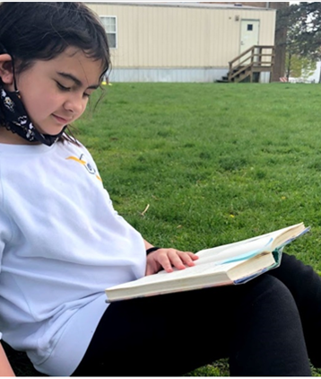
GPRA Measures Discussion
Answer this question:
How well did your program do if the only measure of success was performance on the GPRA Measures?
If the answer is not very well, include a discussion on how to improve.

Slide 24
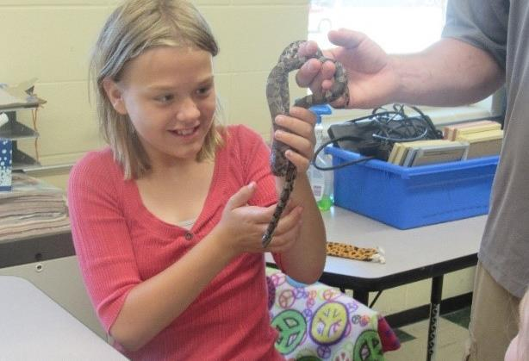

Local Objectives

Slide 25
Local Objectives
Local Objectives should NOT mirror GPRA Measures. For example, since Reading and Math achievement are covered by GPRA Measure 1 there is no need to have Local Objectives on Reading or Math achievement.
Objectives are rated using one of four ways ONLY.
  Met the stated objective.
  Did not meet but made progress toward the stated objective.
  Did not meet and no progress was made toward the stated objective.
  Unable to measure the stated objective.
Additional Objectives can be summarized in the Discussion Section

Slide 26
Local Objectives Tables
Separate Tables for each Cohort 12-16
There can be only Five.
One of four ratings.
What method of measurement was used and how was the rating determined.

Slide 27
Local Objectives Discussion

Slide 28
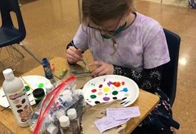
Anecdotal Data

Slide 29
Anecdotal Data

Slide 30
Best Practices
Possible categories of Best Practices
Program Operations
Community and Parental Involvement
Objectives
COVID-19 Coping Mechanisms
Developed for State Evaluation for 2020-2021.
Iowa Afterschool Alliance Quality Standards
https://www.iowaafterschoolalliance.org/quality

Slide 31
Best Practices
Description of the practice/activity.
Students were given a snack and some physical activity time before working on academic tutoring.
Methodology of measuring success of best practice.
Students will become more engaged once they experience some downtime.
Information on why practice/activity was implemented.
Students complained and were easily distracted if academic tutoring was immediately after school.
Impact of practice/activity on attendance OR student achievement.
Students were more likely to make gains in grades and test scores. (GPRA Measures 1 and 2)

Slide 32
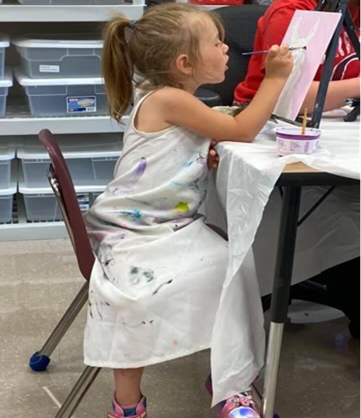
Pictures
Students engaged in activities and learning – Action shots.
Use posed pictures sparingly.
4-8 of your best pictures.
No montages – individual pictures.
No links to social media.
Show kids learning and having fun.

Slide 33
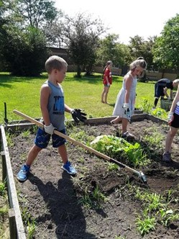
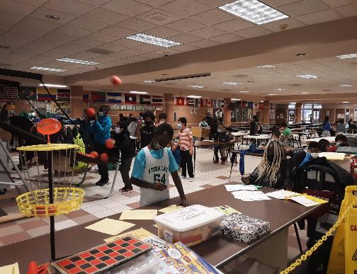
Pictures Examples

Slide 34
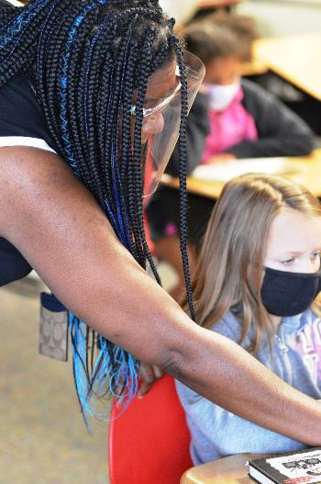
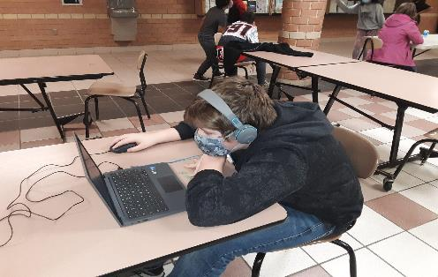
Pictures Examples

Slide 35
Anecdotal Data

Slide 36
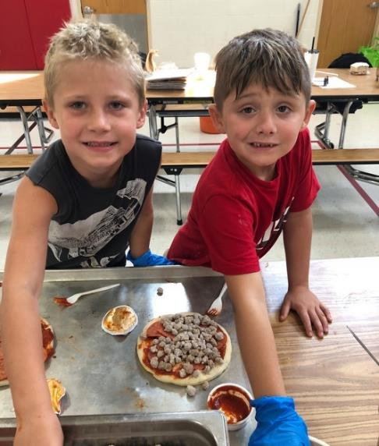
Sustainability Plans
It is not necessary to paste your entire plan.
Discuss formal sustainability plan from your original grant application including how it has changed.
How program will continue without 21st CCLC grant funding.
How partnership contributions will help the program continue (refer to partnership table from section 3).

Slide 37
Summary and Recommendations
The URL should pull up the Local Evaluation, not just the page where it can be found. The URL should also not download the file. The Local Evaluation should be readable in the browser window.

Slide 38
Summary and Recommendations

Slide 39
Unexpected Data
(Unusual circumstances that occurred during the past school year- Flood, Tornado, Storm, Pandemic or other).
Explain how this affected the program and how you responded to continue to serve children.
What new procedures did you introduce?
How did the Staff, Students and Parents respond?
You may include pictures to help illustrate the challenges faced because of natural disaster.

Slide 40
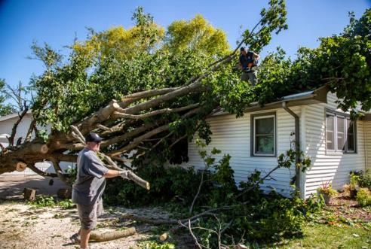
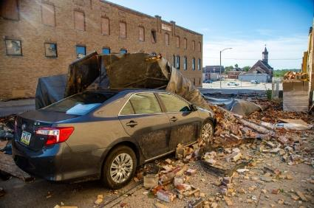
Unexpected Data Example
The second year proved to be the most challenging. On August 10, Marshalltown was devastated by a derecho storm equivalent to a category 4 hurricane with rain, hail, and sustained winds between 90-115 mph, just two years after an EF3 tornado created an eight-mile path of destruction through the north side of Marshalltown, mostly impacting lower-income neighborhoods and migrant families, including three of the six elementary schools – Franklin, Rogers, and Woodbury. The derecho was much more widespread, affecting the entire community, including all school buildings. Much of the community sustained major damage and was without electricity for a week and, in some cases, much longer, making it impossible to begin school as scheduled.
Excerpt from MICA Local Evaluation 2020-2021.

Slide 41
Do’s and Don’ts
Do’s
Put your name on the paper and the file name.
Fill out the form completely.
Have no more than five Local Objectives.
Have data for all of the GPRA Measures.
Take attendance at all parent meetings and events.
Check your math.
Check your grammar and spelling.
Include url where Local Evaluation is posted.
Make sure url brings up the Local Evaluation for viewing.
Don’ts
Don’t change the form.
When Local Evaluator finishes the Local Evaluation, don’t send it in without checking it.
Don’t have local objectives that measure the same thing as the GPRA measures.
Don’t give a url that requires the user to download the Local Evaluation.

Slide 42
HELP!
Vic Jaras
vic.jaras@iowa.gov
Dr. Ron Cravey
cravey@rredcon.com
Ernest (Rusty) Sinclair
sinclair@rredcon.com

