Slide 1
21st Century Community Learning Centers Best Practices Webinar

Slide 2
Presenters

Slide 3
About uVoice

Slide 4
Grant making Cycle

Slide 5
Grant Making Cycle Continued

Slide 6
Youth leadership opportunities

Slide 7
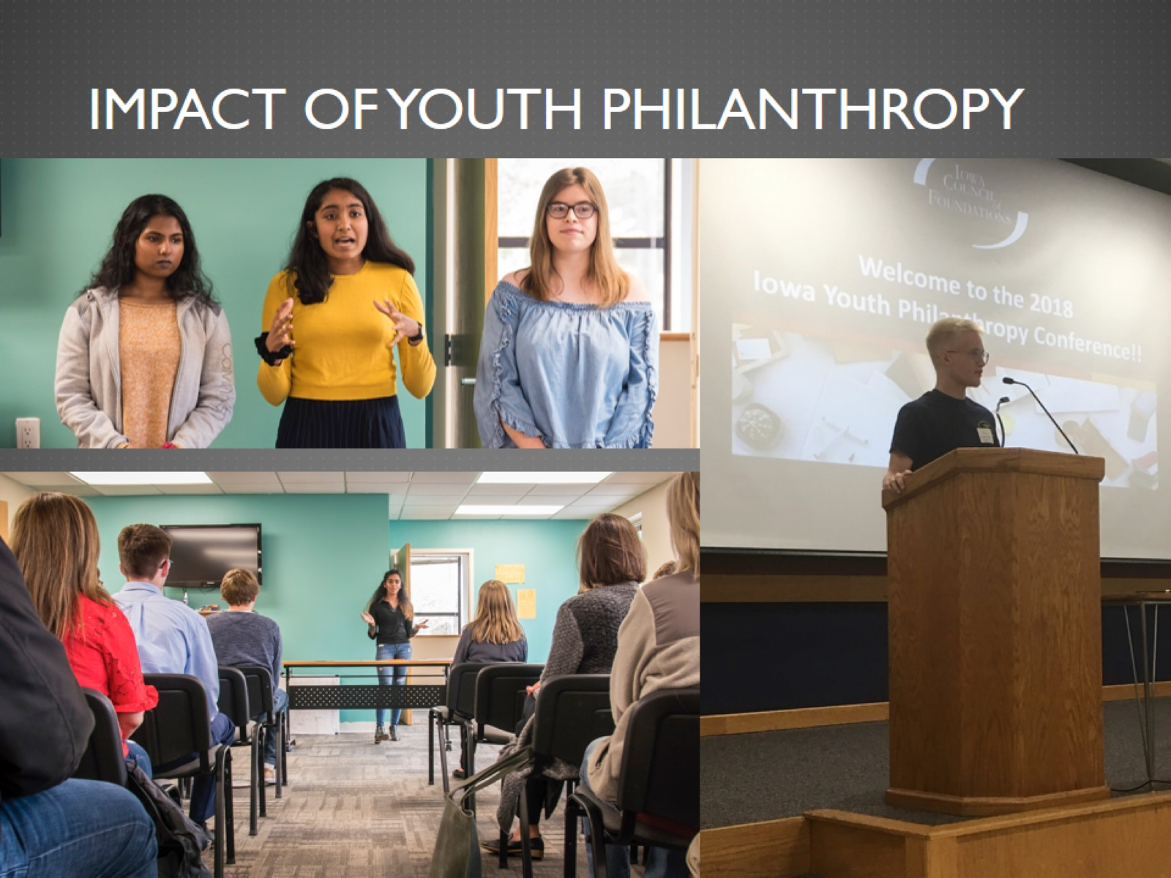
Impact of Youth Philanthropy

Slide 8
Questions?

