Slide 1
New GPRA Measures for 21st CCLC Grantees: Offering Tools & Support
Kaitlin Schmidt, Director of Strategic Resources, St. Mark Youth Enrichment
Billy Stone, OASIS Youth Education Director at Oakridge Neighborhood Services
Vic Jaras, Iowa Department of Education
Dr. Ron Cravey & Rusty Sinclair, R&R Educational Consulting

Slide 2
Agenda
Overview of new GPRA Measures
Demonstration of APR template
Overview of 21st CCLC Evaluation
Exploring other areas of evaluation support
Open discussion Q/A

Slide 3
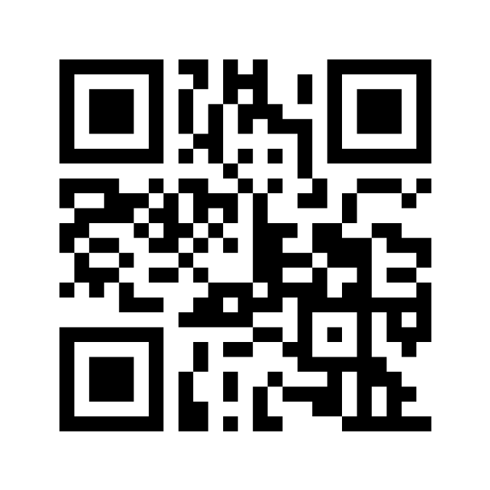
Let’s check in, how do you feel about evaluation?
https://www.menti.com/6xez8pccrr

Slide 6
New GPRA Measures: Other Changes
Effective for summer 2021 and this current, 2021-2022 school year
Last use of old GPRA will be for the 2020-2021 school year due this December.
All students reported (not just regular attendees)
Attendance will be in hours instead of days
Reporting is 2x a year instead of 3x
Vic shared at Directors Meeting:
https://www.iowa21cclc.com/directors-meetings for March 12th meeting.
Best Practice Webinar Recording
https://www.iowa21cclc.com/best-practice-webinars for June 22nd.
Days | Hours
Less than a week | Less than 15 hours
More than a week | 15-44 hours
More than a month | 45-89 hours
More than two months | 90-179 hours
More than three months | 180-269 hours
More than four months | More than 270 hours

Slide 7
APR Template for New GPRA measures
Notes:
Demonstrate the similarities with tabs/layout from previous template
-participation is currently not finalized due to not knowing how that will appear
Outcomes tab
-the outcomes tab is the main feature updated
-overview of how it is laid out
Fake data set
-From evaluation committee survey, data is managed through spreadsheets, software systems (Cayen), and dashboards
-demonstrate the switch to days into hours
-pivot table data into outcomes

Slide 8
Questions or Comments?

Slide 9
Evaluation at a Glance
Local Evaluation
21 APR
Other Data Requirements
April-June: collect assessment data and surveys
*Additional data may be required for GPRA
August-November: prepare local evaluation
November 30th: local evaluation due & posted
December- January: state evaluator review, read, and aggregate local evaluations
Found on: https://www.iowa21cclc.com/grant-info under evaluation resources
May 5th – June 30th: Summer 2020 Data
July 1st – Aug. 31st: Fall 2020
Sep.1st – Dec. 15th: Spring 2021 (last entry of old GPRA)
New dates to be determined in January and will be related to new GPRA data entry
September 30th: Community Partnership List
September 30th: Professional Development log
January: Statewide survey
Site visits
Anecdotal data collected throughout
Ongoing support bi-monthly through evaluation committee: next meeting October 5th

Slide 10
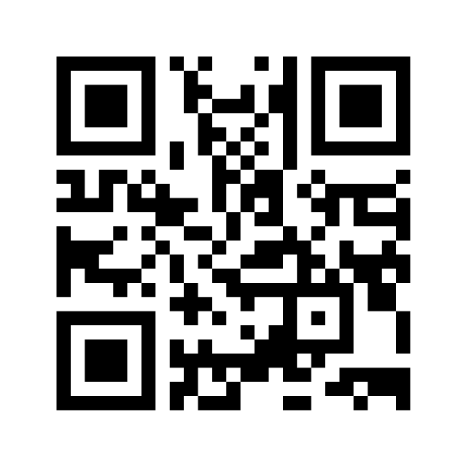
What areas are you in need of support?
https://www.menti.com/jc5kkomjxq

Slide 11
Resources
https://www.iowa21cclc.com/grant-info
APR Data Spreadsheets
Templates
Local evaluation
Data sharing agreement
Local evaluator contract
Timelines
Evaluation Committee
Meets bi-monthly next meeting 10/5

Slide 12
Contacts
Kaitlin Schmidt, Evaluation Committee
kschmidt@stmarkyouthenrichment.org
Billy Stone, Oakridge Neighborhood Services
bstone@oakridgeneighborhood.org
Vic Jaras, Iowa Department of Education
vic.jaras@iowa.gov
Dr. Ron Cravey & Rusty Sinclair, R&R Educational Consulting
cravey@rredcon.com
sinclair@rredcon.com

