Slide 1
Empowering girls across Iowa to shape a better world
Notes:
Welcome and introductions. Purpose for the meeting/call.

Slide 2
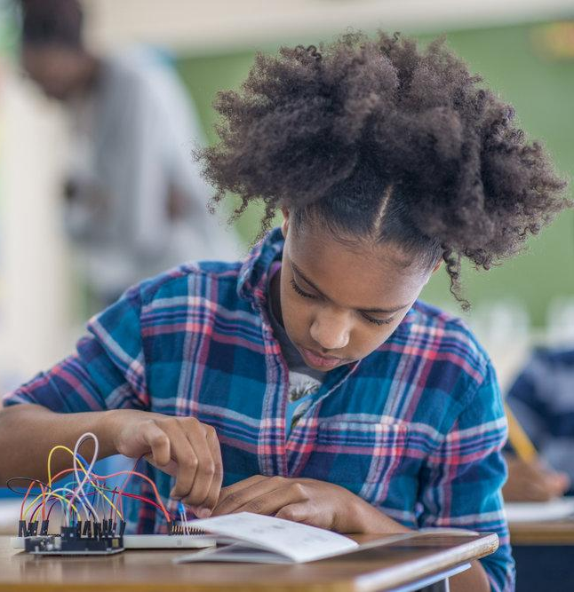
About Million Girls Moonshot
New afterschool initiative designed to close the science and engineering gender gap by engaging one million girls across the country in STEM learning by 2025.
Notes:
Talking Points:
The Million Girls Moonshot is a national initiative designed to increase diversity and equity in STEM.
The Million Girls Moonshot involves a wide range of partners working together to break down the systemic barriers that have kept girls and youth of color out of STEM for too long.
It is led nationally by the STEM Next Opportunity Fund and the Charles Stewart Mott Foundation in partnership with the Intel Foundation and the Gordon and Betty Moore Foundation.

Slide 3
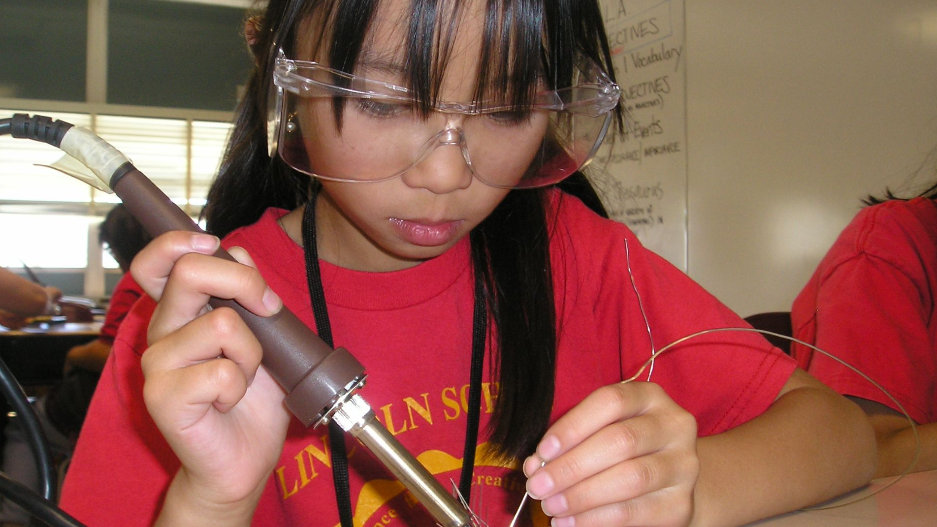
Why Now?
Notes:
NEW SLIDE Talking Points:
NEW: This new initiative is more important now than ever. The COVID-19 pandemic has hindered learning opportunities and exacerbated the impact of the digital divide and the engineering skills gap among school-age children and youth of color.
NEW: The hands-on STEM learning in afterschool is a perfect complement to the school day, especially as students have had limited experience with STEM in virtual and hybrid schooling this past school year. In a recent survey, 65% of parents with children in online or hybrid school don’t believe the STEM offerings for their students meet their standards of quality, engaging activities. Afterschool can provide opportunities for students to explore STEM in new ways, addressing the pandemic-inflicted challenges students have experienced.
NEW: Afterschool programs provide a low-risk setting for students to explore new STEM subjects and hands-on activities without pressure of failure -- building resiliency and interest in STEM.

Slide 4
A powerful network reaching millions of students
50 State Afterschool Networks
100,000+
Afterschool Programs
10.2 million
Students
5,000
Partnerships
Notes:
Talking Points:
The Million Girls Moonshot is unique in both its scale and approach.
It involves charitable organizations and technology leaders. Additional partners include NASA, Qualcomm, Technovation, STEMconnector, National Girls Collaborative Project, Jobs For The Future, Techbridge Girls and Lyda Hill Philanthropies. More are joining every day to provide grant funding, in-kind resources and mentors.
The Million Girls Moonshot is providing grant funding and in-kind resources such as technical assistance, access to educational resources and STEM mentors to the afterschool networks in all 50 states so they can provide high-quality, immersive STEM learning opportunities to afterschool students.
The Intel Foundation and the Gordon and Betty Moore Foundation are each contributing $1 million in grant funding in the first year and STEM Next Opportunity Fund is contributing $1.25 million.
These contributions build on the more than $300 million the C.S. Mott Foundation has invested over the years in the 50 state afterschool networks, including ours.
The Million Girls Moonshot is leveraging afterschool networks in all 50 states to help school-age girls access high-quality STEM education, support, and mentors.

Slide 5
The Iowa Afterschool Alliance is leading the Million Girls Moonshot initiative in Iowa. We are working with partners and afterschool programs across our state.
Notes:
Talking Points:
[Your state network] has joined the Million Girls Moonshot. This initiative helps engage more girls and more kids across our state in STEM learning. We’re especially focused on reaching kids who have been left out of STEM in the past.
The Million Girls Moonshot has provided a multi-year grant to [state network] to do this work, with [$55,000] in the first year. We will use these funds to help afterschool programs across the state offer new STEM learning experiences. (Note: you do not need to disclose the amount of funding your state receives, only if you feel it is helpful.)
Our state partners include [ALCP – Iowa Children’s Museum, Science Center of Iowa, and Blank Park Zoo].
Our national partners include [list national partners of your choosing, which can be found at https://milliongirlsmoonshot.org/partners].

Slide 6
Iowa students need STEM skills.
By 2025 more than 2M STEM jobs will go unfilled in the U.S. due to a lack of skilled candidates.
Demand for STEM workers in Iowa is growing faster than other fields.
Between 2017 and 2027
STEM jobs will grow
Non-STEM jobs will grow
8%
4%
Notes:
Talking Points:
Gaining skills in STEM can unlock pathways to socio-economic mobility and gender equity.
These skills are critical for helping young people understand the world we live in and prepare for jobs in health care, information technology, renewable energy, and other fields vital for our economy.
Jobs in the STEM fields power the global economy and are growing at faster rates than other career fields.
Nationally, STEM jobs are expected to grow by 13% between 2017 and 2027, compared with 9% for other jobs.
By 2025 more than 2M STEM jobs will go unfilled in the U.S. due to a lack of skilled candidates.
Right here in STATE, STEM jobs are expected to grow (read the graphic). Plug in your own stats from this site: https://vitalsigns.ecs.org/
NEW: The sudden emergence of the COVID-19 pandemic has dealt a significant blow to state economies, businesses, and working families. Meanwhile, accelerating demands for STEM jobs underscore the urgency of strengthening the STEM-literate workforce.
NEW: The learning loss in STEM for the current cohort of students can have ripple effects that threaten the long-term economic health of communities and our nation as demand for STEM talent accelerates due to the pandemic.
An analysis based on previous studies of school closures and the impact on economies conducted by the Organisation for Economic Cooperation and Development suggests that current students might expect lower earnings than current workers and the United States GDP would shrink by 1.5% or $14.2 trillion in economic value.

Slide 7
STEM careers power Iowa’s economy
One job in the high-tech sector leads to four new jobs in local goods and service industries.
=
Notes:
Talking Points:
STEM careers positively impact other career opportunities in our state.
Every one job in the high-tech (STEM) sector, leads to four new jobs in local goods and service industries.

Slide 8
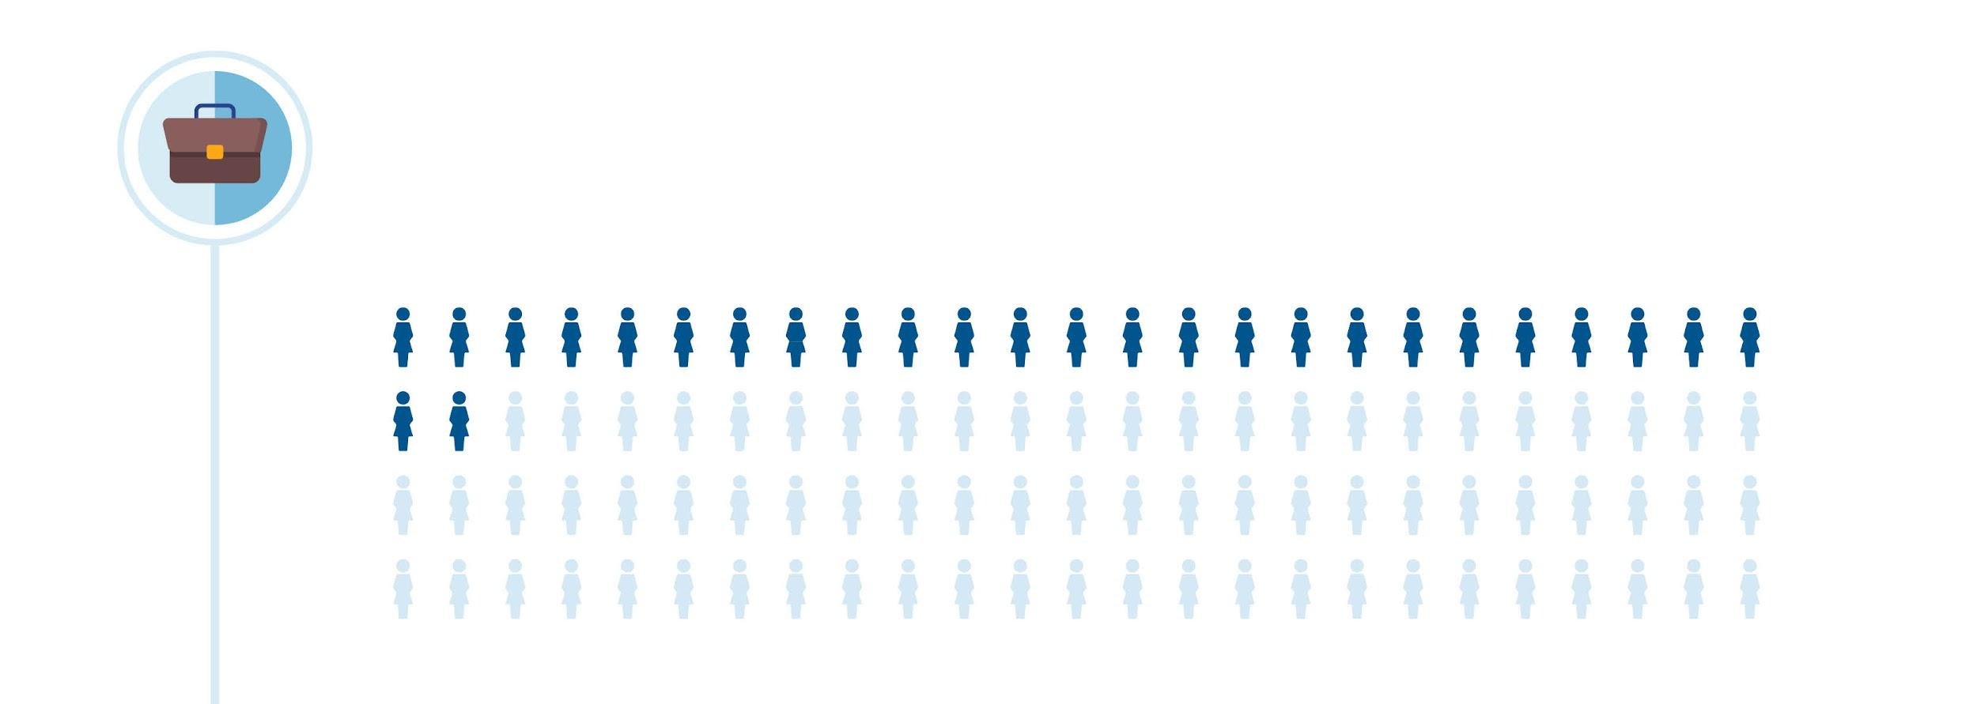
Right now, few women are earning college degrees in STEM fields.
Women make up half of the total U.S. college-educated workforce of 58.9 million workers, but represent much lower shares in computer and mathematical sciences (27 percent).
Afterschool is changing that.
Notes:
Talking Points:
Our state does not have enough qualified candidates to fill STEM jobs.
Over the next decade, the U.S. will need one million more STEM professionals to meet the market demand.
We are not trending that way. Despite decades of efforts, there remains a persistent gender gap and lack of racial diversity in STEM fields.
Women make up half of the total U.S. college-educated workforce, but represent much lower shares in engineering (15 percent) and in computer and mathematical sciences (27 percent).

Slide 9
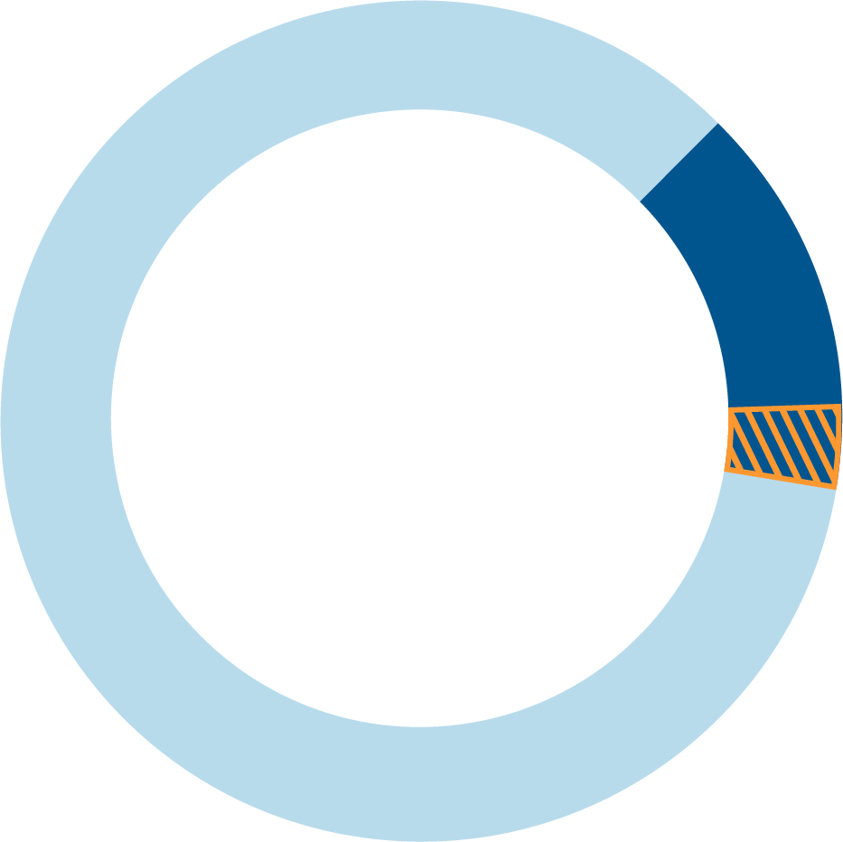
Only
15%
Statistics are more dire for women of color.
of engineers are women.
Only 2% (each) of engineers are Latinx or Black women.
Notes:
Talking Points:
NEW: The economic consequences of COVID-19 have not been felt evenly, reflecting racial and gender disparities that existed before the pandemic and have widened even more.
And women, especially Black and Latinx women, continue to be underrepresented in high-quality, highly paid STEM careers.
Women are not receiving degrees in engineering and computer science - and rates are either flat or dropping, hovering between 18 - 28 percent.
Latinx and Black women are earning only 3 percent of the degrees in engineering and 5 percent in computer science.
Only 15% are engineers are women, and less than 2% (each) of those 15% are Black or Latinx.

Slide 10
Power of Afterschool as a STEM Learning Partner
80%
20%
Time students spend in informal learning settings
Time students spend in school
Notes:
Talking Points:
Before the pandemic, afterschool programs had the potential to almost double the time that some students have to question, tinker, learn, and explore STEM topics.
For students in elementary through high school, more than 80% of their time is spent learning outside of school at afterschool and summer programs, in libraries, museums, science centers, or at home or in the community.
NEW: Research shows that hands-on, experiential learning by students is linked to higher levels of interest in STEM and leads to better STEM learning outcomes. Even before the pandemic, schools often provided few opportunities of this kind, especially in schools that serve under-resourced communities and communities of color.
NEW: Afterschool programs thrive at serving students from low-income communities and communities of color and will play a critical role in re-engaging students from underserved communities in high-quality STEM activities.
NEW: Afterschool programs offer extended-learning efforts, sustained engagement, and learning recovery and acceleration in the STEM subjects through hands-on, personalized learning.
To solve today’s most pressing problems – from health pandemics, to climate change, to economic uncertainty and more – we must tap into the great potential embodied in our nation’s girls.
By inspiring and keeping them engaged in STEM pursuits, they can become the break-through scientists, inventors, builders, engineers and entrepreneurs of tomorrow that will drive our society forward.

Slide 11
Afterschool STEM Has Unique Benefits for Kids
80% gained a deeper understanding of science careers
78% increased their interest in STEM
73% developed a “STEM identity,” a personal belief that she/he can do well and succeed at science
Notes:
Talking Points:
High-quality afterschool STEM programs boost students’ proficiency in math and science, increase their likelihood of graduation, help students connect STEM to their lives and future, and put them on the path to pursuing a career in the STEM fields.

Slide 12
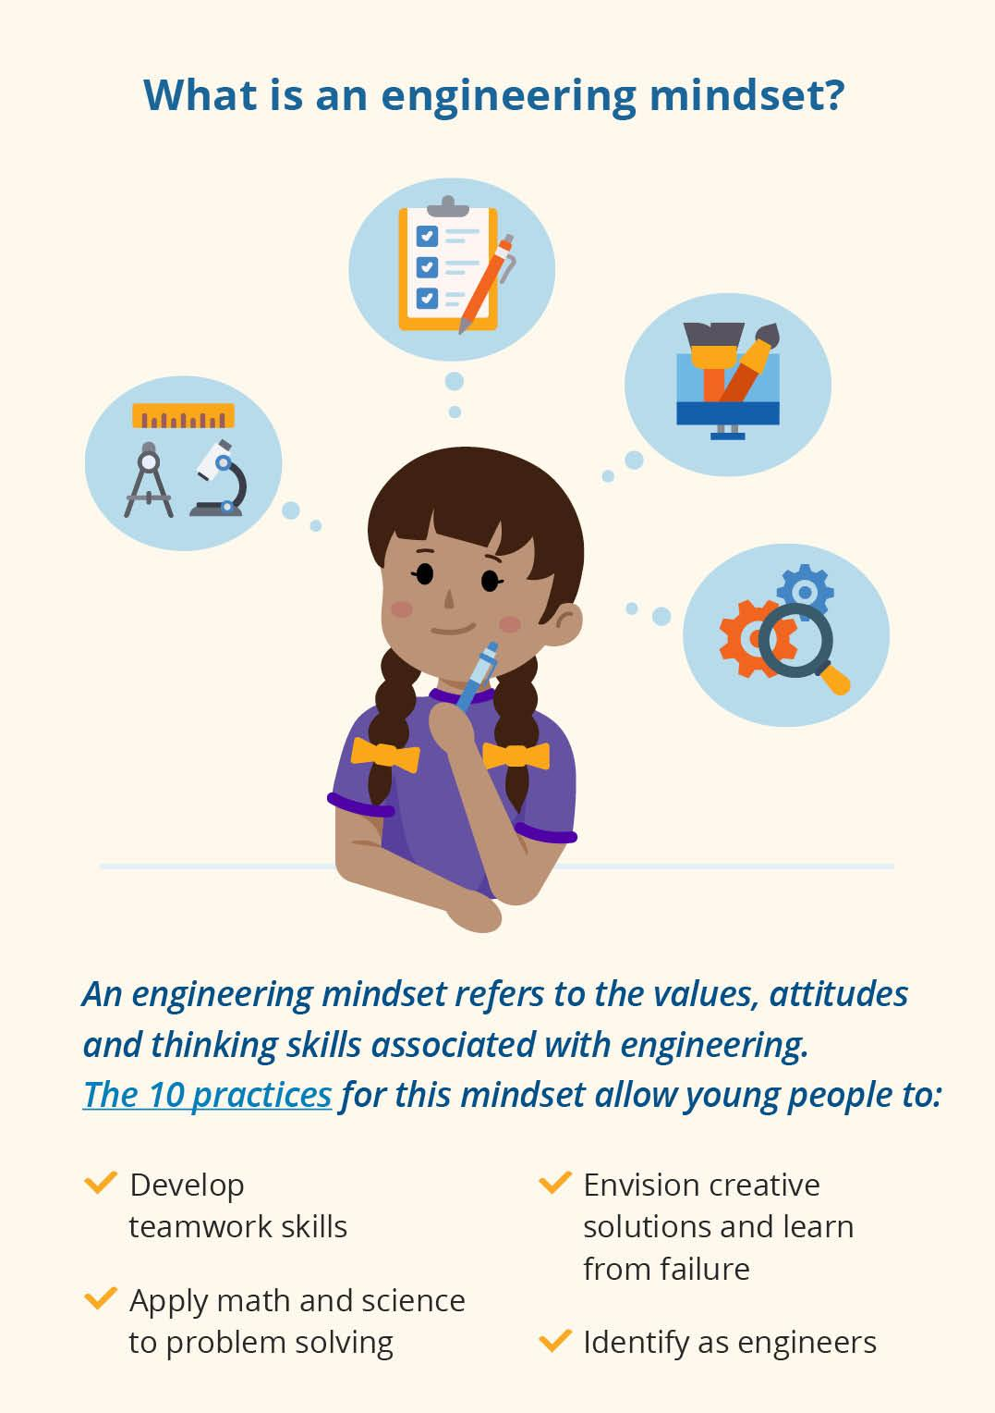
Our Commitments with Million Girls Moonshot for Iowa Students
Deliver STEM learning experiences designed to help girls gain confidence, develop an engineering mindset, and build skills that employers demand.
Create opportunities to interact with mentors who will help spark interest in STEM and STEM careers.
Increase access to STEM learning for underserved youth.
Ensure afterschool educators have STEM resources and mentors.
Notes:
Talking Points:
With the support of the Million Girls Moonshot initiative, partners and funders, we’ll be able to deliver high quality STEM programming to girls and underserved youth across our state.
The Million Girls Moonshot focuses on the Engineering Mindset which compliments the STEM mindset, as well as innovation, invention, and entrepreneurial education.
An engeginning mindset helps girls apply math and science to problem solving, envision multiple solutions, evaluate and improve design, and collaborate and persist through failure.

Slide 13
Systemic barriers exist that prevent girls and youth of color from pursuing STEM interests.
Kids who live in poverty receive
5 less years
in Schooling
in school and learning, compared to their middle-income peers
Afterschool is changing that.
Notes:
Talking Points:
Systemic barriers exist for girls and youth of color to pursue STEM interests.
The wealthiest 20% of families spend almost seven times more on enrichment activities outside school for their children than do the families with the lowest income.
By the time students reach the 6th grade, middle class kids have likely spent 6K more hours learning than kids born into poverty. Equivalent to 5 years of schooling.
75% of Latinx and African-American students attend high-poverty schools. These schools provide fewer resources to young girls of color. These young women are under-prepared for the workforce.
Girls with less educated parents or low-socioeconomic status are not pursuing advanced STEM coursework in high school.

Slide 14
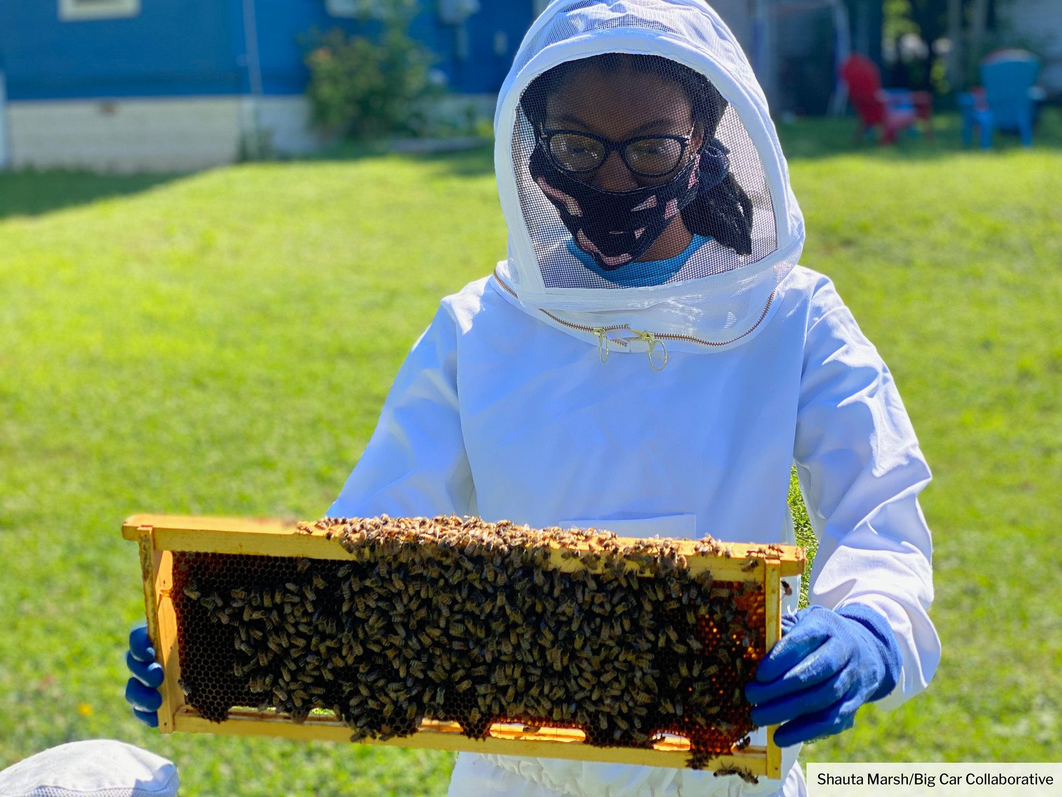
The COVID-19 pandemic has deepened inequities in education. Afterschool programs are expanding to meet students’ needs today.
Notes:
Talking Points:
Afterschool STEM helps to close these gaps by offering engaging learning programs to a diverse range of students, including Million Girls Moonshot which was designed to close the racial and gender gap.
Million Girls Moonshot uses an equity and inclusion framework that is youth-centric and culturally responsive. It is a unique approach focused on making STEM more accessible and more engaging for all young people, especially girls and populations who are underrepresented in STEM careers.
This initiative is more important now than ever. The COVID-19 pandemic has hindered learning opportunities and exacerbated the impact of the digital divide and the engineering skills gap among school-age children and youth of color.

Slide 15
With your support, the Million Girls Moonshot will bring new STEM learning opportunities to kids across Iowa.
The Time Is Now.
Notes:
Talking Points:
NETWORK NAME is critical to the Million Girls Moonshot Initiative.
We provide an access point to the initiative - so programs know about the program and are properly trained to implement it.
We ensure educators have the resources, support, mentorship, and expert guidance they need to deliver hands-on STEM learning experiences.
NEW: Together, with your help we can recover and accelerate learning with the Million Girls Moonshot, allowing young people to see themselves as ones who can succeed in STEM learning and STEM careers.

Slide 16
Here’s what we’ve
been up to.
Notes:
Talking Points (pick most appropriate for your audience):
Join us in helping girls and youth of color access new, high quality STEM learning opportunities and realize their full potential.
Talk about the Million Girls Moonshot with community organizations and families in your network. Doing so helps elevate the importance of STEM, along with youth interest and persistence in STEM.
Enroll your program. Sign up with your state afterschool network for news and updates about STEM training and resources available through the Million Girls Moonshot.
Become a partner. Help us reach more youth by providing financial or in-kind support. We need partners of all sizes and from all sectors.
Engage workforce and STEM councils with the Million Girls Moonshot to build awareness for STEM learning.
Serve as a mentor or sponsor internships to help girls gain hands-on skills and explore STEM careers.

Slide 17
Members of the ALCP:
Iowa Afterschool Alliance
Science Center of Iowa
Iowa Children’s Museum
Blank Park Zoo
With help from the Active Learning Community Partnership (ALCP), the Iowa Afterschool Alliance launched their MGM work.
Notes:
Talking Points:
NEW: The economic consequences of COVID-19 have not been felt evenly, reflecting racial and gender disparities that existed before the pandemic and have widened even more.
And women, especially Black and Latinx women, continue to be underrepresented in high-quality, highly paid STEM careers.
Women are not receiving degrees in engineering and computer science - and rates are either flat or dropping, hovering between 18 - 28 percent.
Latinx and Black women are earning only 3 percent of the degrees in engineering and 5 percent in computer science.
Only 15% are engineers are women, and less than 2% (each) of those 15% are Black or Latinx.

Slide 18
Members of the ALCP worked together to create STEM based lesson plans for Iowa afterschool programs.

Slide 19
You can view the Lesson Plan Repository by visiting www.stemforiowa.org.
Notes:
Will review the lesson plan repository here

Slide 20
If you’re still in need of activities for your out-of-school time program, download the Mizzen by Mott app!

Slide 21
The Mizzen by Mott app allows you to pick activities based on:
Time
Age of students
Number of students
Academic field
Type of activity
Etc.
Let’s see it in action : https://www.youtube.com/watch?v=mlfpQbo4z6g
Notes:
Watch 3:00 youtube video https://www.youtube.com/watch?v=mlfpQbo4z6g

Slide 22
Let’s try it out!
Notes:
Start 20 min Mizzen activity here

Slide 23
The Million Girls Moonshot©️ is an initiative of STEM Next Opportunity Fund.

