Slide 1
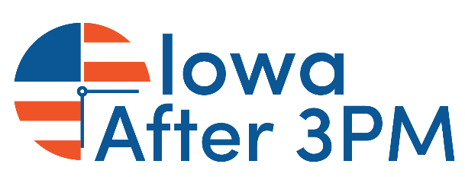
Afterschool in Iowa Demand Grows, Opportunity Shrinks
Notes:
Welcome
Thank you for taking time out of lunch
IAA
“afterschool” collectively

Slide 2
America After 3PM
America After 3PM is the nation’s most comprehensive look at how children spend their time during the hours after school. Conducted roughly every five years, the 2020 report is the fourth edition of the survey. Previous reports were issued in 2004, 2009, and 2014.
America After 3PM serves as a resource for policy makers, educators, parents, and advocates on afterschool program participation, demand for afterschool programs, expectations and benefits and programs, and children who are alone and unsupervised during the after school hours.
America After 3PM 2020 is made possible by the generous support of the New York Life Foundation, Overdeck Family Foundation, The Wallace Foundation, the S.D. Bechtel, Jr. Foundation, Altria Group, the Walton Family Foundation, and the Charles Stewart Mott Foundation.
Notes:
America After 3PM is the most comprehensive look at how kids in America spend their after school hours
Kids spend most of their waking hours outside of school
This survey is done every 5-6 years– the last one was in 2014
These data will be used by afterschool providers, advocates, policymakers and more for years to come

Slide 3
Methodology Statement
America After 3PM includes data from 31,055 households. In Iowa, 464 households and 614 children were screened for this study.
A minimum of 200 interviews were completed in every state and the District of Columbia online and supplemented by phone. Respondents are parents or guardians with a school age child in their household. The survey was offered in both English and Spanish. Interviews were completed January 27th-March 17th, 2020.
An Advisory Committee comprised of afterschool and research experts provided input on the design of the survey instrument.
Notes:
The most important things to know from the methodology:
The Afterschool Alliance worked with Edge Research to conduct this study
It includes more than 30,000 respondents, including 464 households and 614 children in Iowa
Surveys were conducted mostly online and supplemented with interviews by phone
All data were collected between January and March of 2020
Pre-pandemic data was supplemented with a national survey in October that reached about 1200 families to offer a mid-pandemic national update to the study

Slide 4
5 Big Takeaways
1.
Unmet demand for afterschool has reached an all-time high
4.
Inequities evident – barriers higher for families with low income
2.
Demand surges as parents see key benefits from afterschool
5.
Parents show strong support for expanding afterschool opportunities
3.
Cost and access block participation, pointing to lack of affordable programs
Notes:
There are 5 big takeaways from the research

Slide 5
1.
Unmet demand for afterschool has reached an all-time high
Notes:
The first big takeaway is that unmet demand has reached an all-time high

Slide 6
Unmet Demand for Afterschool Skyrockets
More than 195,000 Iowa children would enroll in an afterschool program, if one were available. This marks an increase of more than 34,000 children since 2009.
195,758
161,290
145,383
25%
35%
33%
41%
Unmet demand has jumped16 percentage points since 2004
2004
2009
2014
2020
*Projections for child-level data are based on 2018-2019 Department of Education, National Center for Education Statistics
Notes:
(state level)
If afterschool programs were available to them, 41% of all non-participants in Iowa, or more than 195,000 children, would take advantage of those programs
That is up 16 percentage points since America After 3PM started back in 2004
This is the highest unmet demand level in the history of America After 3PM

Slide 7
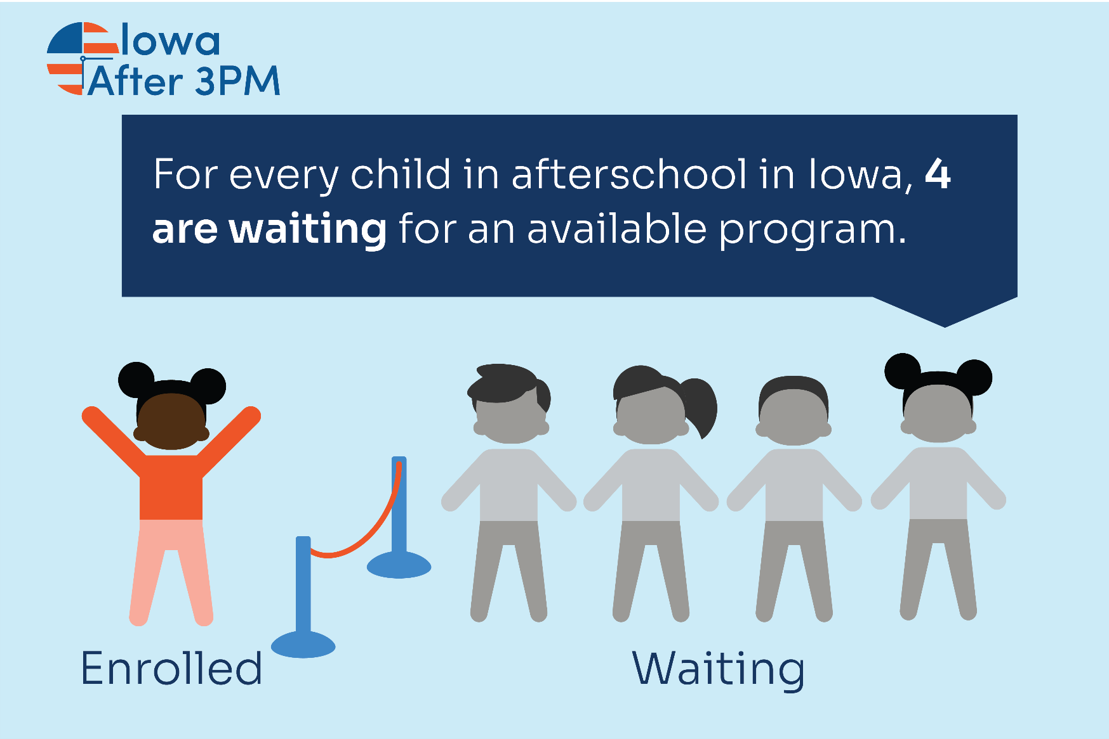
More Students Than Ever Are Missing Out
Notes:
(state level)
In 2020, for every one child in a program, there are 4 more who would be in an afterschool program if one were available to them

Slide 8
Groups with Greatest Unmet Demand
GRADE LEVEL | LIKELY TO ENROLL
Elementary (K-5) | 51%
Middle (6-8) | 33%
High (9-12) | 27%
RACE | LIKELY TO ENROLL
White | 39%
Black | 58%
Hispanic | 50%
Asian | 74%
Native Hawaiian/Pacific Islander | 100%
Native American | 31%
FREE/REDUCED PRICE LUNCH | LIKELY TO ENROLL
Qualify | 45%
Do Not Qualify | 55%
Notes:
(state level)
Looking more closely at the families expressing demand for afterschool, it was found that families of color, families with higher income, and those with children in elementary school are more likely to want to participate in a program
More than half of elementary students would participate if they had access
More than a third of middle school
More than a fourth of high school students

Slide 9
Who’s Alone After School in Iowa?
The number of children alone and unsupervised during the hours after school reached its lowest level:
127,592 children in 2020
Down from the peak of 166,583 children in 2009
Since 2014, the number of unsupervised elementary schoolers increased:
21,998* elementary school students in 2020
*An increase/decrease of 14,462 students since 2014
Notes:
(state level)
Even though demand for afterschool has increased, Fortunately, the number of young people unsupervised in the hours after school has declined since 2014
Family care, grandparents, one parent able to be home
Notably there has been an increase in the number of elementary school age kids now in self care
Issue of safety -

Slide 10
2.
Demand surges as parents see key benefits from afterschool
Notes:
Moving on to the second key takeaway - Demand surges as parents recognize key benefits from afterschool participation

Slide 11
Benefits Afterschool Programs Offer Students
Kids in afterschool in Iowa enjoy a wide range of benefits:
89%
66%
76%
88%
56%
66%
Base= Afterschool parents in Iowa (n= 41)
Notes:
(state level)
Behind the high levels of demand for afterschool is a growing recognition of the wide range of benefits that afterschool programs provide for young people and families

Slide 12
Benefits Afterschool Programs Offer Parents
Parents in Iowa agree with the benefits afterschool programs provide to families:
79%
81%
69%
71%
87%
Base= Iowa parents (n= 305)
Notes:
(state level)
Benefits to parents are also recognized – programs are seen as a lifeline for working families

Slide 13
Parent Satisfaction Hits All-Time High
96% of Iowa parents are satisfied with their child’s afterschool program
96%
Extremely Satisfied
2020: 64%
2014: 43%
Total Satisfied
2020: 96%
2014: 87%
Notes:
(state level)
For families fortunate enough to have access to a program, parents report high levels of satisfaction with their afterschool program, with 96% of Iowa parents satisfied with their program overall

Slide 14
3.
Cost and access block participation, pointing to lack of affordable programs
Notes:
Sadly, cost and lack of programs are barriers to students benefitting from afterschool programs

Slide 15
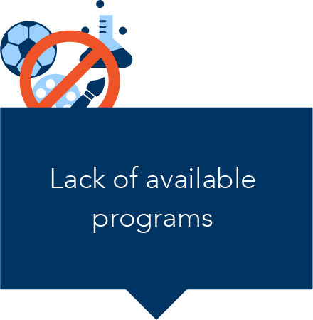
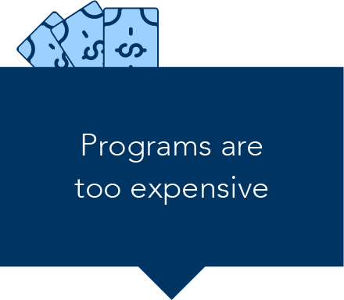
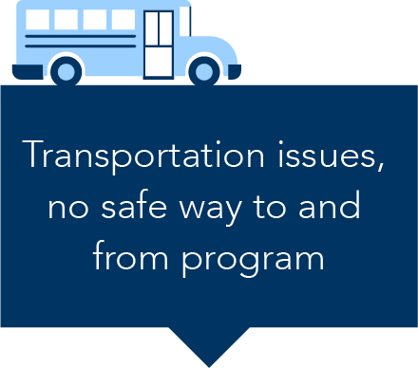
Cost and access top the list of roadblocks to afterschool program participation
2014
2020
37%
60%
25%
50%
20%
46%
Notes:
(state level)
Cost, lack of a safe way to get to and from programs, and lack of available programs top the list of roadblocks
Overall, parents in Iowa were more likely to report challenges to accessing afterschool programs compared to 2014

Slide 16
Afterschool Participation Declines
As high levels of parents reported barriers to participation, afterschool program participation in Iowa saw a decrease for the first time ever.
-22,887
58,123
68,516
45,629
For the first time in more than a decade, the number of kids in afterschool programs decreased.
11%
11%
14%
9%
2004
2009
2014
2020
*Projections for child-level data are based on 2018-2019 Department of Education, National Center for Education Statistics
Notes:
(state level-)
These growing barriers translate into fewer young people in afterschool programs today

Slide 17
Decline greatest among low-income families
The number of children in low-income households in afterschool fell 40%, from 4.6 million in 2014 to 2.7 million in 2020. Meanwhile the number of higher income children in afterschool decreased by a fraction of that amount; 446,000 over that same time period.
-1.9M
- 445,839
4.6M
5.6M
5.2M
2.7M
2014
2020
2014
2020
Low-income
Higher-income
Notes:
(national level)
While that decline alone is troubling, even more troubling is that low-income families are most affected
Between 2014 and 2020, the number of low-income kids in afterschool fell by nearly 2 million, while the number of higher income kids dropped by less than half a million

Slide 18
Afterschool funding has not kept up with the rate of inflation
Cost is a major driver behind the decline in participation among low-income families, and points to a lack of available affordable programs nationwide. The decline comes as public investments in afterschool programs have largely stalled and not kept up with growing demand.
Funding for 21st Century Community Learning Centers
21st CCLC is the only federal funding stream dedicated exclusively to afterschool, before-school, and summer learning programs.
Adjusted for inflation, 21stCCLC funding in 2020 is actually $10M below the 2014 level.
Notes:
(national level)
America After 3PM data was coupled with data on participation in the nation’s largest funding streams for afterschool, and found that over this time period about 2.1 million low-income young people were benefitting from publicly funded programs, like 21st CCLC
The public funding streams have been a lifeline for low-income young people and families, but most of them are not keeping up with the costs of providing a high quality program and therefore are unable to serve more young people
For example, 21st CCLC, which increased by $28 million from 2014 to 2020, is actually $10 million less when adjusted for inflation
This is significant b/c Iowa’s only funding source for afterschool is 21CCLC

Slide 19
4.
Inequities evident – barriers higher for families with low income
Notes:
Unfortunately the study found a number of inequities

Slide 20
Barriers to participation are higher for low-income families
Programs are too expensive
55%
61%
56%
58%
Lack of available programs
40%
44%
47%
43%
Transportation issues, no safe way to and from program
50%
58%
62%
62%
Notes:
(national level)
Here you can see that these barriers previously mentioned are even bigger among low-income families
As a result of those barriers, the unmet demand for afterschool has increased and is greater among low-income families

Slide 21
5.
Parents show strong support for expanding afterschool opportunities
Notes:
The final takeaway is that parents show strong support for expanding afterschool opportunities

Slide 22
Nearly 9 in 10 Iowa parents support investment in afterschool programs
86% of parents in Iowa favor public funding of afterschool programs to expand opportunities for kids in underserved communities
Support in Iowa is strong and bipartisan:
90%
Democrats
87%
Independents
83%
Republicans
Base= Iowa parents (n=305)
Notes:
(state level)
86% of parents favor public funding for afterschool programs
Support for public funding for afterschool opportunities is up from 75% in 2014
This strong level of support cuts across party lines, ethnicity and geography – support for afterschool unites America

Slide 23
Parents support additional funding for afterschool during COVID school closures
In the face of the ongoing pandemic, parents nationally continue to see afterschool programs as a resource to promote their child’s growth and development while also helping parents maintain or find employment.
agreed that Congress should provide additional funding for afterschool programs to operate during virtual school days
Based on an October 2020 national survey of parents
77% OF PARENTS
Base=Total respondents (N=1,202)
Notes:
(national level)
The AA3PM research included a follow-up survey in October 2020 to gauge how COVID may have affected parents’ attitudes toward afterschool
Even amidst a global pandemic, parents see afterschool as a strong source of support for children and families and show strong levels of support for funding afterschool programs to operate during virtual school days

Slide 24
Fall 2020 Parent Survey Findings
After COVID concerns, the main barriers to participating in afterschool remain very similar to pre-COVID.
DESPITE CONCERNS, DEMAND IS HIGH
Even amidst COVID, 49% of children would participate in a program if one were available
PARENT SUPPORT FOR PUBLIC FUNDING REMAINS VERY STRONG
85% (Oct.) vs. 87% (pre-COVID)
Notes:
(national level)
Of course, concerns about COVID dominate barriers to participation in afterschool this fall, but beyond those specific concerns, the same top barriers remain as pre-pandemic – cost, transportation and lack of available programs
And, unmet demand for programs remains high, with 49% of children who would participate this fall (either in-person, virtually or in a hybrid program) if one were available to them
It was also found that parent support for public investments in afterschool remains strong in the midst of COVID– this fall, 85% support public funding, down only 2 percentage points from earlier in the year

Slide 25
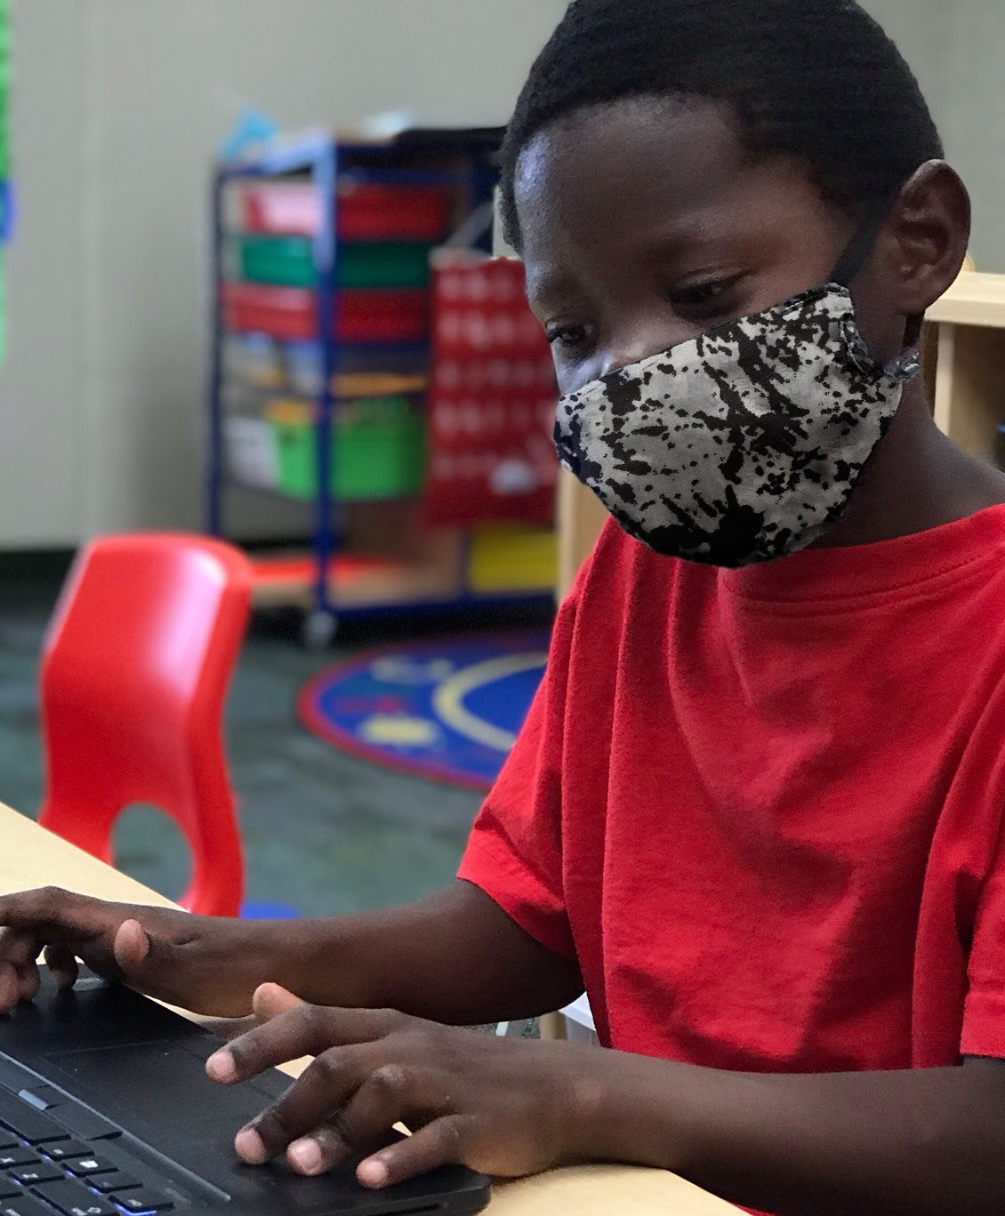
Fall 2020 Parent Survey Findings
PARENTS MANAGING, BUT WORRIED ABOUT KIDS:
staying on track in school
social and emotional well-being
friendships
screen time
physical activity
PARENTS WANT OFFERINGS BEYOND ACADEMICS:
physical activity
opportunities to build life skills
activities to excite them about learning
social connections with peers
Notes:
(national level)
Lastly, while parents report that they are managing during the pandemic, they express concerns for their children, as we all do
Learning loss is going to be more significant for at-risk youth and these children will likely need support beyond the school day to get caught up
Parents want afterschool programs to address more than academics as a result of those concerns

Slide 26
LEARN MORE:
www.afterschoolalliance.org/AA3PM

