Slide 1

Notes:
Welcome! We’re so pleased that you could join us. As you know, the 50 statewide afterschool networks are funded by the Charles Stewart Mott Foundation and so is Mizzen by Mott.
Our network is proud to be able to bring the Mizzen app to you as a new resource in support of your work. In the first part of this presentation, we will discuss the inspiration and purpose of the app and in the latter part, we will dive in and play around with the app.
Let’s start with a little background. It all began with a question from Ridgway White, president and CEO of the Mott Foundation.

Slide 2

How can we leverage technology for the benefit of children in afterschool programs?
Copyright 2020, Mizzen®
2
Notes:
[Ridgway asked: How can we leverage technology for the benefit of children in afterschool programs?] The answer was Mizzen by Mott. The app was developed and beta tested with afterschool professionals, content providers and a team of staff and consultants. Today, it is ready for you to use.

Slide 3
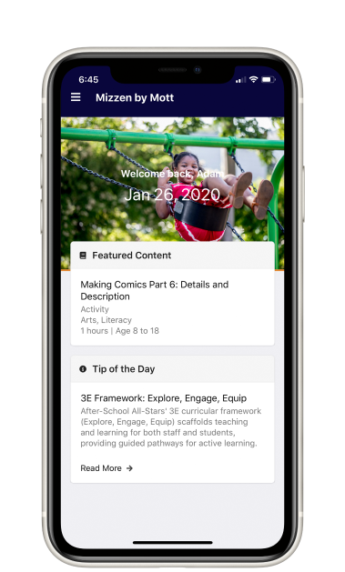
Meet Mizzen by Mott
Mizzen by Mott is a new mobile app, developed with and for afterschool professionals.
With hands-on activities and lessons, from building rockets to exploring elements of jazz improv, Mizzen delivers content that challenges, nurtures, delights and inspires youth.
Copyright 2020, Mizzen®
3
Notes:
1. High quality content, 2. operational efficiency, 3. professional growth.

Slide 4

To meet the needs of this moment, the Mizzen team has added:
New activity playlists and
multi-week modules for
home or small-group settings.
Engaging content that fosters
well-being.
Pro Tips to support afterschool professionals as they help students
to continue learning, growing and exploring — wherever they are.
Copyright 2020, Mizzen®
4
Notes:
The app team pivoted to provide activities, modules and playlists to help afterschool providers support students – wherever they are.

Slide 5
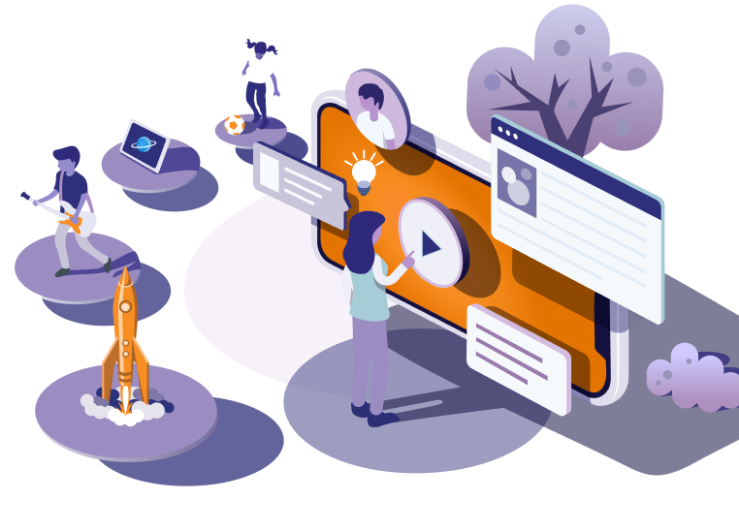
Mizzen by Mott
Through support from the Mott Foundation, this all-in-one tool
is free to afterschool professionals who are empowering young learners everywhere.
Copyright 2020, Mizzen®
5
Notes:
Not for kids to be behind a screen—to help empower the adults in OST Programs that work with them.

Slide 6



Mizzen is built with and for afterschool professionals
Copyright 2020, Mizzen®
6
Notes:
This app is designed for afterschool professionals including frontline staff, site directors and program directors. So, let’s talk about what Mizzen by Mott offers.

Slide 7
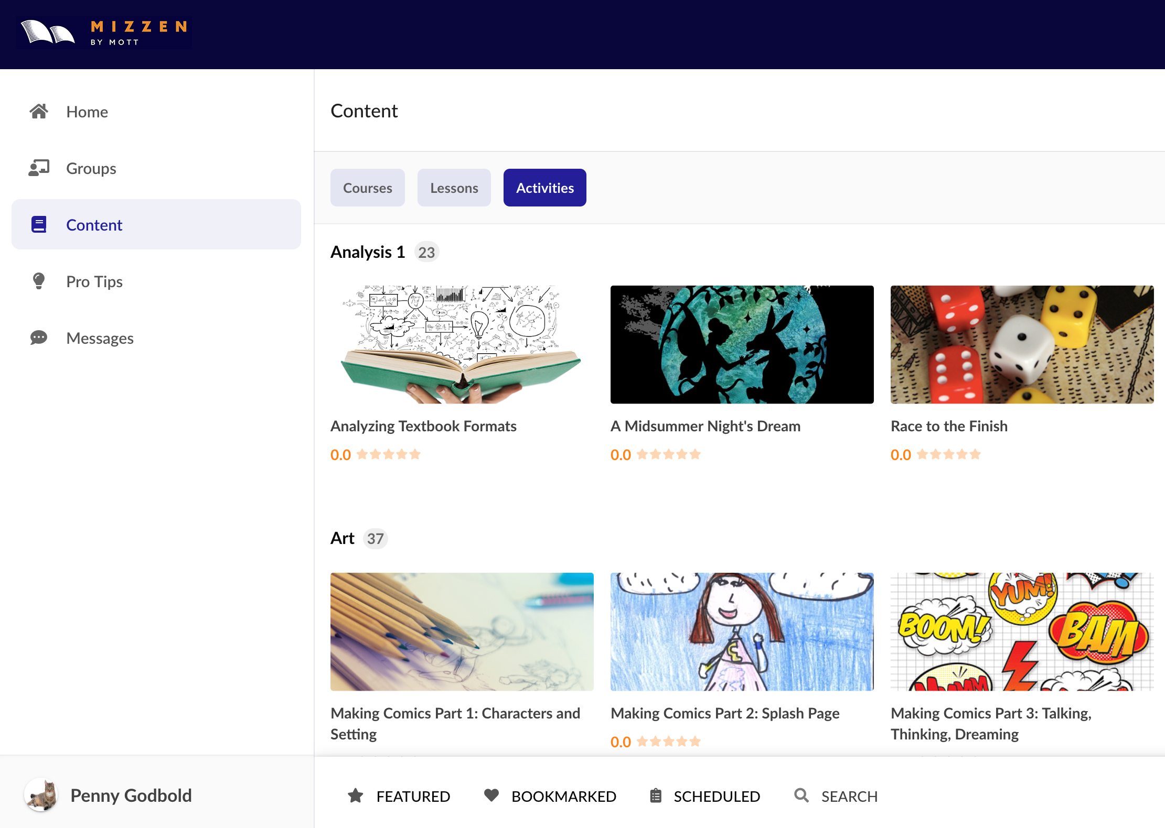
Mizzen by Mott
High-quality content from top afterschool curriculum experts. Over 1,000 pieces of content that foster youth learning and well-being through hands-on activities in arts, STEM, literacy, digital media and entrepreneurship.
Copyright 2020, Mizzen®
7
Notes:
Also: fun and engaging activities in visual arts; storytelling; health and wellness for families at home; SEL; music; physical exercise; and yoga and mindfulness.

Slide 8
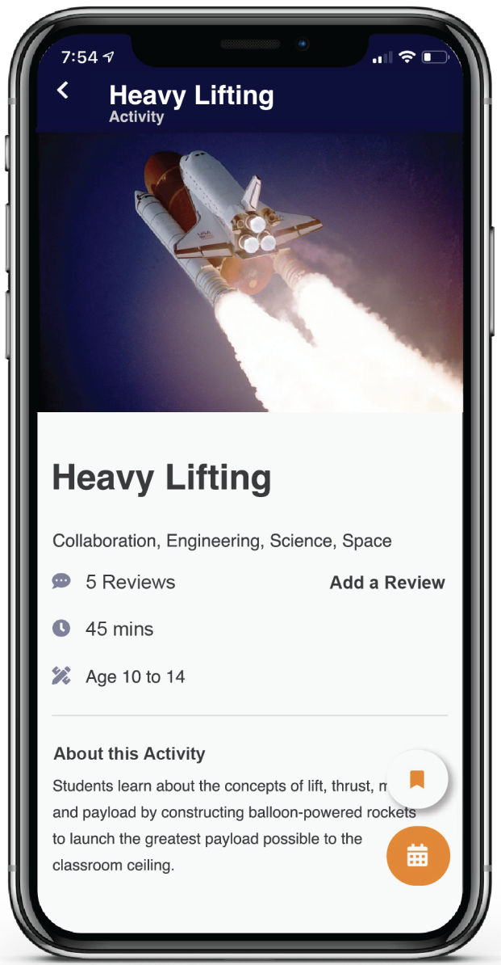
Mizzen by Mott
Easy-to-use activities and multi-week projects
Examples include:
Jazz, Blues and Music from Jazz at Lincoln Center;
Learning Scientific Sketching from California Academy of Sciences;
Make It Move Invention Camp from OregonAsk; and
Many more fun and inspiring activities!
Copyright 2020, Mizzen®
8
Notes:
More examples: Intro to Entrepreneurship from VentureLab and Virtual Backpacks from Beyond School Bells (Nebraska’s Afterschool and Summer Learning Network).

Slide 9
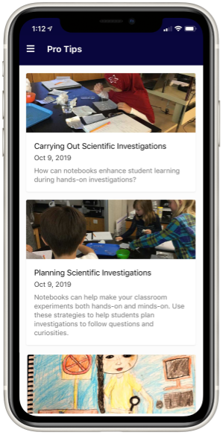
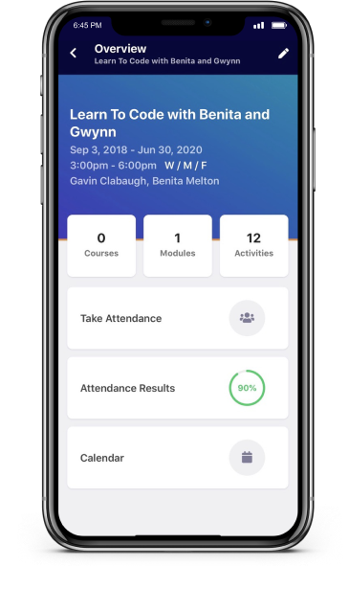
Mizzen by Mott
Pro Tips help you hone your skills, bring content to life, and address challenges and opportunities.
Organizational Features — like scheduling, attendance and messaging — support your planning, coordination and communications.
Copyright 2020, Mizzen®
9
Notes:
Professional development

Slide 10
Mizzen Early Adopters
“The app helped expand and reignite my creativity. I am excited to see what I can do with this app this summer!” LeShelle Berry, YMCA and Collective
for Youth
“I loved that the lesson categories were broken down beyond your traditional STEAM. This makes it fun and easy to find content.” Jenna Ruiz, YouthQuest
“Game changer for the afterschool program sector.” Sandy, Beta Test Participant
“I created a group and WOW! Taking attendance has never been this easy.”
Raven Whitfield, D.R.E.A.M.
“
”
Copyright 2020, Mizzen®
10
Notes:
This is what early adopters and beta testers said. We would love to hear how the app works for you–and what content you need most, heading into summer. We’ll pass along what we hear to the Mizzen team.

Slide 11
The 50 State Afterschool Network can help
The 50 statewide afterschool networks, funded by the Mott Foundation and local funders, play an important role in sharing Mizzen by Mott with the field and helping programs access this content.
We’re here to help you figure out how to use Mizzen content as part of your quality improvement systems.
Connect with us to let us know how we can support you.
Copyright 2020, Mizzen®
11

Slide 12

How to use Mizzen by Mott
Copyright 2020, Mizzen®
12
Notes:
If you haven’t already, take a moment to download the app. We would love to hear how it is going.

Slide 13
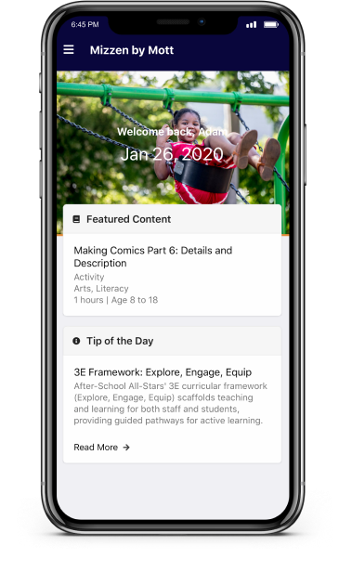
Mizzen by Mott
Dashboard
It shows everything you need, at-a-glance, to start your
day and make it productive.
See the day’s “featured content,” with user reviews, and activity descriptions.
Check out the Tip of the Day with inspiration to elevate the learning experience.
Review the day’s attendance and schedules.
Navigate the app, including content, Pro Tips and messages.
Copyright 2020, Mizzen®
13
Notes:
When you open Mizzen by Mott, you will first see the Home screen and these features:
Groups For Attendance - Once you've created a group} it will appear in Home during the dates and times you set. Tapping a group in the Home area will allow you to take attendance. [Resources: Plan and organize activities for your students using groups
Track classroom attendance]
Featured Content This content updates regularly, please check back often. Our activities optimize your time and maximize learning
Tip of the Day – tips updated regularly

Slide 14
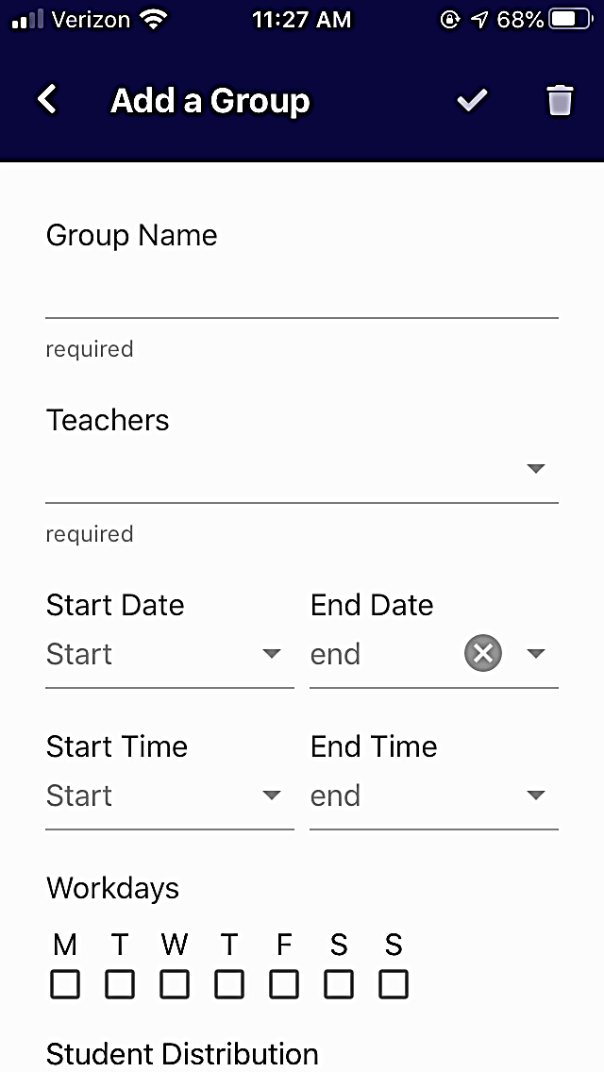
Mizzen by Mott
Groups
What’s everyone up to? Groups in Mizzen helps you keep on top of the schedule, letting you see who will learn what and when.
Know what groups are scheduled and how many students are registered.
Coordinate and better manage activities.
Copyright 2020, Mizzen®
14
Notes:
Invite a Colleague
Groups help educators organize, plan, and prepare for scheduled activities as well as take attendance.
Create a group - You can create one for each group of kids in your class or create one for the whole class. Each group can have their own schedule and their own activities. [Resource: Creating a group]
Attendance - After creating a group you can take attendance for that group. [Resource: Take Attendance]
Schedule activities using the calendar
The calendar feature lets you easily schedule activities for that group. [Resource: Calendar]

Slide 15
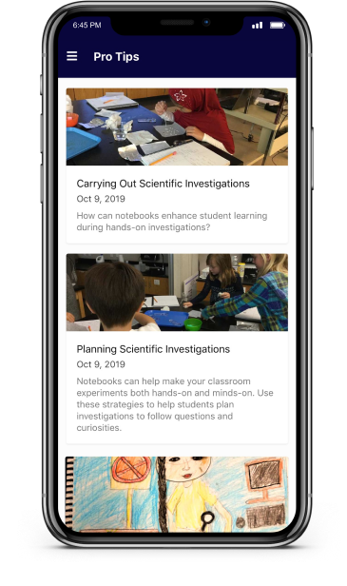
Mizzen by Mott
Pro Tips
Browse this informative library of practical, simple tips from educational experts.
Learn best practices for afterschool programs.
Read suggestions on how to bring content to life.
Discover ways to build your skills and solve problems.
Copyright 2020, Mizzen®
15
Notes:
Pro Tips: Pro tips offer advice, inspiration, and encouragement from experts to help you grow professionally and be your best.
Tap the menu icon in the upper left corner.
Tap Pro Tips.
Pro Tips are shown newest first so you'll always be able to see the newest at the top.
Mizzen will add more Pro Tips regularly check back often!
Do you have a topic you would like to see covered in Pro Tips? The Mizzen team loves hearing feedback so please send a message

Slide 16
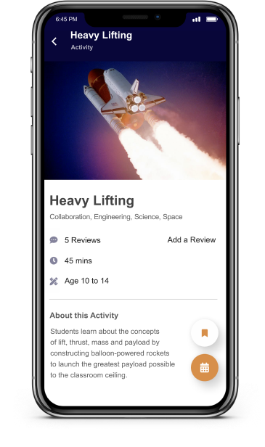
Mizzen by Mott
Content
Explore a world of exciting and engaging lessons
and activities.
Search for subjects ranging from arts to zoology.
View detailed descriptions of each module.
Read user reviews — and add reviews of your own.
See step-by-step guidance for each session, including learning objectives and necessary materials.
Review discussion points and ways to evaluate outcomes.
Copyright 2020, Mizzen®
16
Notes:
Mizzen provides over 1,000 activities that you can use in your classroom. Each activity has easy to access information such as the age range, the total time it will take to complete, a quick overview of the activity along with learning objectives, and a list of any materials needed to complete the activity.
Every playlist, module, and activity is structured the same way: with step-by-step instructions for how to teach the content, as well as variations you can use if you want to change the lesson around to better fit your classroom.
[Resource: Using Content: learn how to use it.]

Slide 17
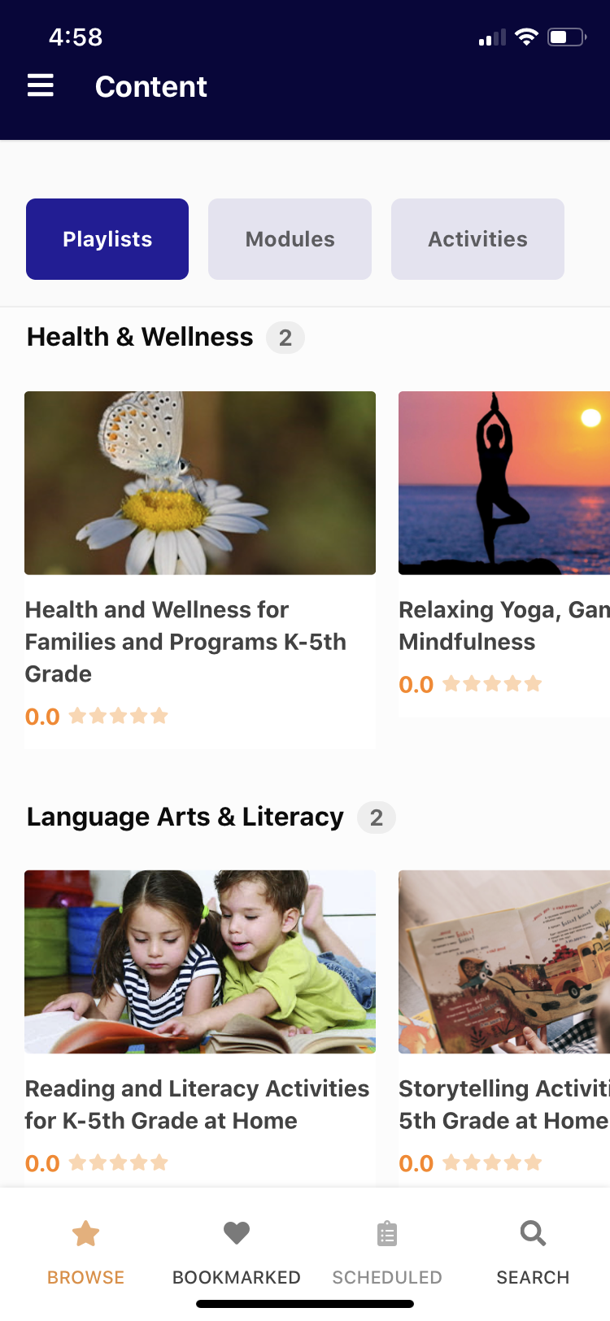
Mizzen by Mott
Find Playlists, Modules and Activities
Activities: individual lessons for one session. Use activities for single day lessons.
Modules: groups of activities that form a unit on the same topic. Use Modules to span multiple sessions.
Playlists: self-contained groupings of activities on a similar topic. Use a Playlist for multiple sessions planned around a larger topic.
Copyright 2020, Mizzen®
18
Notes:
Activities are individual lessons that are designed to be completed in one session. Use activities for single day lessons.
Modules are a grouping of activities that form a unit together on the same topic. Each activity in a module may build on prior activities. Use a Module for activities that will span multiple sessions.
Playlists are also groupings of activities but often longer and more diverse. Activities in a Playlist are usually self-contained on a similar topic. Use a Playlist for multiple sessions planned around a larger topic.

Slide 18
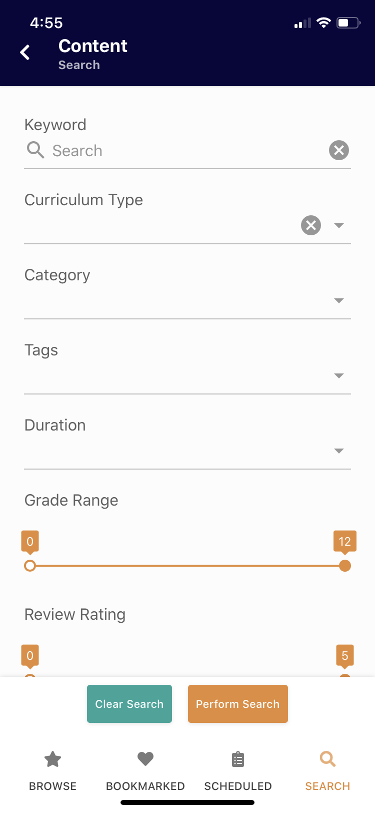
Mizzen by Mott
Search Mizzen’s content
The Search function in Mizzen allows you to find rich, relevant content for kids.
You can search by many criteria, including keyword, curriculum type, content creator, category, grade range, activity length, and learning standards.
The Mizzen team has also added a rating system so that you and other afterschool professionals can rate and share your favorite activities.
Copyright 2020, Mizzen®
17
Notes:
Search: It’s important to know that you do not have to fill in all of the fields. Only use the fields that are going to narrow down the results to what is being searched for. The more fields being used, the more specific the search and will result in fewer matching activities. [Resource: Learn how to search for content]
Find Content by Browsing Browsing will let you scroll through the activities, modules and playlists to see if anything sparks an interest.
[Resource: Learn how to browse for content]

Slide 19

Mizzen by Mott
Save (bookmark) and print activities
Your kids loved the activity you found on Mizzen today. Bookmark it to find it easily so more kids can love it later.
While viewing the activity, all you have to do is tap the Print icon in the lower right corner of the screen. This will start the print process, just follow the on screen instructions.
Copyright 2020, Mizzen®
19
Notes:
How to Bookmark an activity:
Locate the activity.
On the right lower corner, tap the bookmark icon.
To remove a bookmarked activity, simply tap the bookmark icon again.
You can find bookmarked activities later by:
Tapping the menu icon in the top left corner of the app.
Tapping Content in the menu that displays on screen.
Tapping Bookmarks in the bottom menu bar.
Note on Printing: You will need a wireless printer available to print. Your IT department may be best to assist with setting your mobile device up to print.

Slide 20
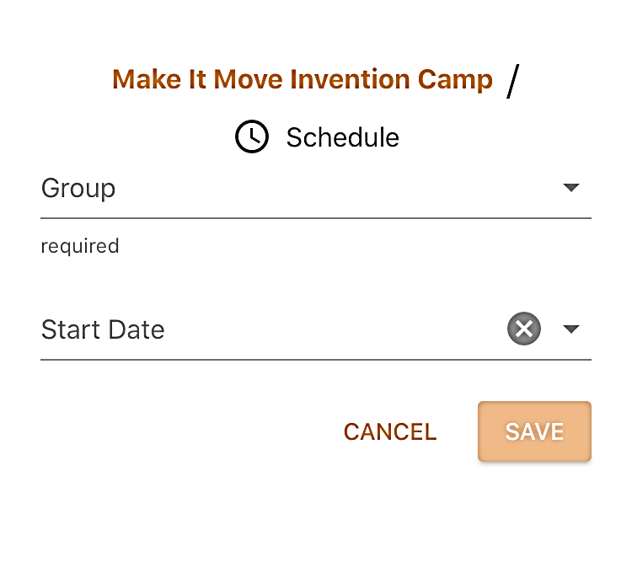

Mizzen by Mott
Content can be easily scheduled while viewing any content in Mizzen.
Tap the Calendar icon in the lower right corner.
Select a group and set a start date for that content.
Copyright 2020, Mizzen®
20
Notes:
Scheduling: You’ll need to create groups for your kids first, start there. After you have groups set up you can add an activity to a group by tapping the calendar icon in the lower right corner while viewing an activity. Once you’ve saved the scheduled activity you can view the calendar for the group to see your schedule for any particular group.
[Resource: https://www.mizzen.org/knowledge/schedule-activities-with-the-calendar]
You can also Schedule for others: Some afterschool Program Directors may handle scheduling of content for all teachers. You do not need to be a member of a group to schedule content for that group. Simply choose the group to schedule an activity for and any teachers for that group will see the scheduled content.

Slide 21
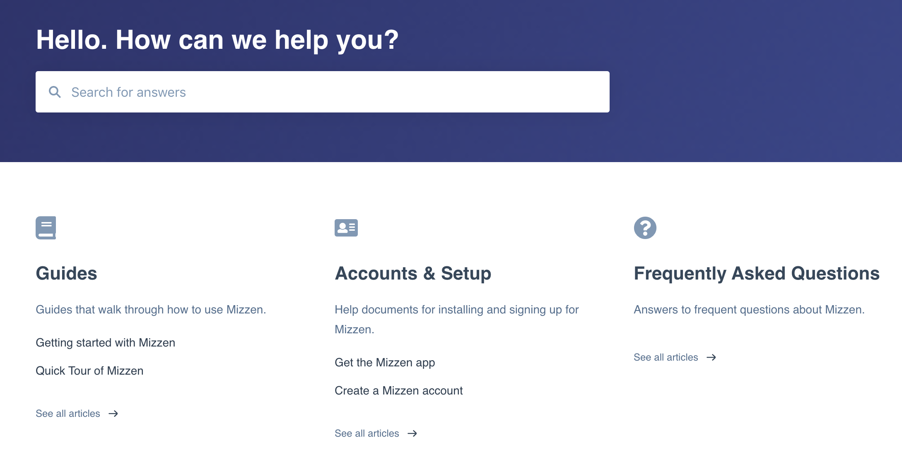
Mizzen by Mott
To build your knowledge of Mizzen and
get support, visit:
https://www.mizzen.org/knowledge
Copyright 2020, Mizzen®
21

Slide 22





Meet Mizzen by Mott
You can download Mizzen at your favorite app store!
Check out Mizzen.org
And don’t forget to follow Mizzen on
Copyright 2020, Mizzen®
22
Notes:
If you haven’t already, take a moment to download the app.
We would love to hear how it is going!

