Slide 1
Farm to Butter: STEM and Literacy Enrichment Through Agriculture
Notes:
Materials: My Family Farm (dairy), heavy whipping cream, little condiment cups, spoons, cups, straws, plastic sheets, scissors, string, dairy cow breeds, dairy cow breeding instructions, pennies (or dice), crayons, corn seed, water beads, baggies for germination necklace

Slide 2
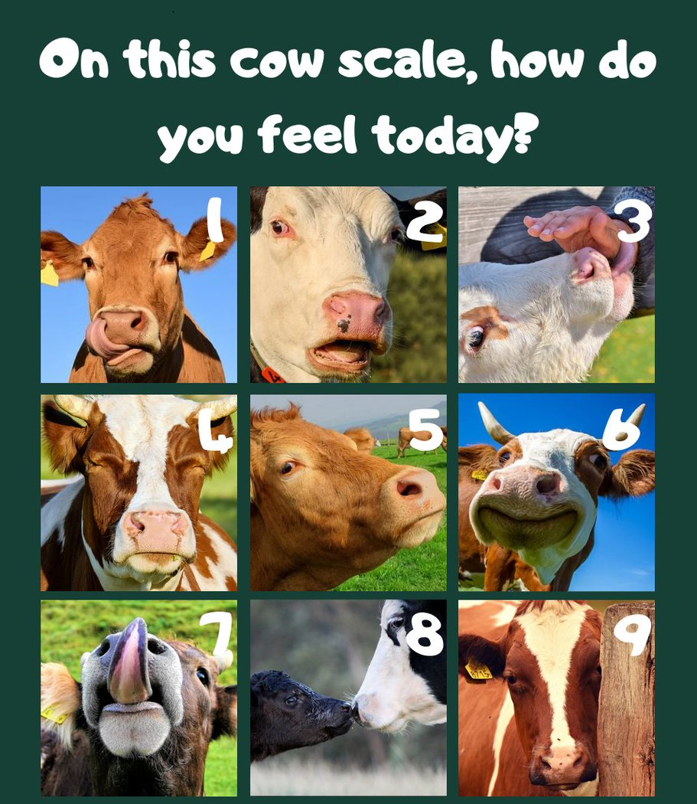

Slide 3
What is Agriculture?
How are your students affected by agriculture?
How do you see agriculture in an afterschool program?
Notes:
www.iowaagliteracy.org

Slide 4
Literacy Enrichment

Slide 5
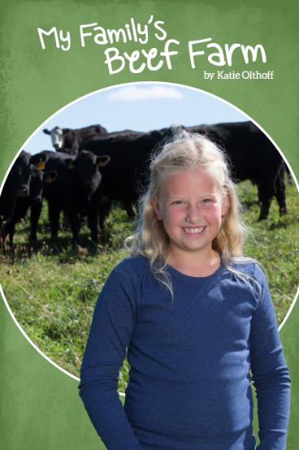
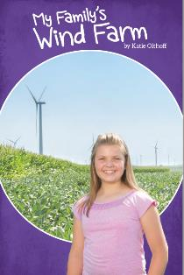
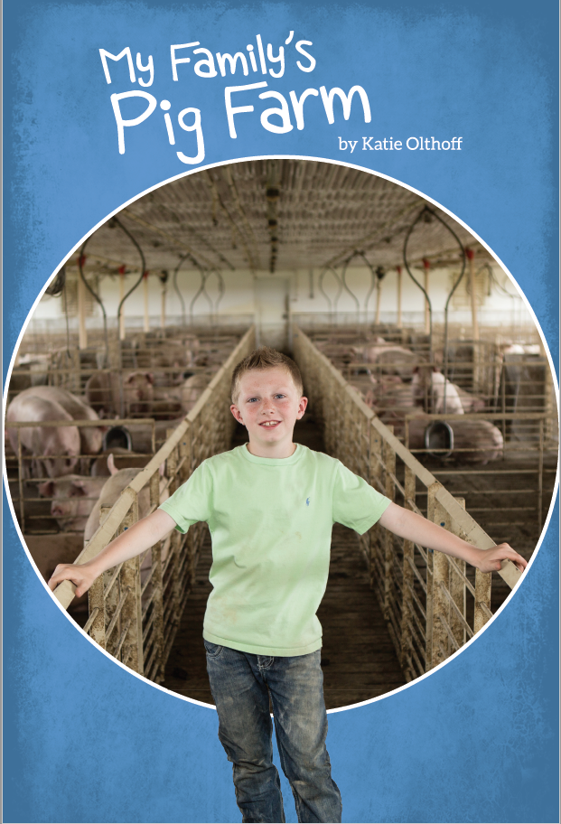
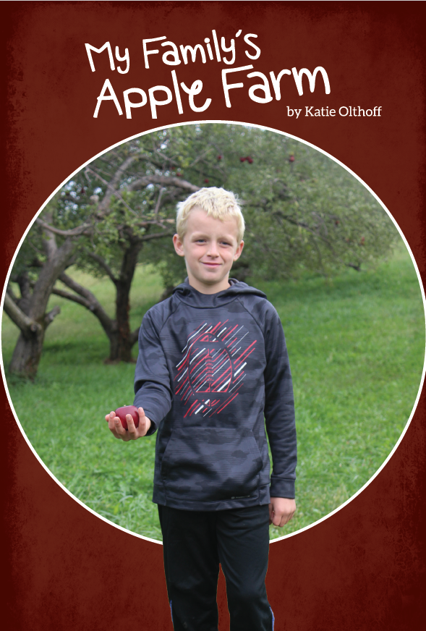
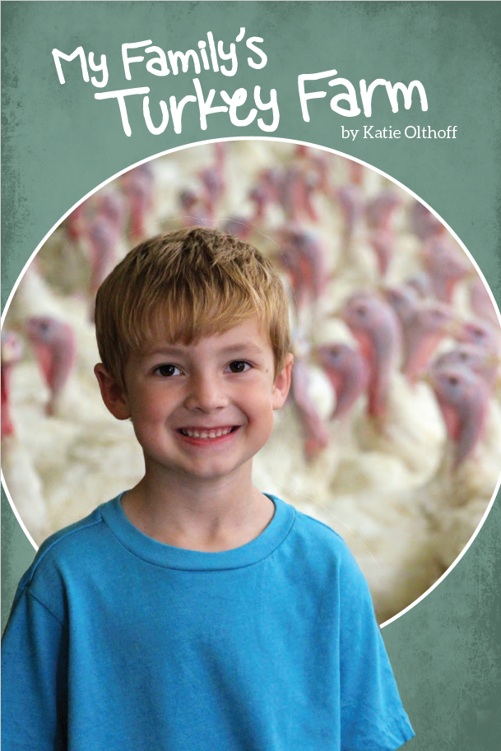
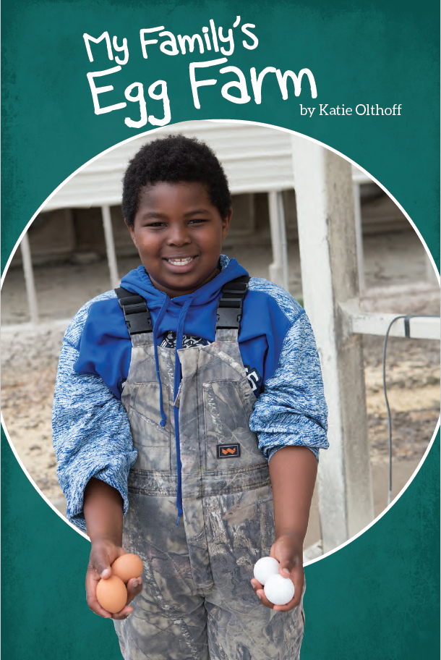
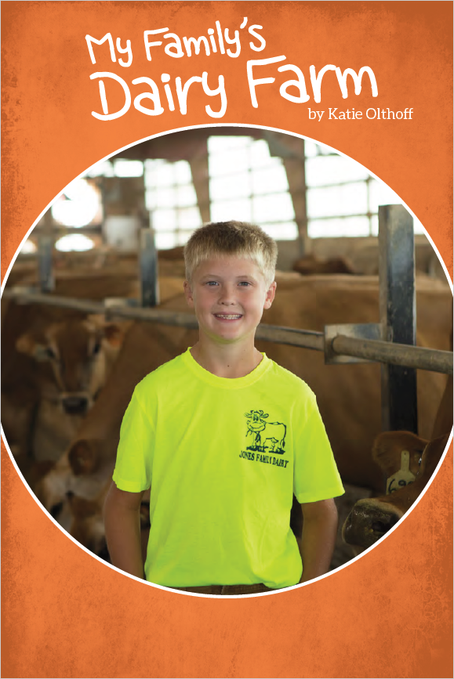
My Family’s Farm
Each book has two associated lesson plans
One copy shipped to every 3rd grade classroom (new books)
Direct requests to info@iowaagliteracy.org
Digital version available at www.iowaagliteracy.org > resources > publications
Virtual Copies!

Slide 6
Core Subject Enrichment

Slide 7
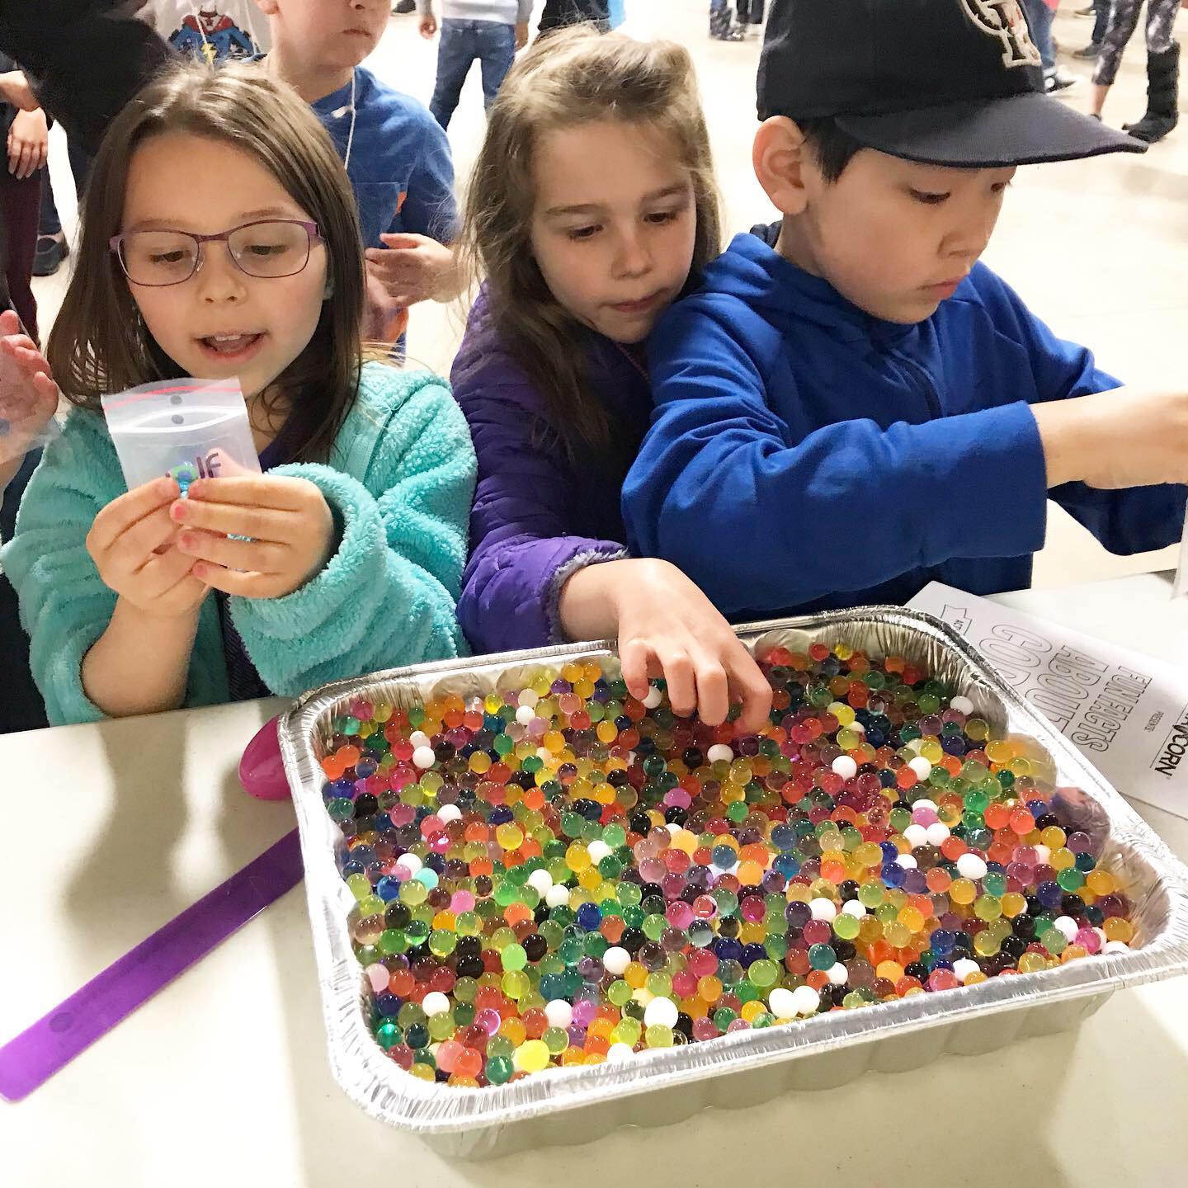
Seed Germination Necklace ~Science~
What is seed germination?
What do seeds need to germinate?
Let’s GERMINATE!
Notes:
Show participants the materials to make the necklaces
Over 30% of Iowa’s corn goes to feed livestock…

Slide 8
Seed Germination Necklace ~Science~
Where do plants like corn go after they are harvested?
Notes:
Show participants the materials to make the necklaces
Over 30% of Iowa’s corn goes to feed livestock…

Slide 9
Build a Calf ~Science and Math~
How do farmers use genetics?
What type of genetics are used with dairy production?
Notes:
Discuss questions with

Slide 10
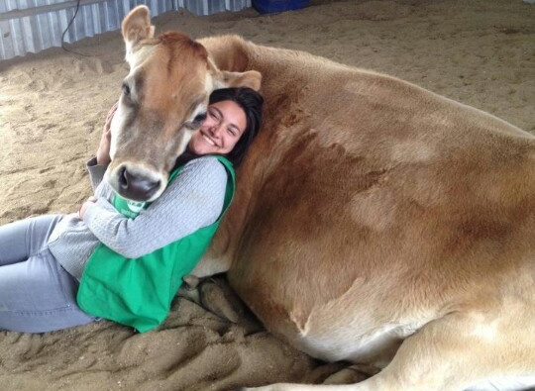
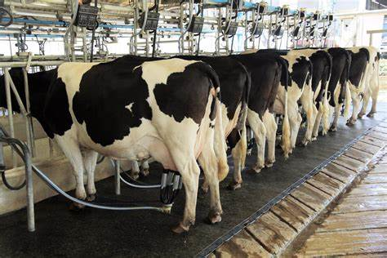
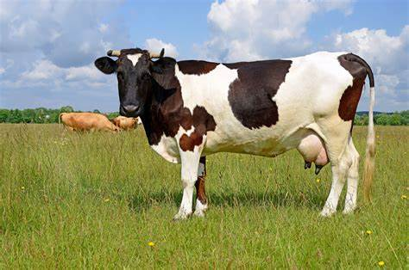
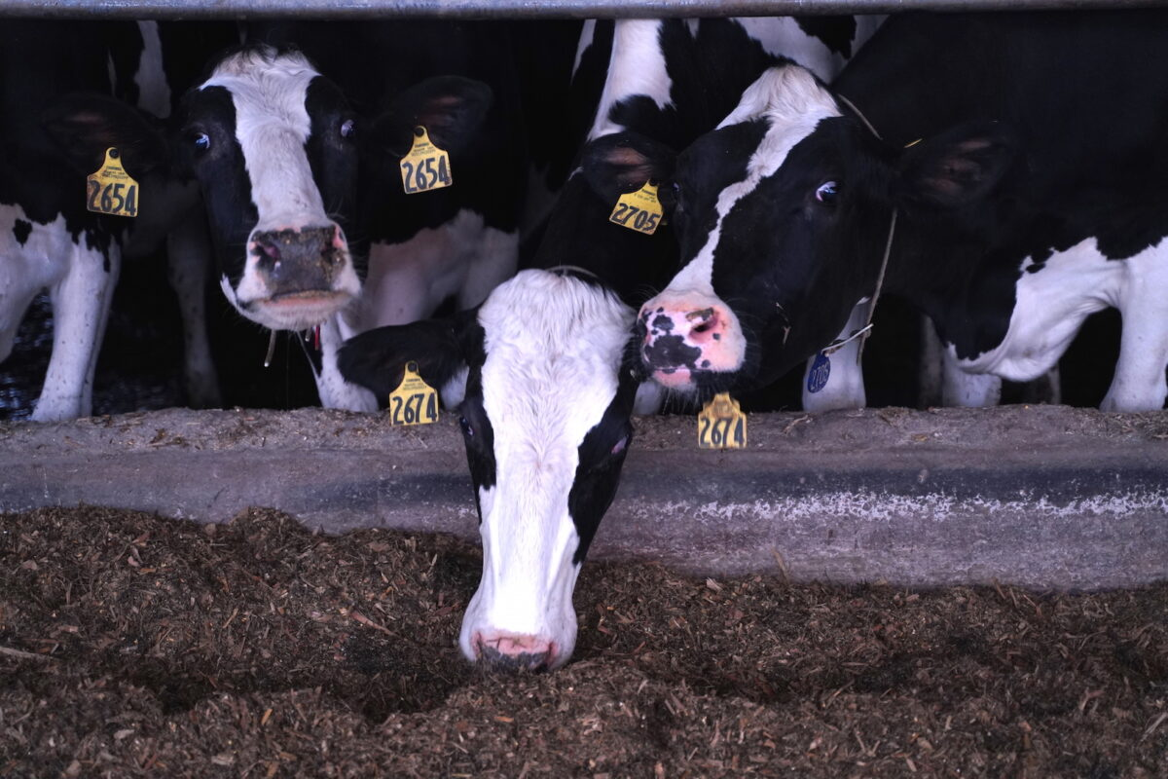
Build a Calf ~Science and Math~
Docility
Milk production
(protein, fat, whey, amount)
&
Longevity
Horned vs. Pulled
Notes:
Farmers want to make sure their dairy cows have these characteristics

Slide 11
Build a Calf ~Science and Math~
How can math be used in genetics?
Let’s Build a Calf!
You can request the kit for this activity HERE!
Notes:
Discuss probability and Punnett squares, how these are models and can be a focus of 3rd grade science or high grades.
Participants do the build a calf activity.

Slide 12
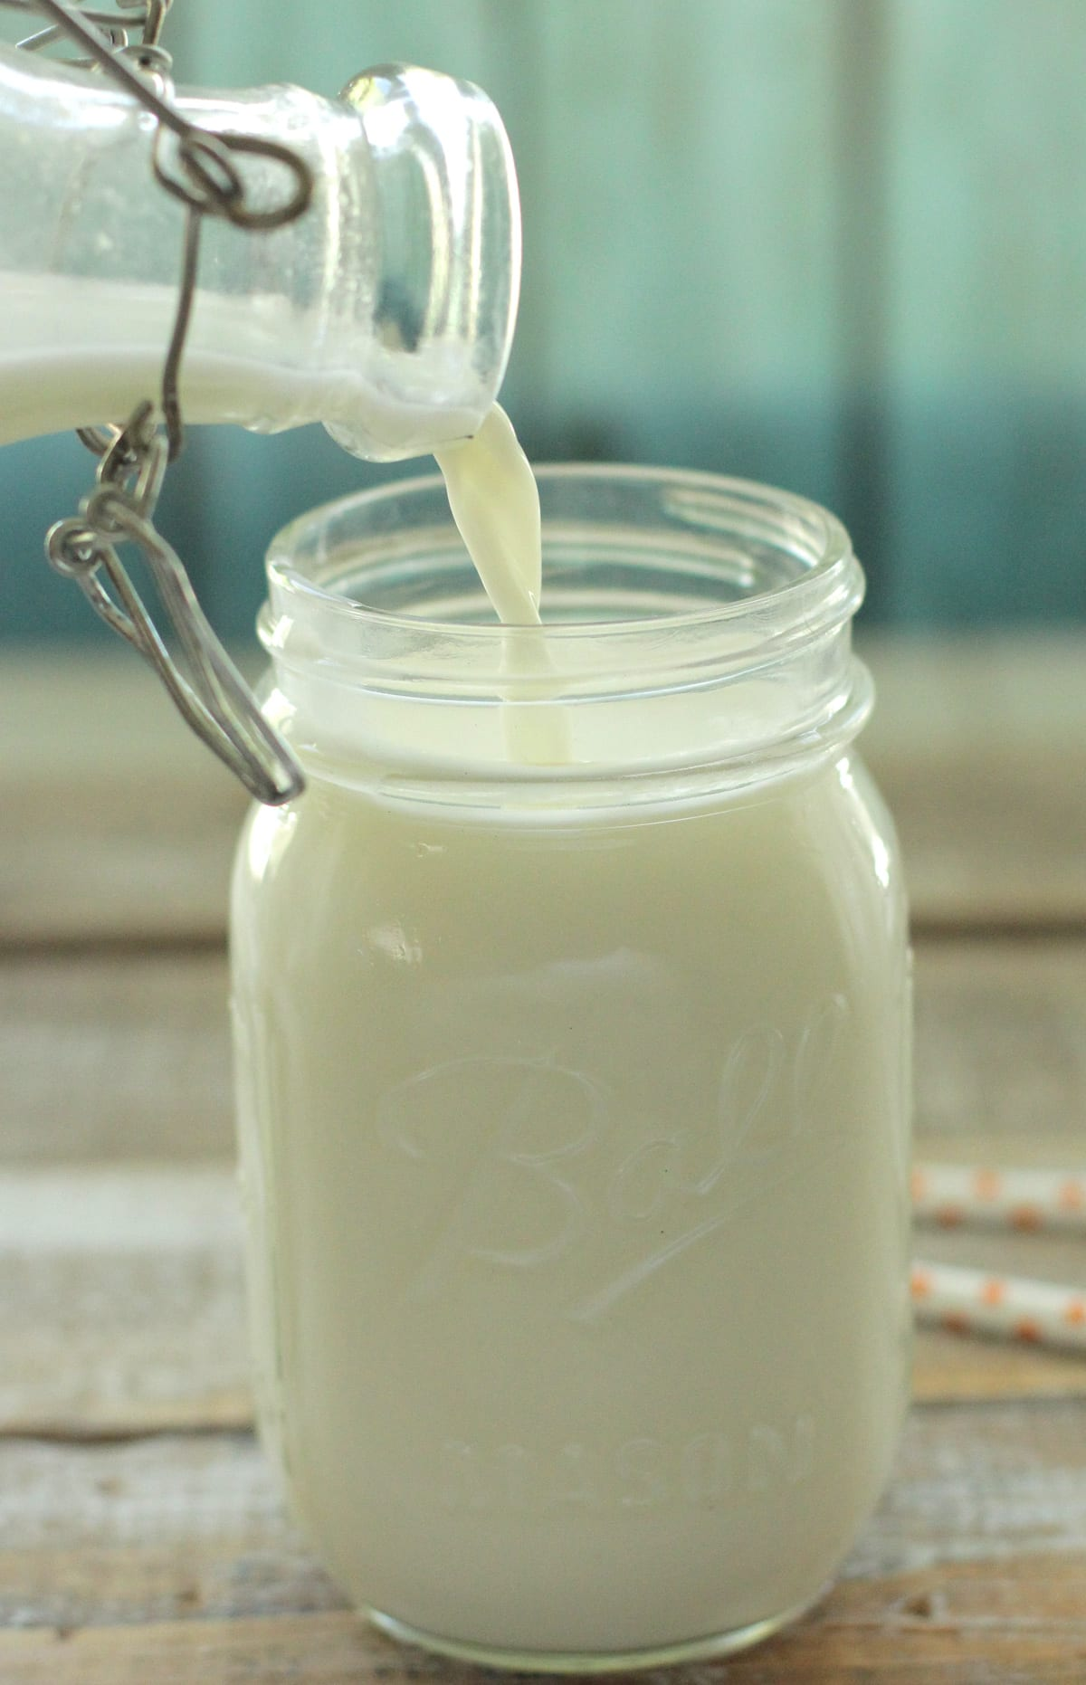
Product of Dairy Cattle
Here’s a Lesson!
Notes:
Ask participants what can be done with this milk…when butter is mentioned use that to transition to next slide.

Slide 13
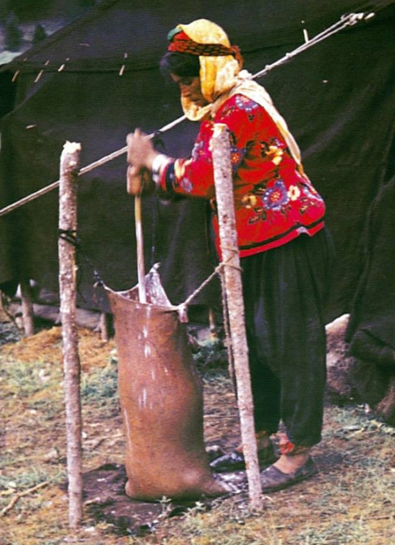
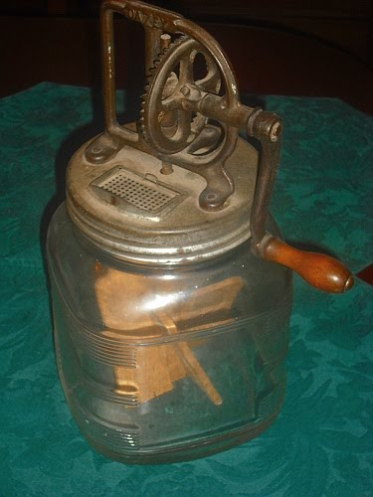
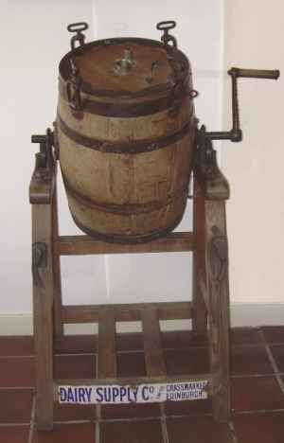
Making Butter ~STEM~
Here’s a Lesson!
Main Challenge→ Create a tool to help make butter.
Animal sack
Dash churn
Paddle churn
Barrel churn
Notes:
Photo 1→ Yoruk making butter in animal sack

Slide 14
Butter Today

Slide 15
Making Butter ~STEM~
Main Challenge→ Create a tool to help make butter.
Questions to Consider:
How much time do you want to spend making butter?
What materials do you think would be helpful?
How can the history of butter making help you design your tool?
What might you do to measure the success of your technology?
Here’s a Lesson!

Slide 16
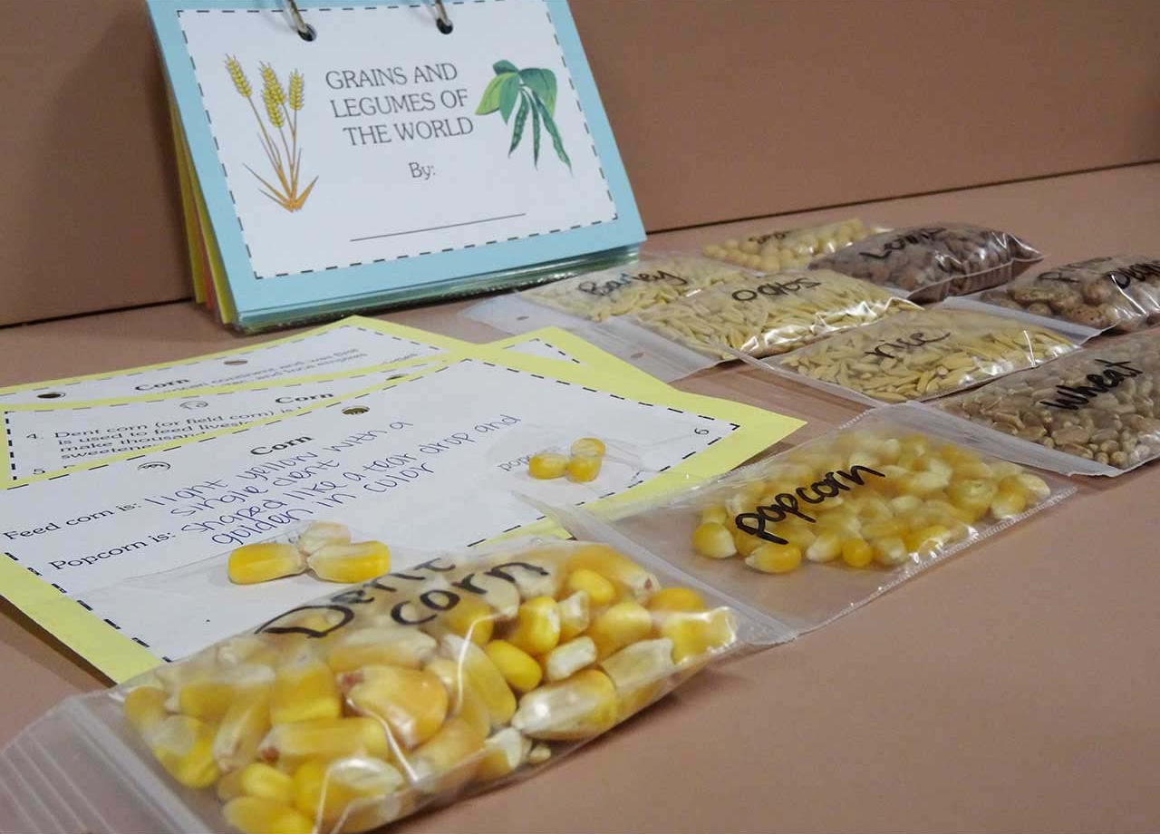
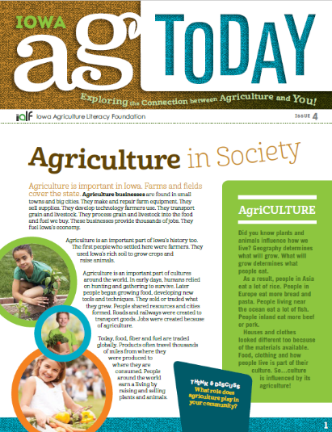
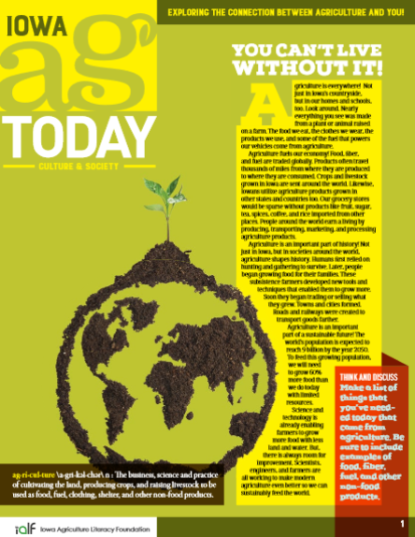
IALF Resources
Standards-Aligned Lesson Plans
Student Publications
Iowa Ag Today
My Family’s Farm
Teacher Professional Development
Summer Workshops
Online Courses
On-Demand
Grants
Lending Library
Outreach
School & Community Events
Journey 2050
Competitions
Gobble Up Turkey!
Bushel of Stories

Slide 17
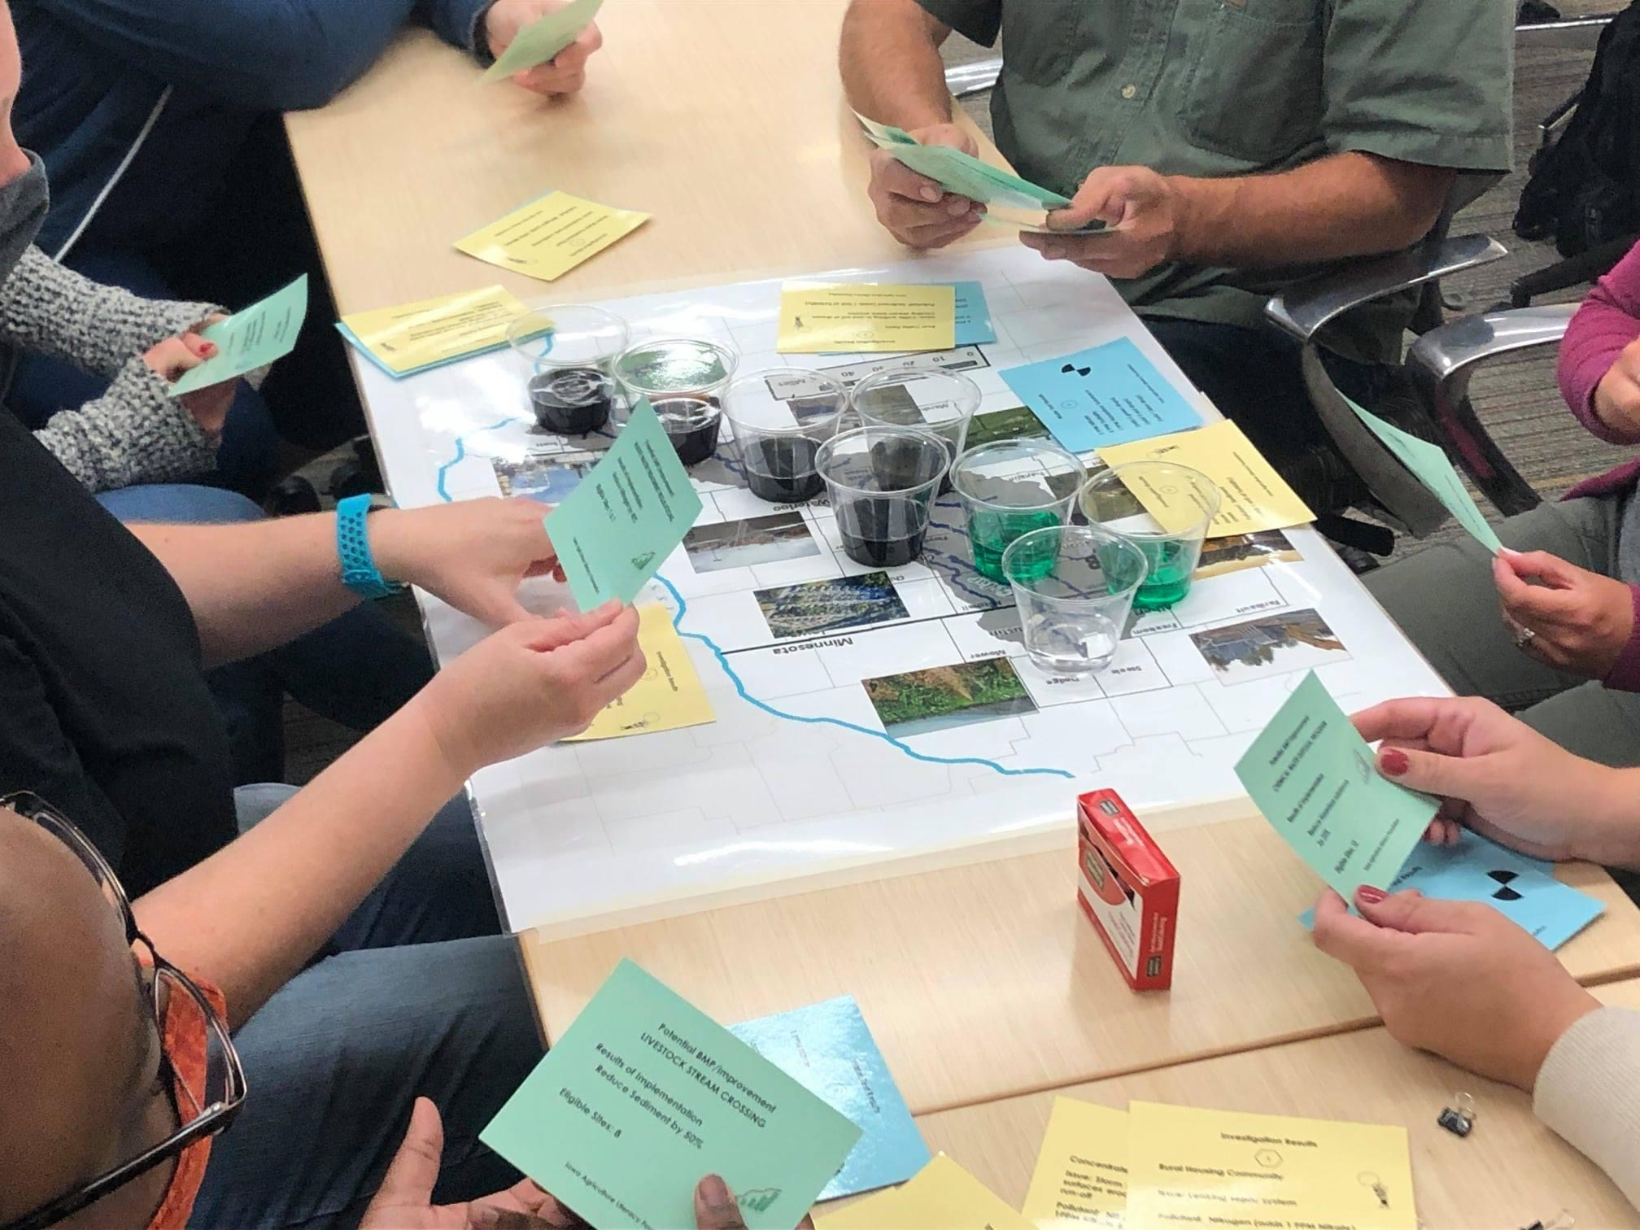
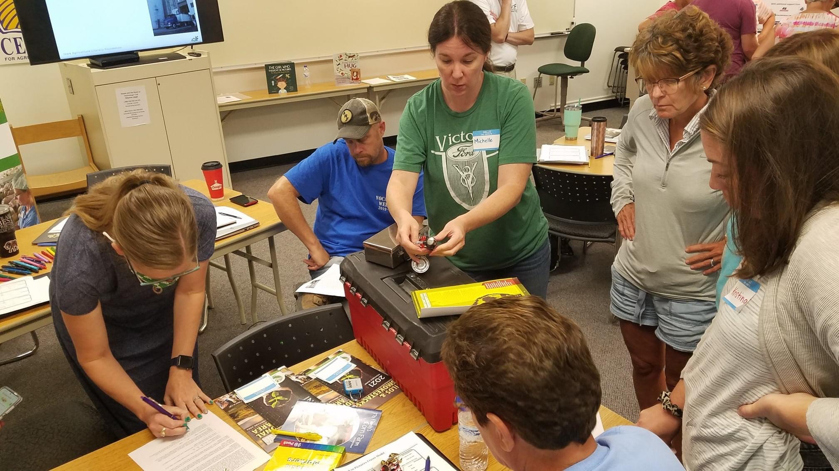
After School Professional Development Funds: Invite Us Out!
Who’s eligible
After school programs
Timeline
2021-2022 school year
What could it look like
Professional Development for your staff!
Hands-On Activities
Materials
Travel
What do I need to do?
Contact us: info@iowaagliteracy.org

Slide 18
Get Connected
Website: www.IowaAgLiteracy.org
Blog: www.iowaagliteracy.wordpress.com
Facebook: www.facebook.com/iowaagliteracy
Twitter: www.twitter.com/iowaagliteracy
Pinterest: www.pinterest.com/IAAgLit
Instagram: https://www.instagram.com/iowaagliteracyfoundation

