Slide 1
Return to learn Afterschool planning
Presented by:
Cassie Gerst, Burlington community school district
Cory Johnson, Burlington community school district
Director of curriculum

Slide 2
Agenda for today
BCSD PIECES Afterschool Program
BCSD Director of Curriculum

Slide 3
Before we begin
Zoom Poll
Your role with 21CCLC
Where you are with your Return to Learn Plan (after school specific)

Slide 6
Links to reference
Iowa DOE COVID-19 Guidance and Information Page
https://sites.google.com/iowa.gov/returntolearn
https://educateiowa.gov/article/2020/06/25/covid-19-guidance-and-information
June 25, 2020 Reopening Guidance for Schools
https://educateiowa.gov/sites/files/ed/documents/2020-06-25_ReopeningGuidanceforSchools.pdf
July 1 Beginning July 1, school districts and accredited nonpublic schools may begin offering all school activities.
No masks required, teach safety and how to not spread germs (hand washing, etc.)
(7-9-20) 2020-21 Early Literacy Implementation (ELI) Guidance – Provides guidance that revises and extends the fall, winter and spring screening windows for 2020-21 and addresses remote assessment considerations, staff training, screening and progress monitoring recommendations, and interpretation of assessment results.
(7-1-20) Open Enrollment Guidance for Senate File 2310 - Provides guidance on open enrollment in accordance to Senate File 2310. This law extends the open enrollment deadline for the 2020-21 school year to July 15 for parents, guardians and caregivers to apply using the application form to open enroll a student at an approved online public school in certain circumstances where the student, or a person who resides with the student, has a significant health condition that may increase the risk of COVID-19. This guidance and form are only for use during the 2020-21 school year.

Slide 7
This school year will look like………

Slide 8
Return to learn plan
DOE sections

Slide 9
Critical components DOE Return to Learn
Leadership
Infrastructure
Health & Safety
Iowa Academic Standards
Social-Emotional-Behavioral Health (SEBH)
Special Education
Data
Preschool Programs and Services
The components for our Afterschool Task Force to work through

Slide 10
Leadership and infrastructure
https://sites.google.com/iowa.gov/returntolearn/leadership-infrastructure?authuser=0
Leadership actions are:
A. Establish a DLT;
B. Use a Continuous Improvement Process to develop, implement, and monitor the Return-to-Learn Plan; and
C. Develop and support an effective communication plan.

Slide 11
Health and safety
The health and safety of Iowa’s teachers, staff, students, and families are first and foremost in planning for the 2020-2021 school year. There are several considerations that cut across delivery models; however, Hybrid and On-Site learning pose the most challenges and need for careful consideration and planning.
Please note that the considerations embedded in the resources below are not a replacement of a district’s emergency, crisis, or safety plan(s) and in no way are these considerations an exhaustive list of health and safety needs. Rather, these are specific additional considerations due to the current COVID-19 crisis that should be noted in any Return-to-Learn Plan.
https://sites.google.com/iowa.gov/returntolearn/health-safety?authuser=0

Slide 12
Iowa academic standards (equity)
Academic learning will continue to be a priority, regardless of the methods by which students return to learning for the 2020-2021 school year. While some planning considerations will be similar across different return to learning delivery models, there are also unique factors that need to be considered by districts in their planning depending on the approach taken for returning to learning. Planning should also take into account other guidance regarding grading, credits, and learning requirements defined in federal law and state code.
https://sites.google.com/iowa.gov/returntolearn/iowa-academic-standards-equity?authuser=0
This Photo by Unknown Author is licensed under CC BY

Slide 13
Social emotional behavioral health
The social-emotional-behavioral health (SEBH) of Iowa’s teachers, staff, students, and families are first and foremost in planning for the 2020-2021 school year. Thinking about supporting SEBH at this time may seem a daunting task; however, the critical focus is securing and enhancing supportive relationships with staff, students, and their families during this crisis.
https://sites.google.com/iowa.gov/returntolearn/social-emotional-behavioral-health-equity?authuser=0

Slide 14
Special education
Creating equitable learning opportunities is of the utmost importance to Iowa’s educators and families. The Department recognizes districts, schools, and families are at different places in their capacity to provide distance learning. Equity in this context is focused on ensuring all students:
Have access to a free and appropriate public education (FAPE),
Are able to access the Iowa Content Standards, and
Have the supports needed to progress in their learning.
There are some common considerations across subgroups, as well as specific considerations within the following populations: students with individualized education programs (IEPs), English learners, students at-risk (broadly defined), and gifted and talented.
https://sites.google.com/iowa.gov/returntolearn/special-education?authuser=0

Slide 15
Data: district and community capacity
Designed to help districts organize and interpret their local survey data and identify community and school resources to meet those needs. The questions included in the Resources and Needs Survey were designed to provide data relative to the specific areas in Return-to-Learn plans. The original surveys are described and found in the Resources and Needs Survey on the Iowa Return-to-Learn Support site. The staff, family and learner surveys provided were built using items from the Survey Question Bank. Use of the survey and data tables is not required, yet are available.
The survey items are organized to put similar items for family, learner and teacher together for interpretation. The order and grouping places more basic needs (such as food and shelter) at the beginning of each section then progresses to more advanced needs throughout the section.
Before School Begins, After School Begins, Resources
https://docs.google.com/document/d/13c5IAaj7k4Zx9t5kfCywZmsjokd61iQGjekt3kZgYIM/edit#heading=h.978jqak7xxvy
This Photo by Unknown Author is licensed under CC BY-SA

Slide 16
Data….local conversation
FAST in one school year
Reading and Math scores by students
Grades?
Summative Assessment | Formative Assessment
Summative Assessments are assessments OF learning and are given at a point in time to measure and monitor student learning. They provide the feedback to educators, students, parents, and community members and are used to make adjustments in instructional programs, report student progress, identify and place students, and grade students. Examples | Formative Assessment is assessment FOR learning. It is a process used by teachers and students as part of instruction that provides feedback to adjust ongoing teaching and learning to improve students’ achievement of core content. Formative assessment practices provide students with clear learning targets, examples and models of strong and weak work, regular descriptive feedback, and the ability to self-assess, track learning, and set goals. (Adapted from Council of Chief State School Officers, FAST SCASS) Connections Professional Development

Slide 17
Data examples of each
Summative
ACT/ SAT
ISASP
ELL (ELPA21)
Formative
Non-graded quizzes
Pretests
Progress Monitoring
Learning Logs
MTSS (RtI)
Point in time
Measure students’ achievements
compared to defined set of
standards
To increase students’ learning
To adjust instructions
To diagnosis student needs
To improve the instructional program

Slide 18
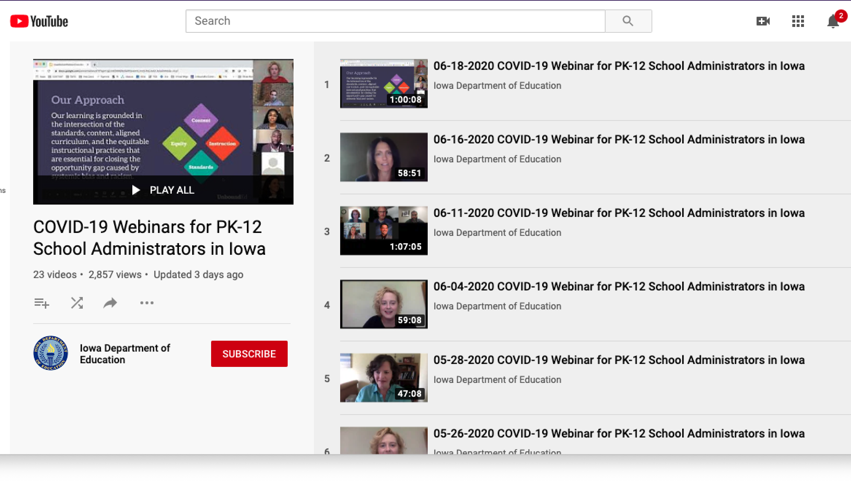
you tube

Slide 19
Instructions

Slide 20
DOE to plan PIECES
What BCSD’s PIECES did next….

Slide 21
Prepare for change…..and pivot
Decisions to be made and a Task Force with Stakeholders was best option
Community Partners, Parents, Staff, Administration, and Student Input
To determine suggestions for all aspects of program and varying models
PIECES is a School District program using the school buildings, classrooms and staff
Planning and Pivoting is going to be necessary

Slide 22
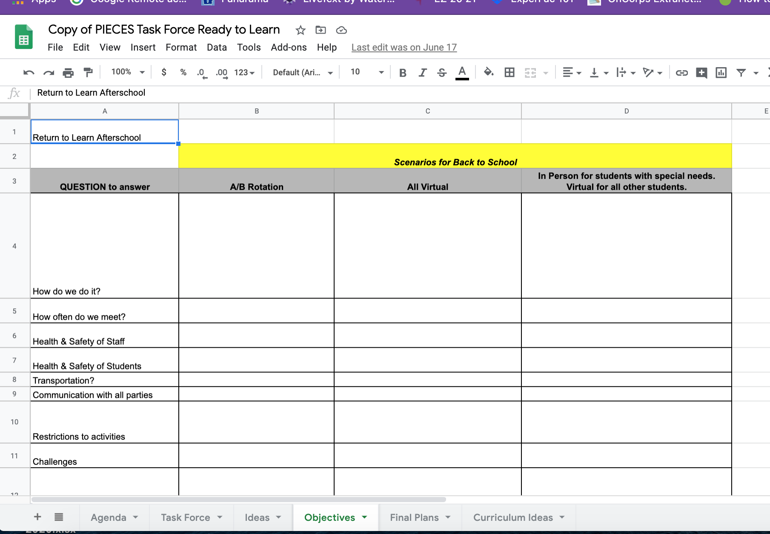
https://docs.google.com/spreadsheets/d/1nNnxMnbE76Tg3qgt_XCHQovHS0BjJHN2V-moouEKSfU/edit#gid=200924610
https://www.iowa21cclc.com/program-support

Slide 23
Things to think about
Thoughts and Ideas
Put masking tape on ground to denote 6 feet apart when leading group activities
Disinfect materials after finished (stay later)
Think about what the parents and students are thinking/feeling (anxious, fear, concern)
In Person Guidelines
Keep students together and minimzie exposure to other children and staff
Monitor the flow of students in/out as they pass
Have students use the same props over and over and not share with other groups
Keep track of people for contact tracing
Greetings
Hula Hoops for social distancing instruction (teaching tool)
Laminate everything for ease of cleaning
Change of Doing Daily Activities
How to change greetings at door
Job Board changes
Safe Space changes (no soft items or carpets)
Parent Check-In and Dismissals

Slide 24
Projected models idea one and two…..
A, b rotation?
All virtual?
What does program look like if we only have half the students?
Can we run program only for students there?
What happens to students not in school?
Can we move to virtual all day every day?
Do we want a virtual option when students are not there?
Do we conduct weekly/daily activities?
Do we have staff who specialize in virtual programming?

Slide 25
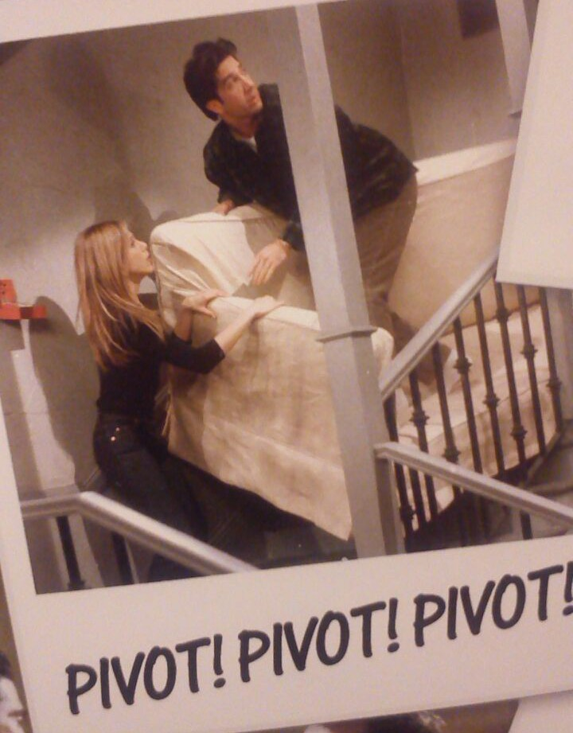
More considerations idea 3 and 4…..
Hybrid model
Normal programming
Most back at school but some home
Can we offer both virtual and in person?
Do we have enough staff?
Back to norm….YEAH
But what if we shift in a day?
This Photo by Unknown Author is licensed under CC BY

Slide 26
 | Scenarios for Back to School
QUESTION to answer | A/B Rotation | All Virtual | In Person for students with special needs. Virtual for all other students.
How do we do it?
How often do we meet?
Health & Safety of Staff
Health & Safety of Students
Transportation?
Communication with all parties
Restrictions to activities
Challenges
Challenges for staff
Equipment needed
- Extra props, crayons?
Classrooms and Room space
Enrollment of students
Number of students
Community Partners

Slide 27
Questions to ask task force
How do we do it?
How often do we meet?
Health & Safety of Staff
Health & Safety of Students
Transportation?
Communication with all parties
Restrictions to activities
Challenges
Challenges for staff
Equipment needed
Classrooms and Room space
Enrollment of students
Number of students

Slide 28
Curriculum lesson plans….that can pivot
Our own or use a ”ready to go” program we purchase?
Funding
MindWorks
Essentials, STEAM, and Project kits
STEMFinity
https://www.stemfinity.com/virtual-steam
Virtual Tools, Kits, and Ideas
Clubs
Boy Scouts, Girl Scouts, Library offer virtual activities
Chess, Coding, …….Clubs that can run virtual OR in person

Slide 29
mindworks
Essential Kits - Each student will receive a kit containing 36 different lessons (12 - Math, 12 - Science, 12 - Language Arts). These lessons represent approximately 36 hours of programming. The kits contain the materials the students need to do the activities and variations for at home, on Zoom, and with other students. The cost will be $50 per kit plus shipping and has to be ordered in sets of six. (PDFs lessons only are $20 per student) Sample lesson CLICK HERE.
Project Kits - Each student will receive a kit of high quality art supplies and 6 comprehensive art lessons, each designed to be completed over the course of a week. The art projects are designed for students of all artistic abilities and incorporate elements of STEAM. Culminating activity questions are included for students to reflect on how each activity incorporated elements of STEAM. The cost for each Project kit is $150 per kit plus shipping and has to be ordered in sets of six. (PDFs lessons only are $20 per student) Sample lesson CLICK HERE.

Slide 30
stemfinity
STEMfinity’s Virtual Tools include:
Immersive teaching methods that allows users to interact with environments around them using Virtual Reality (VR) products
Enhanced learning experiences using projected images in front of the user’s real-world environment with Augmented Reality (AR)
Virtual learning products, allowing learning from any distance
Virtual Tools allow students to:
Zoom in and manipulate 3D models, maps, and landscapes
Access tutoring, develop STEAM competencies, experience field trips, and more
Learn remotely from anywhere

Slide 31
Pieces decisions
A/B
Same Lesson 2 days in a row
Virtual
Weekly Virtual
Normal
Follow typical lesson plan structure
Hybrid
Weekly Virtual
Virtual Option
Parent Pick up supplies from school site
Some in person

Slide 32
Cory johnson
Director of Curriculum for BCSD

Slide 33
Return To Learn and Return to School
Iowa Return to Learn Plans
Leadership,
Infrastructure,
Health and Safety,
Iowa Academic Standards,
Social-Emotional-Behavioral Health (SEBH),
Equity, and
Data Considerations.
School Reopening Guidance
Work Teams
TLC and Curriculum Leads
Counselors/Social Workers
Nurses
Administration
Maintenance
LMC/BEA Representation

Slide 34
Health and Hygiene
Specific Plans and Procedures for Each Site
All students and staff are encouraged to wear masks or other face covering.
Temperature taken when arriving at school. Identify a specified area for students with symptoms of COVID-19.
No water fountains. Water bottle filling stations allowed to remain on.
No lockers. Students need to carry their belongings to class.
1:1 Chromebooks for all K-12 students.
Cohorts and Traveling Teachers.
Procure, inventory, and warehouse PPE, hygiene, and cleaning supplies.
Cleaning procedures and protocols.

Slide 35
Return To Learn and Return to School
Required Continuous Learning | Hybrid Limited Attendance | Most Students On-Site
When it is deemed unsafe for students and staff to gather in school buildings. | When it is deemed necessary to limit attendance to promote social distancing | When it is deemed safe for students and staff to be in school in typical sized groups.
Some students and staff may be able to continue in person instruction. | Some students may be able to, or need to, come to campus every day. | Some students will still be unable (or unwilling) to come to campus.
Most/All teachers working remotely. | Most/All staff working on campus everyday. | Most/All staff working on campus everyday.
Who comes to campus everyday? Is there childcare available?
How do we help teachers balance an A/B schedule? Teaching on site everyday AND managing ‘off-day’ virtual learning for their students? Which courses/content is prioritized for in-person instruction?
For whom is full-time virtual learning available? Who is responsible for teaching?
How will transportation restrictions impact schedules?
PIECES After School Programs, Athletics, and Extra-Curricular Activities

Slide 36
Legal Considerations
Student Considerations
Staff Considerations

Slide 37
What we want …..what we have…

Slide 38
questions

