Slide 1
Accessing online professional development resources for out of school time programs
Iowa Afterschool alliance
April 14, 2020

Slide 2
Iowa Afterschool alliance
The Iowa Afterschool Alliance (IAA) is here for you. Feel free to contact us if you have any questions or concerns at any time.
Britney Samuelson, IAA Project Lead bsamuelson@sppg.com 641-831-4236
Crystal Hall, 21CCLC Monitoring and Support Manager chall@sppg.com 319-310-8312
Emilee Harris, Policy Lead eharris@sppg.com 563-681-7274
Online survey link: How COVID-19 has affected your site? https://www.surveymonkey.com/r/IAACOVID19

Slide 3
Guidance for PROFESSIONAL DEVELOPMENT FOR Out-of-school time programs
Guidance for 21CCLC sites – we will be referencing already established guidance for existing program supports for the purpose of this webinar.
Guidance for all out of school time programs – may be site specific so check with your HR Department.

Slide 4
Online Professional development opportunities
www.iowa21CCLC.com – Iowa’s 21CCLC Program as managed by the IAA and supported by the Iowa Department of Education
www.iowaafterschoolalliance.org – The official website of the Iowa Afterschool Alliance and supported by the Mott Foundation
https://y4y.ed.gov/ - You 4 Youth, a contracted provider for the federal Department of Education and available as a free service to all out-of-school time programs
Additional opportunities from networks and partners across the country

Slide 5
2020 National Service-Learning Conference
Professional Development Opportunity for Afterschool Providers: 2020 National Service-Learning Conference: https://bit.ly/2xmOOrQ
The National Youth Leadership Council will be hosting (free of charge) a PD opportunity for afterschool providers on April 16 and April 17 featuring 12 hours of educational sessions, virtual exhibitors, a service project you can do from home, and connecting opportunities via the Service-learning Network.
There is also an option for young people ages 13 and older to participate. In order to assist with safety for the youth portion, NYLC staff will be moderating this session and attendees will have to be let into the conference and there will be no cameras or audio from participants. They will also have a password set-up and will not send out the link to the event until two-days prior.

Slide 6
Iowa 21CClc website

Slide 7
Best practice webinar schedule and archive

Slide 8
Best practice webinar schedule and archives

Slide 9
Additional archived webinars can be found here:

Slide 10
Upcoming webinars on the iowa21cclc.com site platform
The IAA will also be offering bi-monthly webinars through the month of May. The dates and topics include:
April 14 – Accessing Online Professional Development
April 28 – Outdoor Classrooms and Making the Most of Outdoor Learning Experiences
May 12 – TBD
May 26 – TBD
Calendar invites will be sent. These will be done via Zoom.
What areas of interest do you have?

Slide 11
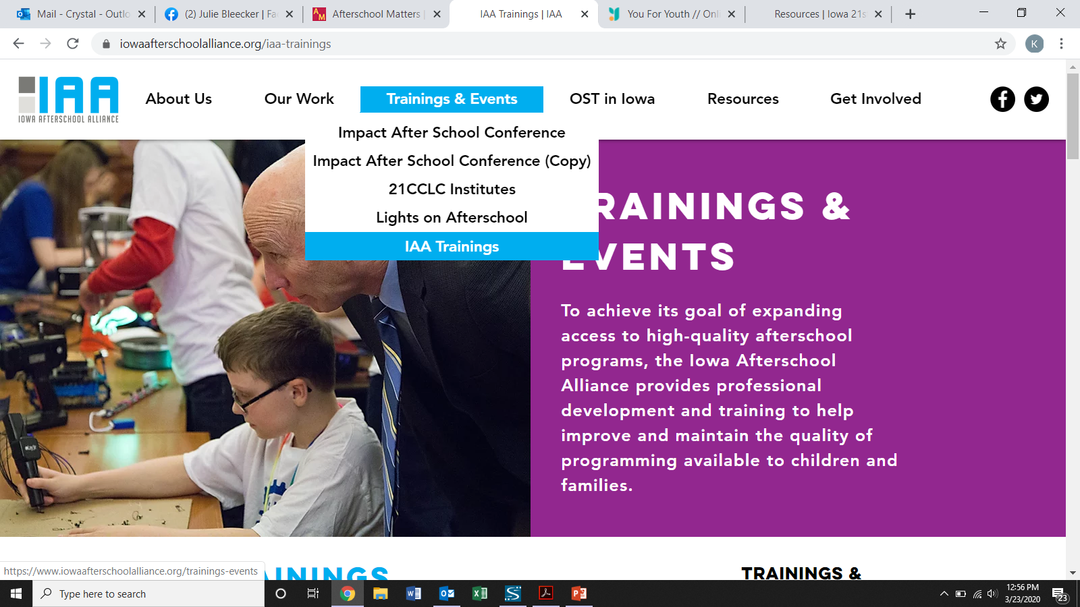
Iowa afterschool alliance website

Slide 12
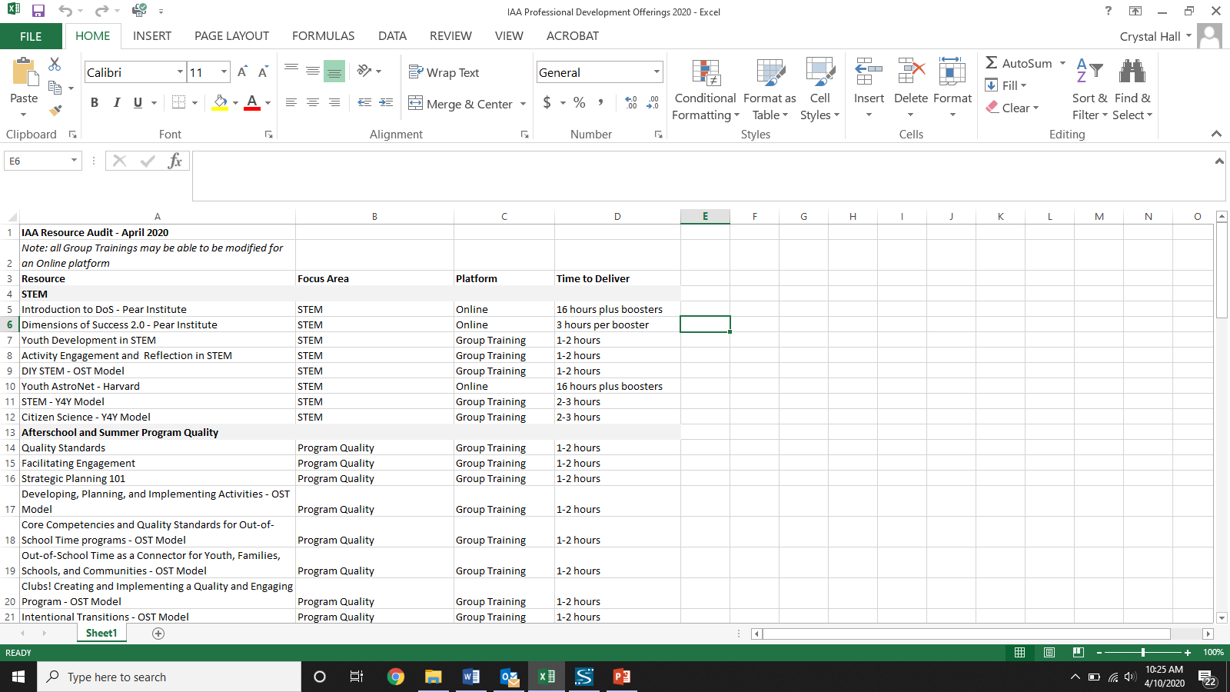
Ways to connect with iaa staff for other Pd offerings
The professional development offerings listed on the IAA website can be done, with some modifications, via a web based platform. We will send this document out as an attachment

Slide 13
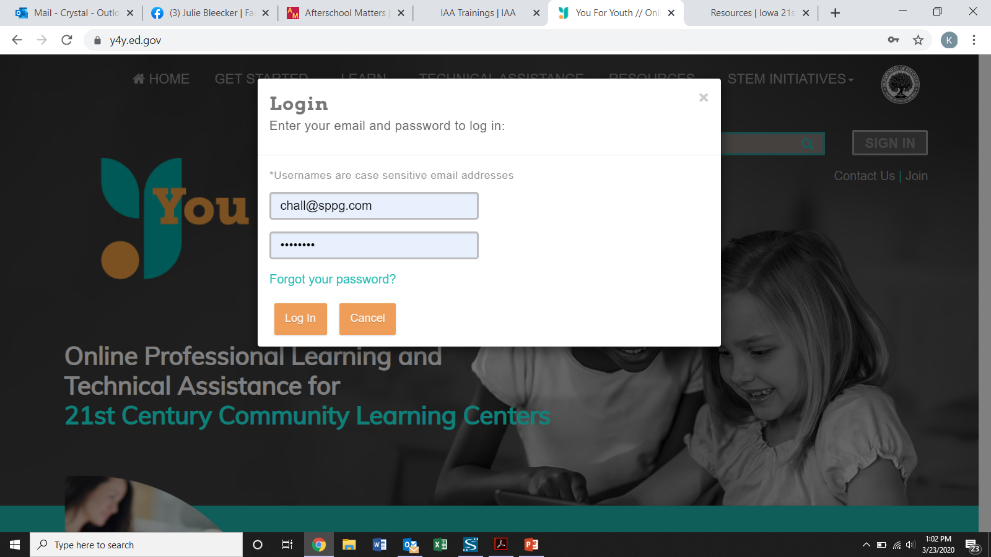
YOU 4 YOUTH

Slide 14
Y4Y COURSE OPTIONS

Slide 15
Y4Y COURSE OVERVIEW

Slide 16
Y4Y COURSE INFO

Slide 17
Y4Y COURSE SECTIONS
Introduction – estimated time, what type of certificate you can earn, summary of the lesson
Implementation Strategies- how to use at your site, estimated time, what type of certificate you can earn, summary of the lesson
Coaching My Staff – how to use with your staff, estimated time, what type of certificate you can earn, summary of the lesson
Tools – customizable tools, where to find resources
Learn More Library – videos, lesson plans, publications
My notebook option in which to record your notes (you can also send/print)
Course Glossary

Slide 18
The iaa’s ability to help with you 4 youth trainings
The IAA can also assist in providing the You 4 Youth’s Train Your Staff Training. These can be done in person or online with your staff. There may be a cost associated with these, so please reach out to the IAA to discuss. Topics include:
Managing your 21CCLC Site
Human Resources
Project Based Learning
Literacy
College and Career Readiness
Citizen Science
Family Engagement
Continuous Education (aligning with the school day)
Summer Learning
Strategic Partnerships
Financial Literacy

Slide 19
Network opportunities
The IAA belongs to a 50 state network in which we share information, insights, and resources.
The following websites have high-quality professional development materials for out-of-school time professionals:
http://afterschoolalliance.org/webinars.cfm - The Afterschool Alliance is a national partner that provides professional development opportunities and resources for the afterschool field.
https://casel.org/covid-resources/ - The Collaborative for Academic, Social, and Emotional Learning (CASEL) is providing several different webinars about how to support youth’s social and emotional learning needs during a pandemic.
https://naaweb.org/naa-events/webinars - The National AfterSchool Association has an archive of webinars covering a variety of topics related to afterschool.
https://nextwavestem.com/pages/professional-development - NextWaveSTEM is providing free professional development on how to facilitate STEM learning from home.

Slide 20
Thank you for your participation
Out-of-school time programs are more important than ever. During this gap in education due to COVID-19, it will be critical to help youth maintain their learning, especially those who are already most vulnerable to the summer slide. OST providers can help bridge the learning loss gap and complement the school day by providing a safe, caring, and interactive environment in which youth can access new experiences and continue enriching their education.

Slide 21
Iowa Afterschool alliance
The Iowa Afterschool Alliance (IAA) is here for you. Feel free to contact us if you have any questions or concerns at any time.
Britney Samuelson, IAA Project Lead bsamuelson@sppg.com 641-831-4236
Crystal Hall, 21CCLC Monitoring and Support Manager chall@sppg.com 319-310-8312
Emilee Harris, Policy Lead eharris@sppg.com 563-681-7274
Online survey link: How COVID-19 has affected your site? https://www.surveymonkey.com/r/IAACOVID19

