Slide 1
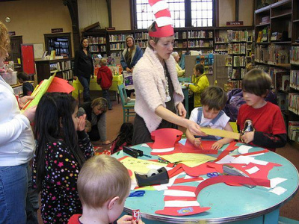
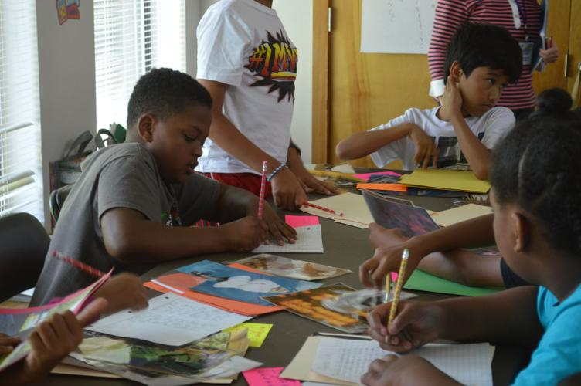
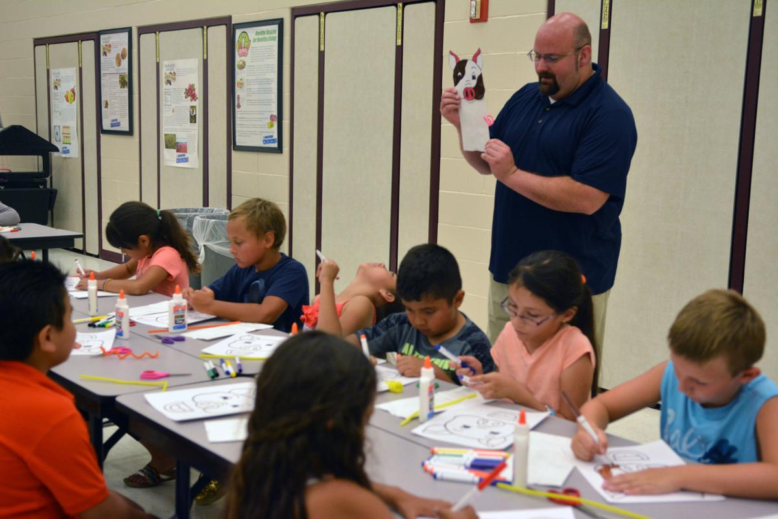
LITERACY ENRICHMENT PD READY, SET, GO!! PART 2
Presented by
Theresa Slaughter, Literacy Enrichment Coach
April 14, 2022
In collaboration with SPPG, & Dept. of Education (21 CCLC)

Slide 2
AS YOU JOIN…
In the Chat Box tell us:
Name, Organization,
3 words describing your favorite color.

Slide 3
HOUSE KEEPING
Encourage participation (camera, chat box, discussions)
Add your name (this makes it more personal and easier to interact)
Utilize the chat box (to connect with others or ask questions)
Need to step away momentarily? Use the toolbar to turn off video/sound

Slide 4
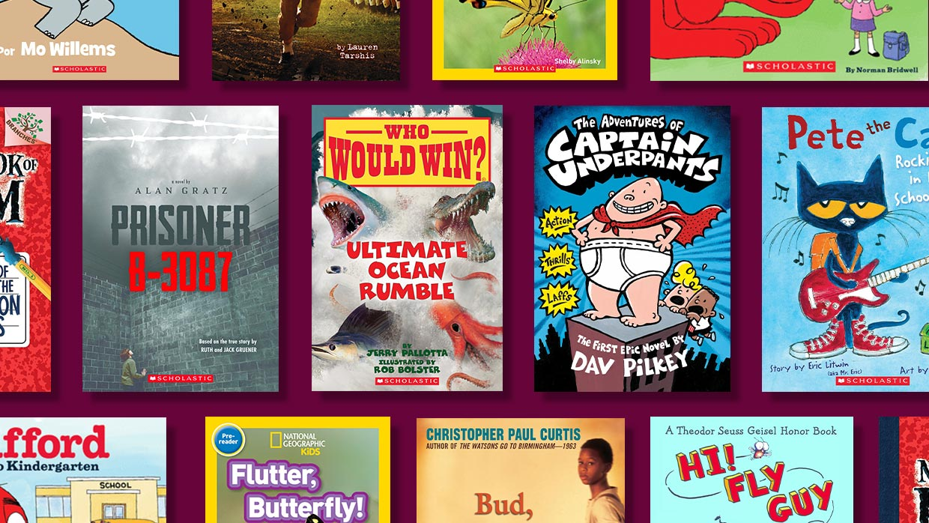
Library Summer Reading Programs
Scholastic Summer Reading Programs
(April – September)

Slide 5
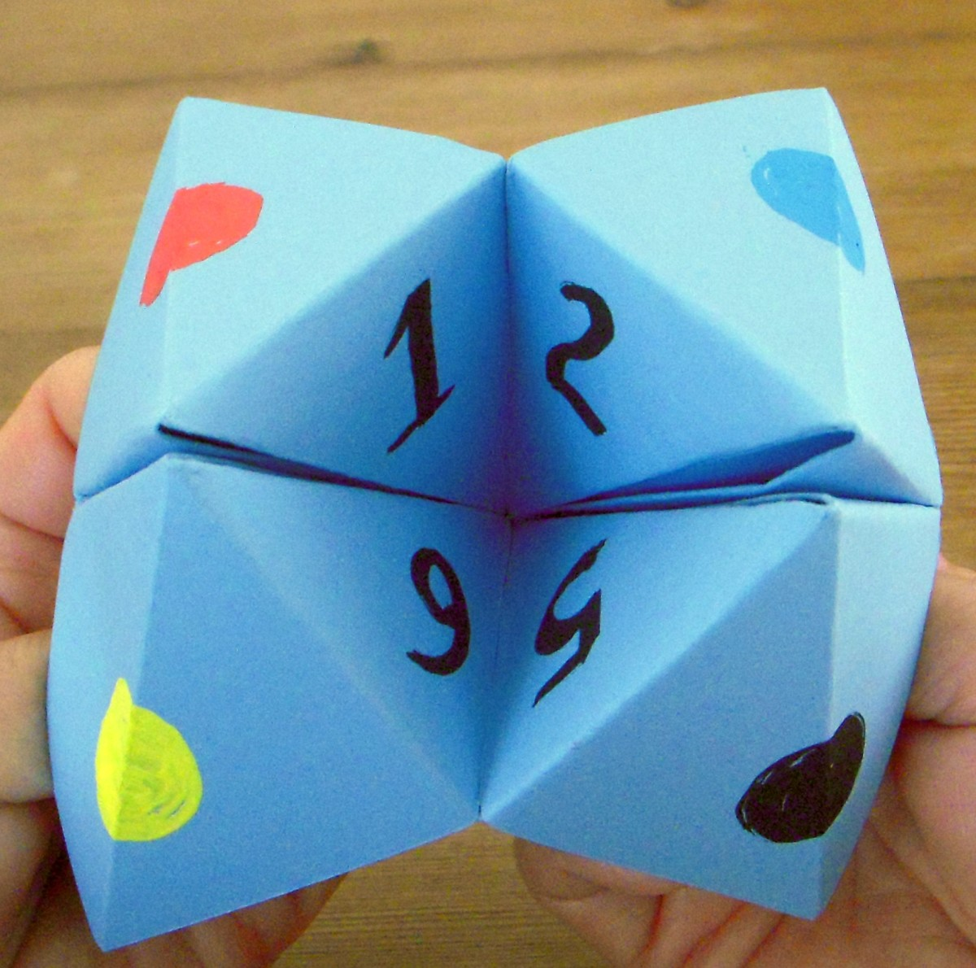
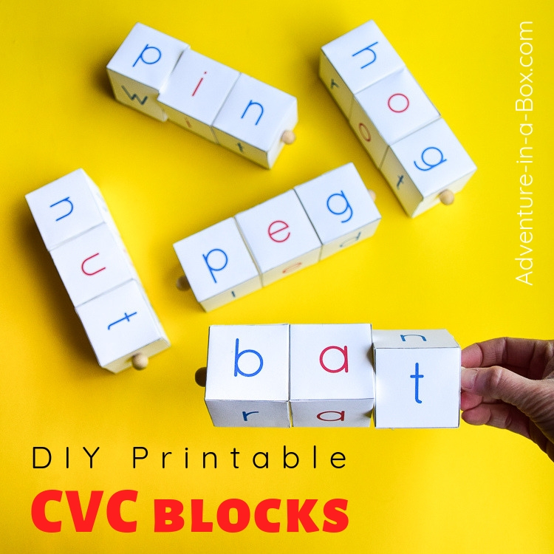
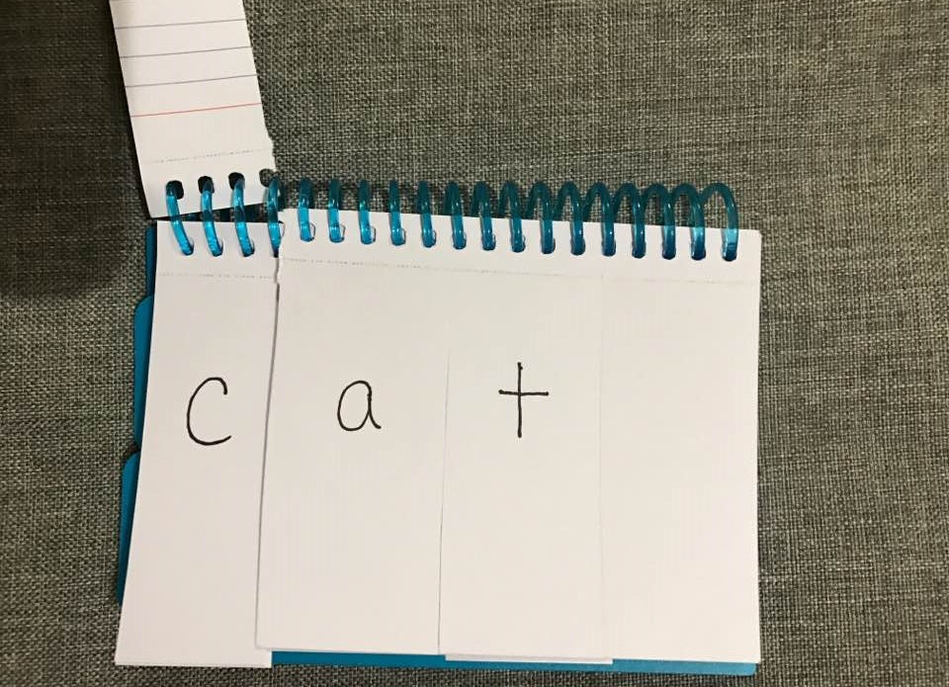
LITERACY ENRICHMENT STATIONS 15 - 30 MIN ROTATIONS
Elementary
Site Word Go Fish; Site Word Memory
CVC activities (map, cap, tap) - word dominoes game; building w/blocks; flip books
Read selective short stories (Popcorn read w/partner) + 1st story check for understanding (grades 3-5)
Technology -- PBS Learning Media, ABC Mouse, school ready programs, Reader Rabbit/Clue Finders??
Middle School
Writing prompts (cootie catcher) – If I Had a Million Dollars; If I Was Principal for the Day
CVC activities (flip, grip, trip); word dominoes game; building w/blocks; flip books
Vocabulary Builders
Technology
Critical thinking (math word problems, social skills, trivia/puzzles, etc.)

Slide 6
VOCABULARY Development & BUILDING
According to research, knowledge is stored in 2 forms: -- linguistic (words, phrases, statements) -- nonlinguistic (pictures that physical sensations like smell, taste, touch, kinesthetic association, and sound)
Word exposure – broadens vocabulary, allows for kids to create meaning, connecting to prior knowledge
Proficient in areas in listening, speaking, reading, and writing → Literacy
Deliverance of vocabulary based on grade, classroom, or group -- discussion and/or writing assignment -- Graphic organizers, vocabulary journals, word wall (mobile)
Done before an activity/lesson -- discuss the word, provide a definition, give examples
Done to build meaning -- Dolch & Fry’s site word list; spelling list; DIY list; games (Scrabble, Boggle, etc.)

Slide 7
VOCABULARY BUILDERS
[Grades 3+] Choose 3 words (method, motion, government, captain, city) Using a dictionary find the following – -- definition -- word pronunciation -- 2 synonyms, 2 antonyms
[K-2] Staff will choose 3 words to discuss w/group (city, place, number, name, map) -- say and spell the word (write out on board) -- discuss definition providing examples
[K-12] Before a Lesson -- discuss the word, definitions, and provide examples -- Ex. parts of a story (characters, setting, plot, conflict and resolution); lava lamps (density, states of matter, water/carbon dioxide)

Slide 8
LITERACY KITS: Program & Family Literacy Night
Grouping: large group; small group (3-4 kids/group)
Time frame: 20 – 45 minutes; days will vary depending on book
Purpose -- Participants will be able to identify vocabulary words within the story. -- Participants will be able to display connections from their world to the outside world.
Directions [literacy kit instructions] Staff will decide whether to do activities as a whole group or divide group into smaller groups (preferred method). Before reading selected story go over any vocabulary words giving examples as needed.

Slide 9
MIDDLE/HIGH SCHOOL LITERACY ENRICHMENT
Bio Boards -- a poster that focuses on an important individual in history. -- a way to celebrate their accomplishments, influence on our history, and a platform to retell their story.
Journaling --Have participants create a journal -3, 2, 1 Exit Slip (3 things learned, 2 things I found interesting, 1 thought I had)
Book Preview -- build excited about books within the classroom library -- selection of books (4-6) -- provide instructions for how to preview [may listen to snippets on audio; kids choose a book and read the first chapter; have them look up reviews on designated websites]
Life Skills & Leadership -- activities/lessons are assessed according to needs along with interest of participants.

Slide 10
BENEFITS of a BOOK CLUB
Kids are able to practice and master Literacy skills (read, write, comprehension [discussion])
Encourages a positive attitude toward reading; forms a deeper appreciation and understanding
Promotes different perspectives on the approach to reading
Develops and grows kids’ inquiry and critical thinking skills

Slide 11
LESSON (UNIT) PLAN PROCESS Chapter Books and/or Graphic Novels
Looking at the title and the book cover, what are some themes or topics that jump out at you? - What are some questions you can ask in regards to the title/book cover? These are the Before Reading discussion questions.
Research – Utilizing the Internet, search for comprehension questions for your book. - Feel free to read the book and come up with your own questions.
Connection Activity – What are some activities that you can pull out of the book to make the “connection.” Think of at least 2-3 activities, fieldtrips, and/or community partners. - Feel free to utilize the Internet for activities

Slide 12
Book Club Chicken Soup SEL Lesson: Being Kind
Storybooks -- At School – Kindness Starts with You by Jacquelyn Stagg -- Listening with my Heart: a story of kindness and self-compassion by Gabi Garcia and Ying Hui Tan
Connection Activity https://www.youtube.com/watch?v=M4ALRY5LyBM&t=87s
Delivery of Lesson -- Vocabulary Builders -- Group Discussion -- Checking for Understanding (writing and/or verbal) -- Various Connection Activities
Gratitude and Acts of Kindness https://www.centervention.com/social-emotional-learning-activities/
What “Random Acts of Kindness” can your program do within the community?

Slide 13
Nat Enough by Maria Scrivan Theme: Self-Awareness
Natalie has never felt that she's enough -- athletic enough, stylish enough, or talented enough. And on the first day of middle school, Natalie discovers that things are worse than she thought -- now she's not even cool enough for her best friend, Lily! As Natalie tries to get her best friend back, she learns more about her true self and natural talents.
Connection Activity: -- look carefully at your reflection, then ask yourself: What do I see that makes me unique from others? -- write down 3-5 positive affirmations about your uniqueness.

Slide 14
JUST FOR FUN NAME THAT MOVIE
Music sometimes makes the movie.
Smash Mouth
Lowrider
“Axle Foley”
George Thorogood
& the Destroyers
AC/DC
Sam the Sham & the Pharoahs
Harry Belafonte
Pharrell Williams

Slide 15
WORKS CITED
Black Hills Special Services Cooperative (BHSSC). (2006). On Target: Strategies to build student vocabularies. http://celi.olemiss.edu/wp-content/uploads/sites/7/2014/01/StrategiesVocabulary-080808.pdf
Fountas and Pinnell Literacy. (2021). What are book clubs? https://fpblog.fountasandpinnell.com/what-are-book-clubs
Petrich, N. R. (). Book clubs: Conversations inspiring community. i.e.: inquiry in education, 7(1) Article 4. Retrieved from http://digitalcommons.nl.edu/ie/vol7/iss1/4
Stone, B. and Urquhart, V. (2008). Remove limits to learning with systematic vocabulary instruction. McREL. Retrieved April 5, 2021 from https://files.eric.ed.gov/fulltext/ED544614.pdf

