Slide 1
LITERACY ENRICHMENT: obstacles of implementation
Presented by
Theresa Slaughter, Literacy Enrichment Coach
March 11, 2021
In collaboration with SPPG & Iowa Department of Education (21 CCLC)

Slide 2
AS YOU JOIN…
In the Chat Box tell us:
Name, Organization,
Tell us 1-2 things you like to do in the Spring.

Slide 3
HOUSE KEEPING
Encourage participation (camera, chat box, discussions)
Add your name (this makes it more personal and easier to interact)
Utilize the chat box (to connect with others or ask questions)
Need to step away momentarily? Use the toolbar to turn off video/sound

Slide 4
Agenda
SPEAKER – ANNE SCIORROTTA-SCHMITZ from BARNES & NOBLE
OBSTACLES OF IMPLEMENTATION -- 3 Areas of Concern -- Breakout sessions
CONCLUSION – TYING IT ALL TOGETHER

Slide 5
Guest speaker
Anne Sciorrotta-Schmitz, Business Development Manager asciorrotta-schmitz@bn.com Barnes & Noble’s Story Design: Innovative STEAM Projects

Slide 6
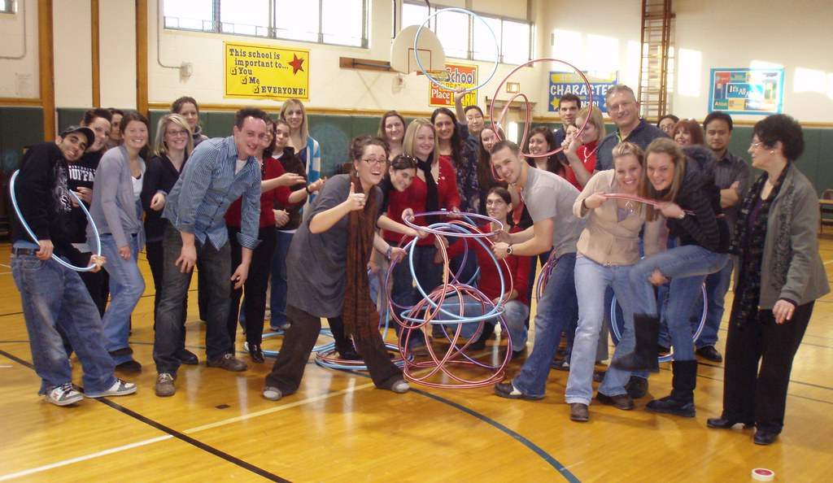
LITERACY ENRICHMENT – obstacles For IMPLEMENTATION
3 AREAS OF CONCERNS -- Program fit -- Skillset of staff -- Engagement of youth

Slide 7
areas of concern
Program Fit -- Literacy within the program -- Complimenting school day instruction --Research/evidence based practices
Skillset of Staff (non-teacher) -- Professional Development (delivery of) -- teacher off-days -- doable activity/curriculum
Thinking Out Loud Question WHAT CAN WE DO AT OUR CAPACITY?
BREAKOUT SESSION #1 SHARE OUT
30 min

Slide 8
Breakout session #1: reflection questions
-- What can we do at our capacity?
-- What are some things your program has done well?
-- What are some challenges you might face with staff and how might you address them?
--Looking at your program, what skills are needed for success? And what role do you play in making that happen?

Slide 9
areas of concern (conT.)
Engagement of youth -- Lack of interest -- Activity does not fit intended group -- Lacks intentionality and relevancy
Thinking Out Loud Question WHAT DOES YOUTH ENGAGEMENT MEAN FOR YOU?
BREAKOUT SESSION #2
SHARE OUT
20 min

Slide 10
Breakout session #2: reflection QUESTIONS
-- What does youth engagement mean for you?
-- What are some challenges and/or limitations you might face with kids and how might you address them?
-- How can staff minimize those challenges/limitations?
-- Thinking Outside of the Box What are ways you can spark enthusiasm within your program?

Slide 11
In conclusion
Engagement of youth -- piggy back off existing activity/curricula, utilize current events -- incorporate purpose (be intentional), change of delivery -- letting kids have a voice
Program fit -- compliments the school day (reinforcing skills/filling in gaps) -- promotes embedded learning opportunities instruction that is embedded in ongoing activities and routines within a program (classroom)
Skillset of staff -- train the trainer -- utilization of veteran staff

