Slide 1
Welcome!
Achievement Unlocked: WIOA Title I Youth Program
Providing Vocational Training, Education, and Support Services for Iowa’s Youth

Slide 2
Introductions
Moderator:
Bri Steirer
One-Stop Operator; Central, North Central, NW, NE Iowa LWDA
Panelists:
Kendra Schaapveld
Project Director, WIOA Title I Adult/Dislocated Worker, Youth Programs; Mississippi Valley LWDA
Emily Smith
Director of WIOA Title I Adult/Dislocated Worker, Youth Programs; Northeast Iowa LWDA
Paul LaMuyon
WIOA Title I Youth Program Supervisor; Central Iowa LWDA
Jade Alsin-Earles (Jay)
WIOA Title I Youth Participant; Connect 2 Careers at Children & Families of Iowa

Slide 3
How We Do What We Do
Federally Funded
Department of Labor
Workforce Innovation and Opportunity Act (WIOA)
IowaWORKS Partner Network

Slide 4
Our Focus: Youth/Young Adults
We work with young people 14-24 with multiple barriers to success to help them identify and achieve their vocational, educational, and independent living goals.
Out of School Youth
Drop outs
Recent High School Graduates
Young adult struggling to find gainful employment.
Age 16-24
In School Youth
Attending School
Age 14-21
Low income
Basic Skills Deficient
Disabled
English Language Learner
Offender
Foster Care
Pregnant or Parenting

Slide 5
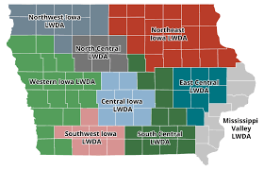
You can connect with a WIOA Title I Youth Program anywhere in Iowa!
9 local WIOA Title I Youth programs serving Iowa’s 99 counties
Emily Smith; Northeast Iowa
Kendra Schaapveld; Mississippi Valley
Paul LaMunyon; Central Iowa
Note: A handout with contact information for your local WIOA Title I Youth Program will be provided at the end of the session.

Slide 6
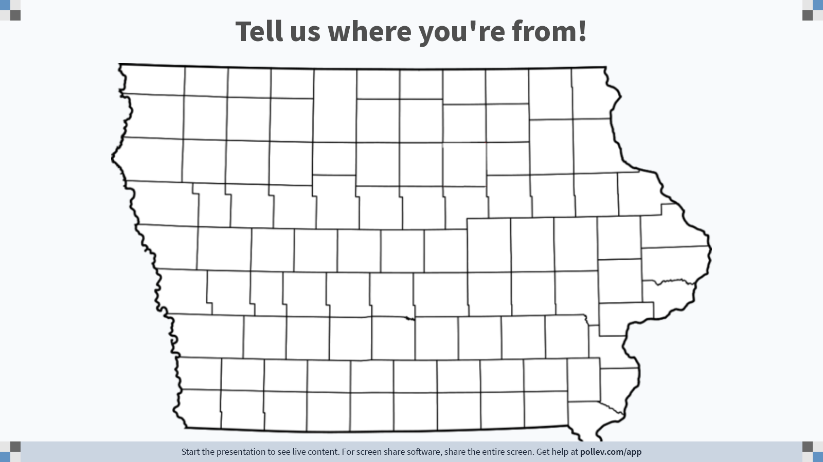
To respond go to PollEv.com/bsteirer087 on your phone or laptop!
Notes:
Poll Title: Do not modify the notes in this section to avoid tampering with the Poll Everywhere activity. More info at polleverywhere.com/support Tell us where you're from! https://www.polleverywhere.com/clickable_images/RzlPCALY6wY37Hg5YQbjM

Slide 7
Who We Serve
Youth & Young Adults ages 14-24
US Citizen or legally able to work in the USA
In-School/Out-School
Ages 14-21 in-school documentation
Ages 16-24 out-of-school documentation
Other Determining Eligibility Criteria
Primary Focus for Funding Is Out Of School Youth Enrollment of Youth with multiple barriers to employment.

Slide 8
What We Do
Monthly one-on-one support that is tailor made to individual needs
Recruitment fairs
Cohort Group Workshops
Long and short-term goal setting
Collaboration, partnerships and co-enrollments with local partner agencies
Create training programs to prepare young people for specific industries
One year of follow-up services (if needed)

Slide 9
Our Focus Areas
Vocation
Education
Self-Sufficiency Skills

Slide 10
Vocation
Job Search
Labor Market Information
Resumes
Interview Prep
Work Readiness Skill Building
Paid Work Experiences
On the Job Training
Internships
Job Shadows

Slide 11
Education
Assistance in finishing High School Diploma or Equivalency
Identify training opportunities necessary to reach career goals
Want to go to college?
We can help with everything from college visits, to how to apply, FAFSA, and can help with costs if funds allow and the need is present!

Slide 12
Self-Sufficiency Skills
Transportation Assistance
Childcare Assistance
Financial Education
Buying first car, renting first apartment
Other Supportive Services
Emotional Intelligence Training

Slide 13
Community Partners
You have the power!
Connect with your local Title I Youth Program—together, we can support, serve, and prepare Iowa’s youth for the future!

Slide 14
Informal
No Appointment Needed
Referral Process

Slide 15
Questions & Comments?

Slide 16
Youth Program Participant Experience
Jade Alsin-Earles (Jay)
WIOA Title I Youth Program Participant
Connect 2 Careers at Children & Families of Iowa; Des Moines

Slide 17
Connecting with your Local WIOA Title I Youth Program
A panel discussion

Slide 18
Thank You!
Please remember to take a handout with contact information for your local WIOA Title I Youth Program!

