Slide 1
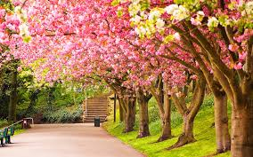
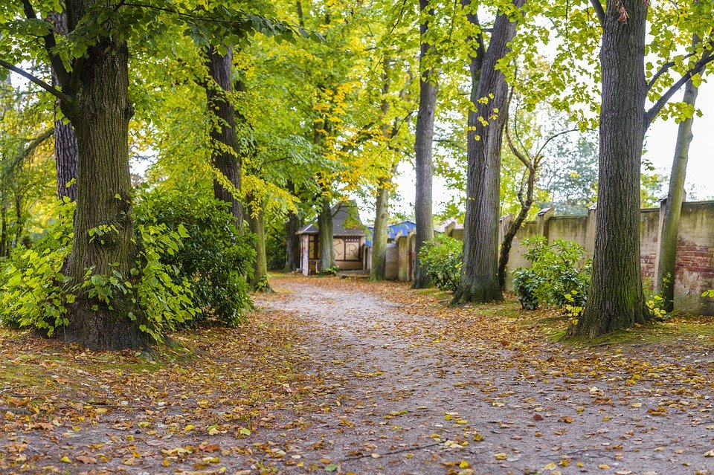
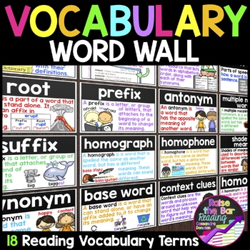
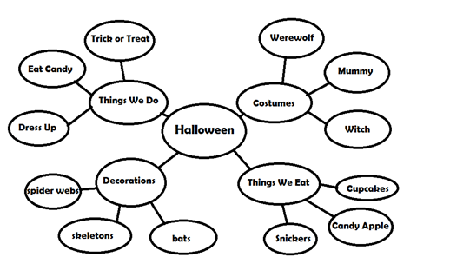
ACTIVITY – WRITING A STORY GRADES 3 - 12
Staff will select 2 pictures for kids to use to write a story. -- allow time for kids to write their story and share out. -- focus is on sentence structure (capital letters at the beginning of a sentence, proper nouns capitalized, ending punctuation, etc.) and not so much on spelling.
Vocabulary Builder – parts of a story (characters, setting, plot, conflict and resolution) -- word wall [definition, sentence, example(s)] -- word web -- graphic organizers -- Be Creative!!

Slide 2
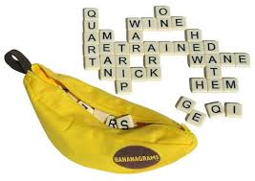
ACTIVITY – BANANAGRAMS with a TWIST GRADES 3 - 12
2-4 players = 21 tiles 5-6 players = 15 tiles 7-8 players = 11 tiles
Place all 144 tiles face down in the center of the table. Each player takes their given starting tiles.
The group will be given a subject and race to arrange the tiles in their own intersecting grid. The objective is to be the first player to come up with 10 words (12 words for advanced) that relate to the subject.
Words have to be 3-letters or more.
At any time during the game, a player can put one of their letters back in the pile face down. However, they MUST take 3 more tiles in exchange.

Slide 3
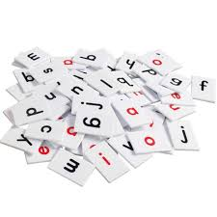
LETTER/WORD RECOGNITION GAME GRADES K - 2
Place all tiles face up in the middle of the table.
Staff will select a word to be spelled out by the participants. Staff will call out the letters in order. Participants then will pick the called letter out of the pile. Ask participants to repeat the letters as you say them.
Once you spell out the word ask participants if they can recognize the word. If not, staff may provide clues for the participants to get the word.

