Slide 1
LITERACY ENRICHMENT
Presented by Theresa Slaughter, Literacy Enrichment Coach
Literacy Enrichment PD
January 27, 2022

Slide 2
AS YOU JOIN…
In the Chat Box tell us:
Name, Organization,
One fun fact about yourself.

Slide 3
HOUSE KEEPING
Encourage participation (camera, chat box, discussions)
Add your name (this makes it more personal and easier to interact)
Utilize the chat box (to connect with others or ask questions)
Need to step away momentarily? Use the toolbar to turn off video/sound

Slide 4
AGENDA
-- Mid-Session Check-In (4 Corners + 1)
-- Evidence-Based Practices [Integrated “Best Practices”]
-- Literacy Activities

Slide 5
4 Corners + 1
List 4-6 community partners who you feel could compliment your Literacy Enrichment program.
What are some challenges/limitations you might face with kids and how might you address them?
Reflecting on your discussions today, what are some “take aways” that can help you continue moving program forward?
List 3-5 next steps in planning/implementing Literacy Enrichment within your program.
So far, has your program implemented any of the suggested Literacy Enrichment strategies and/or activities? AND/OR has your program encountered any challenges along the way? Briefly share your story.
15 min; 8 min

Slide 6
EVIDENCE-BASED PRACTICE
What is Evidence-Based Practice? -- supported by extensive research -- works on a large scale -- practices can be used on various “disciplines”
Benefits of Evidence-Based Practice -- priority of setting goals -- invested time → maximum growth and progress -- high-level of support from ALL stakeholders involved
Various ways to incorporate practices within programming -- Embedded Instruction -- Differentiated Learning -- Structured Lessons -- Checking for Understanding (Comprehensive Questioning) -- Group Work (Cooperative Learning)

Slide 7
EVIDENCE-BASED “BEST PRACTICES”
Embedded Instruction -- planned and intentional learning opportunities that are inserted in everyday routines and activities; done in a way not to point out the obvious. - clear and precise ______ (focus/goals/objectives/purpose)
Differentiated Learning -- providing content and materials that embrace all levels of learning and styles (hands-on, discussion, writing/reading).
Structured Lessons -- planned and intentional; clear and precise (focus/goals/objectives/purpose) -- provides clear understanding to KUD (Know, Understand, Do) -- aides in practicing mastery learning

Slide 8
EVIDENCE-BASED “BEST PRACTICES”
Checking for Understanding (Comprehensive Questioning) -- group and/or individual discussions -- reflective questions and/or reading questions (before, during, after) -- short review of prior knowledge or learning
Group Work (Cooperative Learning) -- intentional learning opportunities for kids to work in partners/small groups -- effectiveness → selective in assigning tasks along w/defined roles/responsibilities -- encourages active learning and positive peer interactions

Slide 9
-> What is Evidence-Based Practices? -> List and explain in your own words, 2-3 ways of implementation.
CHECKING FOR UNDERSTANDING

Slide 10
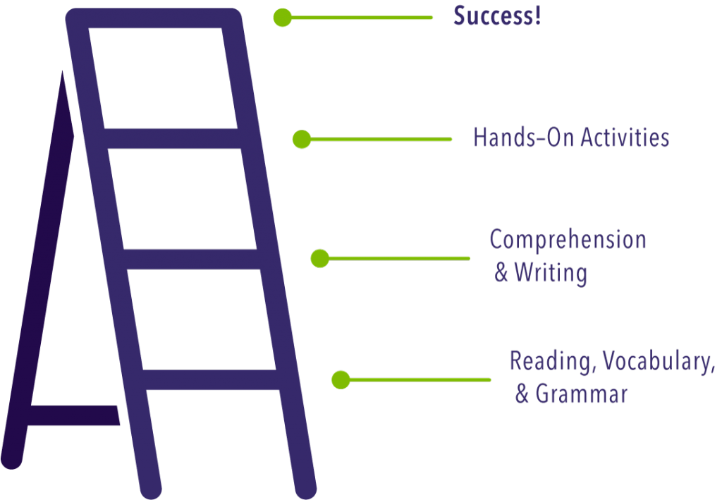
LITERACY ENRICHMENT
ACTIVITY TIME

Slide 11
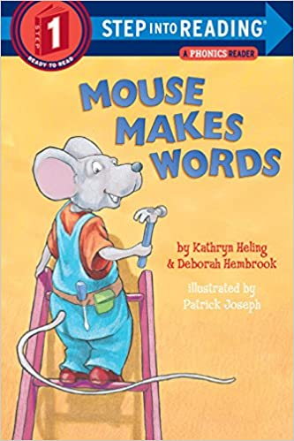
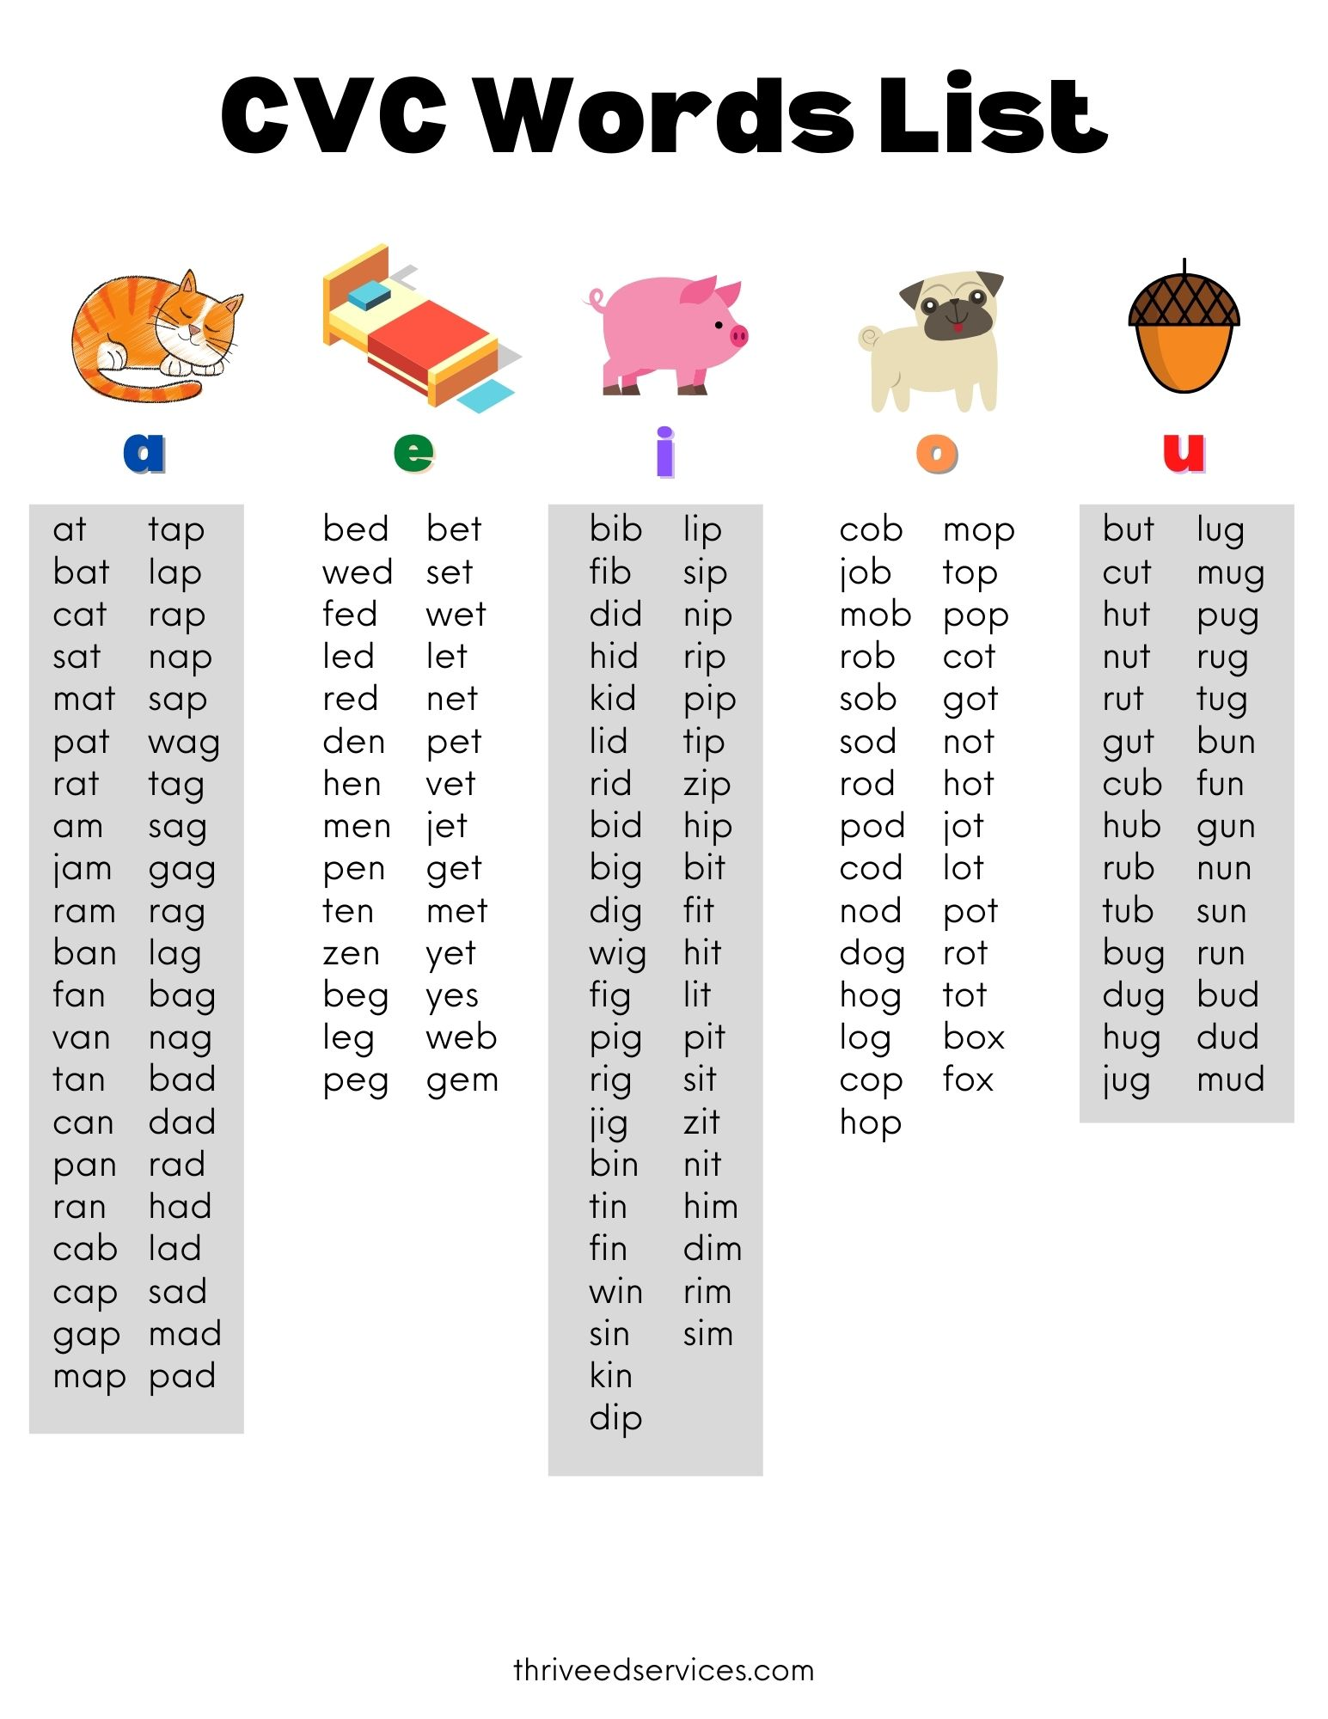
Mouse Makes Words By Kathryn Heling & Deborah Hembrook
Once done with the story, staff may continue the rhyming game using the additional words on the back OR have the kids come up with their own words.
Alternate rhyming word list CVC (consonant-vowel-consonant) short/long vowel sounds
Focus: Kids will be able to identify and formulate 3-letter rhyming words and make sound substitutions.
Directions - Pass out to each individual kid a set of alphabet letters (A-Z). - Instruct kids that this pile will be used to make rhyming words as you read the story.
Before you read – talk about the title. Ask kids, what do you think this story is about?
While reading -- have kids find and spell out the words using their letters. Give them time to do this assisting when necessary. Once kids have spelled out the second word allow for them to say the word.

Slide 12
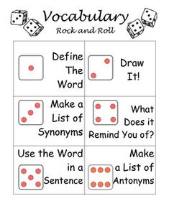
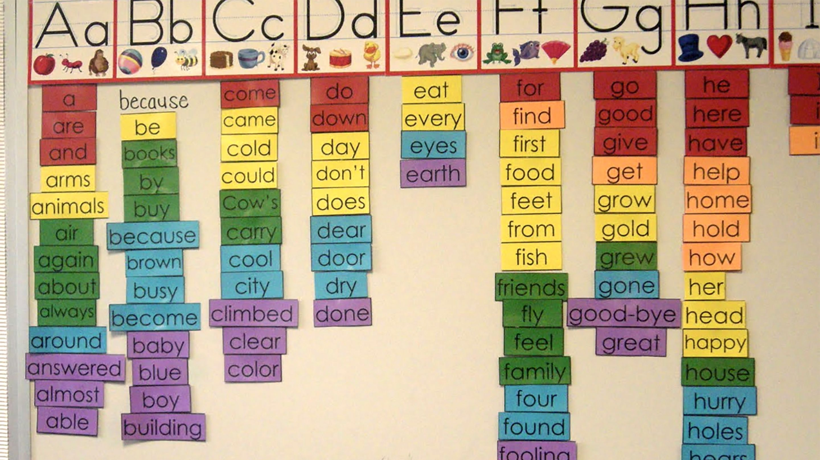
Alphabet Game
Grades: 3-8; K-2 w/modifications
Ways to play: - individual, partners, group (classroom)
Directions: - Pick a letter (A-Z) to reveal the letter that the words must begin with. - Kids will write down at least 5 words; 7 words for older/advanced groups -You may selectively go around the group and have them read some of their answers.
Selective “words” can be turned into a word walls and vocabulary builders.

Slide 13
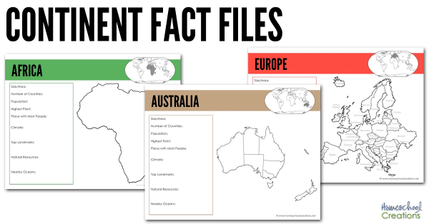
2022 WINTER OLYMPICS Feb 4- 20
Day 1-3 of the Olympics – History of Olympics (6+ facts about the Olympics) -- 5 rings – symbol 5 continents -- 5+1 colors – combined colors of the flags -- Olympic Mascots (2010 – present) https://olympics.com/en/olympic-games/olympic-mascots
Activities: - Olympic Pennant/Flag - Choose 2 mascots to color/draw/trace - Continent Passbook, each color represents a continent* - Torch Run
Take 1-2 days to cover each continent; allowing kids to fill out Continent Passbook and do activities. *Fill out Continent Passbook (location, size, climate, capital)
Discuss facts about the continent
Activities: --- Try a fruit, veggie, or dish from that continent --- learn a new dance, game, and/or language
This Photo by Unknown Author is licensed under CC BY-SA-NC

Slide 14
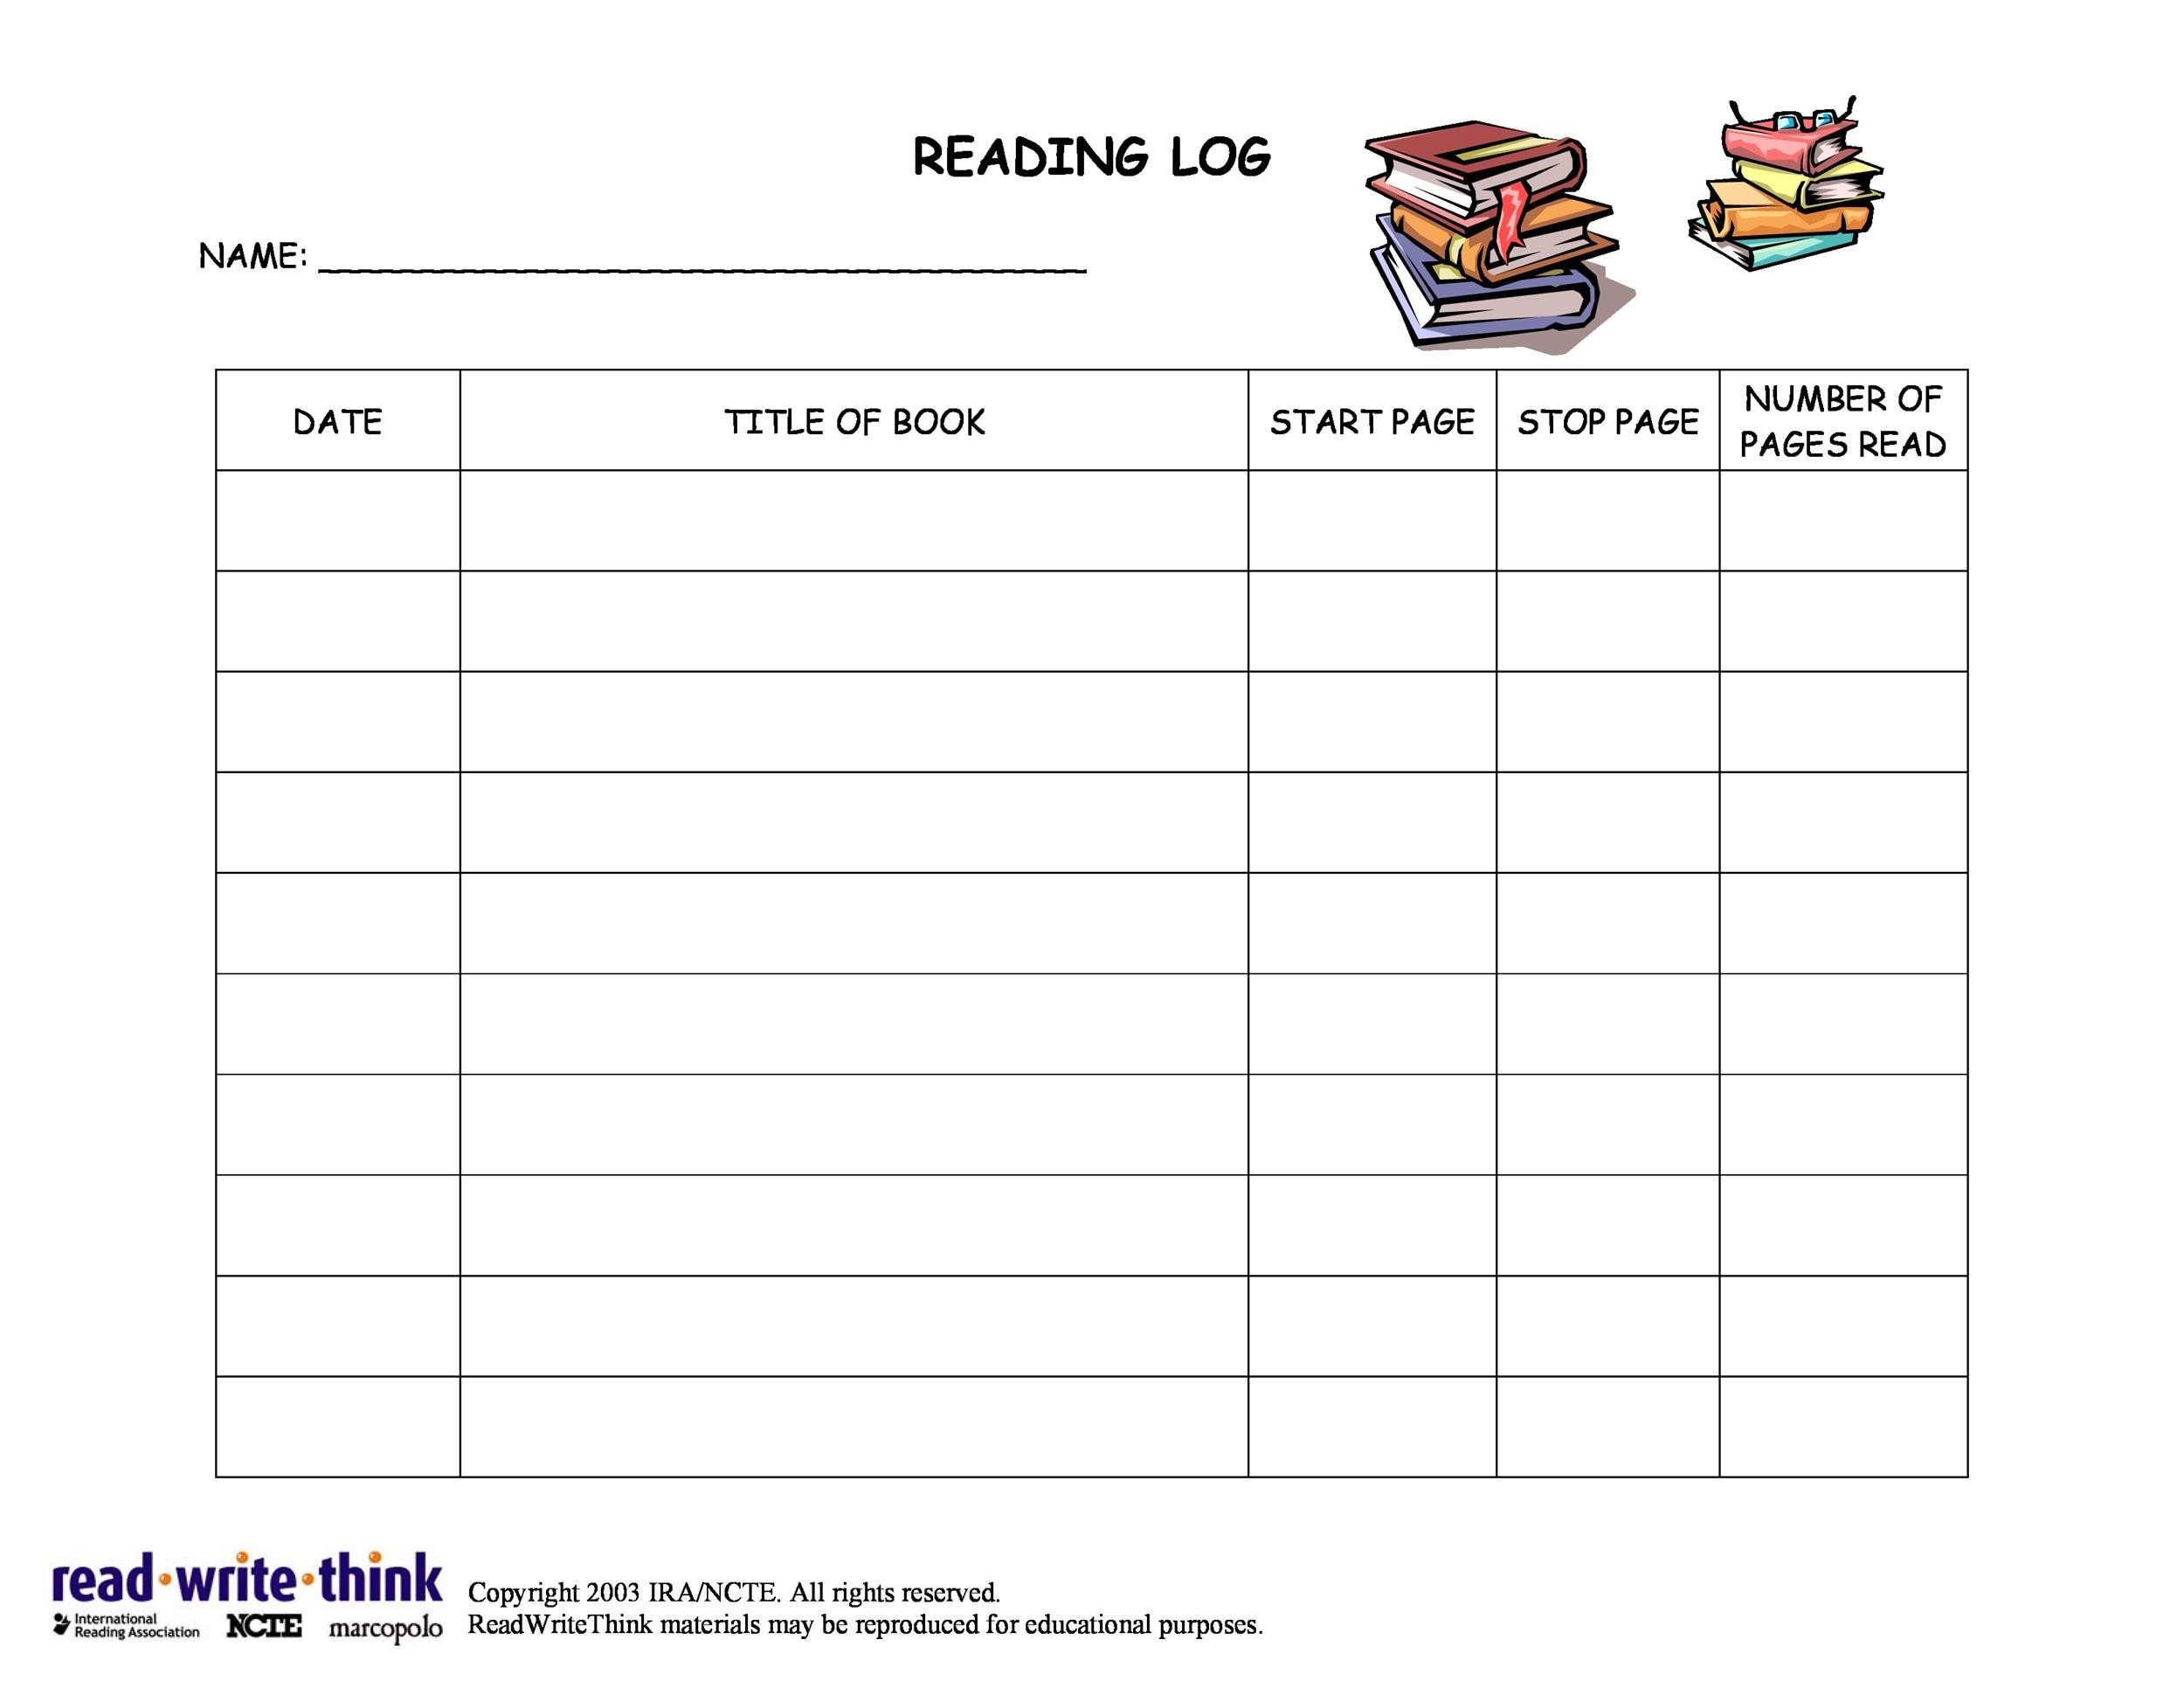
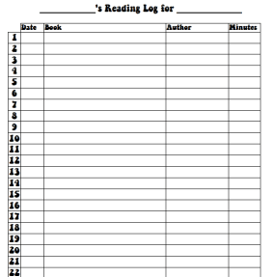
Readers League READ with us and EXPAND YOUR MIND.
Requirements: -- Books must be read within the 4 week time period. Upon completion of requirements, receive a special prize. -- All books will need to be approved by a staff member to make sure that kids are reading at their level. -- Everyone will need to complete a grade-level reading log; provided by staff.
Staff will do periodic checks on participants making sure to
K-1 and 2-3 grades -- read 200+ minutes (Write down the title of the books read and minutes). -- Staff can “selectively” ask comprehensive questions about any of the books read.
4 – 8 grades – read 4-6 books completing a reading log & book report for each book read. (Keep track of the pages you read then do a short report.)

Slide 15
WORKS CITED
Aperture Education. “Evidence-based” vs “research-based:” Understanding the differences. (2022). Retrieved from https://apertureed.com/evidence-based-vs-research-based-understanding-differences/
Diery, A., Vogel, F., Knogler,M., and Seidel, T. (02 June 2020). Evidence-based practice in higher education: Teachers’ educators attitudes, challenges, and uses. https://doi.org/10.3389/feduc.2020.00062
Killian, S. (2021). Top 10 evidence-based teaching strategies for those who care about student results. University of Nebraska-Lincoln Newsroom. Retrieved from https://newsroom.unl.edu/announce/csmce/5272/29630
Special Education Resource Project. (2022). What are evidence based practices? Vanderbilt University. https://my.vanderbilt.edu/spedteacherresources/what-are-evidence-based-practices/
The IRIS Center Peabody College Vanderbilt University. (2021). What is an evidence based practice or program (EBP)? https://iris.peabody.vanderbilt.edu/module/ebp_01/cresource/q1/p01/#content

