Slide 1
Building strong programs through
Community partnerships
September 24, 2021

Slide 2
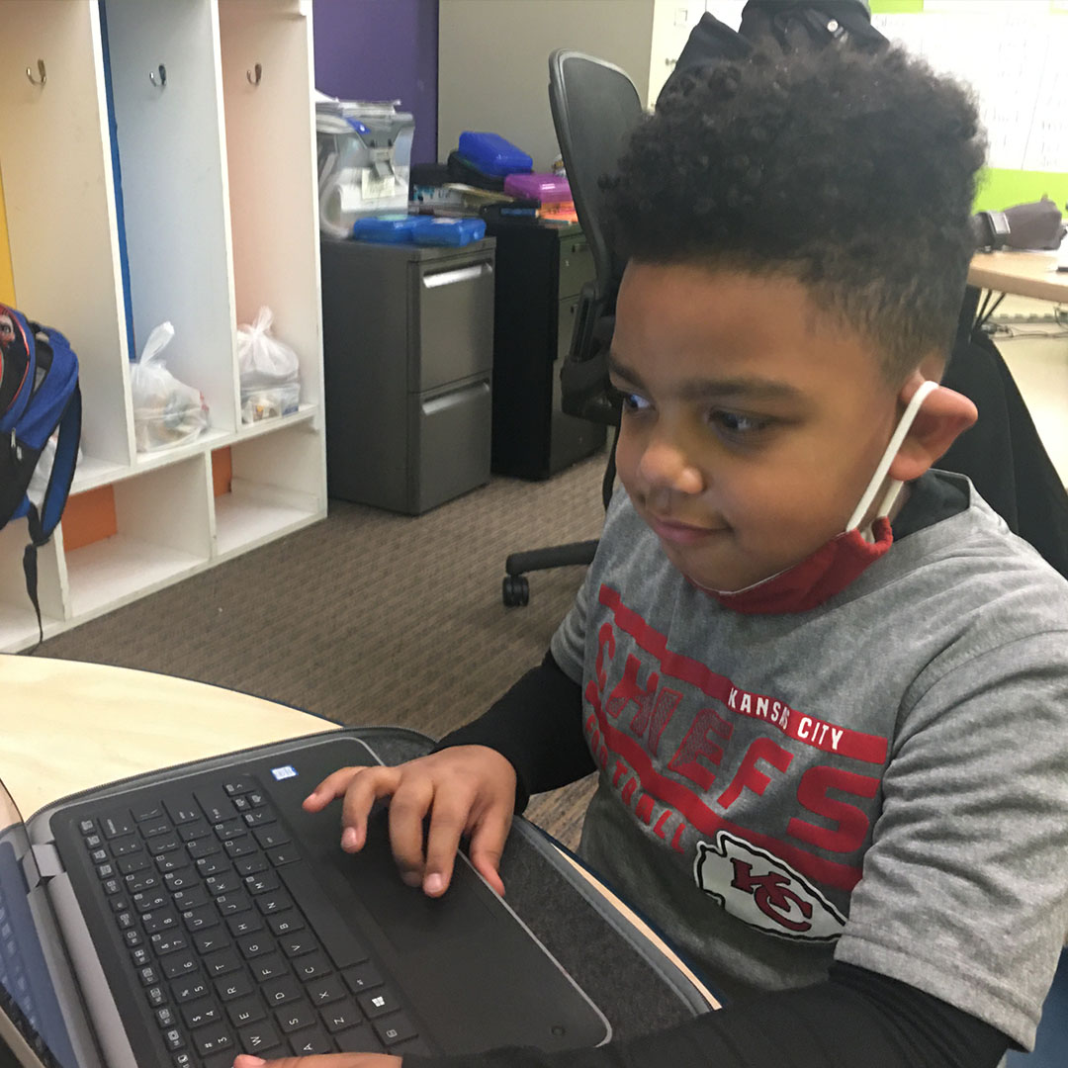
Oakridge Neighborhood
Youth education and engagement
2015 - Designated 21st Century Learning Center
  10 community partners
2021 – Robust after-school and out-of-school programming focused on academic, social, emotional, enrichment
  Serving 180 K-12 students
  Supported by 60 community
  partners
How did we achieve?

Slide 3
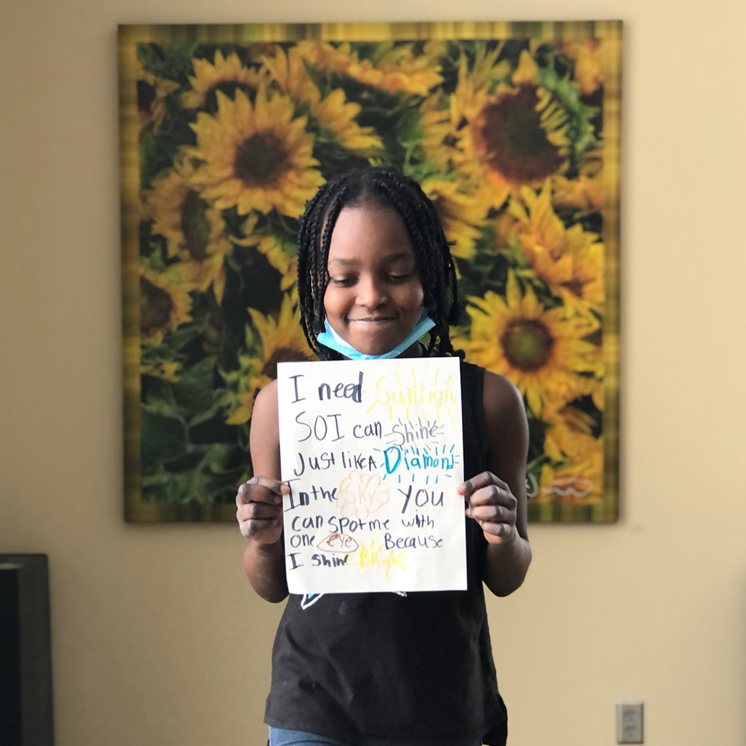
Oakridge Neighborhood
Youth education and engagement
Oakridge Neighborhood team actively built community partnership opportunities
  To address the unique needs of our youth scholars
Focused on key core areas
  Education
  Enrichment, Health & Safety
  Communications

Slide 4
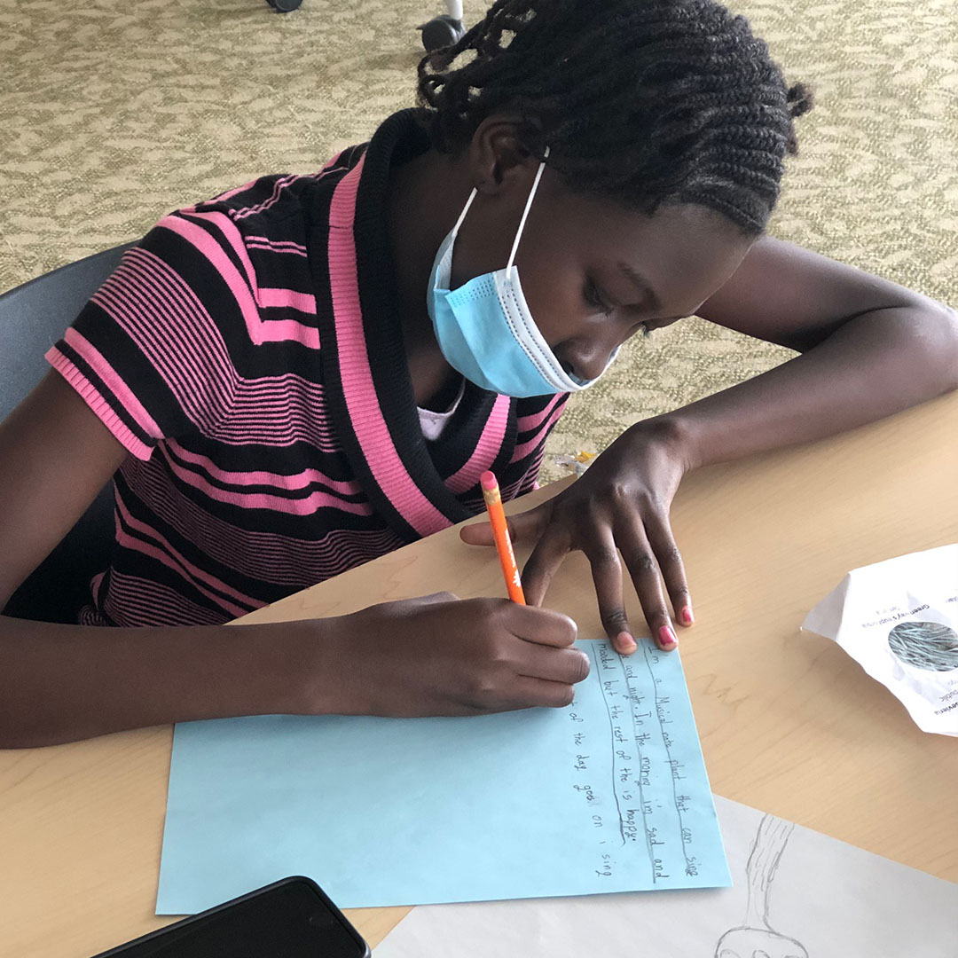
Education
Key: Collaboration with Iowa Department of Education, Des Moines Public Schools
  Core curriculum, state guidelines, district guidelines, local initiatives
  Certified teachers with DMPS,
  including retirees,
  substitute teachers

Slide 5
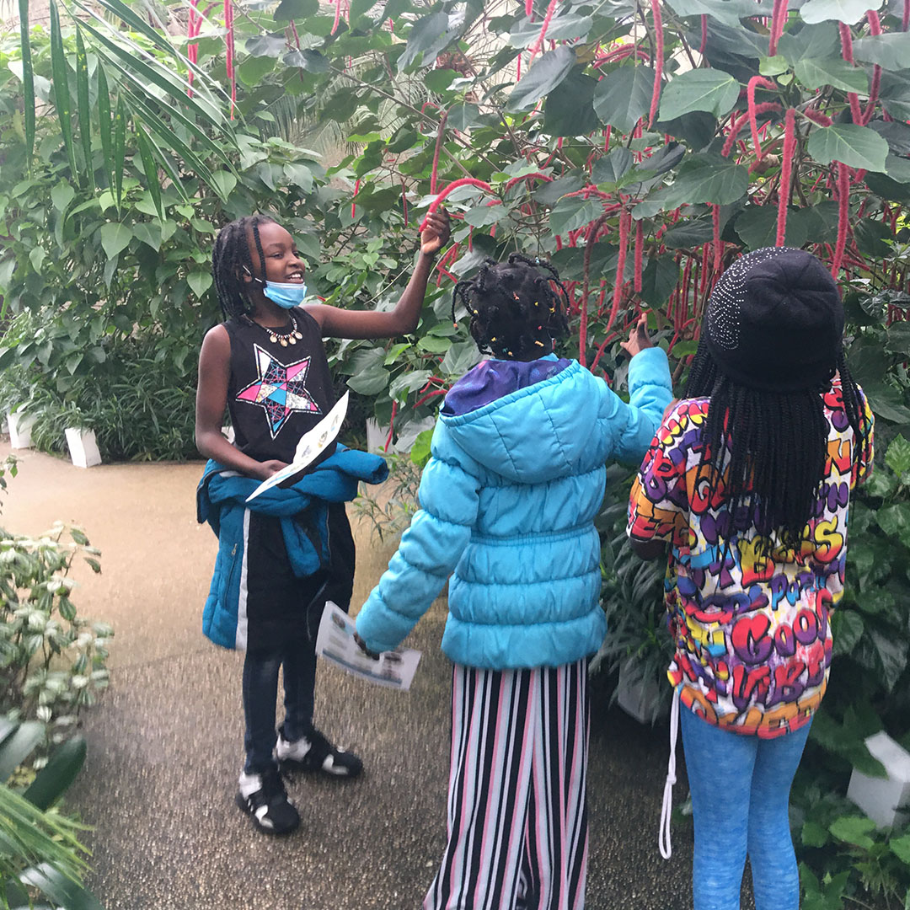
Education
Allows:
  Consistency in academics, attendance and goal setting (SEL)
  Integration of discipline: reading, math, cooking, science
  Updated materials + programs that students are interested in
  Students to have voice
  in activities selected

Slide 6
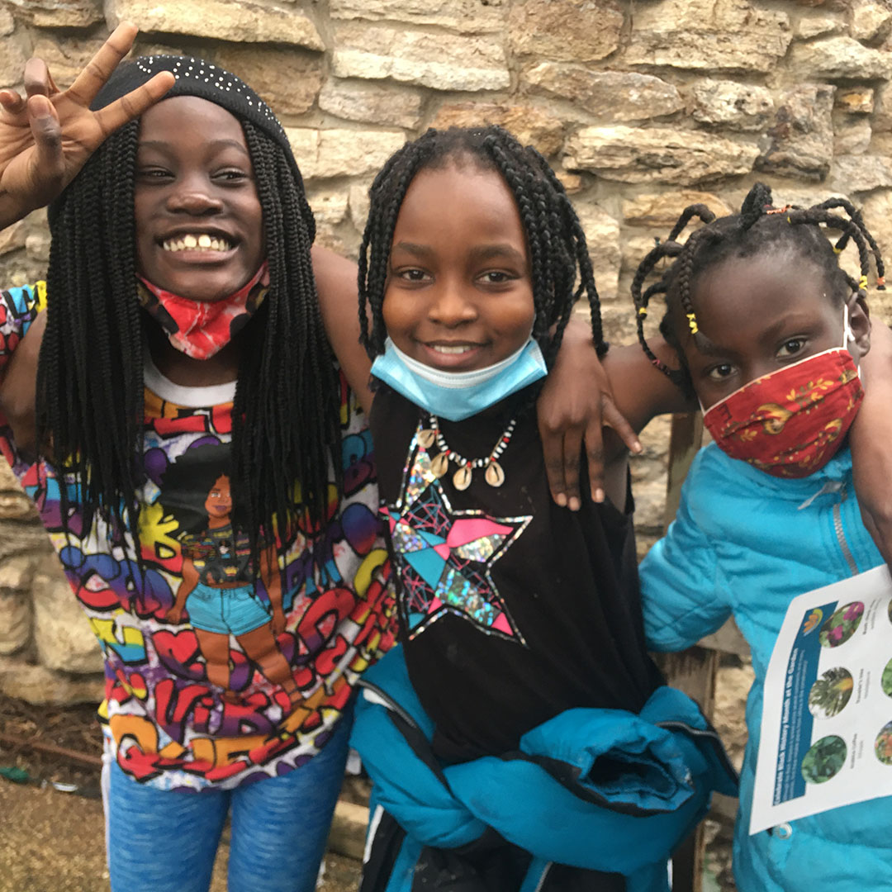
Enrichment, health & safety
Health & Safety
Enrichment
Creative Arts
Sports
Higher Education

Slide 7
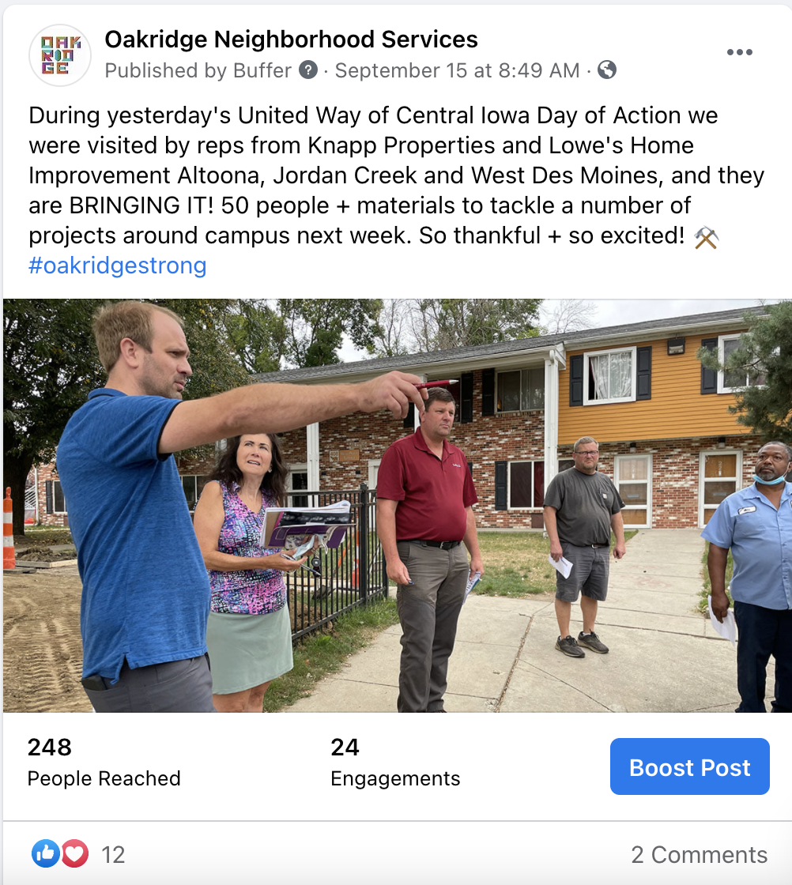
communications
Utilize our communications channels to support, build community partnerships
Target key audiences with messaging to share good work of our community partners
In multiple channels
  Social media
  Media relations
  Advertising
  Newsletters

Slide 8
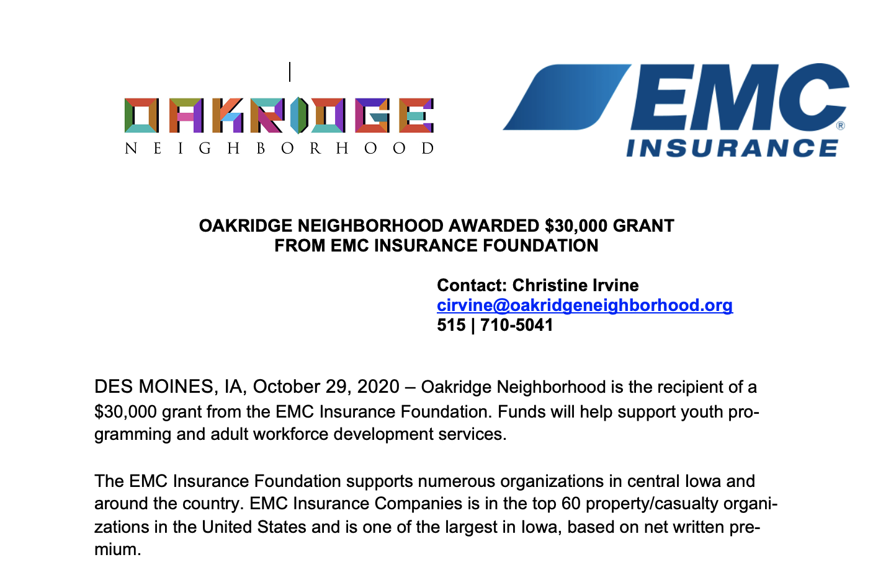
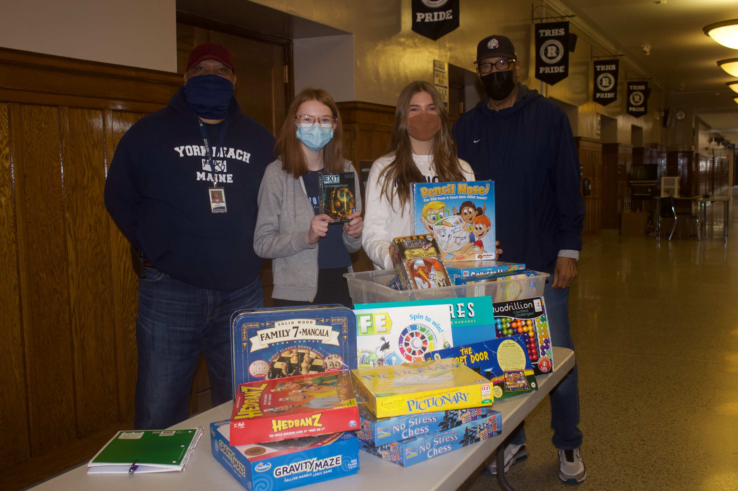

communications
Highlights community partner participation
Showcases grants, financial contributions, contribution of time and material, etc.

Slide 9
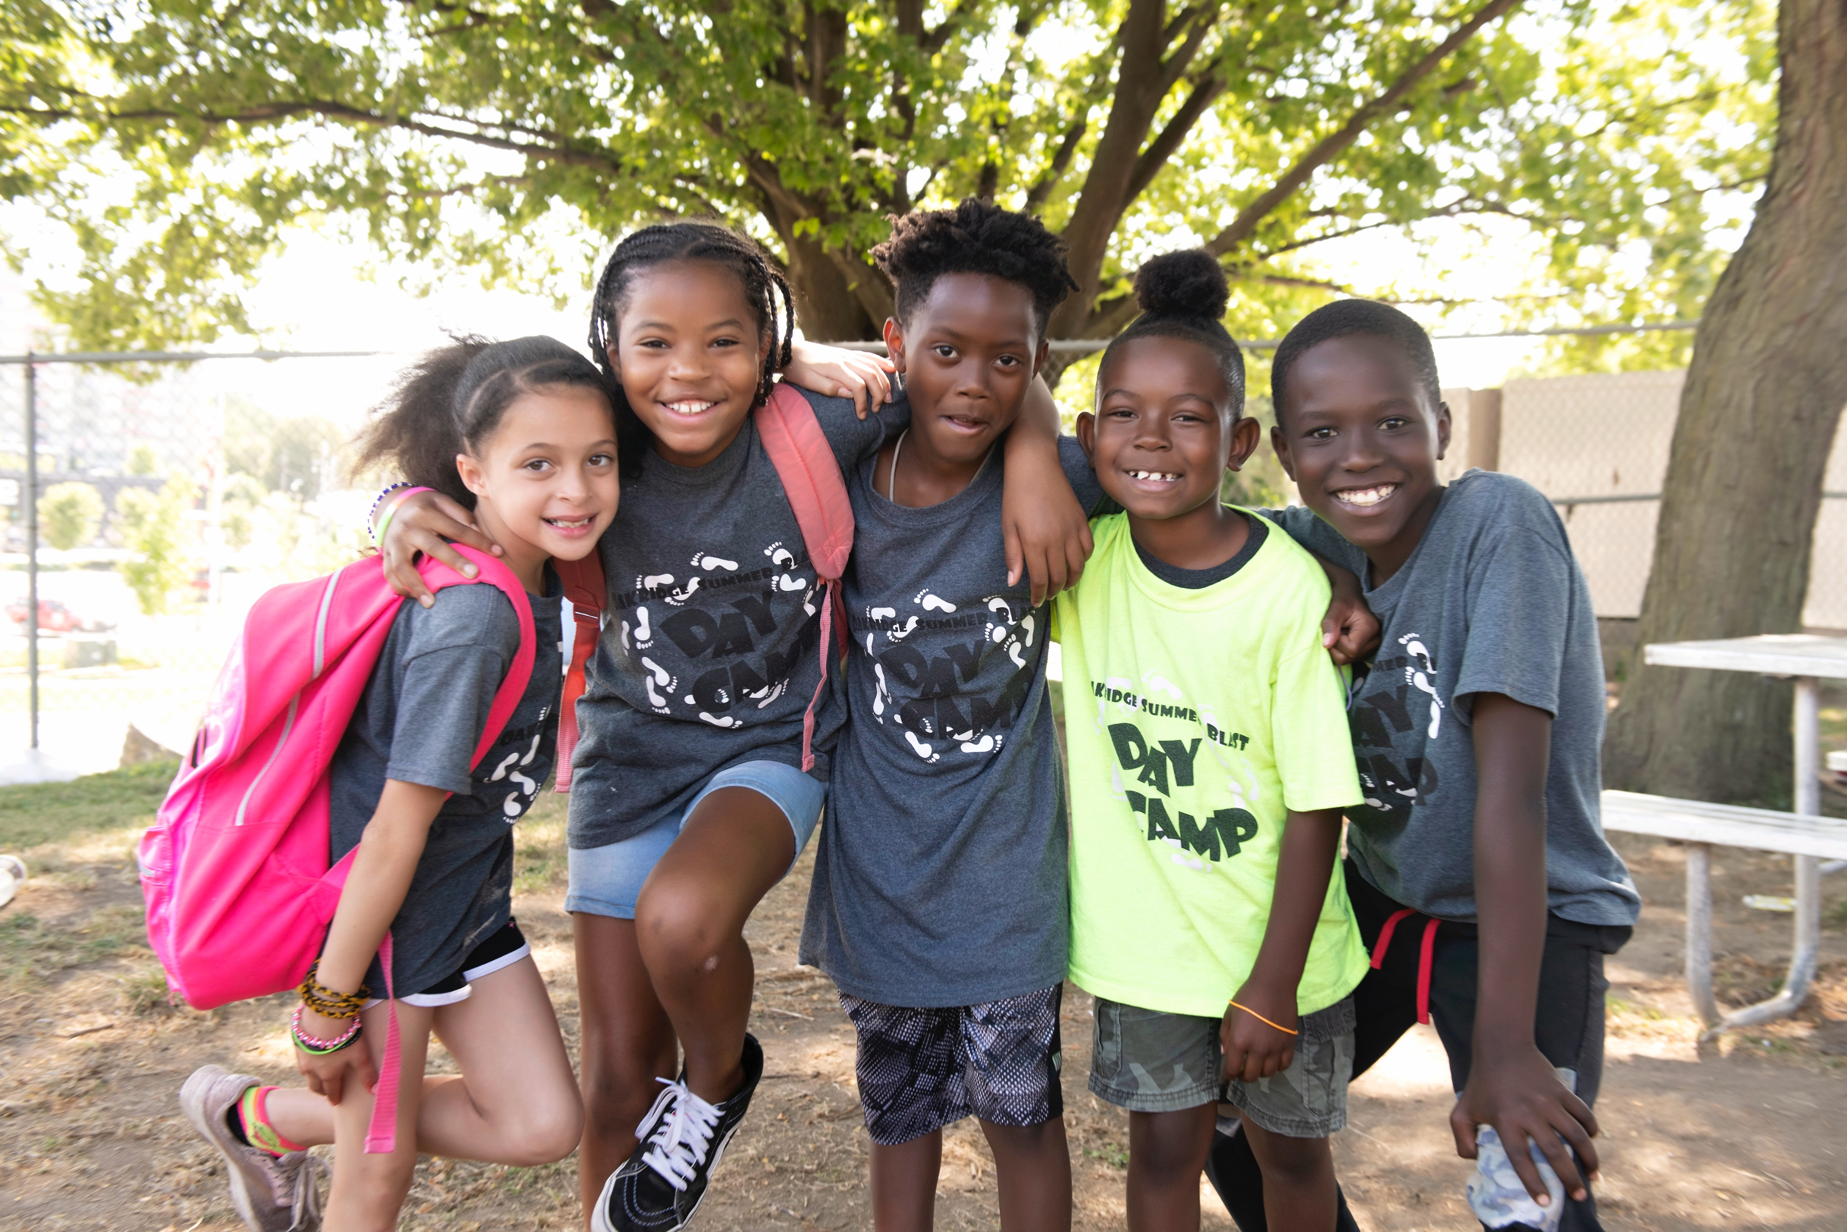
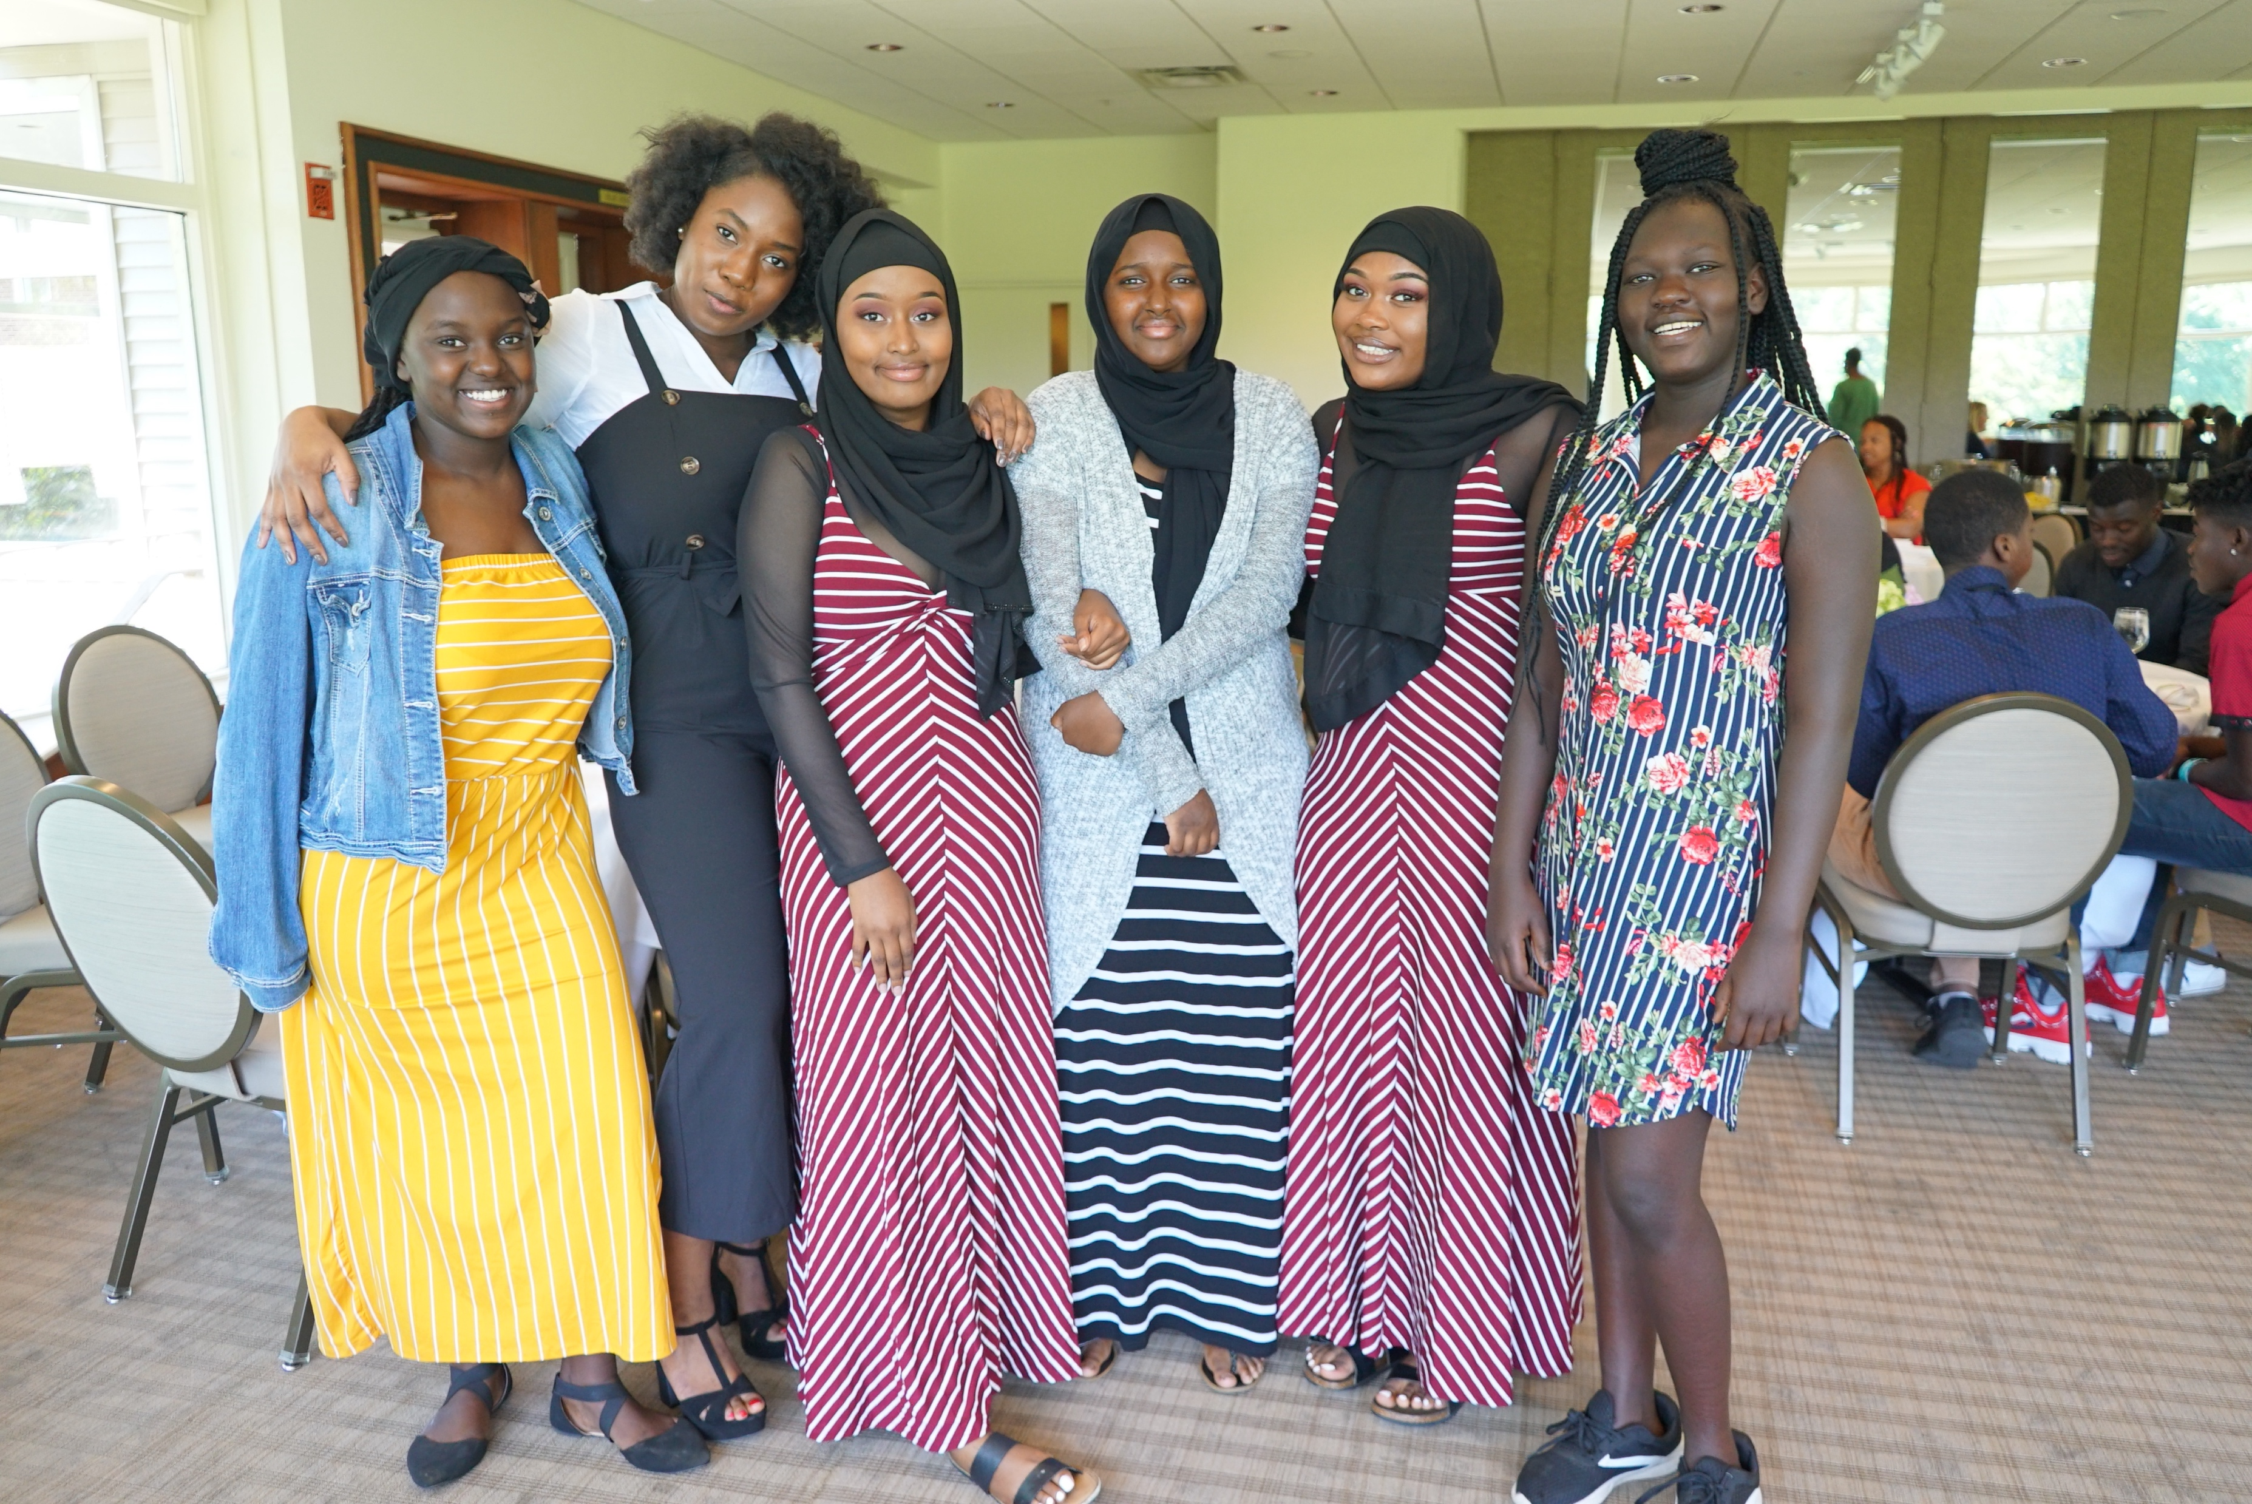
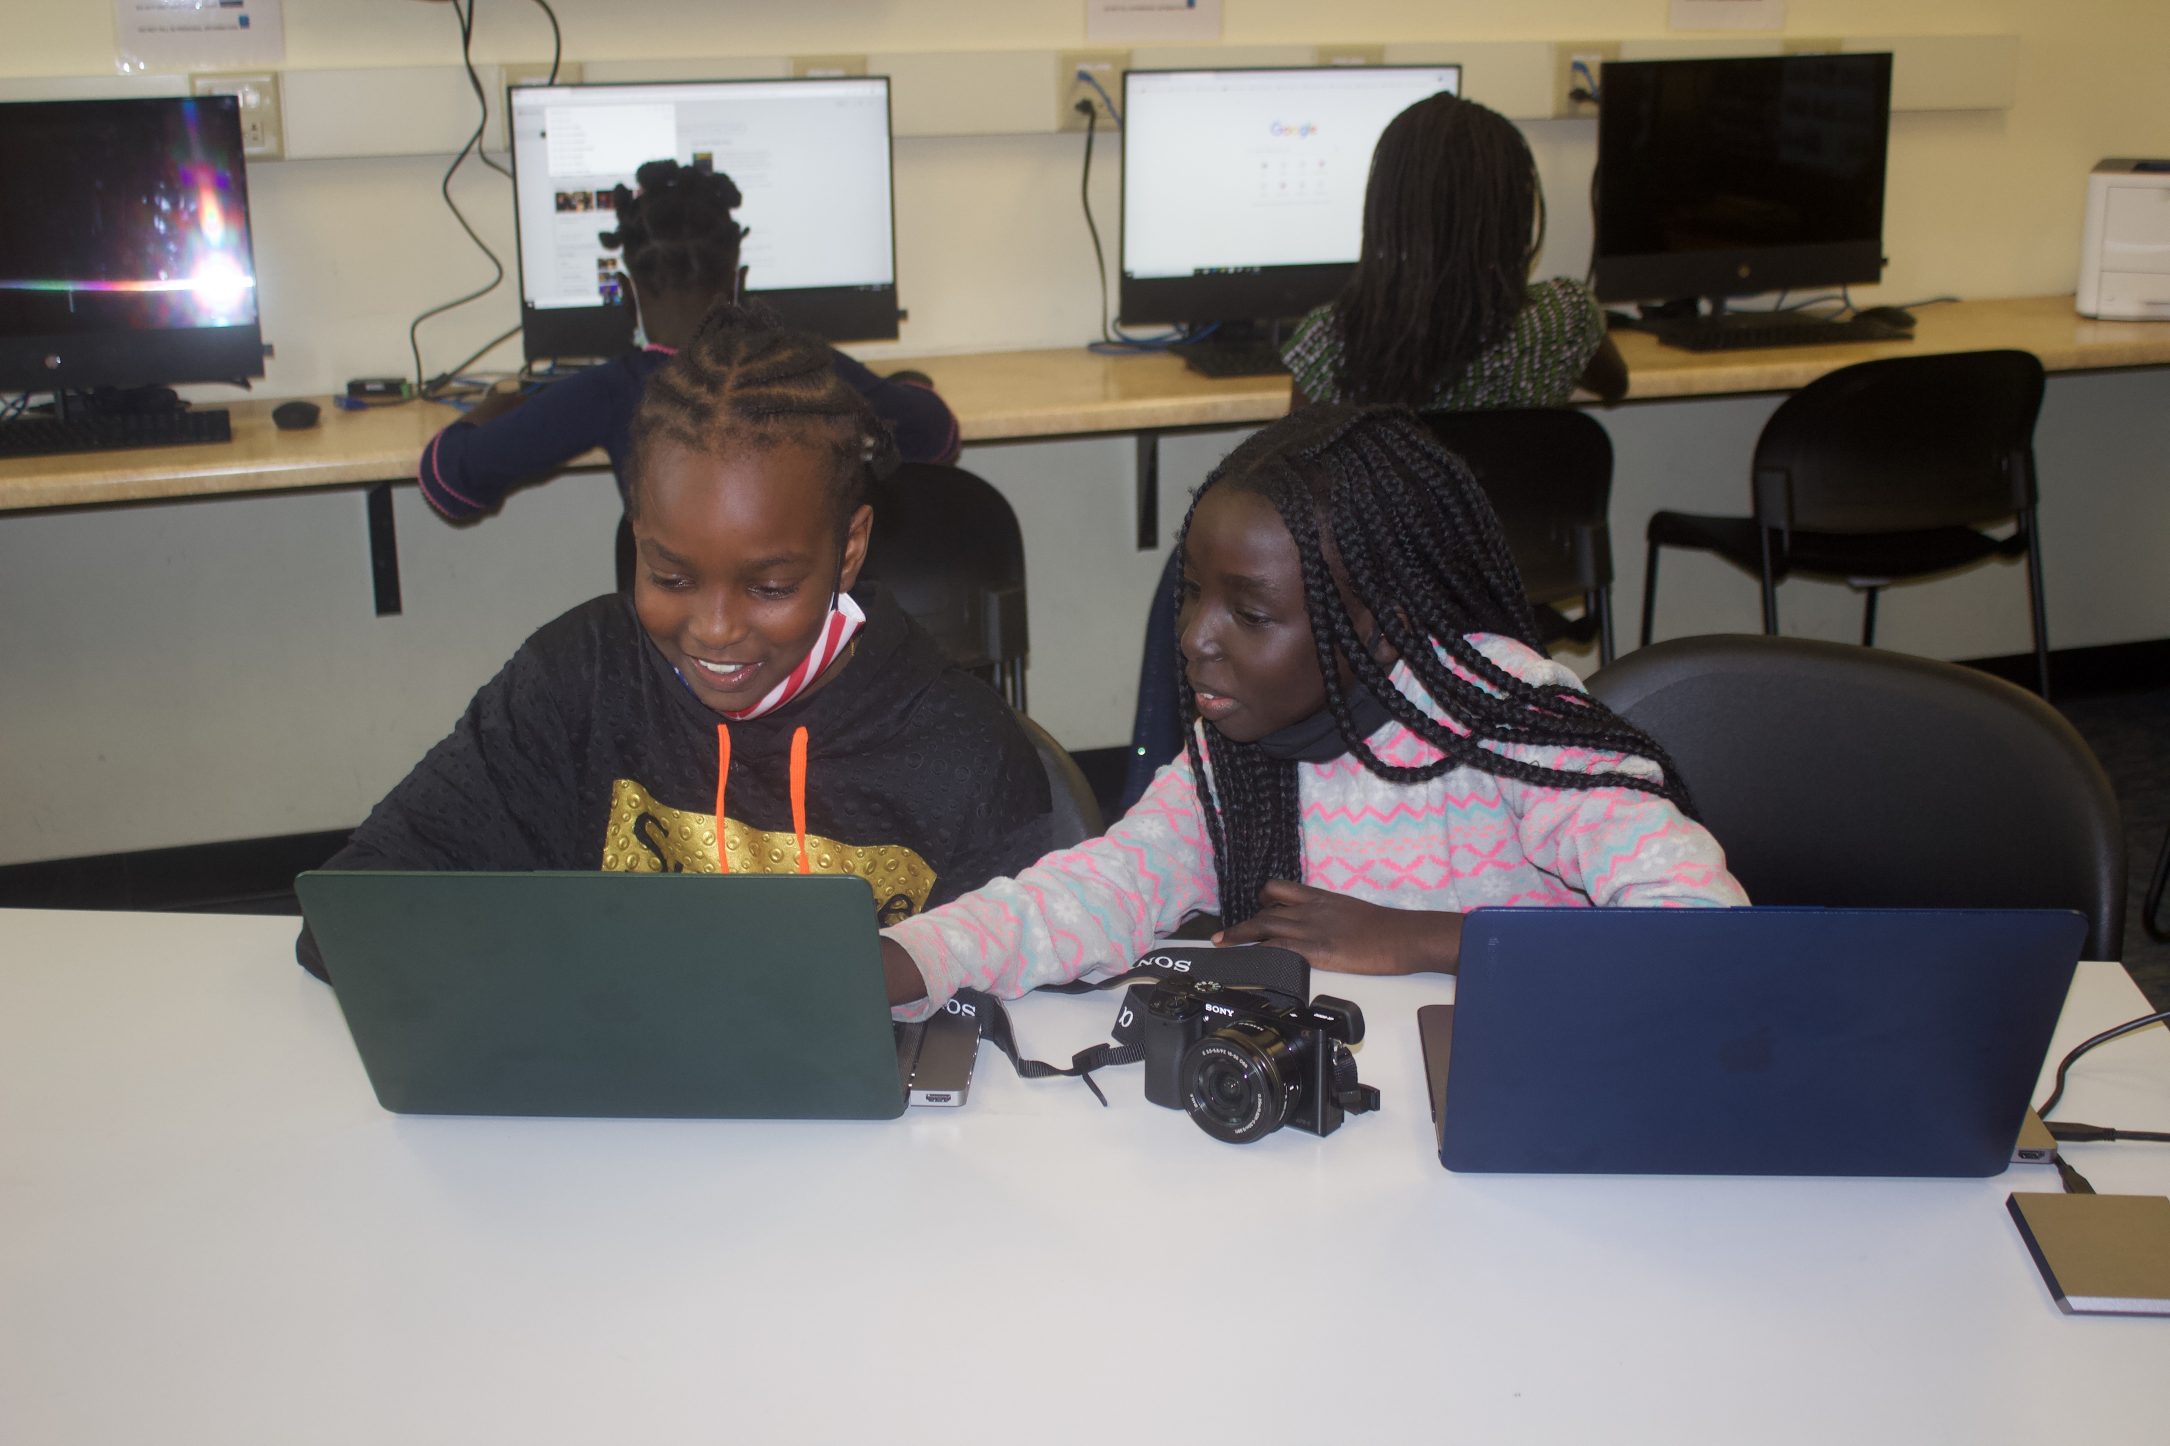
Oakridge Neighborhood
Youth education and engagement
Since being designated a 21st Century Learning Center in 2015
  53 partners have contributed goods, services
  Significantly strengthened ON programming
  Total value: $504,205
  Our youth scholars have greatly benefited!
Questions?

Slide 10
Thank YOU!

