Slide 1
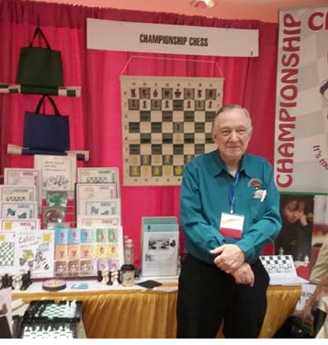
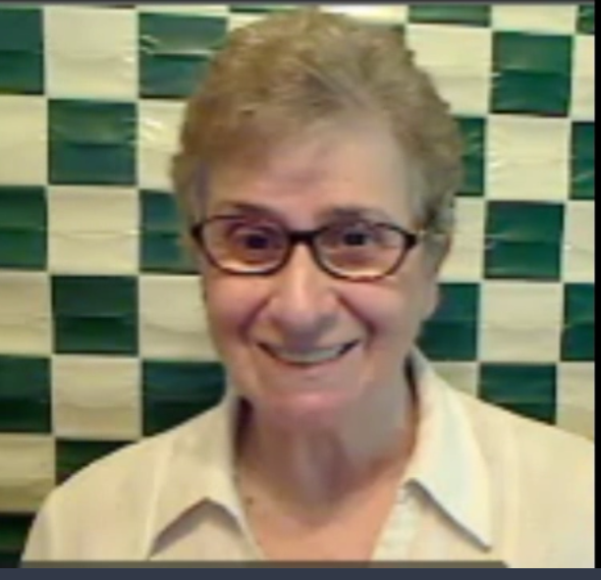
Championship Chess in Our Virtual World
Steve and Pat Schneider
www.championshipchess.net

Slide 2
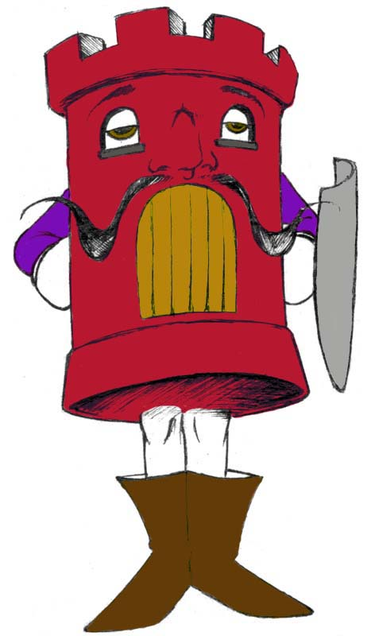
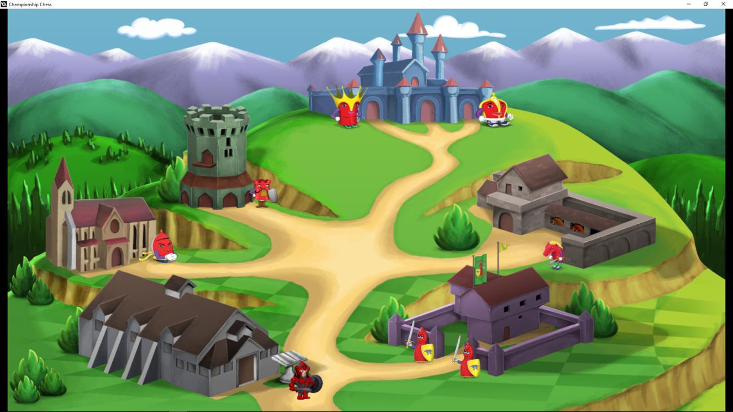
Welcome to Our
World of Chess
www.championshipchess.net

Slide 3

Riddle: Clues by
Vic Jaras, Iowa DOE
A STEM activity you can do on a shoestring budget
Lays a foundation for technology by teaching computational thinking
You don’t need to plug it in
An excellent teacher of problem-solving skills
Teaches kids to recover from setbacks and failure and to be successful
You can meet several common core Math standards
Your students will want to practice this at home
Helps kids learn to follow rules
You could buy hundreds of these for less than the cost of one i-pad
A pre-approved supply item you can afford to give to kids to practice at home
Notes:
3 minutes:
Introduce Championship Chess
Know more about you:
What do you teach?
Stand up if you play chess.
Stand up if you know how the pieces move.

Slide 4
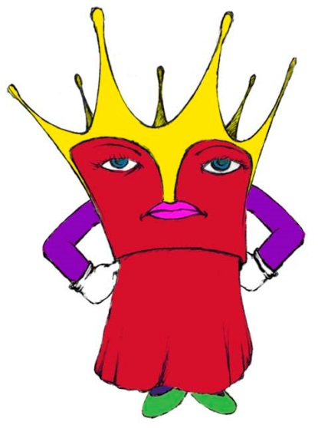
Why Chess After School
Active and Engaged Learning
Links to Standards and STEM
Relationships, Culture and Diversity
Behavioral Health
Team Building
Notes:
Kids love games—all sorts of games. We know there are many reasons for teaching kids how to play chess, but today we’re going to focus on using chess concepts and equipment to focus on problem solving. Chess is motivational because it’s a game. And, more importantly, focusing on the problem-solving aspects of chess can motivate those students who aren’t game-players or risk-takers, often your girls.
Chess taps these higher level thinking skills.
Focusing: You must observe and concentrate. If they don’t watch what’s happening in a game, they can’t respond, no matter how smart they are.
Visualizing: You must imagine a sequence of actions before it happens. Shift the pieces in your mind, first one, then several moves ahead.
Thinking Ahead: You have to ask the question: "If I do this, what might happen then, and how can I respond?" Over time, chess helps develop patience and thoughtfulness.
Weighing Options: You don’t have to do the first thing that pops into your mind. Identify alternatives and consider the pros and cons.
Analyzing Concretely: Evaluate the results of specific actions and sequences. Does this sequence help me or hurt me?
Thinking Abstractly: Consider the bigger picture. Take patterns used in one context and apply them to different, but related situations.
Planning Ahead: Develop longer range goals and take steps toward bringing them about. Reevaluate your plans and make changes.
Juggling Multiple Considerations Simultaneously: Try to weigh various factors all at once.
Educational research shows that chess improves math and reading scores, the Torrance Tests of Creative Thinking, the Watson-Glaser Critical Thinking Appraisal, and IQ scores.
Chess benefits social skills: build individual friendships, practice sportsmanship, persist and pursue personal goals, improve self-concept
Reach all learners: creative chess instruction addresses the first seven of Gardner’s Multiple Intelligences—logical/mathematical, body/kinesthetic, visual/spatial, verbal/linguistic, musical/rhythmic (patterns), interpersonal and intra-personal.

Slide 5
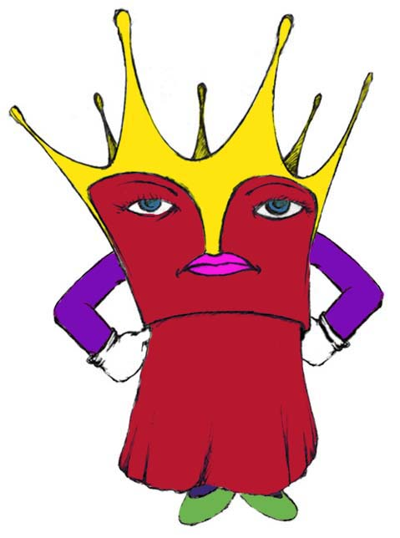
Focus: Problem Solving and Critical Thinking
Deductive/Inductive Reasoning
Estimating and Choosing Alternatives
Thinking Ahead and Planning Systematically
Visualization/Spatial Visualization
Spatial Awareness and Reasoning
Notes:
Kids love games—all sorts of games. We know there are many reasons for teaching kids how to play chess, but today we’re going to focus on using chess concepts and equipment to focus on problem solving. Chess is motivational because it’s a game. And, more importantly, focusing on the problem-solving aspects of chess can motivate those students who aren’t game-players or risk-takers, often your girls.
Chess taps these higher level thinking skills.
Focusing: You must observe and concentrate. If they don’t watch what’s happening in a game, they can’t respond, no matter how smart they are.
Visualizing: You must imagine a sequence of actions before it happens. Shift the pieces in your mind, first one, then several moves ahead.
Thinking Ahead: You have to ask the question: "If I do this, what might happen then, and how can I respond?" Over time, chess helps develop patience and thoughtfulness.
Weighing Options: You don’t have to do the first thing that pops into your mind. Identify alternatives and consider the pros and cons.
Analyzing Concretely: Evaluate the results of specific actions and sequences. Does this sequence help me or hurt me?
Thinking Abstractly: Consider the bigger picture. Take patterns used in one context and apply them to different, but related situations.
Planning Ahead: Develop longer range goals and take steps toward bringing them about. Reevaluate your plans and make changes.
Juggling Multiple Considerations Simultaneously: Try to weigh various factors all at once.
Educational research shows that chess improves math and reading scores, the Torrance Tests of Creative Thinking, the Watson-Glaser Critical Thinking Appraisal, and IQ scores.
Chess benefits social skills: build individual friendships, practice sportsmanship, persist and pursue personal goals, improve self-concept
Reach all learners: creative chess instruction addresses the first seven of Gardner’s Multiple Intelligences—logical/mathematical, body/kinesthetic, visual/spatial, verbal/linguistic, musical/rhythmic (patterns), interpersonal and intra-personal.

Slide 6
Why Use Chess?
A Unique Teaching Tool
Improves math, reading and problem-solving skills
Addresses complex spatial tasks and relationships
Provides collaborative or competitive challenges to develop social skills
Allows students to discern and explain reasoning
Applies, tests and improves strategic thinking
Reaches across multiple intelligences
Notes:
3-5 minutes
Chess taps these higher level thinking skills.
Focusing: You must observe and concentrate. If they don’t watch what’s happening in a game, they can’t respond, no matter how smart they are.
Visualizing: You must imagine a sequence of actions before it happens. Shift the pieces in your mind, first one, then several moves ahead.
Thinking Ahead: You have to ask the question: "If I do this, what might happen then, and how can I respond?" Over time, chess helps develop patience and thoughtfulness.
Weighing Options: You don’t have to do the first thing that pops into your mind. Identify alternatives and consider the pros and cons.
Analyzing Concretely: Evaluate the results of specific actions and sequences. Does this sequence help me or hurt me?
Thinking Abstractly: Consider the bigger picture. Take patterns used in one context and apply them to different, but related situations.
Planning Ahead: Develop longer range goals and take steps toward bringing them about. Reevaluate your plans and make changes.
Juggling Multiple Considerations Simultaneously: Try to weigh various factors all at once.
Educational research shows that chess improves math and reading scores, the Torrance Tests of Creative Thinking, the Watson-Glaser Critical Thinking Appraisal, and IQ scores.
Chess benefits social skills: build individual friendships, practice sportsmanship, persist and pursue personal goals, improve self-concept
Reach all learners: creative chess instruction addresses the first seven of Gardner’s Multiple Intelligences—logical/mathematical, body/kinesthetic, visual/spatial, verbal/linguistic, musical/rhythmic (patterns), interpersonal and intra-personal.

Slide 7
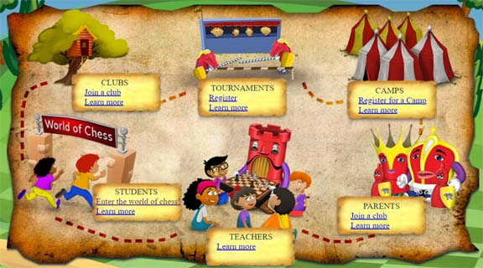
Students: Enter the World of Chess
At www.championshipchess.net, click the World of Chess

Slide 8
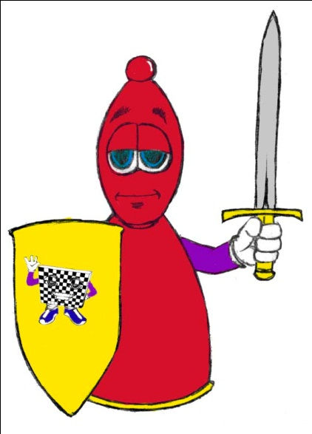
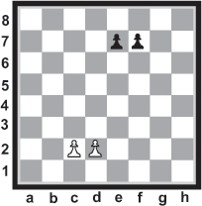
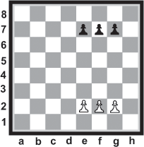
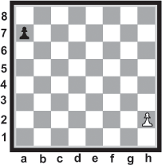
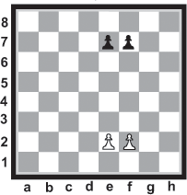
Chess Basics: Basic Pawn Games
1 vs. 1,
apart
2 vs. 2,
adjacent
2 vs. 2,
head-to-head
3 vs. 3,
head-to-head
Notes:
Introduce how the Pawn moves and captures on the DEMO Board
TO DO: We’re going to follow the incremental approach to learning chess.
1 on 1 three ways
2 on 2 2 or 3 ways
Show the next slide—strategies for 2 on 2
PLAY 3 on 3

Slide 9
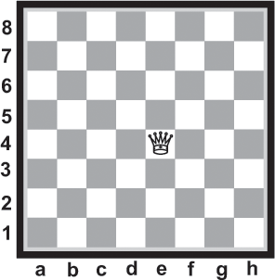


Chessboard Puzzles with Piece Moves
How many moves does the Queen have from the corner of the board?
Counting, Calculating, Estimating
Notes:
Introduce how the pieces move and play
PLAY: Pawns against Queen

Slide 10
The Queen’s Moves from the Corner
1
2
3
4
5
6
7
8
15
9
16
10
17
How many moves from the corner?
11
18
12
19
21
13
20
14
21
Notes:
Introduce how the pieces move and play
PLAY: Pawns against Queen

Slide 11
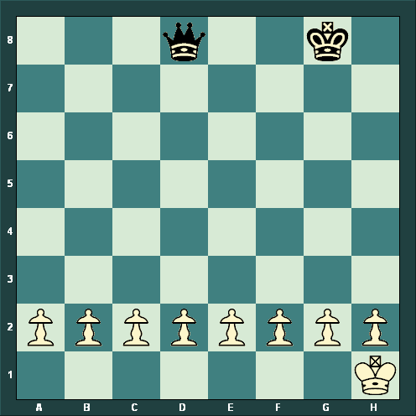

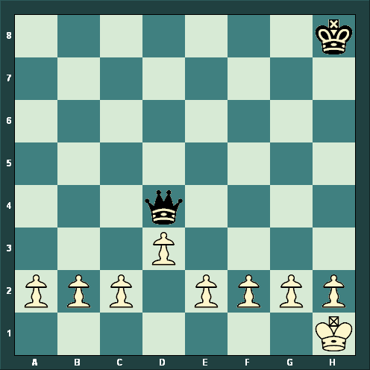
Queen vs 8 Pawns
What is White’s only safe 1st move?
Now, how many squares can the Queen move to and attack more than 1 unprotected Pawn?
Notes:
Introduce how the pieces move and play
PLAY: Pawns against Queen

Slide 12




Queen Forks
Notes:
Introduce how the pieces move and play
PLAY: Pawns against Queen

Slide 13
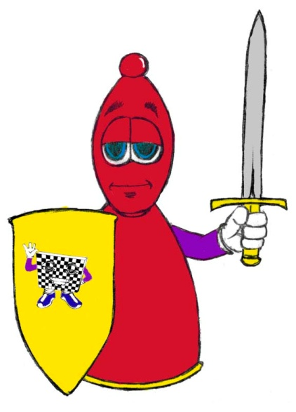

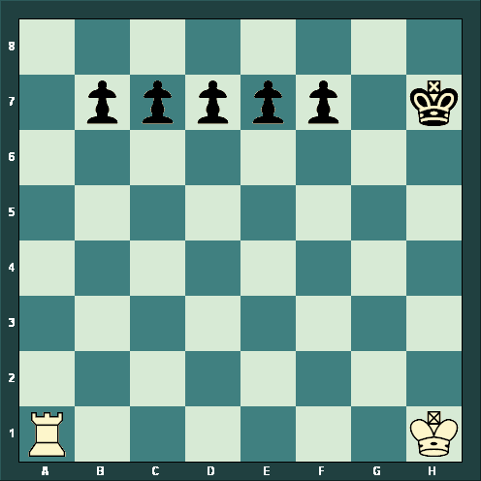

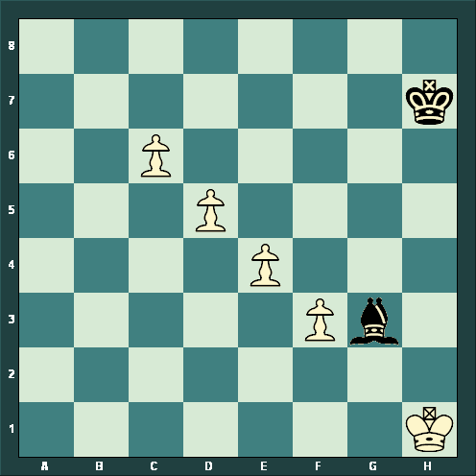
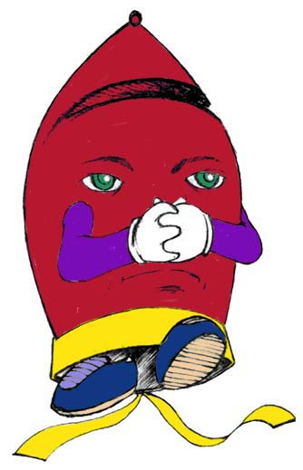
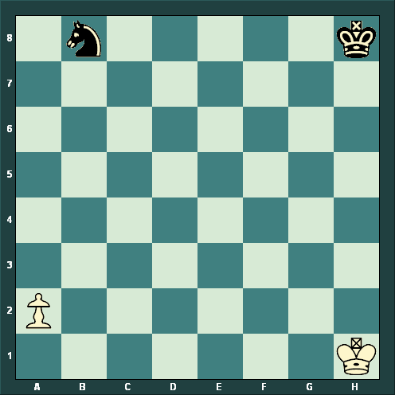
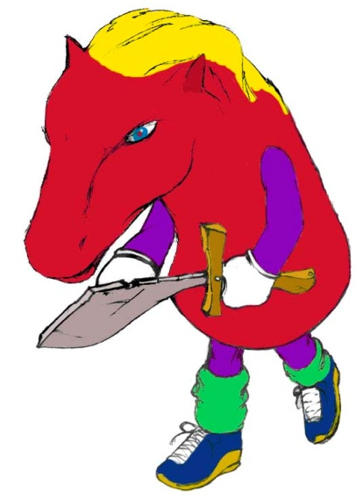

Pawns and Pieces

Slide 14

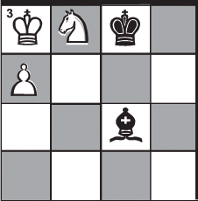
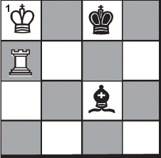
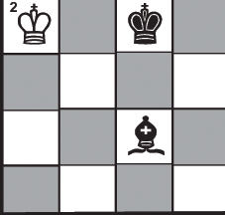
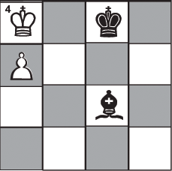
Check or Checkmate:
Can the King Escape?
Interpose
Capture
Run Away
No Escape
Notes:
Once the King is on the board, there are many puzzles to challenge students to learn and apply the concept of check, checkmate and stalemate. By the end of Basics, students are playing full games with all the rules and special moves of chess.

Slide 15
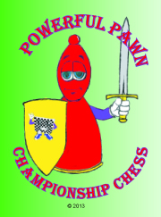
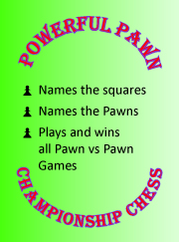
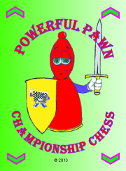
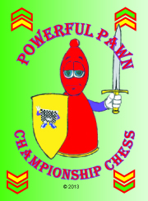
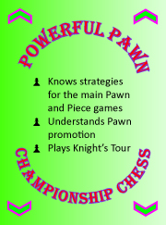
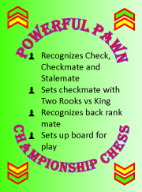
Championship Chess
Achievement Cards
Powerful Pawns
Battling Bishops
Mighty Knights
Rockin’ Rooks
Queen’s Quests
Kickin’ Kings
Notes:
7 minutes
Remember how the Knight moved from our dance and song?
Knight’s tour on demo board with pieces blank. The slide shows two correct answers.
Koltanowski as well!
Looking ahead, planning, focusing.
All the intelligences—from the musical patterns we learned as we sang the Knight Slide through the introspective skills of visualizing and thinking before making the move.

Slide 16
Chess Openings 1:
Winning Plans
Opening Theory
Notation
Queen’s Raid
Two Knights Defense
Stonewall Attack
Tactics: pins, forks, double attacks
Notes:
Attack the center; develop pieces, not pawns; get ready to castle early
Demonstrate Queen’s Raid (three scenarios); Whenever we teach a concept, we walk through it step-by-step—there’s a picture of the board, the notation for the move, and a description of the move.
Demo board: Queen’s Raid (Pat does notation)
Talk about other openings and tactics, etc.

Slide 17
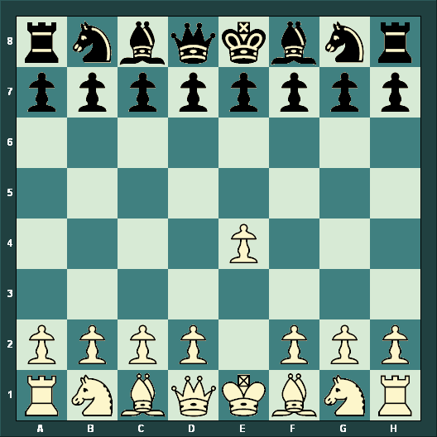



The Power of 10
1. e4
White attacks the center and opens new moves for the Queen, Bishop and Knight at g1.
Notes:
3:02-3:05
Attack the center; develop pieces, not pawns; get ready to castle early
Be aggressive--open games
Power of 10 on the board
3:05-3:15--Queen’s Raid
Demonstrate Queen’s Raid (three scenarios); Whenever we teach a concept, we walk through it step-by-step—there’s a picture of the board, the notation for the move, and a description of the move.
Demo board: Queen’s Raid (Pat does notation)
Talk about other openings and tactics, etc.

Slide 18
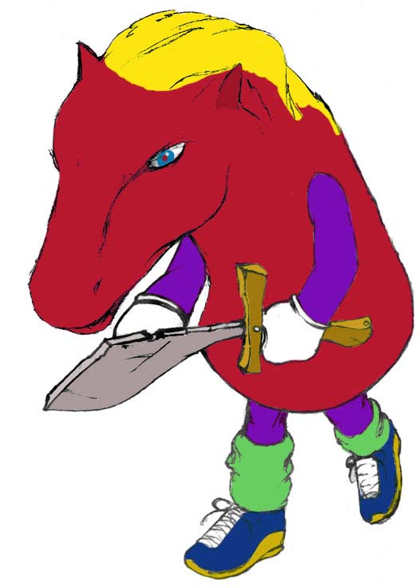
Endgame Strategies 1: Close out the Win or
Hold a Draw
Basic Checkmates
Win or Draw: Take the Advantage
King and Pawn Endgames
Adding Pieces in the Endgame
Notes:
Once a child play 30-40 move games, they need to know how to win the game with only a few pieces left on the board. These are basic endgames. Actually, a book of basic endgames that I have in my library is 571 pages and has 607 pictures. Our endgame book is not quite 200 pages long and often includes 3, 4 or even 6 pictures per page.
Demo 2 Rooks Walking; set up boards to have teachers PLAY to get the checkmate.
Demo 1 Rook
Video second Square of the Pawn (with the King moving down diagonally)
Describe other endgames in the book

Slide 19

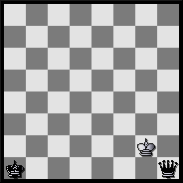
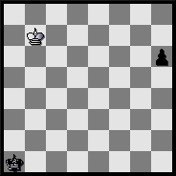
Square of the Pawn
Count from here… …to a draw.
Notes:
If it’s White’s move, it’s a draw.
If it’s Black’s move, Black Queens the Pawn and wins.

Slide 20

Two Rooks Walking
2 Rooks systematically cut the board off to trap the King on the edge.
Notes:
Once a child play 30-40 move games, they need to know how to win the game with only a few pieces left on the board. These are basic endgames. Actually, a book of basic endgames that I have in my library is 571 pages and has 607 pictures. Our endgame book is not quite 200 pages long and often includes 3, 4 or even 6 pictures per page.
Demo 2 Rooks Walking; set up boards to have teachers PLAY to get the checkmate.
Demo 1 Rook
Video second Square of the Pawn (with the King moving down diagonally)
Describe other endgames in the book

Slide 21
Chess Tactics 1: Puzzles to Gain the Advantage
Free Piece Puzzles
Simple Checkmate Puzzles
Pin Puzzles
Skewer Puzzles
Fork Puzzles
Skill Tests
Advanced Logic Puzzles

Slide 22
Students: Enter the World of Chess
At www.championshipchess.net, click the World of Chess

Slide 23
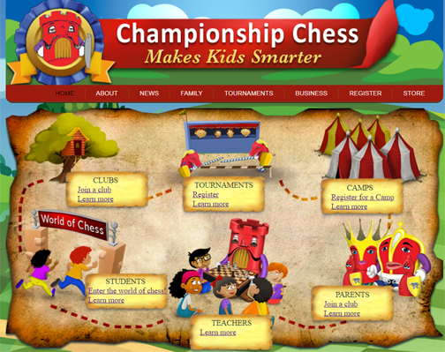
Click to Enter the World of Chess
Then, Login with your Username and Password.

Slide 24
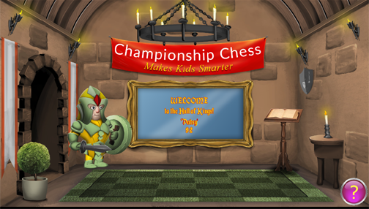
The Hall of Kings
You will be welcomed to the Hall of Kings.

Slide 25
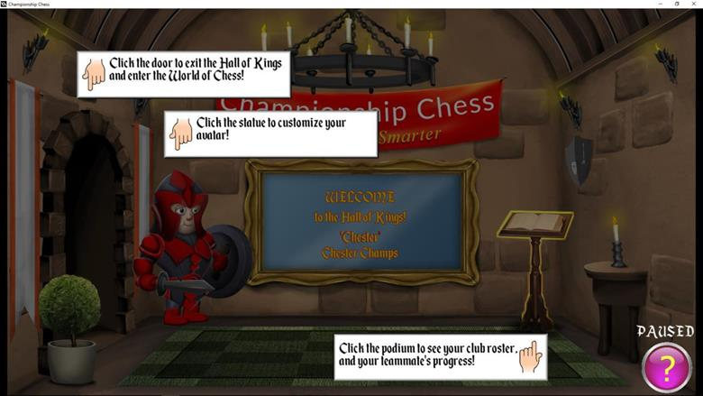
Click “?”: Find Out More
The door: How do I go into the World of Chess
The Avatar: How do I look in the World of Chess?
The Podium: How am I ranked in the World of Chess?

Slide 26
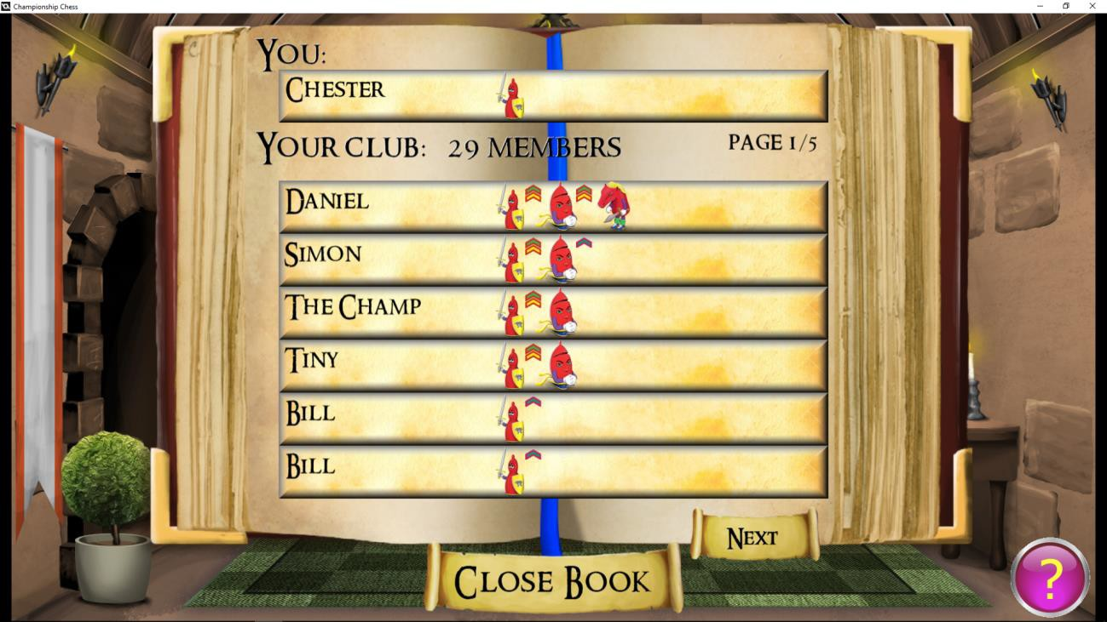
Find Your Class Standings
When you click the podium, you will find where you stand with the rest of your group.

Slide 27
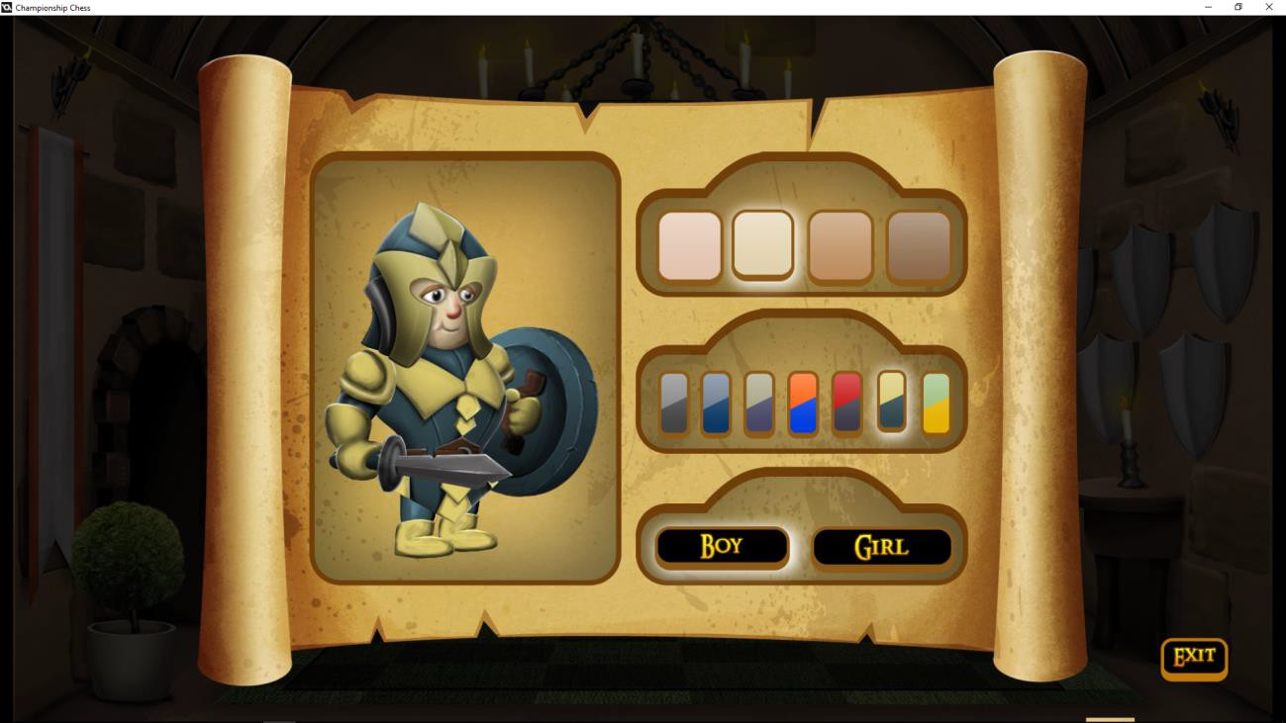
Change Your Avatar
Pick your skin tone.
Design your armor.
Choose your gender.

Slide 28
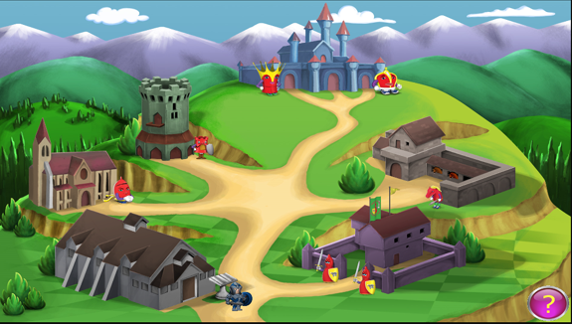
The World of Chess
Click the door to exit the Hall of Kings and enter the World of Chess. Click any “Hall” to find information.
To start earning achievement cards, enter the Pawn Hall, where your flag is flying.
Queen Castle
King Castle
Rook Hall
Knight Hall
Bishop Hall
Pawn Hall

Slide 29
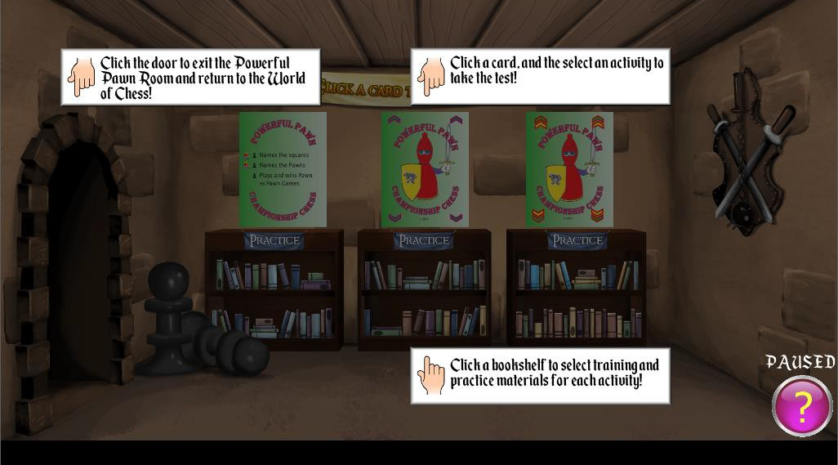
Click “?” to learn more.
Door: Exit back to the World of Chess
Bookcase: Find videos, activities, puzzles & challenges.
Achievement Cards: If a card is flipped over, you can take a test. You can travel and learn anywhere, but you must achieve each card in order.

Slide 30
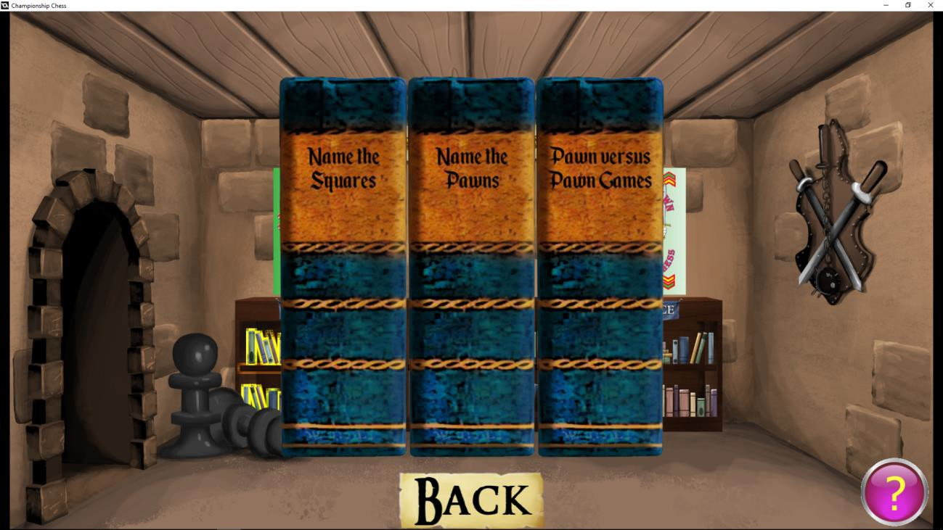
Click a Bookcase
Click the bookcase below the Achievement Card. Each bullet on the Achievement Card has a matching book. Click on the book to learn about and practice each concept.

Slide 31
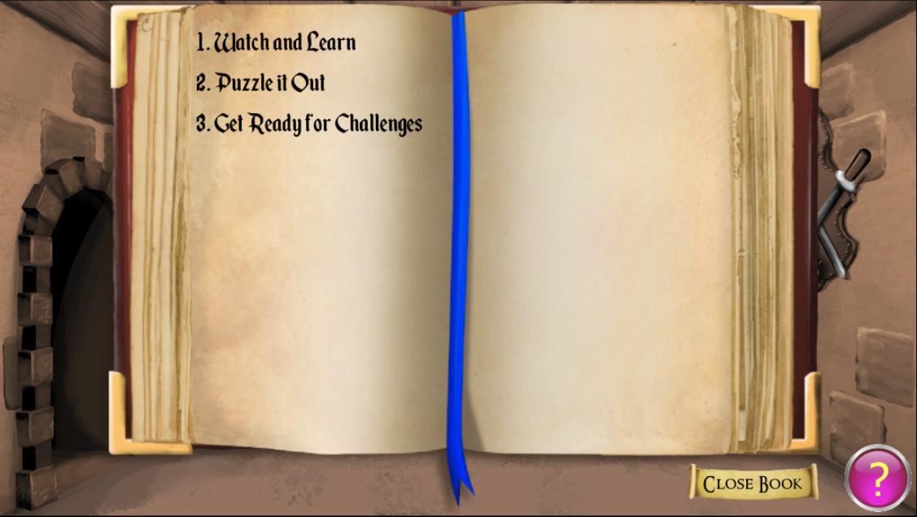
Open a Book
Watch and Learn: Videos and activities for information
Puzzle It Out: Puzzles to apply what you’ve learned
Get Ready for Challenges: Practice to take the tests

Slide 32
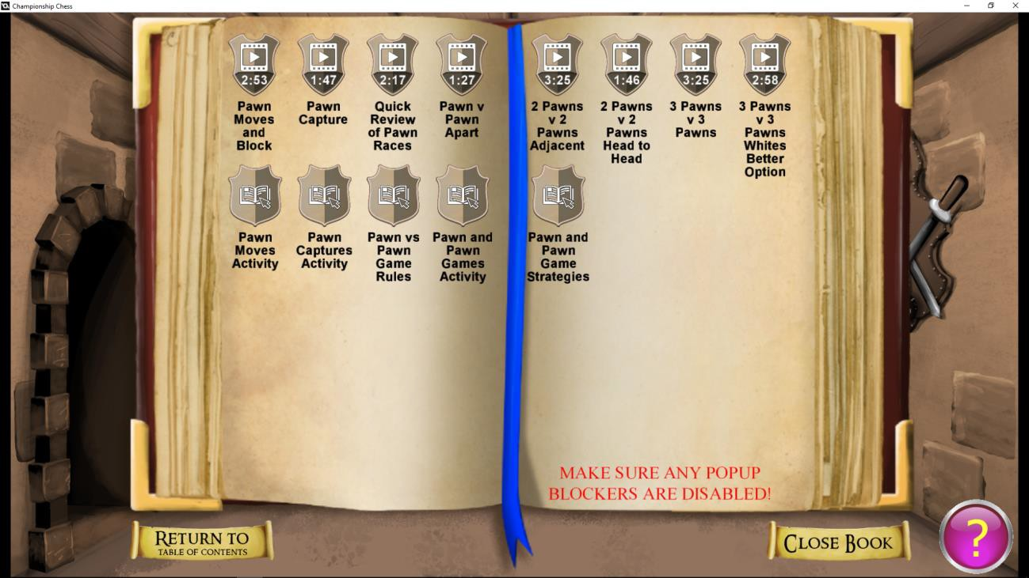
Watch and Learn
Short videos and PDF activities introduce concepts and provide further information.

Slide 33
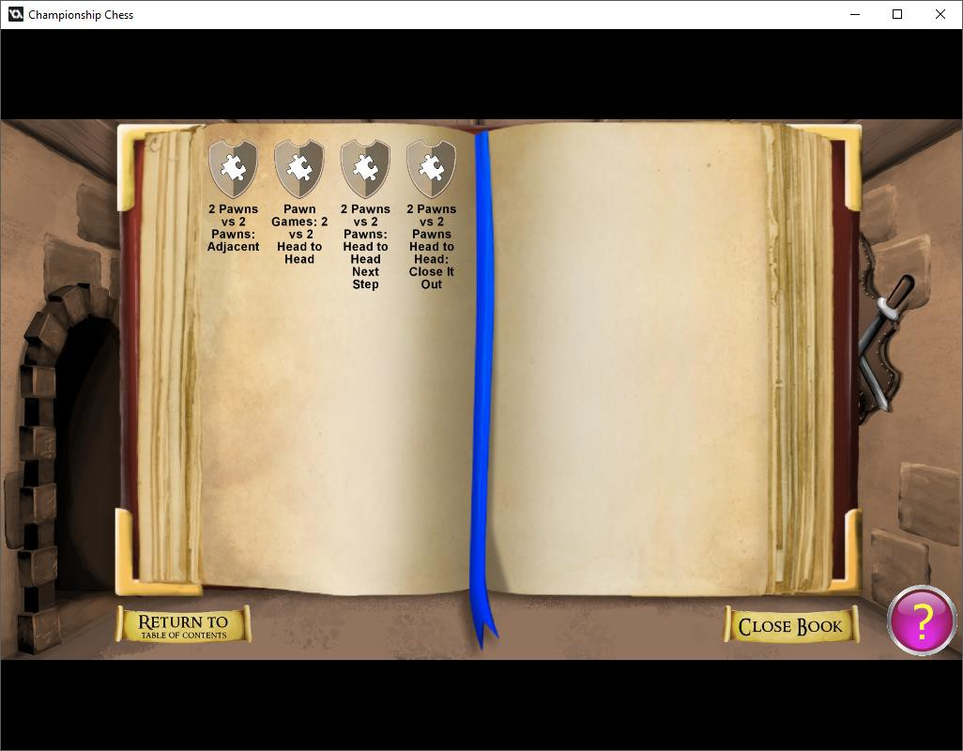
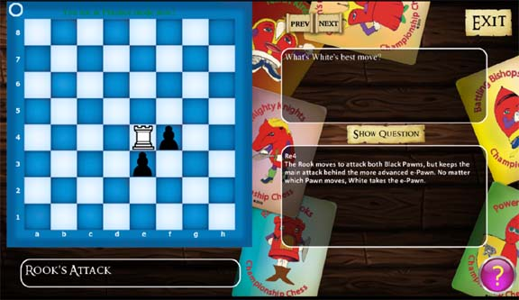
Puzzle It Out
The puzzles make you stop and think about the concept you’ve learned. If you get a wrong answer, you’ll get tips and hints to get it right the next time.

Slide 34
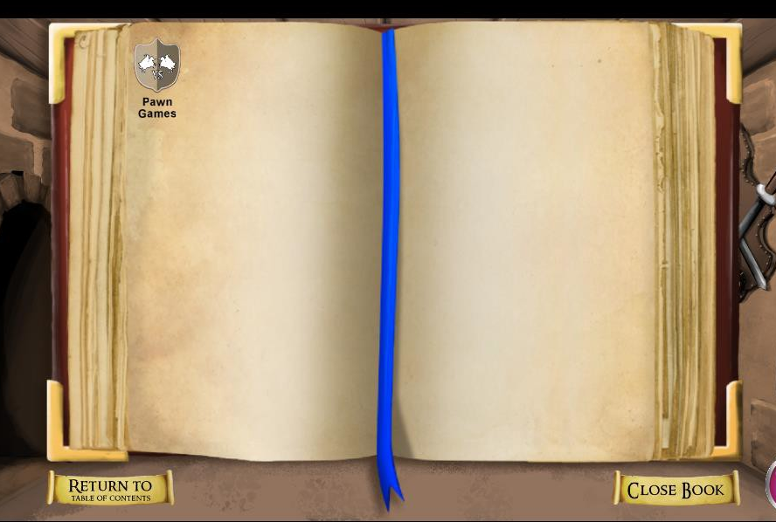
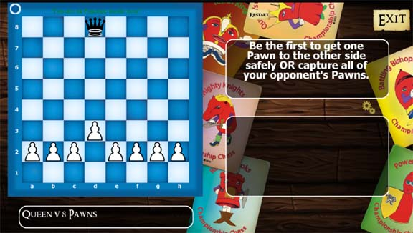
Ready for Challenges
The Challenges look like the tests you’ll take to achieve each card. In fact, if you can’t pass a test, we’ll send you back to practice so you can try again.
Be aware, the circle to the side tells you whose move it is. On top, and filled in, it’s Black to move. On the bottom and light, it’s White to move.

Slide 35
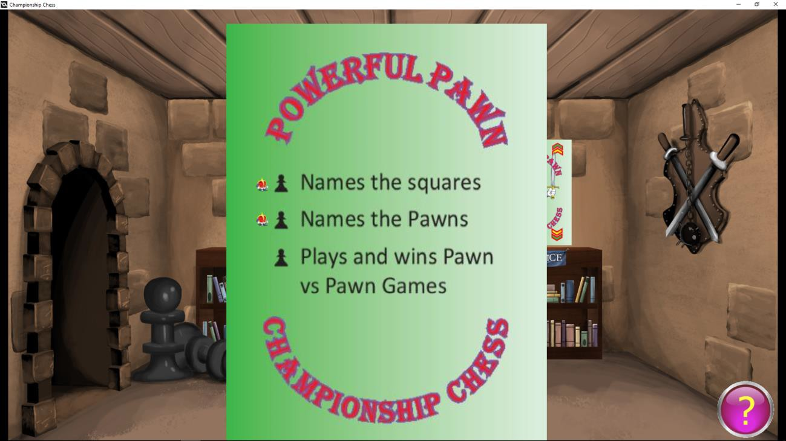

Take a Test
If a card is turned up, you can click to take the tests for that card. When a test is completed, a “King Bullet” appears by the concept.

Slide 36
Work your way through the World:
One card at a time!
Powerful Pawns
Battling Bishops
Mighty Knights
Rockin’ Rooks
Queen’s Quests
Kickin’ Kings

Slide 37

The Castle:
You Against the Computer
Game Play & Study Entry
Enter the Center Door of the Castle to put your chess study to work. Play full Chess Games against the computer or challenge yourself with more Focused Opening Study.
(Note: Work in the Queen and King Halls, the right and left doors, is still in progress.)
Notes:
7 minutes
Remember how the Knight moved from our dance and song?
Knight’s tour on demo board with pieces blank. The slide shows two correct answers.
Koltanowski as well!
Looking ahead, planning, focusing.
All the intelligences—from the musical patterns we learned as we sang the Knight Slide through the introspective skills of visualizing and thinking before making the move.

Slide 38

Game Play in the Castle
Click Play Game Against the Computer and you will be able to choose your color and your difficulty level. Then, click “OK” to open the chess board and play against the computer.
Click Play Game Against Player and you will be able to choose your color and host a game, waiting for an opponent; or, click a name on the list of players online to join a game.
Notes:
7 minutes
Remember how the Knight moved from our dance and song?
Knight’s tour on demo board with pieces blank. The slide shows two correct answers.
Koltanowski as well!
Looking ahead, planning, focusing.
All the intelligences—from the musical patterns we learned as we sang the Knight Slide through the introspective skills of visualizing and thinking before making the move.

Slide 39


Opening Study in the Castle
Now, you’re ready for a unique experience.
Click the filled bookshelf to open a row of books. Each contains openings of a specific type. These practice games go no more than 26 moves so that you can really work on your opening play.
Double King-Pawn Openings
Queen-Pawn Openings
Non-Double King-Pawn Openings
NOTE: Keep checking back: You see a lot of empty bookshelves and we plan to fill them up with Openings, Tactics and Endgame Study.
Notes:
7 minutes
Remember how the Knight moved from our dance and song?
Knight’s tour on demo board with pieces blank. The slide shows two correct answers.
Koltanowski as well!
Looking ahead, planning, focusing.
All the intelligences—from the musical patterns we learned as we sang the Knight Slide through the introspective skills of visualizing and thinking before making the move.

Slide 40


Step-by-Step Opening Play
Click a book and you’ll find a list of Openings.
Click the Opening you want to find options for the move number at which you’ll start playing against the computer.
(Note: We recommend that you start with a higher move number to help you practice the most complete main line of the Opening. In the example above, try Queens Raid Move 5 or 7.)
Notes:
7 minutes
Remember how the Knight moved from our dance and song?
Knight’s tour on demo board with pieces blank. The slide shows two correct answers.
Koltanowski as well!
Looking ahead, planning, focusing.
All the intelligences—from the musical patterns we learned as we sang the Knight Slide through the introspective skills of visualizing and thinking before making the move.

Slide 41
Game Review and Analysis
Whether you play against the computer, another player, or choose to play the Training Games from the bookshelf, students can click “Email Game” to send the game to both Parent and Coach.
Championship Chess Coaches will review appropriate games and send back their analysis and suggestions.
Notes:
7 minutes
Remember how the Knight moved from our dance and song?
Knight’s tour on demo board with pieces blank. The slide shows two correct answers.
Koltanowski as well!
Looking ahead, planning, focusing.
All the intelligences—from the musical patterns we learned as we sang the Knight Slide through the introspective skills of visualizing and thinking before making the move.

Slide 42


Setup…
Step-by-Step
We have you set up as a School Administrator at www.championshipchess.net. Your Username is your email address and Password is Ebenezer2020.
Login with your credentials and you will be taken to the administrator’s home screen.

Slide 43

School Administrator:
Home Screen
Here you’ll see general information about your school set up. If you want to add to your school Administrators, please, let me know at info@championshipchess.net so that I can put them onto the list.
AdminUsers.

Slide 44

Setup…
Put Your Students into Your Club
From your home screen, “click: Setup Rosters , then choose “Edit” to add students to your club.

Slide 45

Setup…
Put Your Students into Your Club
Now, you can fill your club with students.
Add Parent info to let parents receive email as students learn.
Assign each child a unique Username and Password.
Click “Add New” to save each addition.
This is the screen you use to add, edit or delete students.

Slide 46


Setup…
Setting up Coaches
From your home screen, click “Coaches,” then “Add New Coach” to set up staff who will be responsible for working with your students.
Now, just fill in the coach’s information. They’ll be able to change their passwords later, so keep it simple. And, don’t forget to save.

Slide 47

Setup…
Assigning Coaches
From your Home Screen, click Setup Rosters once more and you’ll be able to assign your coaches to the school. Just click the arrow to choose from your list of coaches.

Slide 48

Setup…
What Coaches Can Do
Once coaches sign in, they can click and change their profile, see their list of clubs, and click Play Game to follow the same learning process that their students
can access in the World of Chess.

Slide 49

Parents and
The World of Chess
Parents will need to Register for the website so that they can access student information. They must use the email address you have for them and set up their own Password.

