Slide 1
LITERACY ENRICHMENT: LET’S TALK II
Presented by
Theresa Slaughter, Literacy Enrichment Coach
April 15, 2021
In collaboration with SPPG & Iowa Department of Education (21 CCLC)

Slide 2
AS YOU JOIN…
In the Chat Box tell us:
Name, Organization,
Tell us 1-2 “go to” activities you do on a rainy day.

Slide 3
HOUSE KEEPING
Encourage participation (camera, chat box, discussions)
Add your name (this makes it more personal and easier to interact)
Utilize the chat box (to connect with others or ask questions)
Need to step away momentarily? Use the toolbar to turn off video/sound

Slide 4
Agenda
SPEAKERS – MICHELLE SCHOTT and MADISEN GASKIN, ISU EXTENSION & OUTREACH
LITERACY ACTIVITIES
LET’S TALK II -- Breakout sessions Ripple of Effect of Pandemic and Next Steps

Slide 5
Guest speakers
Michelle Schott and Madisen Gaskin, Extension Educator mim@iastate.edu, odlandc@iastate.edu ISU Extension and Outreach – Family Life: Literacy Development

Slide 6
VOCABULARY Development & BUILDING
According to research, knowledge is stored in 2 forms: -- linguistic (words, phrases, statements) -- nonlinguistic (pictures that physical sensations like smell, taste, touch, kinesthetic association, and sound)
Word exposure – broadens vocabulary, allows for kids to create meaning, connecting to prior knowledge
Proficient in areas in listening, speaking, reading, and writing → Literacy

Slide 7
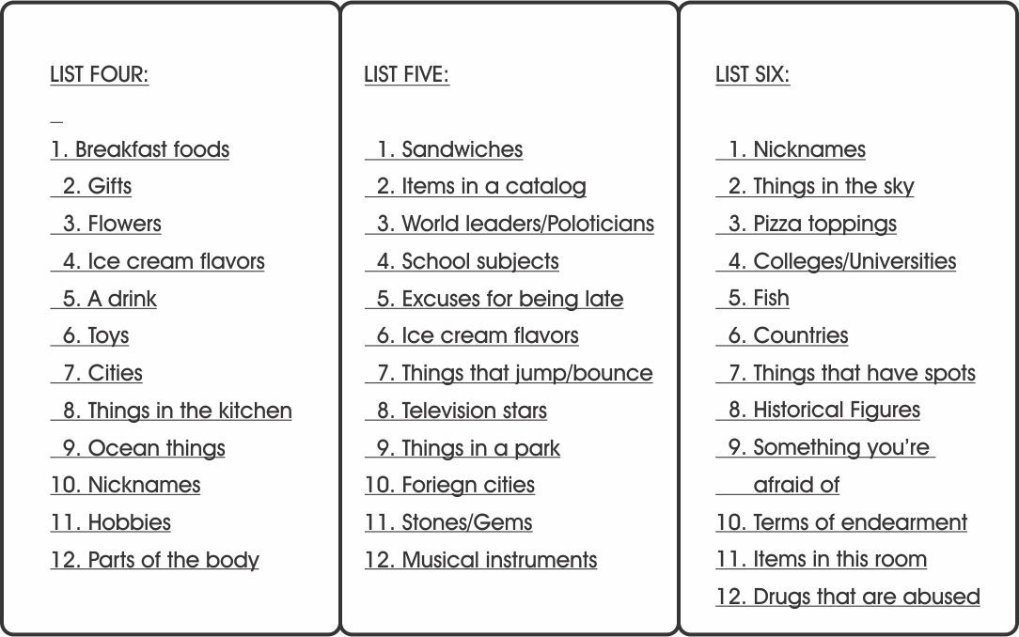
Literacy enrichment activity – scattergories
Grades: 3+; K-2 w/modifications
Ways to play: - individual, partners, group (classroom)
Directions: - Pass out selected category list to each participant - Pick/roll a letter to reveal the letter that all answers must begin with. - Set the timer for 2 minutes. -You may selectively go around the group and have them read some of their answers. https://swellgarfo.com/scattergories/

Slide 8
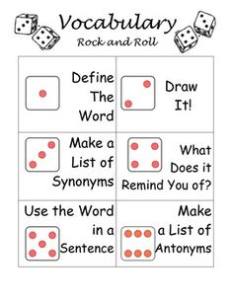
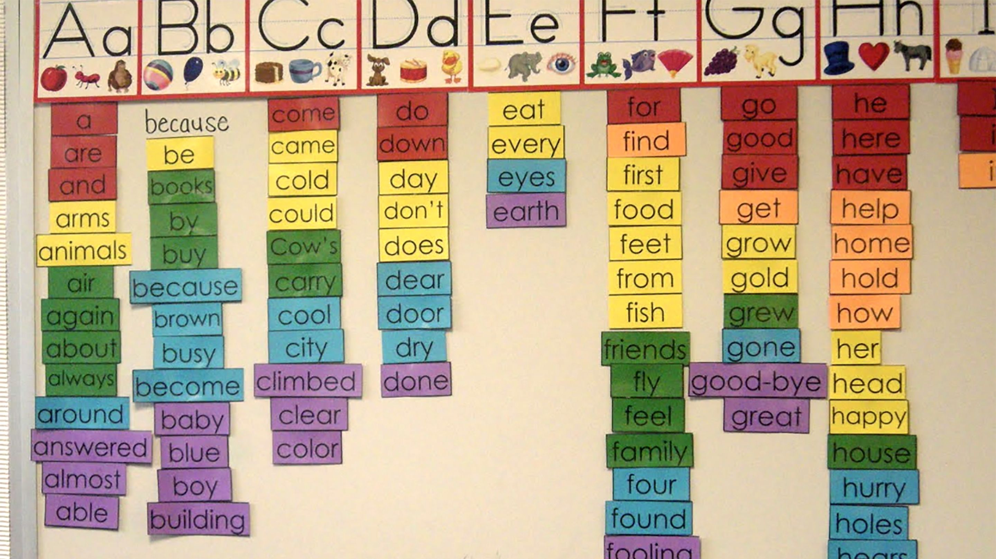
Literacy enrichment Activity – Alphabet game
Grades: 3+; K-2 w/modifications
Ways to play: - individual, partners, group (classroom)
Directions: - Pick a letter (A-Z) to reveal the letter that the words must begin with. - Kids will write down at least 5 words; 7 words for older/advanced groups -You may selectively go around the group and have them read some of their answers.
Selective “words” can be turned into a word walls and vocabulary builders.

Slide 9
LET’S TALK – RIPPLE EFFECT of pandemic
Social-Emotional well-being of youth, families, and program staff/admin.
OST Programs to aide w/educational gap (Reading and Math)
Constantly adjusting to outside environment
Return to Learn plans (pandemic guidelines) - virtual, in-person, hybrid → Program Structure

Slide 10
4 corners + 1
What have you learned about yourself while navigating though this Pandemic? (as a leader, educator, person)
How has the ripple effect of the pandemic effect your program this year?
Which Return to Learn plan(s) has your program used since opening in the fall? Which plan(s) was the most effective, why?
How much commitment do you feel will be required to aide in the educational gap?
What is your next plan of action to prepare for summer and/or afterschool programming?
10 min

Slide 11
LET’S TALK – NEXT STEPS
Structure (outlook) of Afterschool/Summer programming
Overall “outcome” of programming - Where do we stand with…
Social-Emotional well-being of youth, families, and program staff.
Literacy Enrichment best practices/application

Slide 12
4 corners + 1
What are some things you can do to manage stress or emotions while navigating through the Pandemic?
Share out 1-2 things
Reflecting on your discussions today, what are some ways you can help continue moving program forward through the pandemic?
Do they have Fourth of July in England?
List 4-6 ways to incorporate Literacy Enrichment into afterschool/summer programming.
List 2-4 program goals for the upcoming summer program.
10 min

Slide 13
Share at least 1-2 takeaways from your group discussions

Slide 14
Works cited
Black Hills Special Services Cooperative (BHSSC). (2006). On Target: Strategies to build student vocabularies. http://celi.olemiss.edu/wp-content/uploads/sites/7/2014/01/StrategiesVocabulary-080808.pdf
Stone, B. and Urquhart, V. (2008). Remove limits to learning with systematic vocabulary instruction. McREL. Retrieved April 5, 2021 from https://files.eric.ed.gov/fulltext/ED544614.pdf

