Slide 1
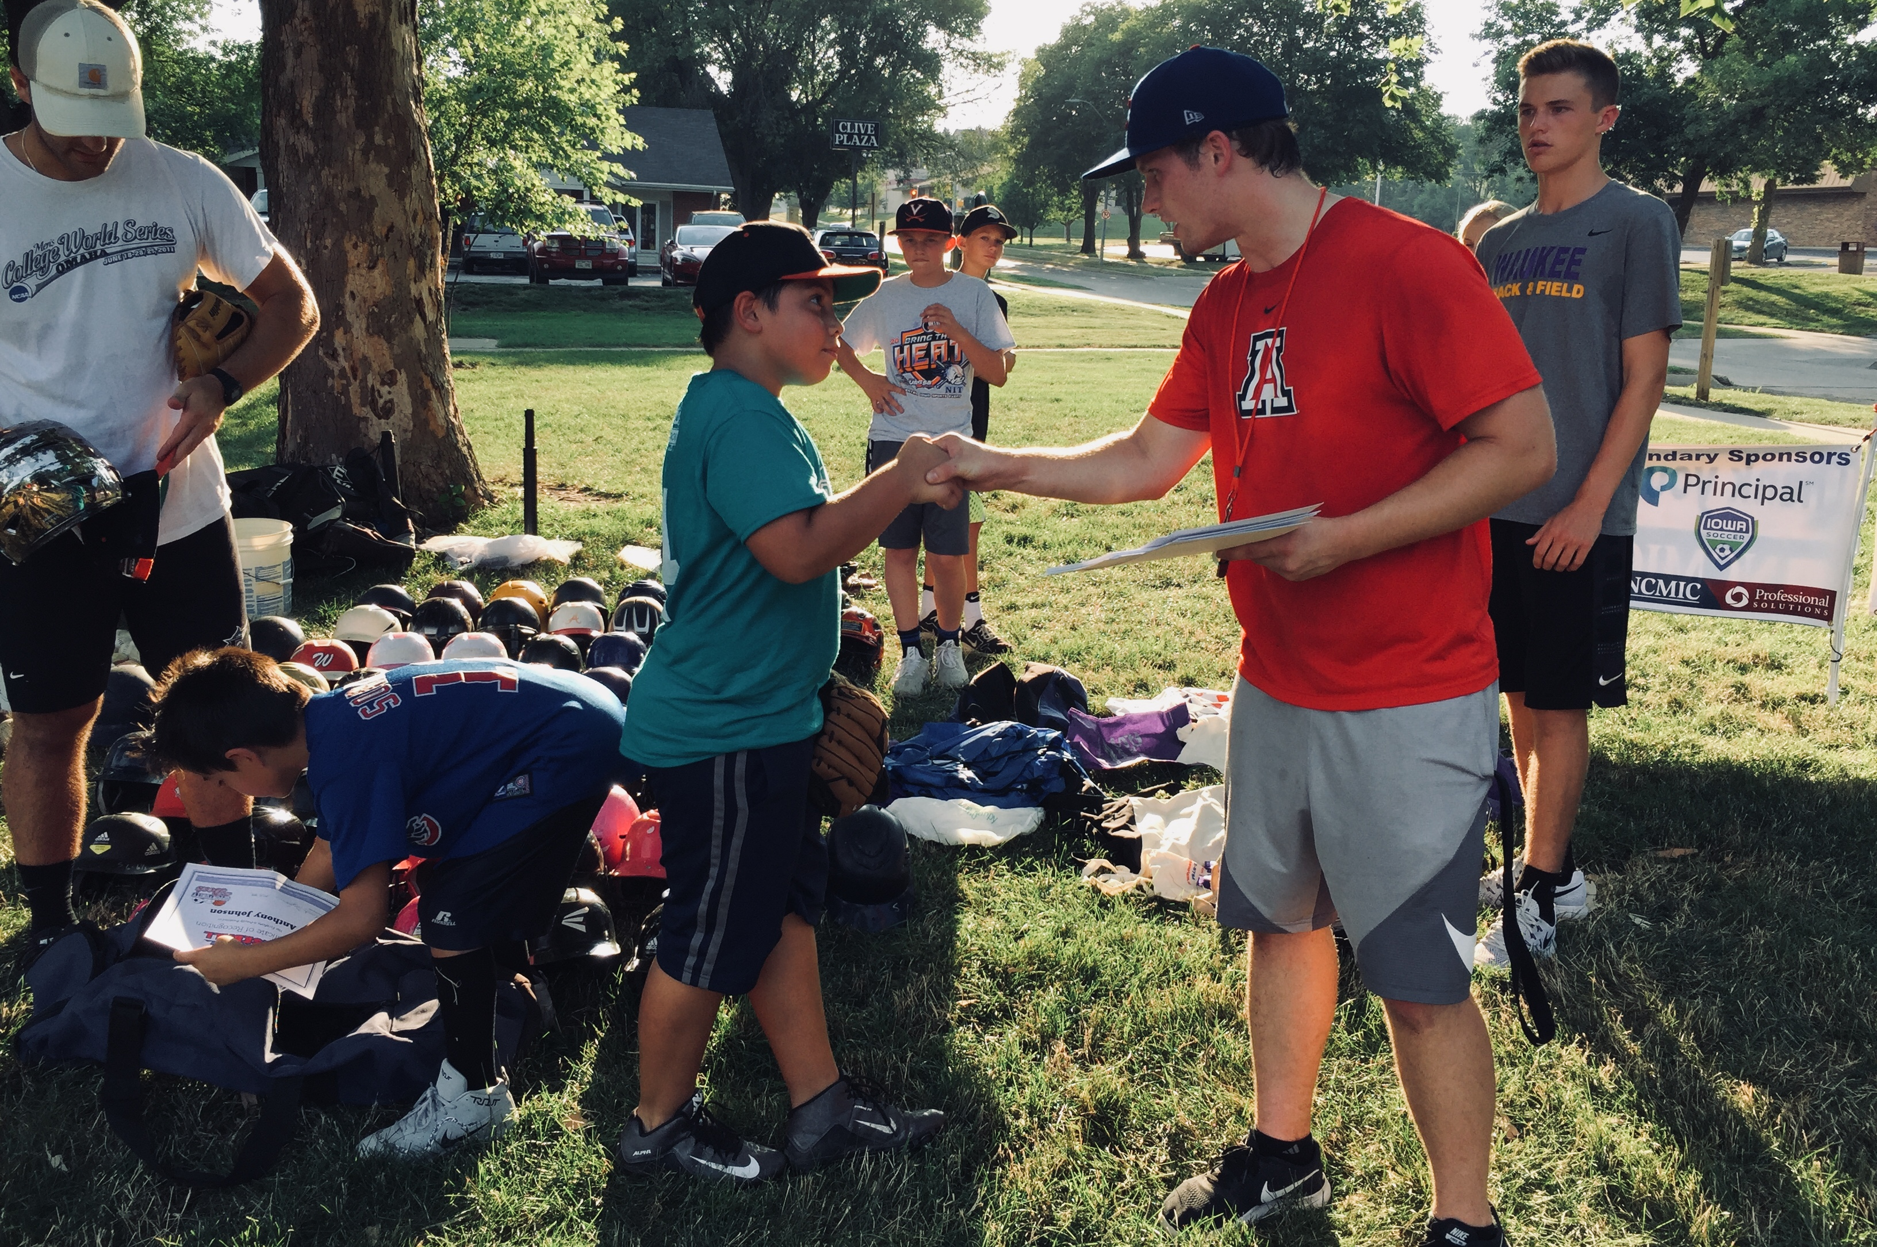
Building Diverse Communities Through Health and Wellness Programs

Slide 2
Agenda
Presenter Introductions
Introduction to Can Play
How we Serve Vulnerable Populations
How we Collaborate with our Community
Objectives
Help you understand how to better reach, serve and support vulnerable populations in your community
Help you understand how to better collaborate with competitors, complimentary programs and other organizations
Brainstorm ideas that you can use to immediately improve your organization’s services and/or community collaborations

Slide 3
Presenter
Born & raised in central Iowa
Undergrad from Drake University
MBA from University of Iowa
9 years of experience in recreation-based youth development
Founder of Opportunity on Deck and co-founder of Can Play
CHPcommunity Board President
Play professional ultimate frisbee for Minnesota Wind Chill

Slide 4
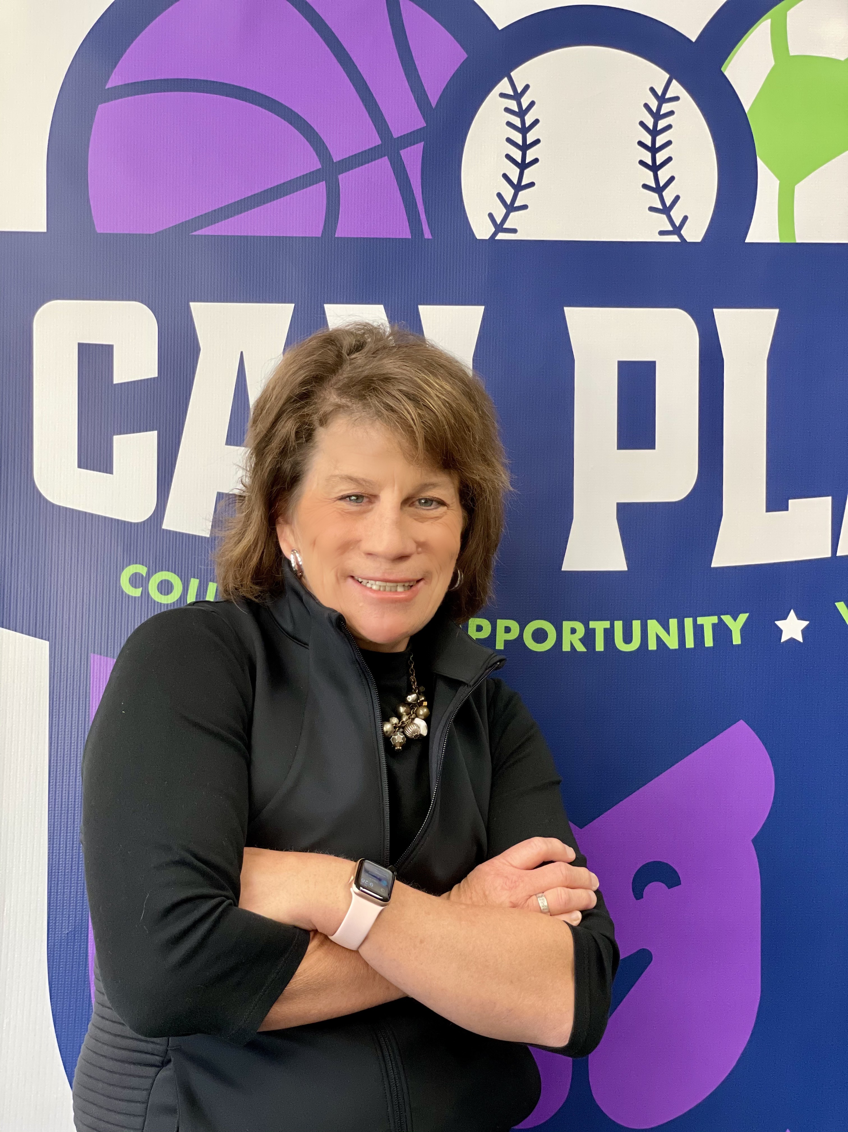
Presenter
Born & raised in Des Moines
Bachelor degree from University of Iowa
25 years of experience in hospitality
9 years of experience in adapted recreation programming
Founder of Courage League Sports and co-founder of Can Play
Board member for Goodwill and various other local organizations
Enjoys playing tennis, pickleball, snowshoeing, kayaking and more

Slide 6
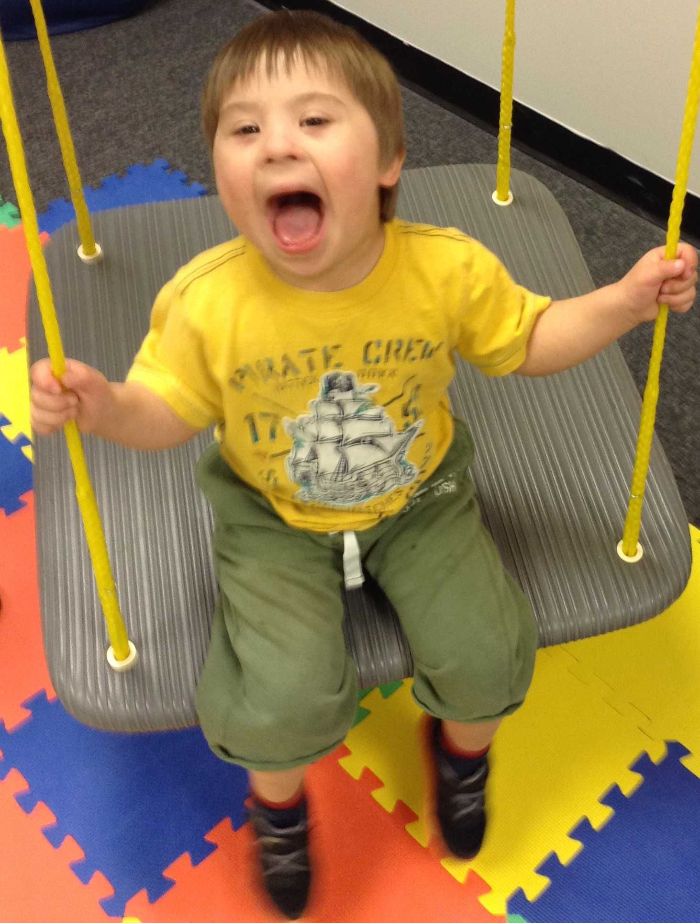
Mission
Can Play provides recreation-based development programs adapted to meet the needs of those with financial, physical, cognitive, emotional or chronic health care barriers to play.

Slide 7
Programs & Participants
Courage
Opportunity
Adaptive programs for those with special needs
Develop skills and abilities of people ages 2-82
Provide individualized and personalized support and assistance
Utilize recreation and sports to help the population be active and social
No-cost programs, provide everything needed to play
Develop youth in kindergarten through high school in low-socioeconomic areas
Focus on teaching life-long values through positive role models
Utilize sports to prepare youth to be MVPs in community

Slide 8
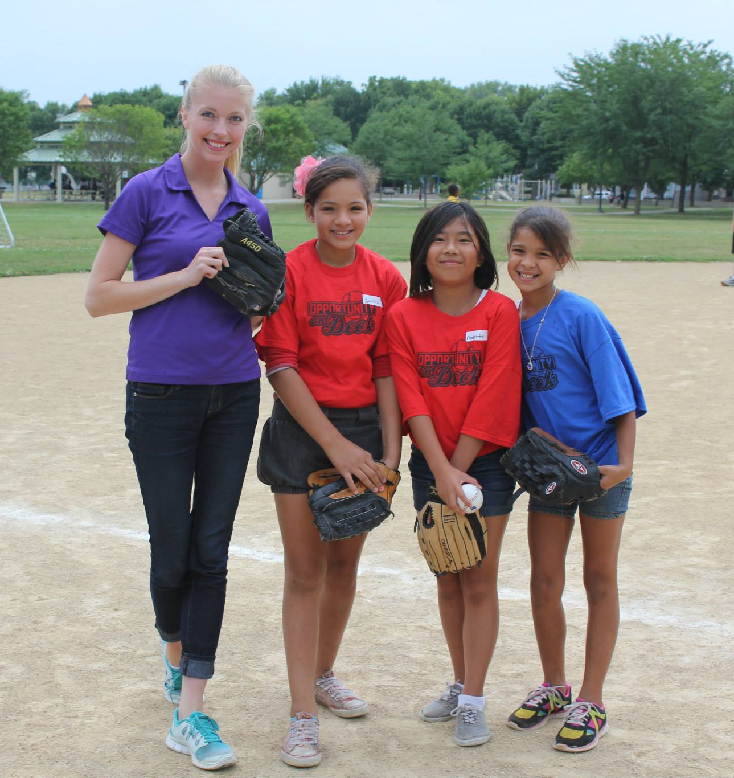
Barriers to participation in low-socioeconomic areas
Pay-to-play programs increasing cost of participation
Small costs add up (equipment, uniforms, water bottles, etc.)
Unable to afford basics (e.g. putting food on the table)
Transportation to practice, games and tournaments
Languages spoken by parents

Slide 9
Solutions to participation in low-socioeconomic areas
Free programming led by positive role models
No proof of income required
Provide all equipment, uniforms, water bottles, etc.
Serve meals every practice
Place programs in accessible community spaces
Provide transportation
Translate flyers for families

Slide 10
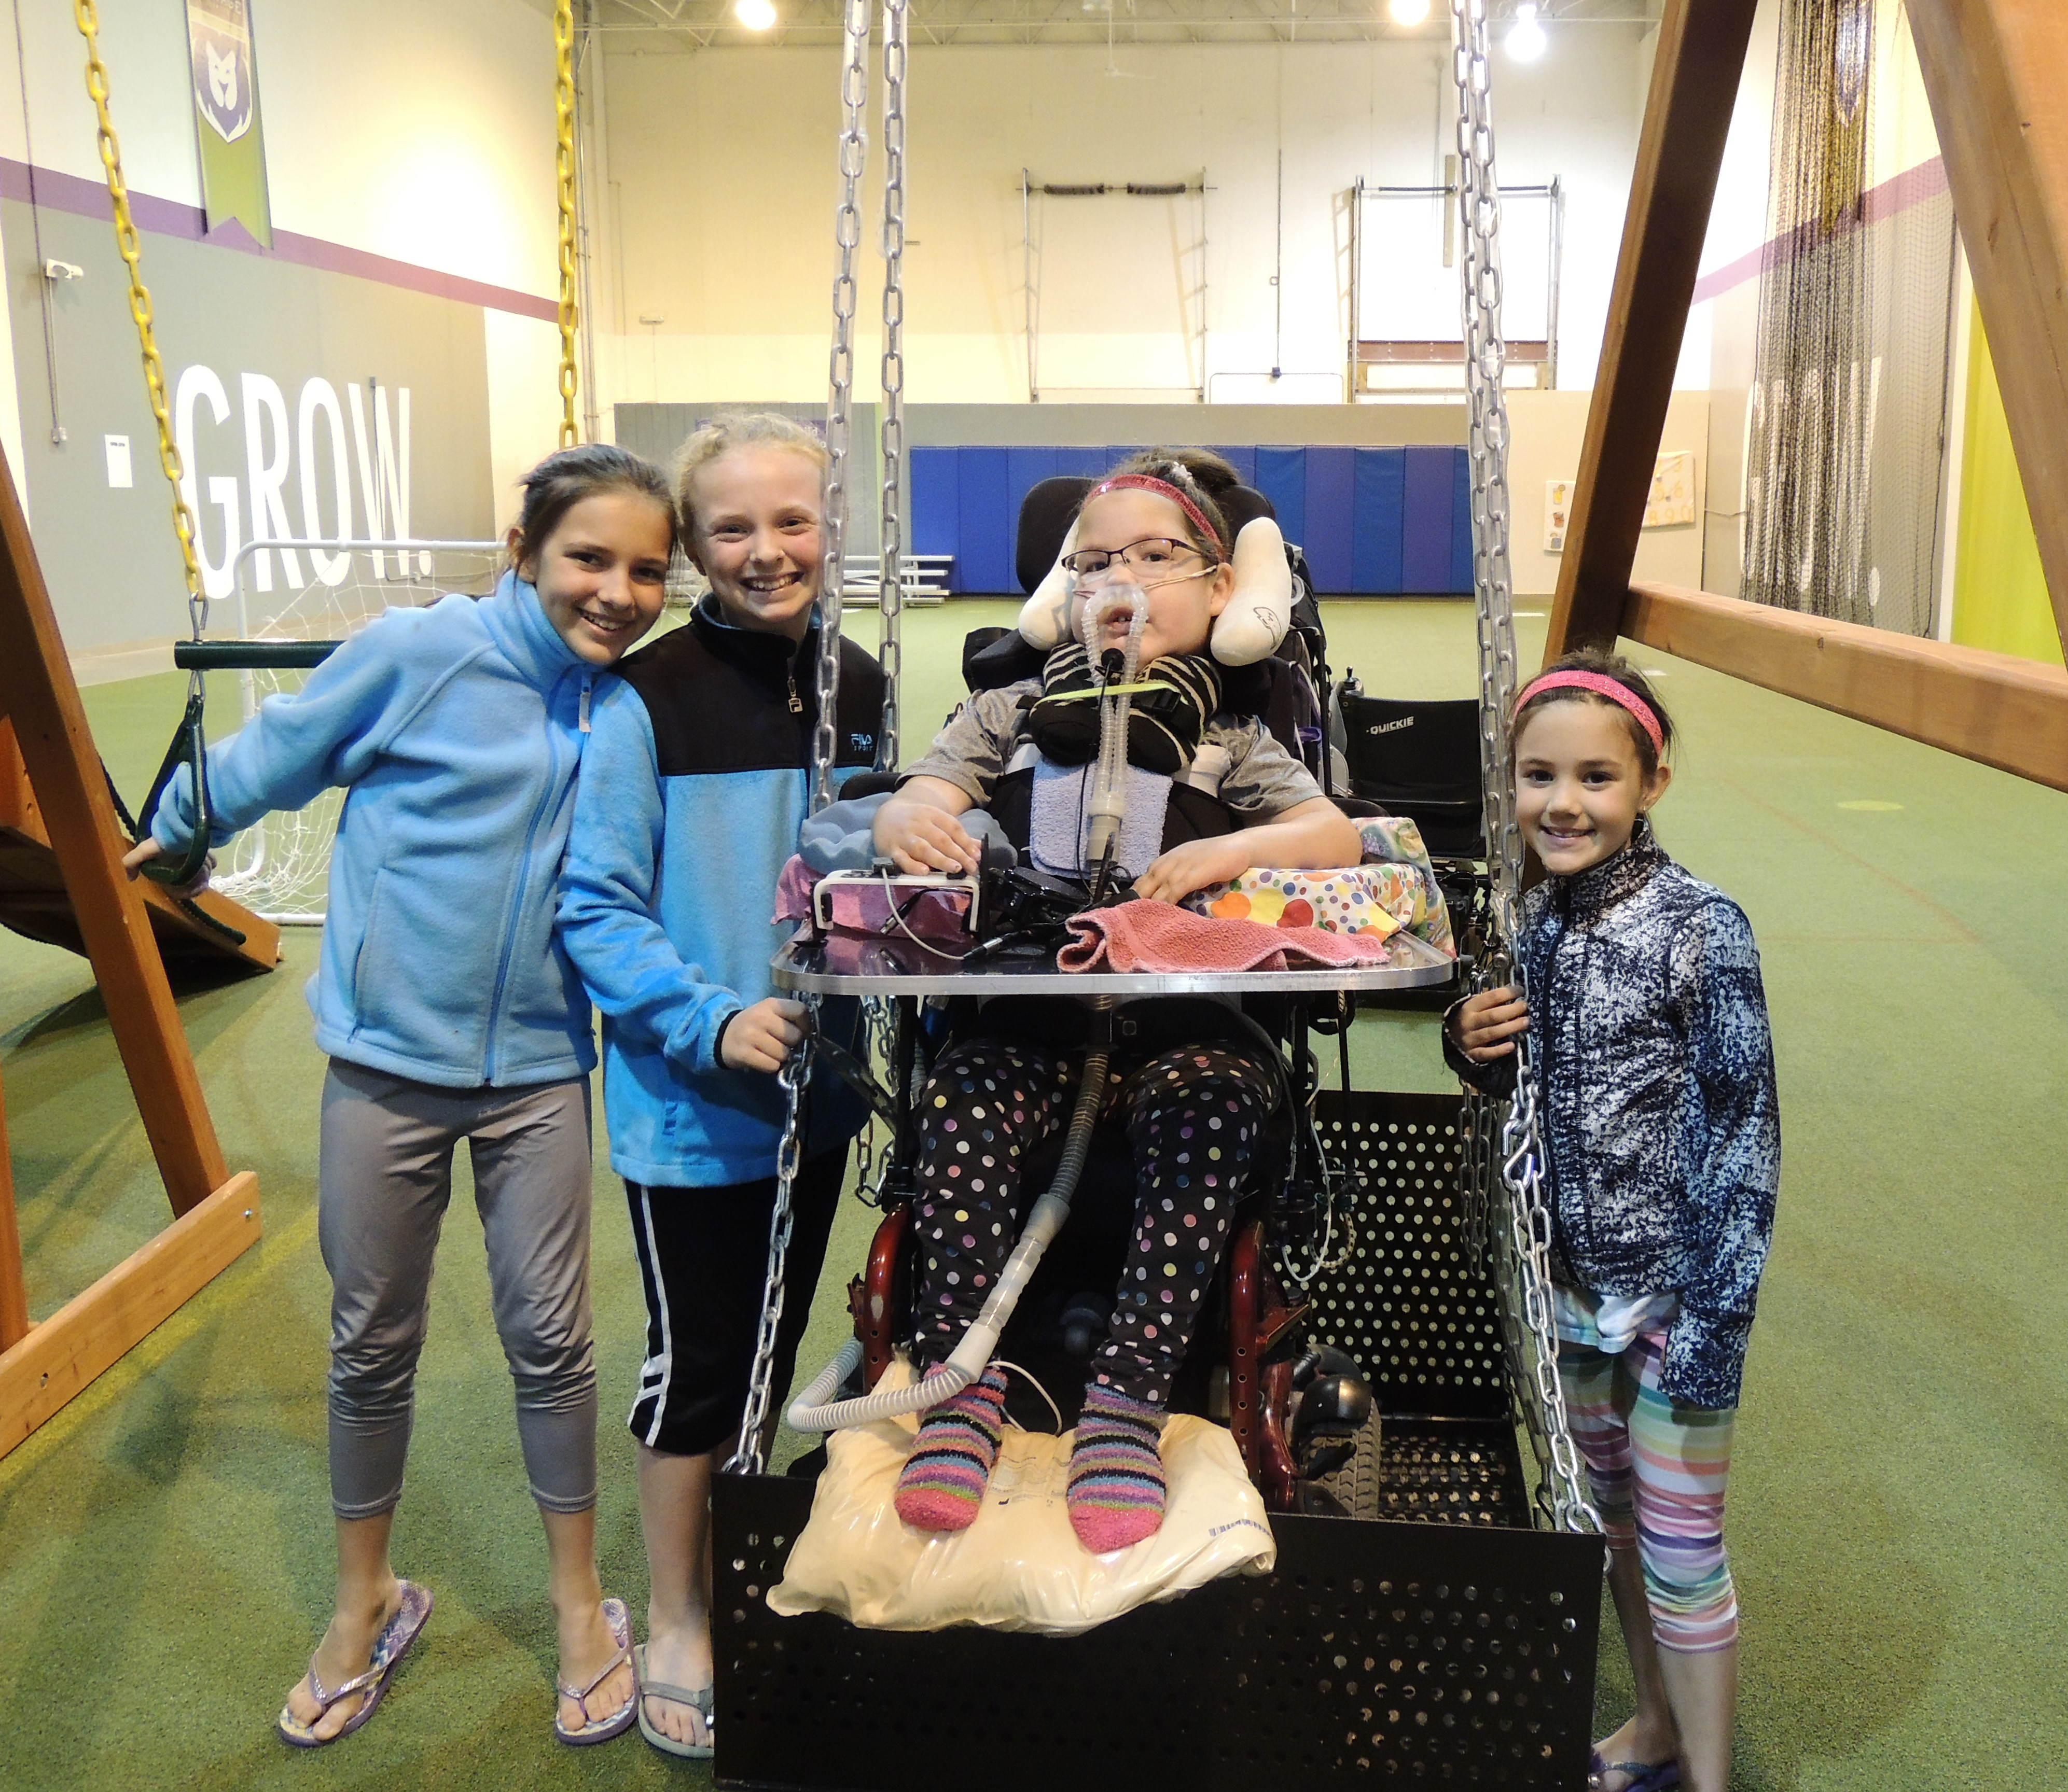
Barriers to participation for the special needs community
Coaches are untrained volunteers
Lack of individualized attention
Playing spaces and surfaces designed for able-bodied individuals
No social support
Financial challenges associated with high healthcare expenses

Slide 11
Solutions to participation for the special needs community
Highly-trained, expert coaches
Activities adapted for the individuals and their abilities
Individual attention and assistance
Utilize inclusive community place surfaces and spaces
Encourage social interaction
Provide scholarships for 40%

Slide 12
What steps can your organization take to better serve vulnerable populations in your community?

Slide 13
community collaborations
Community collaborations = better outcomes for participants
Matches expertise to participants’ needs
Allow us to improve impact with minor resource expenditure
Allow us to focus on recreation-based development programs
Make marketing and referral process more focused and generates higher ROI

Slide 14
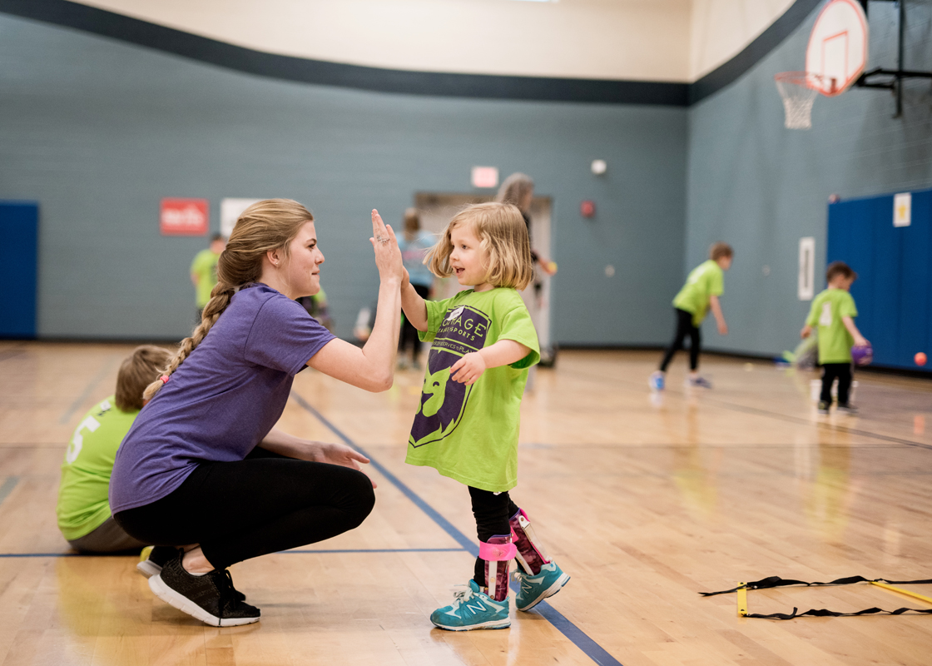
Key community collaborations
Schools
Special education programs
Guidance counselors
Physical education departments
Parks and recreation
Club sports programs
Special needs care facilities
Rehabilitation facilities
Day habilitation centers
Group homes
Non-profit organizations

Slide 15
Who can you collaborate with in your community? How might you collaborate with other people or organizations in your community?

