Slide 1


2021 RFA
TITLE IVB Technical Assistance

Slide 2

Agenda:
Why is this a model program?
RFA Timeline and DE website
What’s new in the RFA
Community Partners/Charging Fees
Monitoring Tools and Risk Assessment
Grant Fraud/Finance/Data Reporting
Application Tips
What is expected and required of you?

Slide 3
What we mean by a MODEL program..
As a federally-funded program, your work is a MODEL of Best Practice, reported to your community (we require your annual local evaluation to be posted online on your website).
Because of the federal funding you are expected to run a high quality program that is an EXAMPLE of excellence to others in the state.
Your grant application is a PUBLIC document- and is available for review on the IDOE website or archive site. Those who are interested in starting an afterschool or summer school program may want to visit you.
Data is reported on a USDOE online data system to create reports for Congress.

Slide 4
THIS GRANT IS FOR AT-RISK CHILDREN
GRANT FUNDS ARE TO BE USED FOR CHILDREN- It is not to create new full time positions. If you operate 3 hours a day x 5 days that is only 15 hours a week, not 40.
PROVIDE SERVICES FOR CHILDREN
IMPROVE ATTENDANCE WITH FUN ACTIVITIES
HELP THEM IMPROVE BEHAVIOR
HELP THEM IMPROVE THEIR READING
HELP THEM IMPROVE THEIR MATH
ALL THIS PROGRESS WILL BE REPORTED IN THE FEDERAL APR DATA SYSTEM USING NEW GPRA MEASURES (Progress instead of Proficiency)

Slide 5
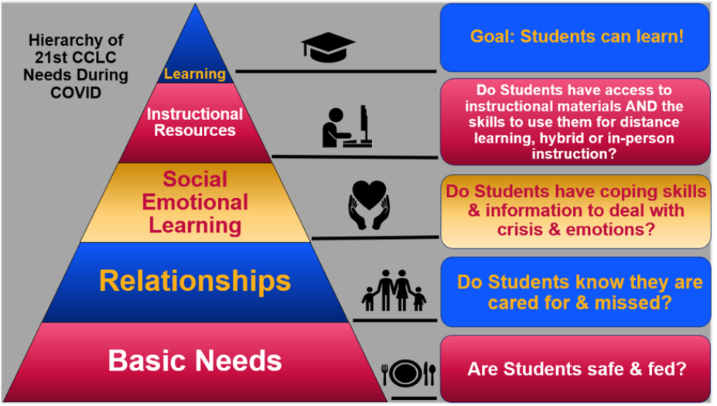

Slide 6
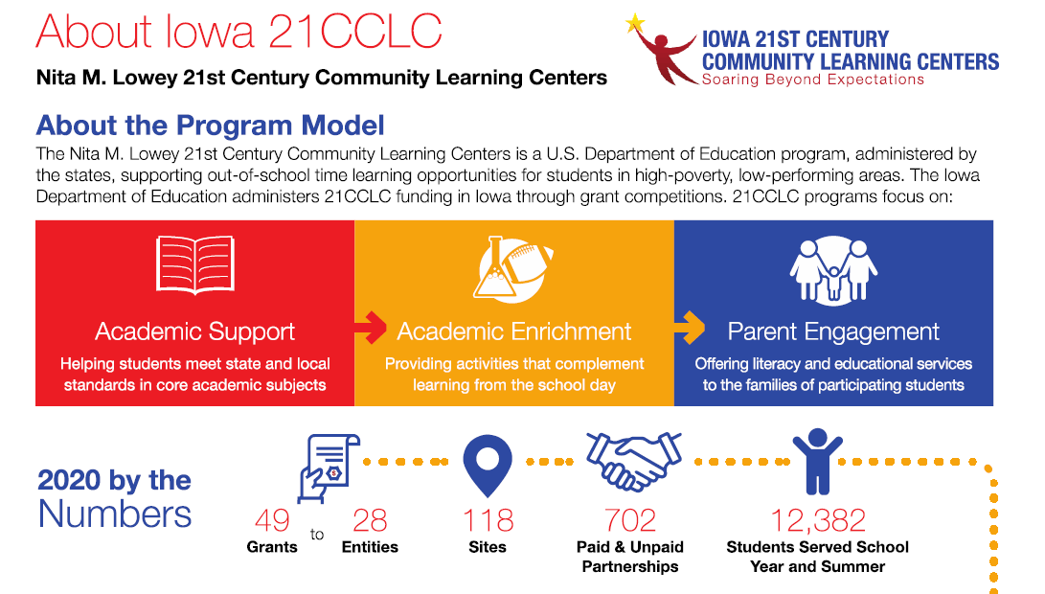

Slide 7
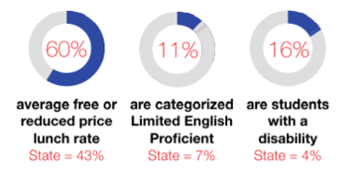
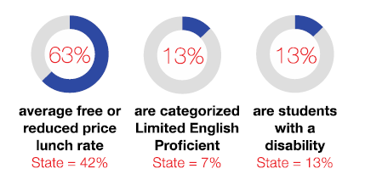
We are serving more children in need..
2019 DATA
2020 DATA

Slide 8
Federal Title Program (TITLE IV B)
This federal title program is competitive (you must apply for this funding).
Just because you received funding in the past does NOT guarantee you funding in the future.
Funding is determined by your performance data and a peer review process and by following the rules, laws and statutes for this program.
Sometimes you may have done a great job in the past, but your new application did not communicate this to peer reviewers and you received a low score and did not get funding.
Sometimes you may have a high score but your application violated a rule, law or federal statute and you did not get funding.

Slide 9

This program CAN change lives
It is focused on helping children in poverty
It requires entering data in a federal reporting system and doing an annual evaluation plus additional reporting about your program
It is a lot of work- but community partners can help
We offer more professional development than any other state through our partnership with the Iowa Afterschool Alliance
We expect Results. A quality program should be able to:
  Increase Attendance
  Reduce referrals to the office
  Increase student achievement in reading
  and math
  Increase self esteem and
  social emotional development

Slide 10

Serving at-risk children
Most of the changes we have made to the RFA are focused on improving how we serve at-risk children.
This program can provide hope and life-changing experiences for children who need a little extra help.
A successful quality program will see attendance increase, behavior problems decrease, reading and math scores rise and children re-connecting with the value of learning in school.
As we provide more social-emotional learning, we are increasing emphasis on providing snacks and full meals that provide the nutrition that growing children need for health and learning.

Slide 11
Grant Competition Timeline:
RFA
Released
Applicant Workshops
And Webinars
Online Letter of Intent
Applicant Webinar
Grants Due
Peer Review Process
Grant Award Process
Awards Announced
Contracts Sent
Grants Begin July1st for summer school
Begin Summer School
June 30th expenses due before Aug 15th
July, Aug, Sept expenses Due before Oct 30th

Slide 12
GRANT TIMELINE:
September 22, 2021 – In-Person Technical Assistance. 10 AM to 12 PM Holiday Inn Merle Hay Rd and I-80 Des Moines, Iowa. 4800 Merle Hay Rd, Urbandale, IA 50322
October 7, 2021 – Grant Local Evaluation Training Webinar 10am – 12pm. We will review the Evaluation Support documents (posted in the Evaluation section).
Virtual Technical Assistance Meetings
October 13,2021 – Second Technical Assistance Meeting
10am – 12pm
November 4, 2021 – Third Technical Assistance Meeting
10am – 12pm
  All Technical Assistance meetings will use the following Zoom meeting
    URL: https://IDOE.zoom.us/my/afterschool21cclc
    Meeting ID: 577.413.5846
    Password: iowa
    For phone: 60277

Slide 13
GRANT TIMELINE:
November 12, 2021 – Letters of Intent to Apply must be submitted via
an online application and survey of students needs
: https://www.surveymonkey.com/r/21CCLCLOI22
December 10, 2021 – Grant applications due date.
  (Must be received electronically via the web portal) by 4:00 p.m. CST.
  NO EXCEPTIONS. You will receive notification when your application
  has been completed and submitted online.
December 2021 – Application Compliance Check
December - January – Grant reviewers read and score applications.
January 2022 – Grant reviewers conference
March – April 2022 – Grant awards announced.
April – June 2022 – Grant contracts finalized.
July 1, 2022 – Program implementation may begin with summer

Slide 14
Application Deadline:
FRIDAY, DECEMBER 10, 2021; 4:00 PM CST
TOTAL FUNDS AVAILABLE FY2012 $5,714,877.00
TOTAL FUNDS AVAILABLE FY2013 $5,658.446.00
TOTAL FUNDS AVAILABLE FY2014: $6,029,497.00
TOTAL FUNDS AVAILABLE FY2015: $6,681,550.45
TOTAL FUNDS AVAILABLE FY2016: $6,243,557.70
TOTAL FUNDS AVAILABLE FY2017: $6,805,627.00
TOTAL FUNDS AVAILABLE FY2018: $6,825,160.00
TOTAL FUNDS AVAILABLE FY2019: $6,789,541.26
TOTAL FUNDS AVAILABLE FY2020 $6,780,000.39
TOTAL FUNDS AVAILABLE FY2021 $5,581,239.69
TOTAL FUNDS AVAILABILE FY2022 $7,092,382.74
$64,543,433 total funding since 2011

Slide 15
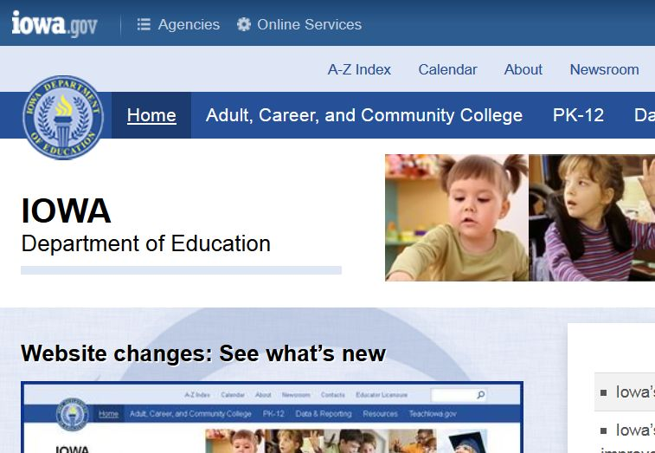

Iowa Dept of Education website
How to find the 21st CCLC website…
Type the URL in your web browser
URL: www.educateiowa.gov

Slide 16
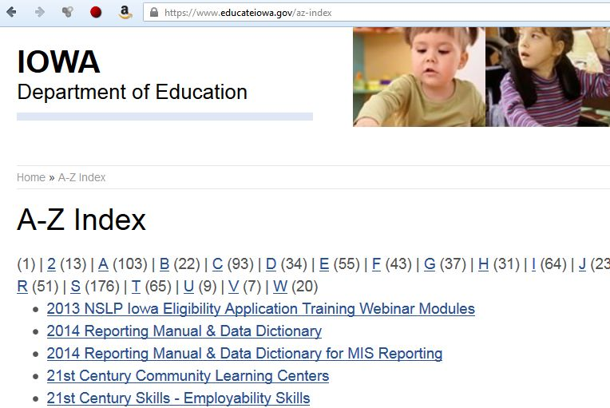
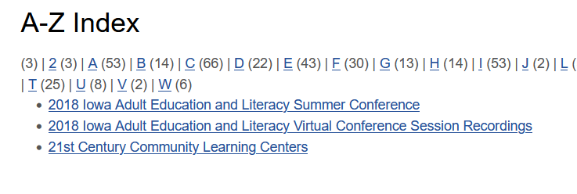
How to find 21st CCLC on the IDOE web site..
1-Click on A-Z Index
2-Click on 2
3-Select 21st Century Learning Centers

Slide 17
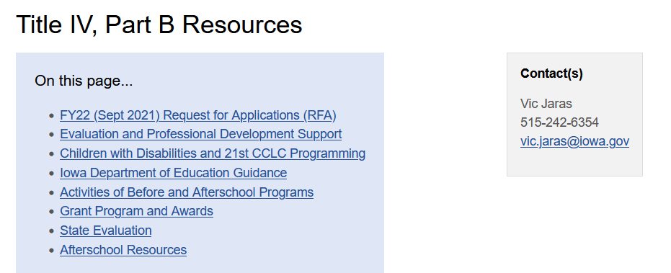
The 21st CCLC webpage
TIP: BOOKMARK
This website for future use.

Slide 18
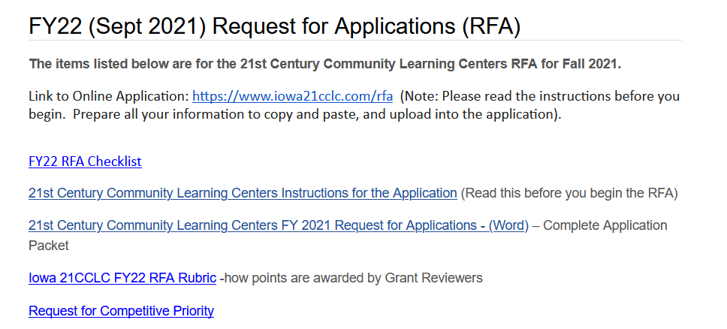
The 2021 Application is online

Slide 19
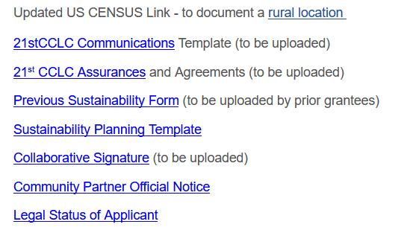
2021 Application materials

Slide 20
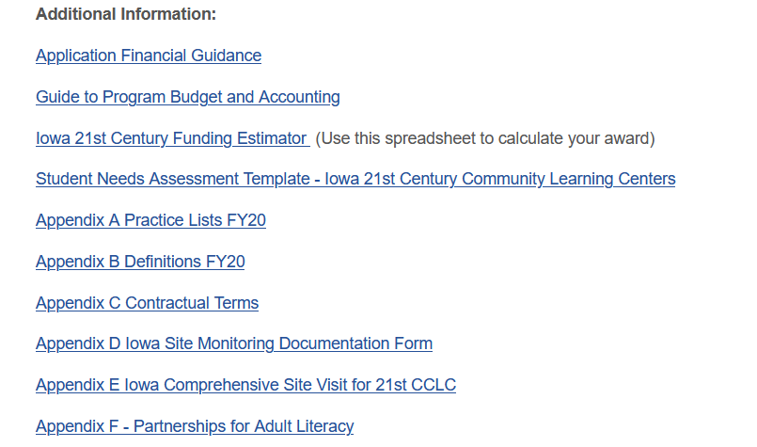
2021 Application materials

Slide 21
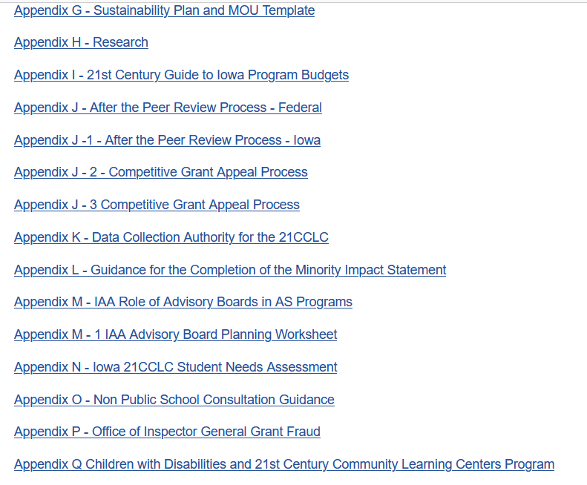

Slide 22

Electronic copy not required
Hard copy not required
The Online Application will generate a final PDF of your application
More BONUS POINTS available
Additional statute clarifications
WHAT NEW IN THE RFA:

Slide 23
The Bonus Points:
If your site is in a County with high child poverty (over 17%) then you will receive 5 bonus points
If your propose to serve children a FULL MEAL daily and provide evidence of this partnership with a school
food system or local food bank. (your attendance should increase) and you will receive 5 bonus points.
If you are a RURAL site, you will receive 5 bonus points.
If you are a MS or HS program and propose to serve middle and/or high school aged youth with Career and Technical Education programs with evidence of a partnership agreement with a local college or university.
If you are a TITLE I school, with a community partner and will serve 50% of the FRL children in that building, you will receive 5 bonus points.

Slide 24
THE APPLICATION PROCESS:
Attend a Technical Assistance Meeting
Complete the Online Letter of Intent
Complete the Online Application
PEER REVIEWERS SCORE- They determine the potential quality of a program based on your grant application narrative
SEA REVIEW- Takes the smaller pool with highest scores and reviews budgets, narratives and history of the applicant. If there are findings (supplanting, false information, violations of statutes, law or rules) you will NOT be funded.
IF YOU ARE AWARDED- This does NOT approve everything in your application. The rules still apply. If you are doing something in violation, it must be corrected. The burden is on YOU to follow the rules. Contact the SEA if you discover any violation or potential issue.

Slide 25
SEA Review:
This SEA review is required by federal statute (see below). It is part of our approved monitoring for new awards.
OMB Uniform Guidance Information
Pre-Award Risk Assessment
One aspect of the Uniform Guidance (2 CFR Part 200 Uniform Administrative Requirements, Cost Principles and Audit Requirements for Federal Awards) is the addition of new language that requires both federal agencies and pass-through entities (e.g. the State of Alaska) to review the merit and risk associated with a potential grant recipient prior to making an award. In evaluating the risks posed by the grant applicants, the awarding agency may use a risk-based approach and consider any items, such as:
Financial stability
Quality of management systems
History of performance
Reports and findings from audits

Slide 26
BEFORE YOU APPLY- Make sure you are eligible:
If you are in non-compliance, STOP. You are not eligible to apply until your non-compliance issues have been resolved.
2 CFR Ch. II 200.338 -If a non-Federal entity fails to comply with Federal statutes, regulations or the terms and conditions of a Federal award, the Federal awarding agency or pass-through entity may impose additional conditions. (e) Withhold further Federal awards for the project or program.
  Free and Reduced Lunch Rate: If you do not have 40 percent minimum free and reduced lunch rate for each building that you are proposing to serve, STOP, and remove the buildings that do not have a 40 percent minimum from your application.
  If you had 41 percent last year but this year, your building is at 39%, STOP. You are no longer eligible. You MUST have 40% FRL to apply. The Average FRL last year was 69% for Cohort 14.

Slide 27
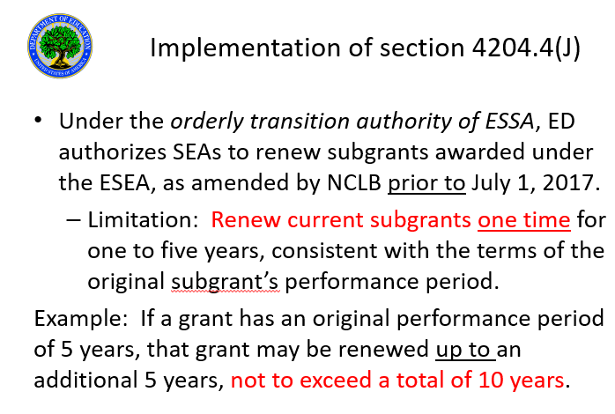

Slide 28
CONTACT TIME:
3 Hours day x 5 days MINIMUM
IOWA is NOT an ELT state.
Iowa requires 60 hours a month (almost 600 hours per year) of contact time to be eligible for funding for this grant (180 days x 3 hours day).
This provides a research-based standard to insure academic progress for children based on findings from the Wallace Foundation.
The data shows that the more time provided for academic remediation, the greater the improvement.

Slide 29
CONTACT TIME:
Every child must have access to 3 hours per day, five days per week.
This has been in statute since the beginning
In Iowa, districts have flexibility- they can offer field trips on Saturday or Sunday and be reimbursed because we say 60 hours a month.
If a school ends at 2:30- your program should run until 5:30
If you offer breakfast and activities –this is an hour each day.
During Christmas and Spring Break when school is not open, simply count 3 hours per day for those days school is open.

Slide 30
Bonus Points:
Bonus points are offered to provide equity and encourage best practices.
1) Application proposes to serve rural communities (community with population 2,499 or below). Up to 5 additional points awarded –This designation of rural is from the US Census.
NOTE: Look up city populations at
2) Application proposes to serve children and youth in schools designated COMPREHENSIVE (old- “Priority”) or TARGETED (old-“Needs Improvement”) on the Iowa School Performance web site AND is jointly submitted as a collaboration between local educational agencies receiving funds under Title I and a community-based organization or other public or private entity that contributes to the program.
NOTE: This collaboration cannot include vendors. Up to 5 additional points awarded NOTE: You should provide for 50% of the FRL students at each school seeking priority points.
https://www.iaschoolperformance.gov (Bookmark this site)
https://www.census.gov/data.html

Slide 31
Bonus Points: (bonus points tied to poverty)
Application proposes to serve a county with more than 17% child poverty. Up to 5 additional points awarded.
Look up your county at https://datacenter.kidscount.org/data/tables/1239-child-poverty?loc=17&loct=5#detailed/5/2715-2813/false/37,871,870,573,869,36,868,867,133,38/any/2685
Use the 2018 (the latest available) data
We offer bonus points to focus on areas with high child poverty in Iowa. If you propose to charge fees, you may be creating a burden for families in poverty. This is NOT a best practice. You should seek out community partners who can help eliminate the need for fees.

Slide 32
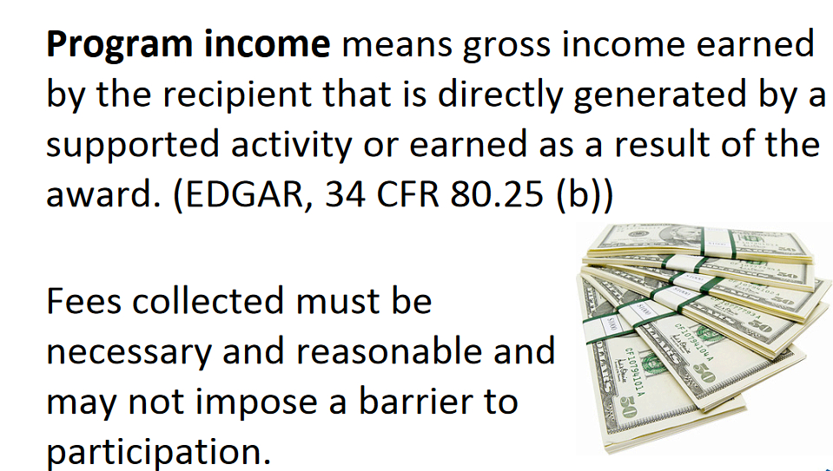
CHARGING FEES IS DISCOURAGED
IT IS NOT A
BEST PRACTICE.
Previously, sites that charge fees were checked every three years. Now, if you charge fees you must submit your enrollment form for approval online every year. https://goo.gl/forms/QlaM6ReToehlyBzx1

Slide 33
Equity Check for programs that charge fees
Programs that charge fees may not prohibit any family from participating due to its financial situation.
The priority of the program to serve poor students and families could be compromised through high program fees.
The IDOE will require you to produce a list of ALL your students by lunch status to insure you are NOT charging free lunch students and have a sliding scale in place. This reporting may be part of a site visit or it may be an email request.

Slide 34




ESSA
Every year we work to make the application easier
2011- 120 pages 2012- 48 pages 2020-42 pgs 2021- Online
“The State Educational Agency will provide the least restrictive and burdensome regulations for local educational agencies and individual schools participating in a program assisted under this part” –ESSA 110(G)18-22

Slide 35
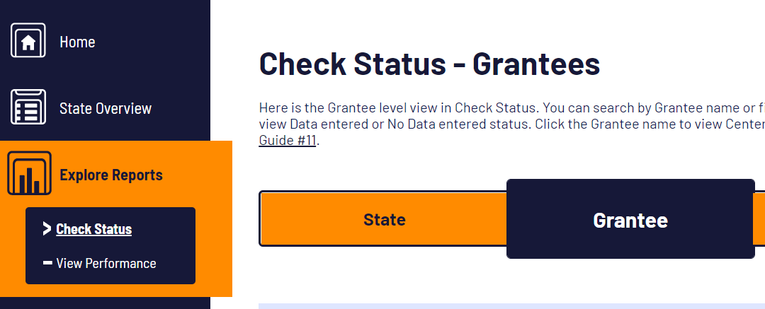
APR- (Annual Performance Report- our Federal Data Collection System
Grantees are required to provide data into this federal monitoring system for afterschool programs. The Iowa Dept. of Education Monitors your progress.
20 U.S.C. 1221e–3, 3474, and 6511(a)) | A State and a sub-grantee shall keep records to show its compliance with program requirements.

Slide 36
Timeline of major data reporting:
If you are funded, you will need to enter data into an online system starting in year 2 –we report 1 year behind.
YEAR 1- No Local Evaluation –
YEAR 2- First Local Evaluation Due- APR data
YEAR 3- Second Local Evaluation Due- APR data
YEAR 4- Third Local Evaluation – APR data
YEAR 5- Fourth Local Evaluation- APR data
YEAR 6- Fifth local evaluation- APR data
Plan on providing 5 years of data for 5 years of funding.

Slide 37
Local and State evaluations
EDGAR 76.591 Federal evaluation—cooperation by a grantee.
A grantee shall cooperate in any evaluation of the program by the Secretary. (Authority: 20 U.S.C. 1221e–3, 1226c, 1231a, 3474, and 6511(a))

Slide 38
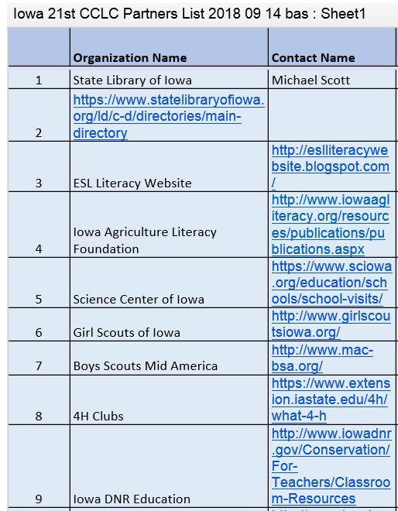
PARTNERS ARE REQUIRED:
You MUST have a minimum of five partners to apply (documented with an MOU).
In 2019 we had a list of 674 Community partners online to share.
The SEA provided a list of 36 statewide partners.
https://www.iowa21cclc.com/21cclc-partners
We also provide a list of 756 libraries in Iowa for a total of 1,330 partners around Iowa. You can contact five or more to be eligible for this grant.

Slide 39
Literacy Resources: Reading is our priority.
Iowa Directory of Libraries (lists libraries around Iowa)
http://www.statelibraryofiowa.org/ld/c-d/directories/main-directory
The Iowa Agriculture Literacy Foundation also has resources to share with programs. http://www.iowaagliteracy.org/
The Iowa Reading Resource Center has resources for families and educators as well as literacy research. https://iowareadingresearch.org/resources
Iowa Authors who do programs in Schools- https://www.iowacenterforthebook.org/authors/authors-that-do-programs/childrens-authors-that-do-programs
Visiting Author Kurt Wagner- https://www.anthonythemouse.com/

Slide 40
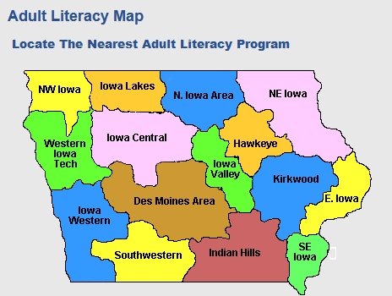
21st Century Statewide Partnerships
IOWA COMMUNITY COLLEGES- THERE IS ONE NEAR YOU

Slide 41

21st Century Statewide Partnerships
Need help with Literacy?
Consider a partnership with your local library.
The IOWA LIBRARY DIRECTORY
lists 756 libraries around the state.
https://silo.knack.com/directory

Slide 42
Required Annual List of Partners
ESSA 4203 (I) Providing a list of prescreened external organizations, as described under section 4203(a)(11).
Each year, grantees will submit a form with new and updated partners.
This list is aggregated into the Iowa list of partners for 21st CCLC and posted online. https://www.iowa21cclc.com/21cclc-partners

Slide 43

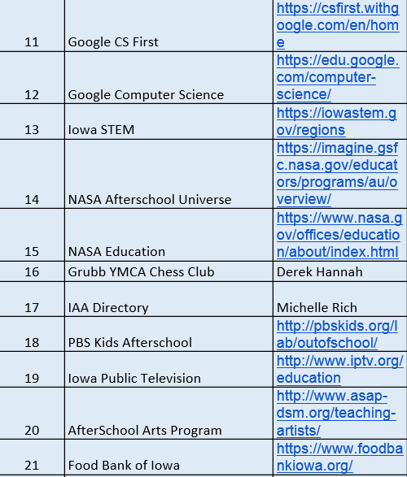
Just a few of the hundreds of partners available on our Iowa Community Partners List:
All of these partners have been working with a 21st Century Community Learning Centers program.
Note: you will be required to submit your partner list annually.

Slide 44
PERCENTAGES in Budget
Evaluation- Up to 4%
Professional Development- Minimum of 5%
Administration – Up to 8% (This includes any indirect costs)
Transportation – Up to 8%
Other line item categories are up to you.
Supplies, Personnel, are up to you
LINE ITEM transfers are allowed each quarter- However, they must be approved by the IDOE.

Slide 45
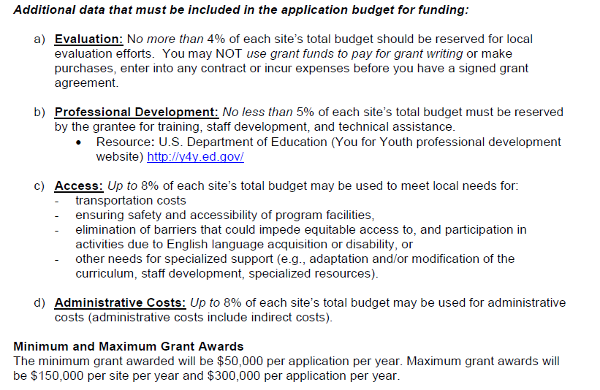
Watch the percentages:

Slide 46
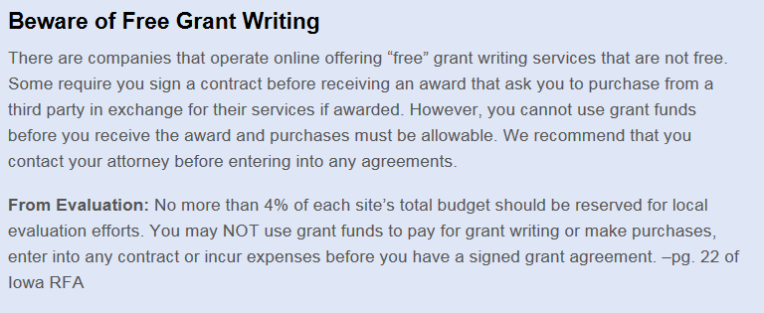
Watch for required percentages in your budget
up to 4% for local evaluation
A warning on the website- Most of these online “free grant writing” places charge between 10-15% for evaluation and up to 30% of your grant for their “free” writing services.

Slide 47
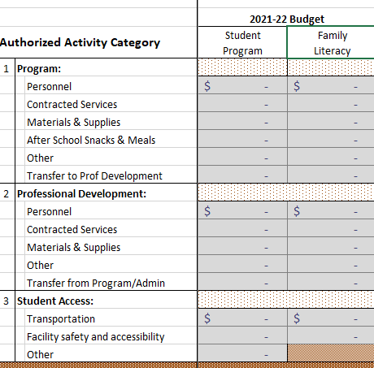
Each Quarter you will upload your budget spreadsheet and general ledger into the CASA online system.
Professional Development- Minimum of 5%
Transportation up to 8%

Slide 48
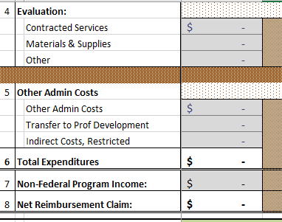
Budget Categories
Evaluation- Up to 4%
Admin- Up to 8%
Fees are reported here as program income

Slide 49

Monitoring of the program
Site monitoring tool that is aligned with the Elementary Secondary Education Act statutes for 21st Century and provides Risk Assessment compliance.
Comprehensive monitoring tool collects data from 4 meetings where all stakeholders have input into program performance. This is a 3 year check and provides Risk Assessment compliance.
NOTE-PROGRAMS THAT CHARGE FEES REQUIRE ADDITIONAL ANNUAL MONITORING

Slide 50
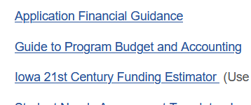
Resources to help you plan your application:
There is a spread sheet titled “Funding Estimator,” which you should download and use to help you calculate your award request. It will allow you to make sure that your request is not too high or too low
This is a Tool to help you- not a per diem. Each grant request is unique based on additional contributions like community partners and district funds.

Slide 51
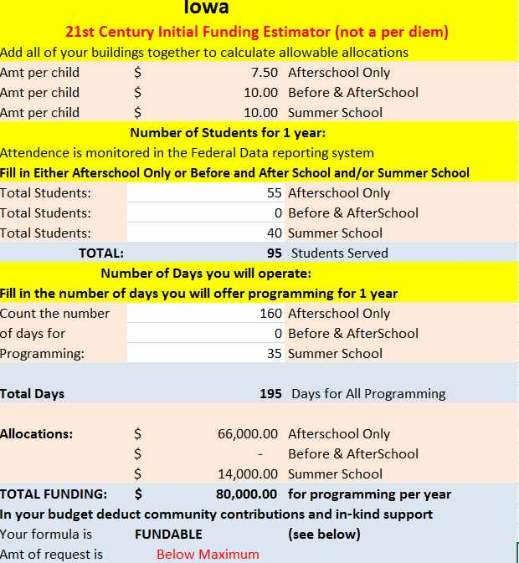
Funding Estimator
This spreadsheet can help see if your base award is fundable. This is a tool to help you ESTIMATE It is NOT a per diem or guarantee of funding
Input your projected number of students for each type of program you will offer, then Input the number of days your will provide service
Note: You MUST include your Community Partner contributions (Deduct from the award requested as evidence of sustainability).

Slide 52
Required non-public school Consultation
Grantees must consult with private and non-public school officials during the design and development of the 21CCLC program on issues such as how the children's needs will be identified and what services will be offered. Services and benefits provided to private school students must be secular, neutral, and non-ideological.
The required form included - it MUST be completed for your proposal to be funded.
This is a statutory requirement of the grant- you MUST include this completed form to be eligible for this competition. Include the outcome of your consultation.

Slide 53
Private School Consultation Rules
A sub-grantee shall provide students enrolled in private schools with a genuine opportunity for equitable participation in accordance with the requirements in §§76.652-76.662 (EDGAR) and in the authorizing statute and implementing regulations for a program.
76.652 Consultation with representatives of private school students.
(a) An applicant for a sub-grant shall consult with appropriate representatives of students enrolled in private schools during all phases of the development and design of the project covered by the application, including consideration of:
(1) Which children will receive benefits under the project;-how many?
(2) How the children's needs will be identified;
(3) What benefits will be provided;
(4) How the benefits will be provided; and
(5) How the project will be evaluated.

Slide 54
Private School Consultation Rules
76.653 Needs, number of students, and types of services.
76.654 Benefits for private school students.
(a) Comparable benefits. The program benefits that a subgrantee provides for students enrolled in private schools must be comparable in quality, scope, and opportunity for participation to the program benefits that the subgrantee provides for students enrolled in public schools.
(b) Same benefits. If a sub-grantee uses funds under a program for public school students in a particular attendance area, or grade or age level, the subgrantee shall insure equitable opportunities for participation by students enrolled in private schools who: (are free and reduced lunch students)
(1) Have the same needs as the public school students to be served; and
(2) Are in that group, attendance area, or age or grade level.
(c) Different benefits. If the needs of students enrolled in private schools are different from the needs of students enrolled in public schools, a sub-grantee shall provide program benefits for the private school students that are different from the benefits the sub-grantee provides for the public school students.

Slide 55

Private School Consultation
Grantees must consult with private and non-public school officials during the design and development of the 21CCLC program on issues such as how the children's needs will be identified and what services will be offered.
Your Consultation form should be completed in September or October NOT December.
  We have included a Consultation Form and instructions to help you with this requirement.
Every Year a non-public school may opt to participate the following year in this program. This notice is provided in the CASA system.

Slide 56
Edgar 76.652
Consultation with representatives of private school students.
(a) An applicant for a subgrant shall consult with appropriate representatives of students enrolled in private schools during all phases of the development and design of the project covered by the application, including consideration of:
(1) Which children will receive benefits under the project; (2) How the children's needs will be identified;
(3) What benefits will be provided;
(4) How the benefits will be provided; and
(5) How the project will be evaluated.
(b) A subgrantee shall consult with appropriate representatives of students enrolled in private schools before the subgrantee makes any decision that affects the opportunities of those students to participate in the project.
(c) The applicant or subgrantee shall give the appropriate representatives a genuine opportunity to express their views regarding each matter subject to the consultation requirements in this section.
(Authority: 20 U.S.C. 1221e–3 and 3474)

Slide 57
RFA KEY POINTS:
New Applications: Iowa will offer three-year grant awards. The funding level will remain 100 percent each year of the grant.
Grantees demonstrating sufficient compliance will be eligible for additional funding for two years at 75 percent of the original funding request after a comprehensive site visit in year 3 or 4.
We cannot extend any grant beyond 5 years per statutory limitations. A New application is needed AND MUST DOCUMENT SUSTAINABILITY. Failure to document previous grant work is supplanting.
The statutory limit for funding is 10 years- this is why we require community partnerships.

Slide 58
RFA KEY POINTS:
Site Visit (between year 1-3) paperwork is done by the IDOE (program may need to provide documentation) one site.
Comprehensive Site Visit (during year 3, before year 4-5) paperwork is done by the IDOE (program provides 4 meetings with all stakeholder groups) all sites. Sustainability Plan is reviewed.
The Site and Comprehensive Visit forms are posted with the application, so you know what to expect from a monitoring visit.
The SEA does ongoing RISK ASSESSMENT on EVERYONE. Issues may be revealed at any time.

Slide 59
Required Sustainability:
A previously funded 21st CCLC program whose grant will end before the funding for the new grant begins is eligible to apply for new grant funds.
However, previous grantees must provide evidence of some level of sustainability that will be used in the new application to provide services at a lower cost or serve more children than the previous grant.
FAILURE TO DOCUMENT YOUR PAST GRANT WORK, SUSTAINABILITY OR WRITE YOUR GRANT LIKE YOU NEVER HAD PRIOR FUNDING IS SUPPLANTING.

Slide 60

Partnerships:
Because of the sustainability expectations of the grant, your application should financially reflect the contributions of your community partners.
A jointly submitted application does not automatically qualify as a partnership. An organization contracted to provide services is not considered to be a partner for this purpose.
Will you be my partner?

Slide 61
Partnerships:
To be considered as an eligible partnership, there must be evidence that:
The partnership includes at least one Local Education Agency (LEA) or school district (with only designated high-poverty, Title I schools) and at least one community-based organization that is not primarily an entity contracted to provide services to the project.
YES, you CAN use Vendors. But, do
NOT call the partners.
IF YOU MISREPRESENT A VENDOR (WHO IS PAID) AS A PARTNER (WHO CONTRIBUTES )
YOU MAY BE SUPPLANTING AT THE LEAST OR ENGAGED IN FEDERAL FRAUD AT THE WORST.

Slide 62

Partnerships:
The school district administration and at least one community-based organization collaborated extensively in the planning and design of the program.
Each partner organization has substantial roles to play in the implementation of the program; delivery of services, program evaluation, and program improvement plans over the duration of the project. Vendors just show up to get paid.

Slide 63

Partnerships and your budget:
The Memorandum of Understanding (MOU) identifies all partner obligations and contributions for cash, direct service, or in-kind, as well as roles and responsibilities for oversight supervision and management of the project.
  TIP: Your EVIDENCE of support from your partners should show up in your budget narrative, as in-kind contributions.
FORM D3- which is a 5 year budget to help you include partner contributions.

Slide 64
Community College Partnerships:
Adult Literacy Partnerships- Many Community Colleges in Iowa offer FREE adult literacy and HiSET (formerly called GED) preparation. We encourage all grantees to partner with their regional colleges to support adult literacy.
The 21st Century grant is not a HiSET program. A list of Iowa Community Colleges is provided in the application. See Appendix G for more details.
We have added a Family Engagement Committee to strengthen our partnership with families of the children we serve.
Colleges would love to partner with your program. You can also ask about college students who might help out as staff

Slide 65
Supplement and NOT supplant:
Evidence of supplanting can render the best application un-fundable.
Failing to document previous experience and how community partners will sustain some of your program is supplanting.
If you have questions about supplanting- email vic.jaras@iowa.gov before you submit your application.

Slide 66
The Supplement, Not Supplant Tests:
When determining whether a fiscal expenditure supplements and not supplants, school districts must run these three tests.
Test I: Required – Is the program or activity that the district wants to fund required under state, local, or another federal law? If it is, then it is supplanting.
Test II: Equivalency – Were state or local funds used in the past to pay for this program or activity? If they were, it is supplanting.
Test III: Non-Title Programs – Are the same programs or activities being implemented in other schools that do not receive Title funds AND are these programs and activities being paid for with state or local funds? If yes, then this is supplanting.
You cannot use federal funds to backfill – that is supplanting
If an expenditure does not pass any of the above tests, then it is presumed that Title funds are supplanting state or local funds. Expenditures must pass all three tests to truly be supplemental.
Source: http://www.isbe.state.il.us/e-bulletins/pdf/02-09.pdf

Slide 67
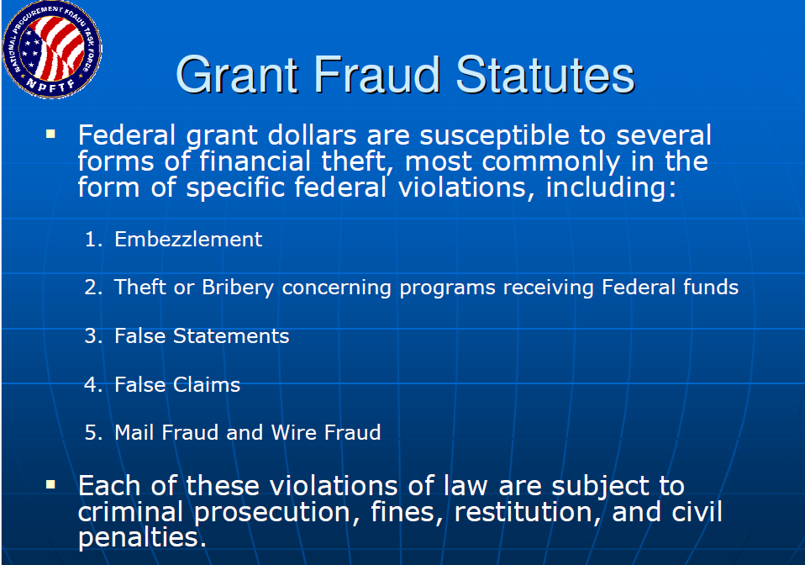

Slide 68
The Office of the Inspector General defines grant fraud as:
Falsifying information in grant applications or contract proposals
Using Federal funds to purchase items that are not for Government use
Billing more than one grant or contract for the same work
Billing for expenses not incurred as part of the grant or contract
Billing for work that was never performed
Falsifying test results or other data
Substituting approved materials with unauthorized products
Misrepresenting a project’s status to continue receiving government funds

Slide 69
EXAMPLES OF FRAUD:
Example- Your grant application reported there were no non-public schools within your school boundary. However, a check showed a non-public school a block away. No Consultation was made and false information was provided in your application.
Example- Your grant application was to provide adult literacy services in cooperation with a local community college. However, you billed the grant for the same services that the college provided with another federal grant at the same time.
Example- A program bills for expenses to repair a copy machine. The copy machine was purchased with other funds. This expense was not incurred as part of the grant.
Example- Your grant application reported serving 400 children. You fail to report an attendance problem to your SEA for technical assistance. You actually only serve 100 children. False information is provided in attendance monitoring that misrepresents your project status to continue funding.

Slide 70
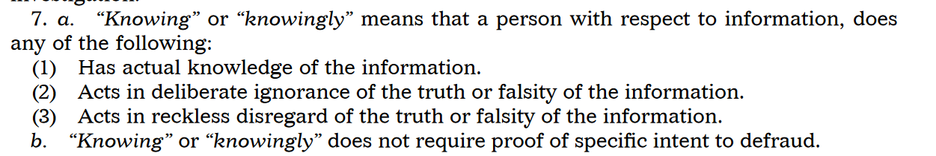
IOWA CODE CHAPTER 685 FALSE CLAIMS
enacted in 2010, it is also one of the stronger false claims laws in the country. The Act, located in Iowa Code §685.1, is similar to the Federal Law
PROVIDING FALSE STATEMENTS CAN LEAD TO AN INVESTIGATION BY THE IOWA STATE AUDITOR

Slide 71
NON-COMPLIANCE ISSUES:
99% RESOLVED WITHIN 5 DAYS VIA EMAIL OR PHONE
Not Resolved? You have 30 days to resolve informally with Consultant
AFTER 30 DAYS- the issue becomes formal and is reported to the Compliance Officer at the IDOE and to the Program Officer at the USDOE
WE BEGIN FORMAL PROCEDURES TO DETAIL FINDINGS (this can take months and during this time, my communication with you is limited)
NON COMPLIANCE AREAS ARE IDENTIFIED AND FINANCES ARE EXAMINED.
GRANTS MAY BE REDUCED OR TERMINATED BASED ON FINDINGS.

Slide 72
What is expected of you?
Serve the needs of children – a quality program will:
Increase attendance, Reduce Referrals to the office, Improve reading and math results.
Become a MODEL of afterschool programming that we can communicate
Maintain a webpage that: Communicates your evaluation with your community and showcases the best practices you develop
Develop and cultivate community partnerships to sustain this program after federal funding expires. Community Partnerships are much better than fees to provide long term sustainability.

Slide 73
What is expected of you?
Serve the needs of children
Monitor your program attendance- report it quarterly
Review your Budgets Monthly
Submit quarterly claims
Manage your budget – Get approvals for line item adjustments
Two Financial Deadlines:
State Fiscal Year (ending June 30th) claims are due by July 15th.
Federal Grant Year (July, Aug, Sept expenses) due by October 30th for expenses up to Sept 30th.

Slide 74
Budget Tips:
We have a spreadsheet to assist you in calculating your funding request based upon the number of students you will serve.
Do NOT simply ask for the maximum award size without the numbers of children to justify that size of award.
Pay attention to the allowable percentages in the budget.
Make sure to document any in-kind contributions in your budget narrative.
We expect you to spend 100% of your annual award
We require that expenses be submitted before July 15 (for the previous fiscal year. State of Iowa deadline.
We require that you submit July, August September expenses before October 30 (for the Sept 30th federal grant deadline).

Slide 75
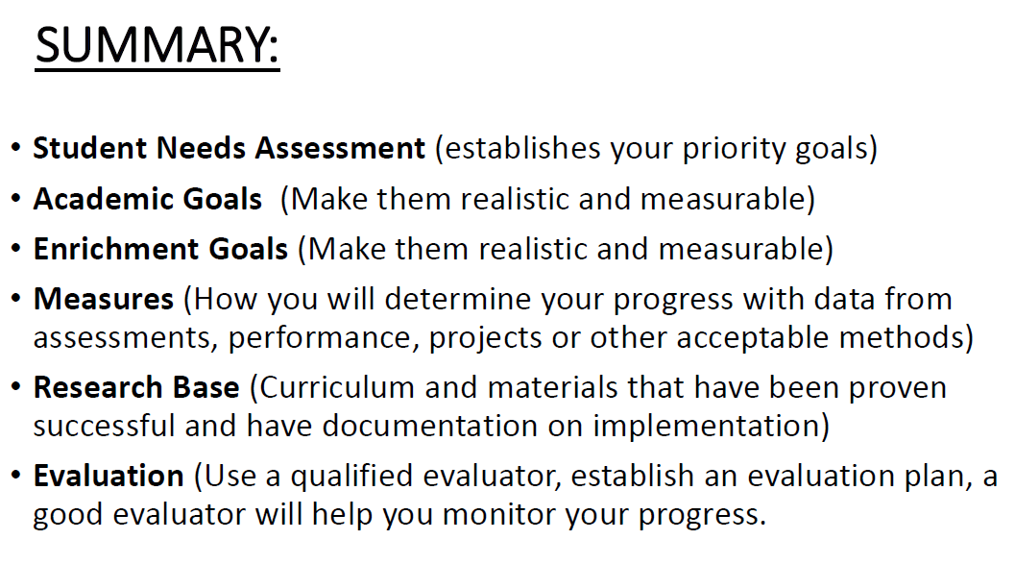
Note: The 4% limit on evaluation would provide $6,000 a year for a $150,000 award

Slide 76


TIPS FOR SUCCESS:
Do not provide false or misleading information in your application.
Have someone outside your organization read your application before you submit it.
Document the needs your children have using data.
Check your budget and numbers for accuracy.
Do not go over the page limits.

Slide 77
Where Points are lost…
Abstract- Not Scored
Student Needs Assessment- 20 points
Project Narrative- 24 points
Research Base -5 points
Management Plan- 20 points
Communication Plan- 5 points
Partnerships -10 points
Evaluation Plan- 10 points
Budget Narrative- 10 points
Every year, I receive emails and calls about 5 bonus points, but few questions about the 20 point sections

Slide 78
Requirements we expect:
Participation in one committee for each cohort you have funding. Attend Professional Development sessions.
Evaluation/ Sustainability Committee- Insight and support on local evaluation, data and sustainability.
PD/ Conference Committee- Input and planning for annual state conference, regional PD and other PD events
Support Committee-Input on best practices and support needed by grantees to support at-risk children
Communications Committee- Input on best practices with communication about programs to all stakeholders
Family Engagement Committee-Input on best practices with family engagement and community college partnerships
These committees are a community of practice where grantees can share best practices and collaborate

Slide 79
Program Attendance Requirements
You set the initial amount of attendance in your application.
We require you to meet 70% of your attendance numbers by the end of year one.
We require you to meet 80% of your attendance numbers by year three.
Failure to meet your attendance numbers will result in your award being reduced in the next fiscal year.
Quality programs have no problem exceeding the numbers in their application.

Slide 80
QUESTIONS?
Contact:
Vic Jaras
Iowa Department of Education
Bureau of School Improvement
vic.jaras@iowa.gov
515-242-6354 office 515-402-2729 cell

