Slide 1
INTEGRATED (Evidence-based) BEST PRACTICES II
Presented by Theresa Slaughter, literacy enrichment coach
Literacy enrichment pd
February 10, 2022
In collaboration with SPPG, & Dept. of Education (21 CCLC)

Slide 2
AS YOU JOIN…
In the Chat Box tell us:
Name, Organization,
An activity you like to do in the Spring.

Slide 3
HOUSE KEEPING
Encourage participation (camera, chat box, discussions)
Add your name (this makes it more personal and easier to interact)
Utilize the chat box (to connect with others or ask questions)
Need to step away momentarily? Use the toolbar to turn off video/sound

Slide 4
Mark your calendars: upcoming literacy enrichment session 5 (3/3) session 6 (4/14)

Slide 5
EVIDENCE-BASED PRACTICEs
What is Evidence-Based Practice? -- supported by extensive research -- works on a large scale -- practices can be used on various “disciplines”
Benefits of Evidence-Based Practice -- priority of setting goals -- invested time → maximum growth and progress -- high-level of support from ALL stakeholders involved
Various ways to incorporate practices within programming -- Embedded Instruction -- Differentiated Learning -- Structured Lessons -- Checking for Understanding (Comprehensive Questioning) -- Group Work (Cooperative Learning)

Slide 6
Evidence based practices (cont.)
Checking for Understanding (Comprehensive Questioning) -- a process allowing for review of learned knowledge and/or skills -- reflective questioning and/or reading questions
Helps us to gauge understanding…before moving on; let’s us know if we’ve met our purpose; guides instruction (“refine, improve, and strengthen”)
discussions (guided), journal writing, connection activities -- observational interactions
Group Work (Cooperative Learning) -- highly intentional, task oriented activities -- partners and/or small groups -- assigned roles/responsibilities
Encourages active learning, problem solving, practice of SEL competencies
Mini-projects; connection activities in reading, writing, discussion

Slide 7
Evidence based practice (cont.)
Structured Lessons -- intentional planning → clear and concise purpose -- answers the question…what do we want kids to Know, Understand, and Do. -- aides in practicing “mastery learning”
Offers a structure for high-quality lessons/activities -- provides a guide to what is needed to accomplish the lesson and staying on purpose -- written in a way that creates a flow of fluidity -- used as a reference point in addressing key knowledge/skills
Displays of confident among staff in implementation; increase of materials in lessons/activities; connection activities in reading, writing, and discussion
Examples – tell a story, readers society, black history

Slide 8
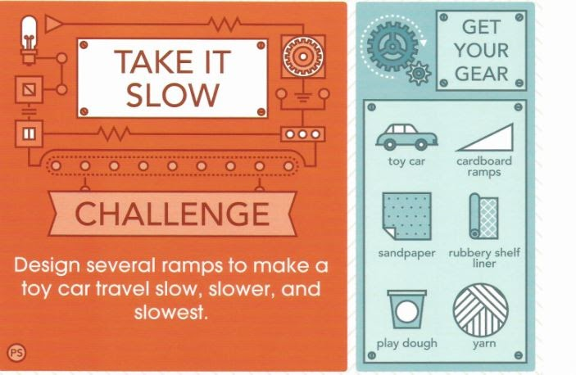
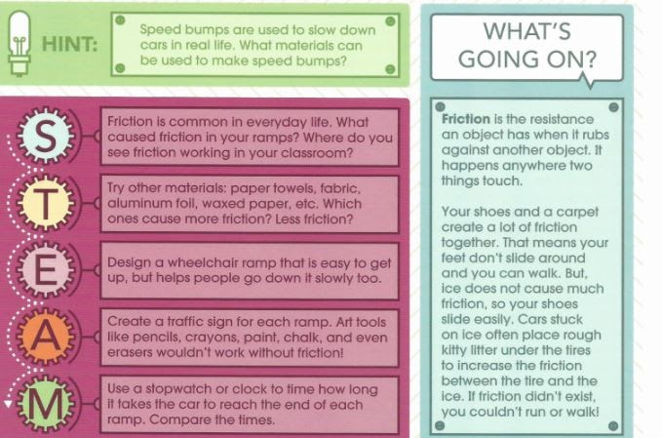
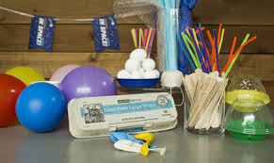
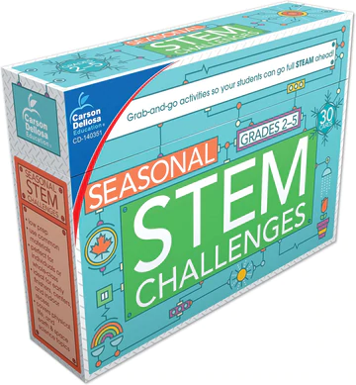
Stem activities
Egg Drop, group work - Using the materials provided, design a device to keep an egg from breaking when dropped from a high place.
Materials: variety
Assigned Roles: material getter, record/time keeper, spokesperson, etc.
STEM Challenges in a Box

Slide 9
Literacy activity
Reading Circles – reading and discussion a shared book over an extended period of time; assigned instructional roles -- For example, discussion director, recorder/time keeper, presenter, etc. -- comprehension questions to probe for understanding of reading -- may be accompanied with mini-activities and/or projects
Reader’s Theater – reading from an already made script or turning a story into play; assigning “theater” roles -- role assignments – director, actors/actresses, costume designer, props designer -- incorporating time for kids to reflect on experience(s) (writing, discussions)

Slide 10
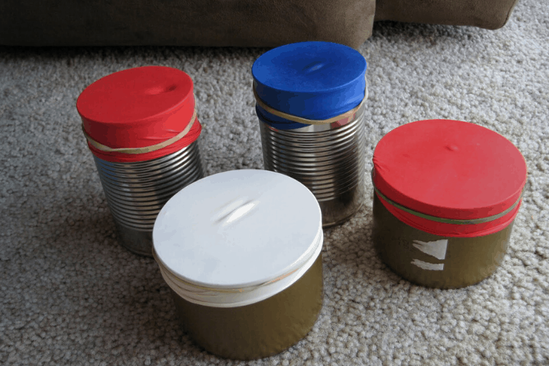
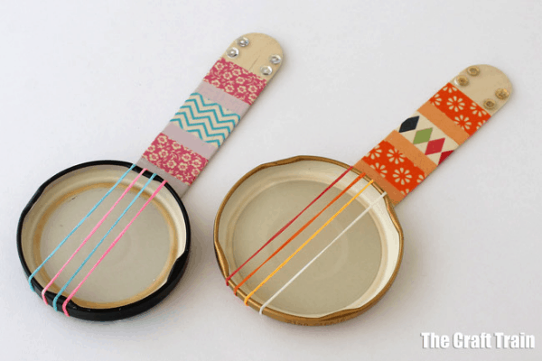
I got the rhythm By Connie Schofield-Morrison Illustrated By Frank Morrison
Read Aloud, checking for understanding -- What do you think this story is about? -- What sounds did you see in the story? -- How do you think the rhythm made her feel? -- When you hear rhythm, how does it make you feel? -- Rhythm is…
STEM activity -- balloon drum -- mini lid banjo

Slide 11
JUST FOR FUN NAME THAT MOVIE
Music sometimes makes the movie.
Rose Royce
Steve Miller Band
Lynyrd Skynyrd
Bee Gees
Katrina & the Waves
Tom Cochrane
Earth, Wind & Fire

