Slide 1
Chess!
I left Chess Club Early this week.
I was just so board.

Slide 2
Benefits of Chess in Afterschool:
Helps build student’s logic, memory and pattern recognition.
Improve problem solving and critical thinking.
Improves math and reading skills.
Boosts memory and retention.

Slide 3
If you forget the rules of chess, don’t worry.
You’re allowed to check.☺

Slide 4
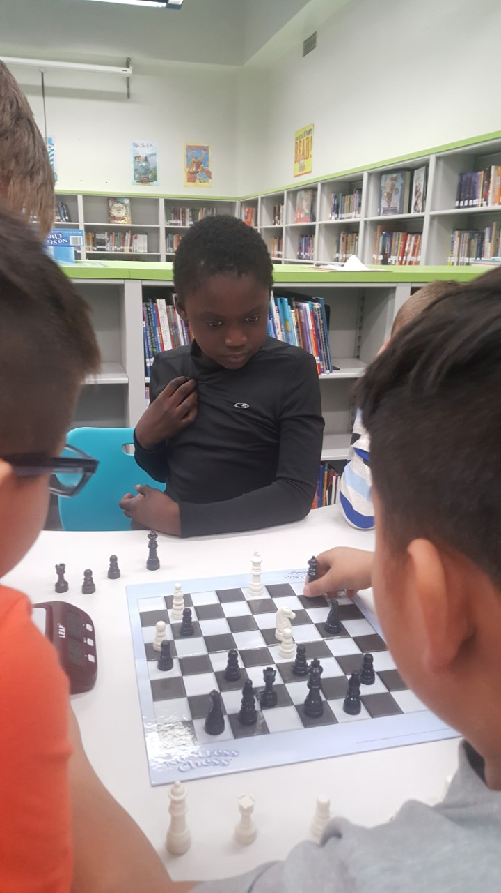
DMPS 21CCLC Chess Clubs
Who participates?
What resources/materials are used?

Slide 5
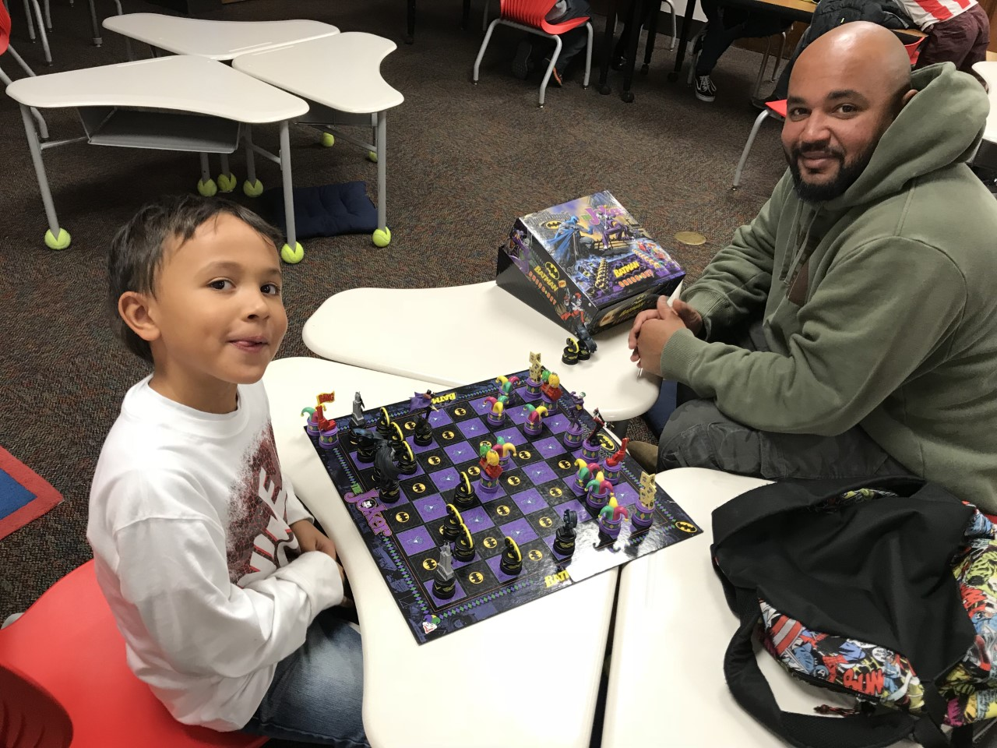
DMPS 21CCLC cHess Clubs
But I don’t know how to play chess!
-
But no one else wants to teach chess!
-

Slide 6
I have a friend In prague I like to play chess with.
He’s my Czech mate. ☺

Slide 7
Chess Exercises both sides of the brain

Slide 8
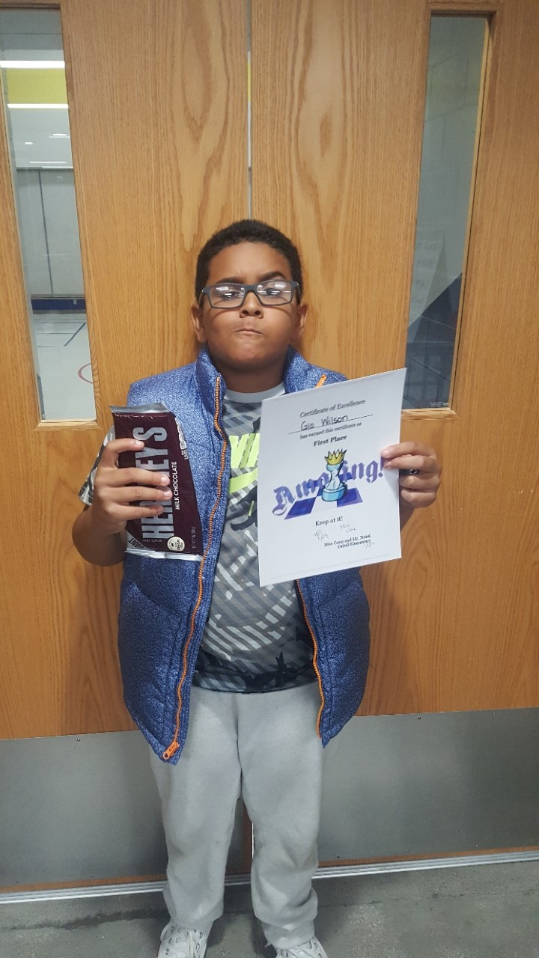
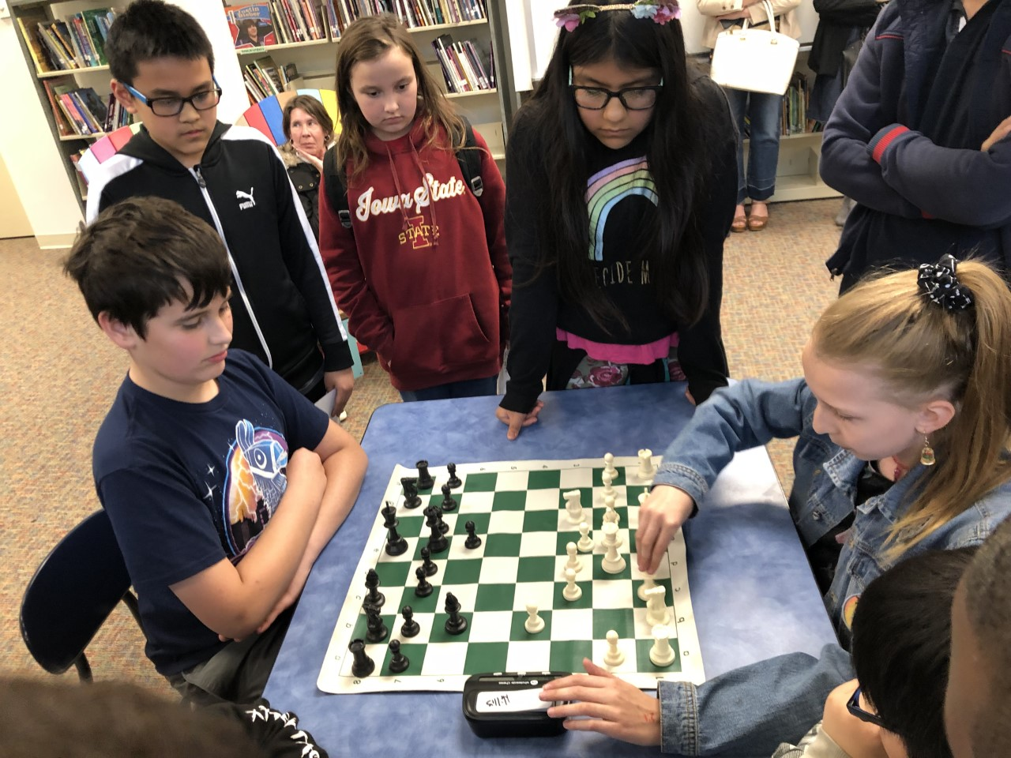
Win with humility
Lose with Dignity
Learning to lose can be tough.
Chess encourages good sportsmanship and helps kids learn that win or lose, it’s always fun to play with friends.

Slide 9
I wanted to learn the history of chess.
Turns out is has a checkered past ☺

Slide 10
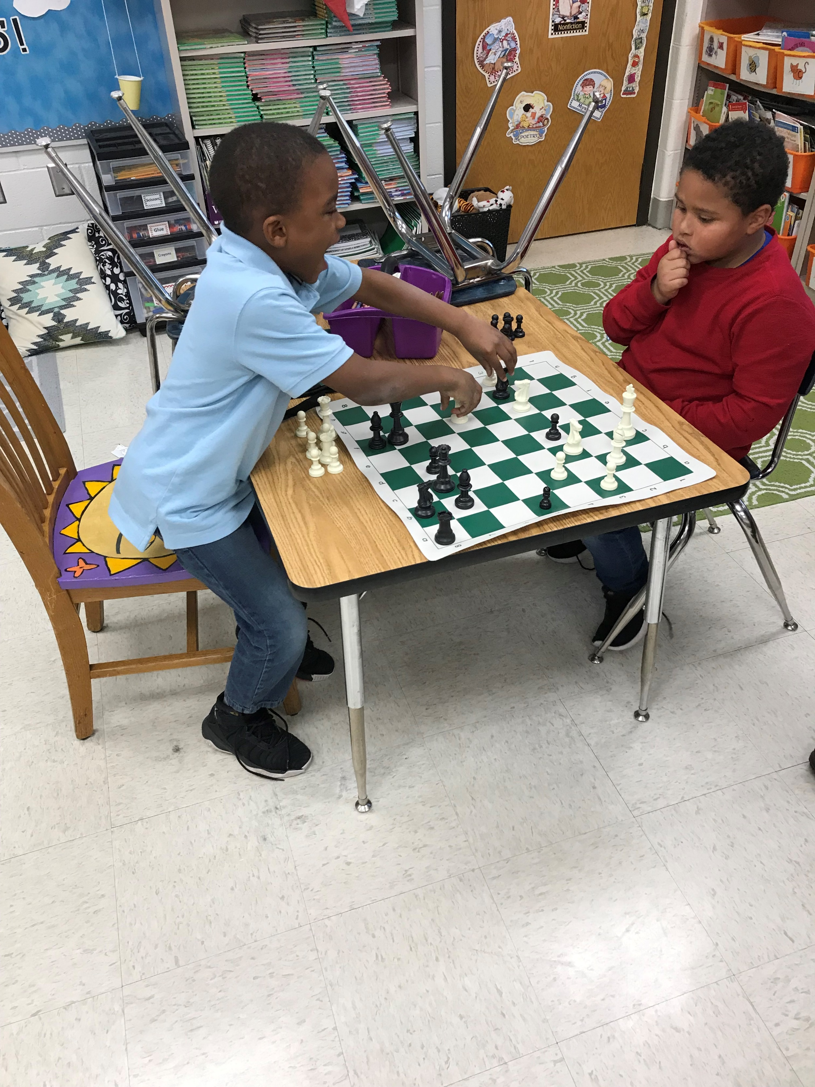
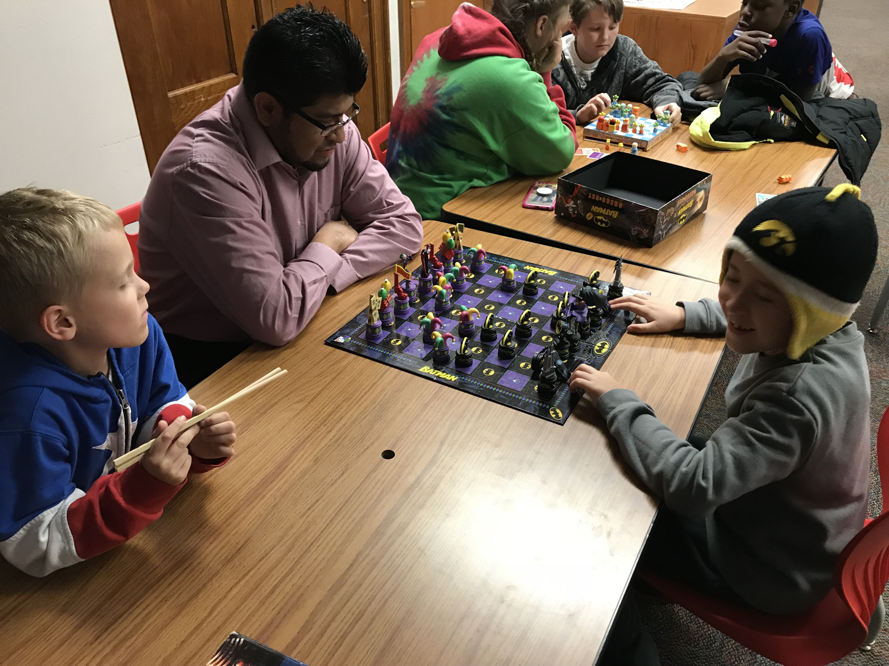
Family chess night

Slide 12
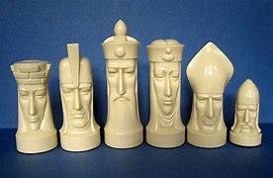
I was asked if my 21CCLC program had a chess club. I said let me check, Mate.

Slide 13
Thank you!

