Slide 1
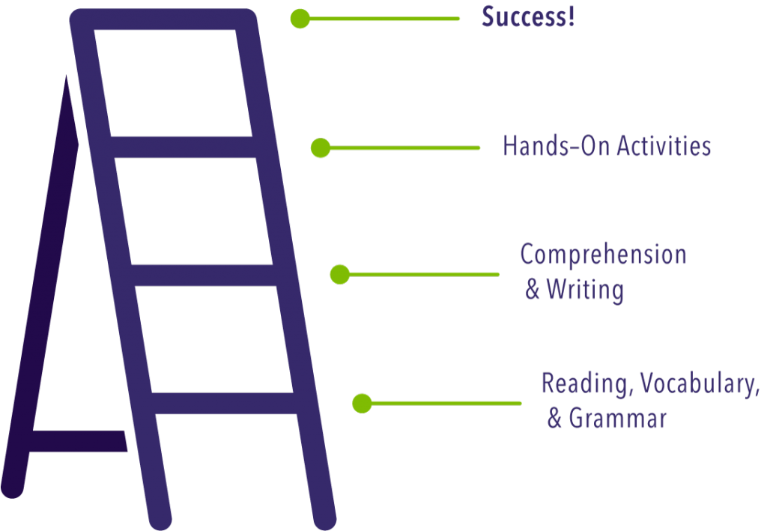
LITERACY ENRICHMENT
ACTIVITY TIME
Created and compiled by
Theresa Slaughter, Literacy Enrichment Coach

Slide 2
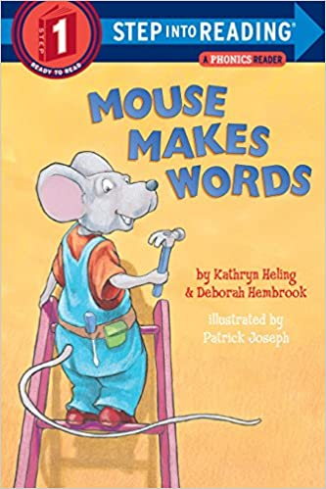
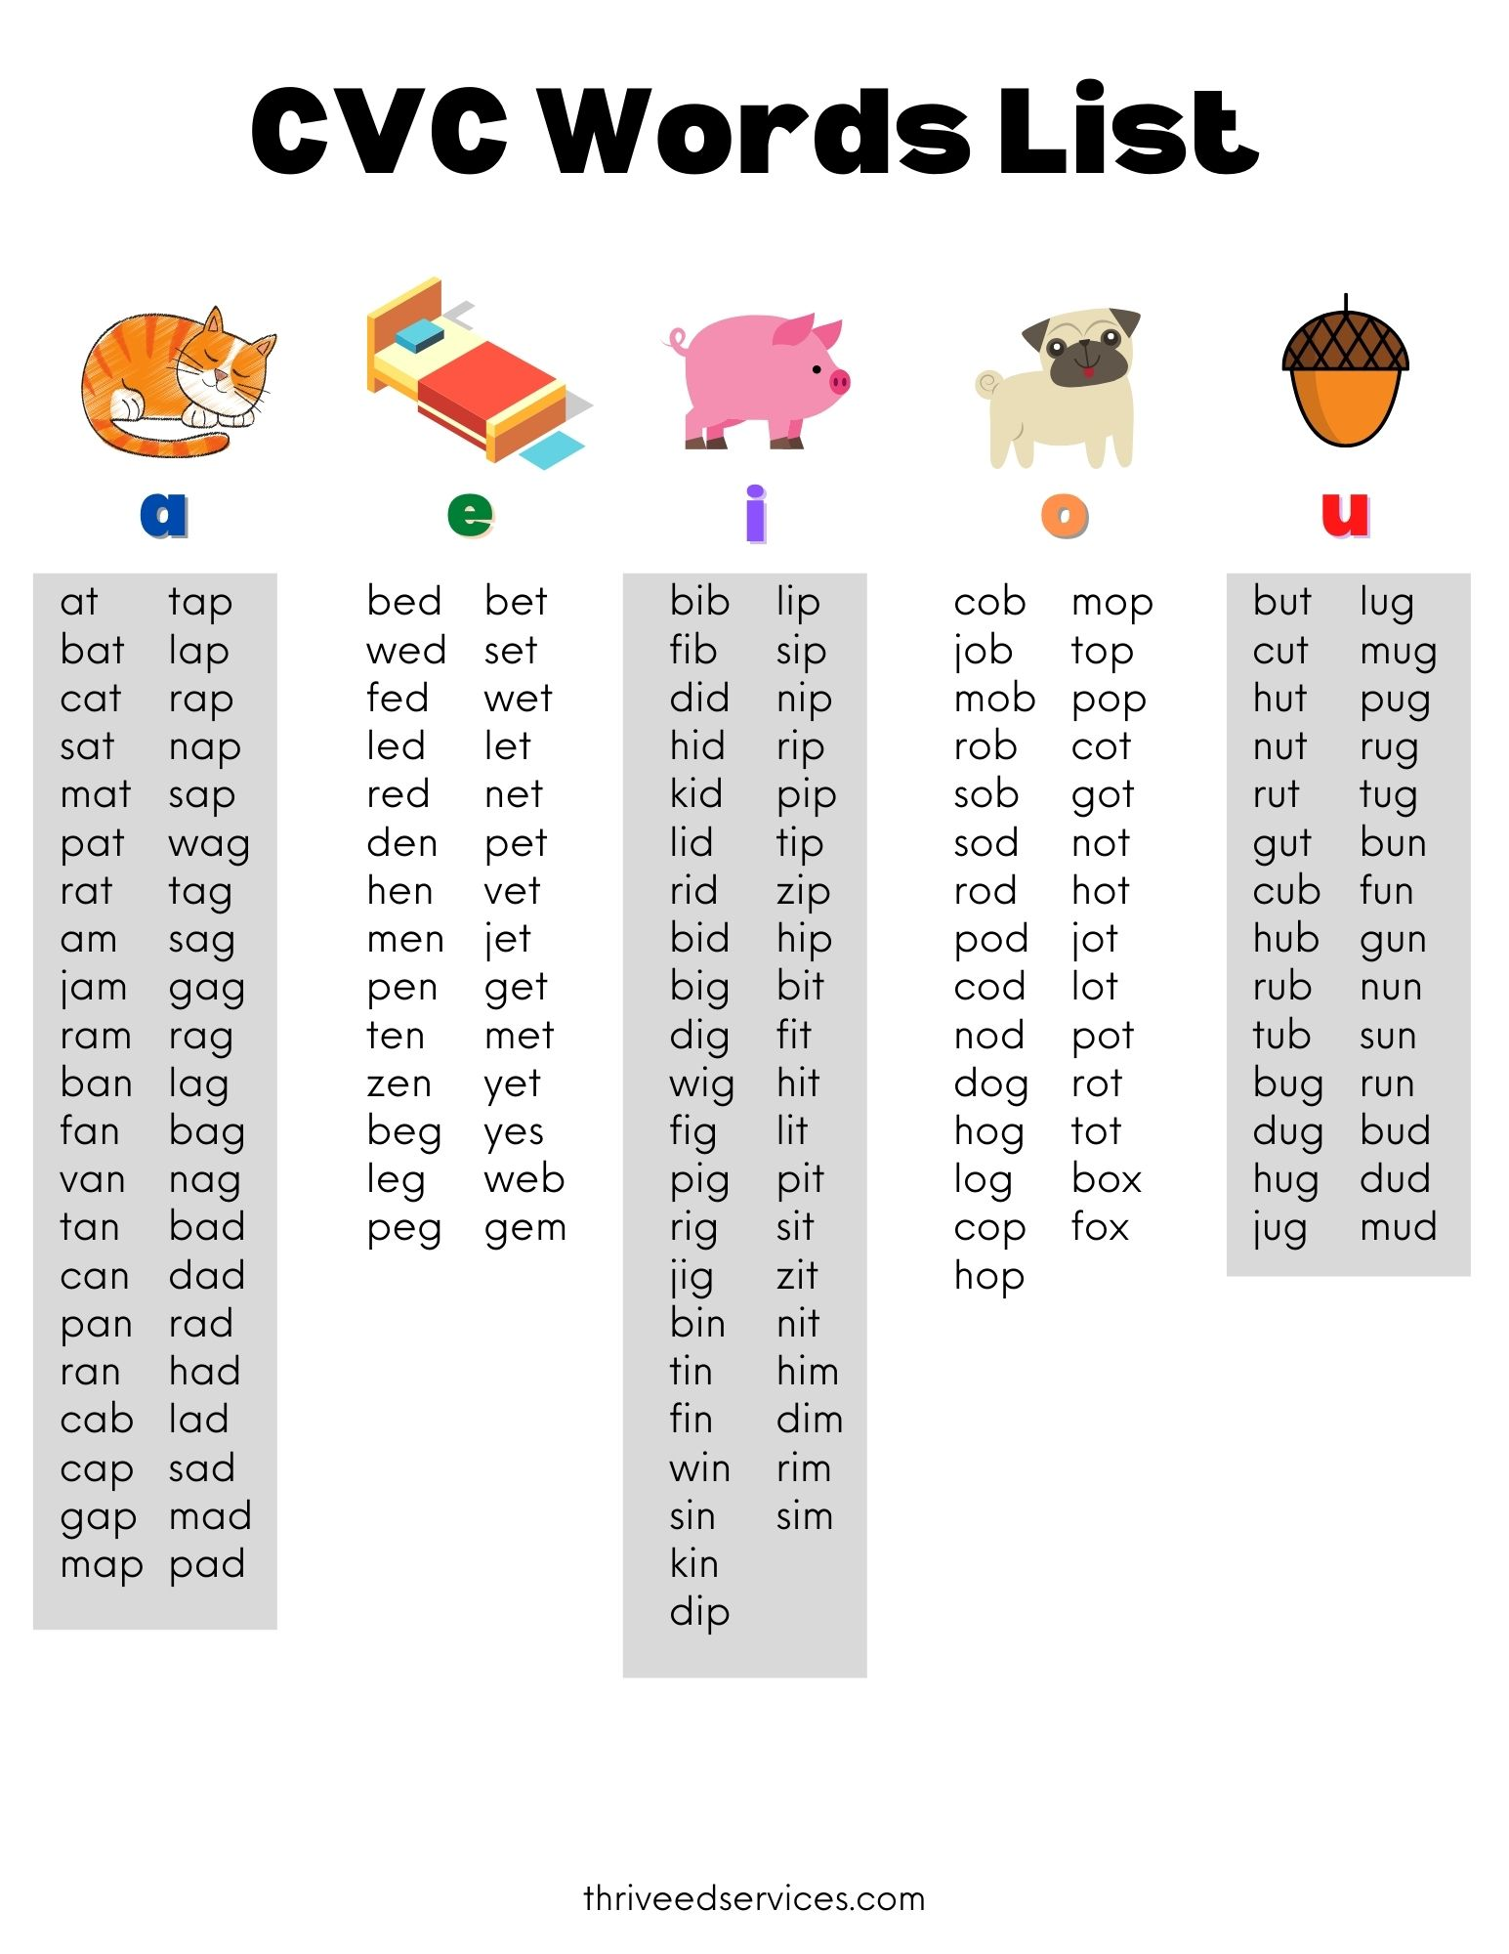
Mouse Makes Words By Kathryn Heling & Deborah Hembrook
Once done with the story, staff may continue the rhyming game using the additional words on the back OR have the kids come up with their own words.
Alternate rhyming word list CVC (consonant-vowel-consonant) short/long vowel sounds
Focus: Kids will be able to identify and formulate 3-letter rhyming words and make sound substitutions.
Directions - Pass out to each individual kid a set of alphabet letters (A-Z). - Instruct kids that this pile will be used to make rhyming words as you read the story.
Before you read – talk about the title. Ask kids, what do you think this story is about?
While reading -- have kids find and spell out the words using their letters. Give them time to do this assisting when necessary. Once kids have spelled out the second word allow for them to say the word.

Slide 3
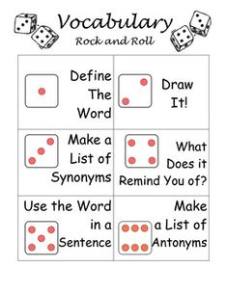
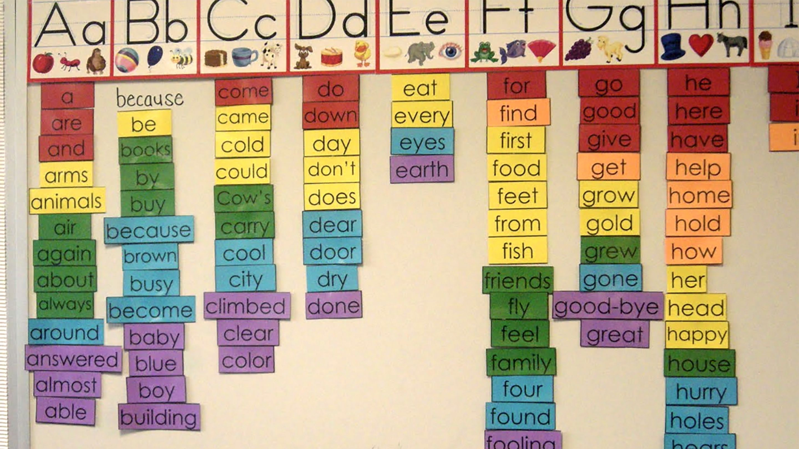
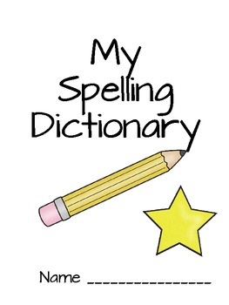
Alphabet Game
Grades: 3-8; K-2 w/modifications
Ways to play: - individual, partners, group (classroom)
Directions: - Pick a letter (A-Z) to reveal the letter that the words must begin with. - Kids will write down at least 5 words; 7 words for older/advanced groups -You may selectively go around the group and have them read some of their answers.
Selective “words” can be turned into a word walls and vocabulary builders.

Slide 4
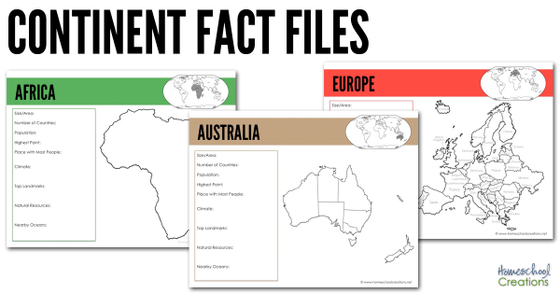
2022 WINTER OLYMPICS Feb 4- 20
Day 1-3 of the Olympics – History of Olympics (6+ facts about the Olympics) -- 5 rings – symbol 5 continents -- 5+1 colors – combined colors of the flags -- Olympic Mascots (2010 – present) https://olympics.com/en/olympic-games/olympic-mascots
Activities: - Olympic Pennant/Flag - Choose 2 mascots to color/draw/trace - Continent Passbook, each color represents a continent* - Torch Run
Take 1-2 days to cover each continent; allowing kids to fill out Continent Passbook and do activities. *Fill out Continent Passbook (location, size, climate, capital)
Discuss facts about the continent
Activities: --- Try a fruit, veggie, or dish from that continent --- learn a new dance, game, and/or language
This Photo by Unknown Author is licensed under CC BY-SA-NC

Slide 5
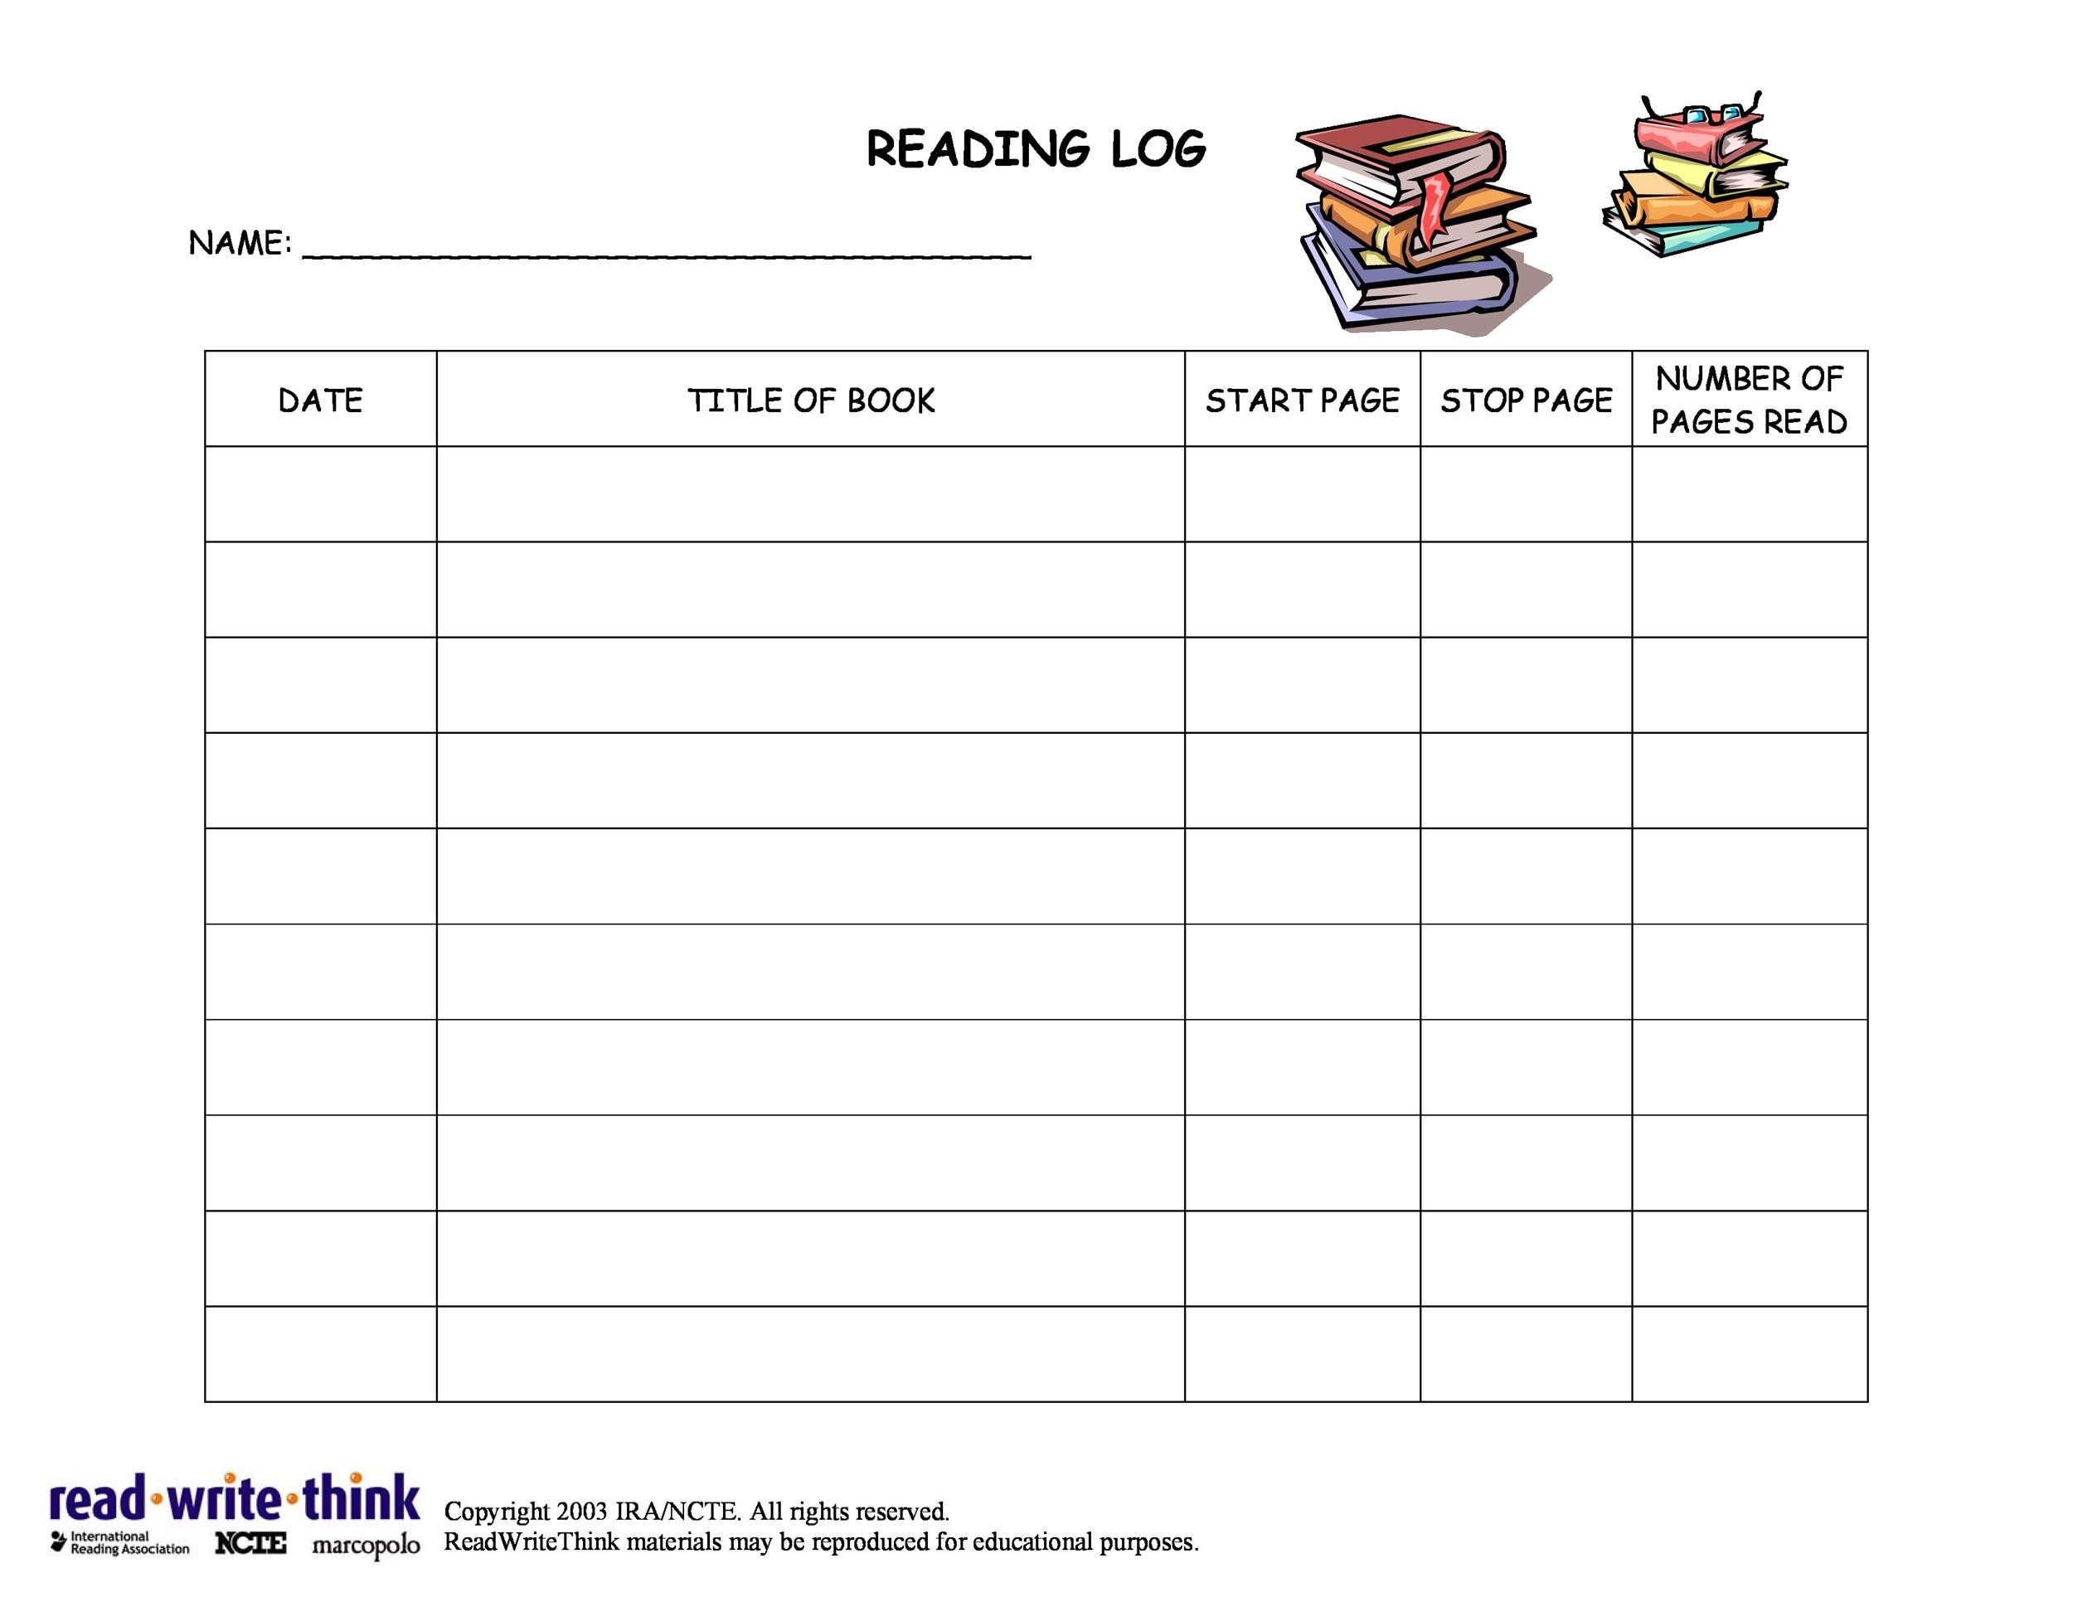
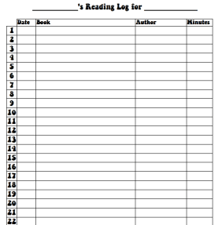
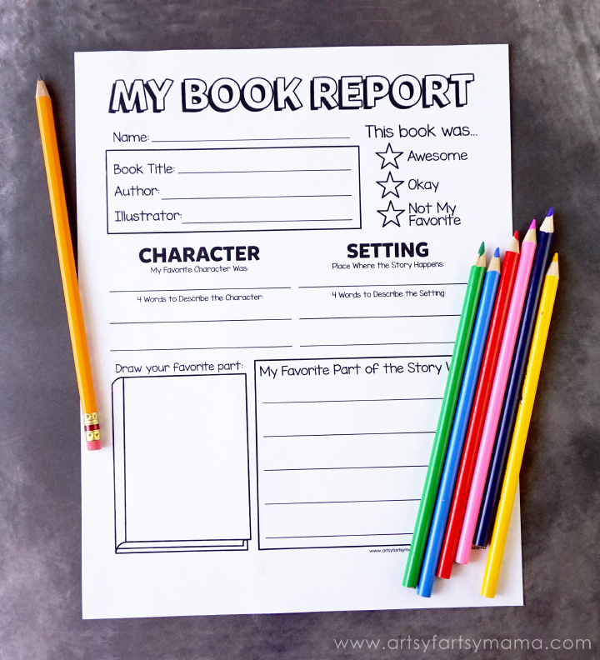
Readers League READ with us and EXPAND YOUR MIND.
Requirements: -- Books must be read within the 4 week time period. Upon completion of requirements, receive a special prize. -- All books will need to be approved by a staff member to make sure that kids are reading at their level. -- Everyone will need to complete a grade-level reading log; provided by staff.
Staff will do periodic checks on participants making sure to
K-1 and 2-3 grades -- read 200+ minutes (Write down the title of the books read and minutes). -- Staff can “selectively” ask comprehensive questions about any of the books read.
4 – 8 grades – read 4-6 books completing a reading log & book report for each book read. (Keep track of the pages you read then do a short report.)

