Slide 1
USDA Afterschool & Summer Meal Programs Bureau of Nutrition and Health Services

Slide 2
Speakers
March 23, 2021
Robin Holz, CACFP Lead Consultant
Deb Linderblood, NSLP Consultant
Stephanie Dross, SFSP Consultant
Bureau of Nutrition and Health Services

Slide 3
USDA Child Nutrition Programs
Child and Adult Care Food Program (CACFP)
National School Lunch Program (NLSP)
Afterschool Snack Program
School Breakfast Program
Special Milk Program
Fruit and Vegetable Program
Summer Food Service Program (SFSP)
USDA Foods (Commodities)
Notes:
The Special Food Service Program for Children was created as an amendment to the NSLA in 1968. Under the umbrella of the Special Food Service Program were two categories – Summer and Child Care. In 1975, the original National School Lunch Act was further amended to establish the two categories as their own separate programs.

Slide 4
Child Nutrition Programs
Authorized by Congress
USDA - Federal
Iowa Department of Education - State
f Bureau of Nutrition and Health Services
Local Organizations in Communities
Child and Adult Care Centers, preschools and Head Starts
Outside School Hours & At-Risk Afterschool Programs
Community Organizations
Schools
Units of local, county, municipal, tribal or State government
Notes:
The Child Nutrition Programs are authorized by congress and are administered at the Federal level by the Food and Nutrition Service (FNS), an agency of the United States Department of Agriculture (USDA).
The Iowa Department of Education administers the CNPs in Iowa.
The following types of organizations are eligible to operate a CNP. These organizations are responsible for overseeing Program operations and receive Federal reimbursement to cover the administrative and operating costs of preparing and serving meals to eligible children.

Slide 5
Topics
USDA Afterschool Programs
Child and Adult Care Food Program (CACFP)
Outside School Hours Childcare
At-Risk Afterschool Meals Program
National School Lunch Program
(NSLP)
Afterschool Care Program (ASCP)
Summer Food Service Program (SFSP)
Questions and Answers

Slide 6
Child and Adult Care Food Program
Goals
Subsidy for serving creditable meals
Promote lifelong healthy eating & physical activity habits
Participant responsibilities
Serve compliant meals
Keep records to support meals claimed
Follow required procedures for use of
Federal funds
Notes:
CACFP started as part of several programs in 1960’s with the summer feeding program
CCFP (Child Care Food Program) became own program
CACFP in Iowa since mid 1970’s
Bureau of Nutrition and Health services
Monitoring programs for compliance with CACFP Regulations
Workshops requirements and successful participation
Outreach
Pass through for CACFP reimbursement to participants
Also responsible for School Lunch, Bft, Summer Feeding, Special Milk Programs, F/V program & Team Nutrition
Funds from USDA – same as WIC, no state dollars for reimbursement or administrative efforts.
Meals must include CACFP required food components using creditable foods in required quantities. Foods must be prepared in a safe and sanitary manner.
Nutrition education to foster good food habits:
Introduce new foods, new methods of preparation
Include a variety of foods
Include fresh fruits and vegetables (2 or more times a week)
Include good food sources of Vitamins A and C, and Iron
Physical activities and healthy foods – aim for a lifetime of good choices.
Encourage use of breast milk for infant feeding
Accuracy of records
Integrity
Viable, capable & accountable with regard to CACFP operation.

Slide 7
Eligible Participants
Infants, ages 0 - 12 months
Children, ages 1 - 12 years (5-12 yr OSHCC)
Disabled, any age
Migrant Children, 0 - 15 years
At-Risk Children, 0 – 18 years, or thru age 19 if still in school (CACFP At-Risk Afterschool Meals Program)
Homeless Children, 0 – 18 years (Emergency Shelters)
Adults, age 60 and over
Notes:
Two age groupings:
Elderly, mentally, neurologically disabled (not discussed today)
Children
Infants until they reach their first birthday.
Transition to older child meal pattern (13 months).
1-12 years
Mentally or physically disabled (no age limit ) if enrolled in child care setting.
Teenagers until they reach their 19 birthday and still in school (at risk programs) (homeless programs).
WIC and CACFP may be serving the same children.

Slide 8
Eligibility for CACFP
Independent or Sponsored
Public organization (school)
Nonprofit organization
For-profit organization (25% low income)
At-Risk Afterschool Programs (area eligible)
Non-residential Program
Licensed by Iowa Department of Human Services or
Child Care or OSHCC in schools (must be licensed)
Child Care Centers (must be licensed)
YMCA programs (may be licensed)
Exempt from Licensing
Boys and Girls Clubs
YMCA programs (may be licensed)
Certain before and afterschool programs
(not in schools)

Slide 9
Outside School Hours Child Care
Serves children before and/or after school
May or may not be licensed
May operate in the summer
Same eligibility as other CACFP centers
Does not have to be area eligible
Meals are claimed based on income level of children (free, reduced-price and paid)
Recordkeeping similar to child care centers
May claim up to one meal and two snacks or two meals and one snack per child per day
Must offer a structured environment
Must follow CACFP meal pattern*
Self-monitoring is required
*School meal pattern allowed if meals are provided by a school
Notes:
Child care organization must be non-residential.
Types of child care organizations: Independent (1 ctr) or Sponsor (>1 ctr)
Public institutions such as public schools, community colleges
All nonprofits under 501(C)(3)rules of IRS
Proprietary centers: privately owned center that has 25% or more free or reduced-price eligible based on enrollment or license capacity (determined each month by center).

Slide 10
CACFP At-Risk Afterschool Meals Program
Serves children when school is not in session during the school year only (unless school operates year round)
May serve children on weekends, holidays and school vacation days
Must offer enrichment programming
May or may not be licensed
Up to one meal and one snack may be served per child per day
Meals and snacks must be served afterschool unless it’s a non-school day
Must follow CACFP Meal pattern*
*School meal pattern allowed if meals are provided by a school

Slide 11
CACFP At-Risk Afterschool Meals Program
Site must be located in the attendance area of a school with at least 50% of its enrollment eligible for free and reduced-price meals
All meals are claimed at the free rate without income applications
Recordkeeping requirements are reduced (no enrollments or FPR)
Sites may be independent or sponsored
Sponsors cannot be for-profit organizations
Self-monitoring reviews are required

Slide 12
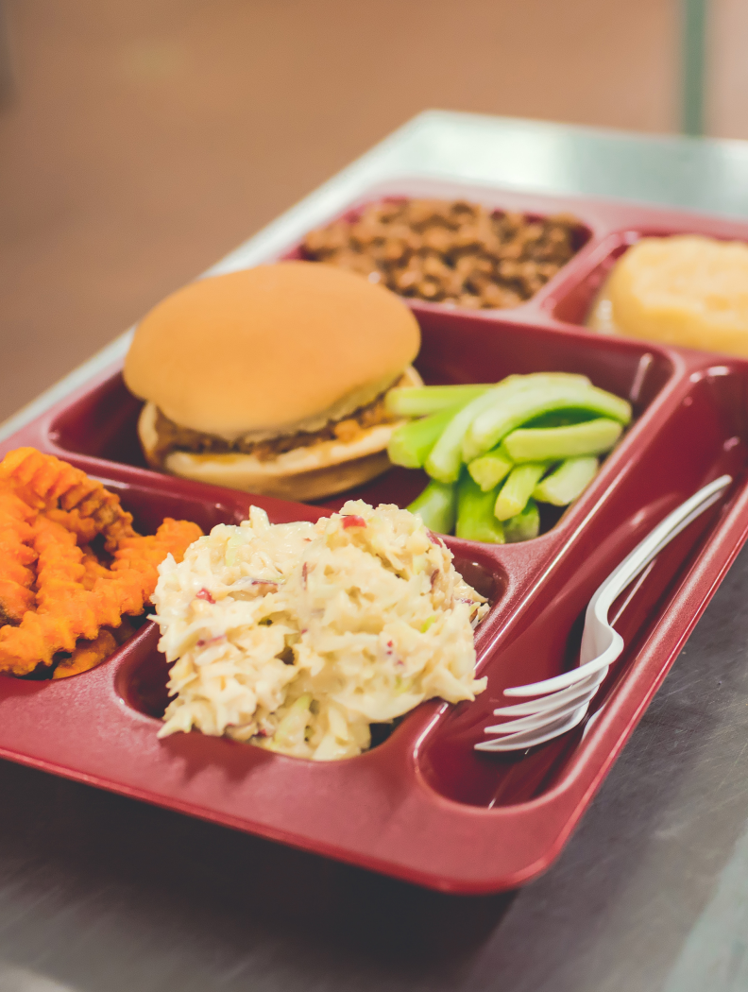
CACFP Center Reimbursement
Effective July 1, 2020– June 30, 2021
Meal Type Rates | Breakfast | Lunch and Supper | Snack | At-Risk
Free 130% | $ 1.89 | $ 3.51 | $ 0.96 | $ 0.96
Reduced 185% | $ 1.59 | $ 3.11 | $ 0.48
Paid > 185% | $ 0.32 | $ 0.33 | $ 0.08
Cash In Lieu Commodities |  | $.245
Notes:
USDA Reimbursement (meals: breakfast, lunch, supper, AM/PM/Late PM snack) (Cash in lieu of Commodities value is given only for all lunches and suppers).
Meals served meeting CACFP meal pattern guidelines.
Maximum of three meals per child per day (2 meals/1 snack or 1 meal/2 snacks or 3 snacks).
Current meal reimbursement rates for centers. Rates change July 1 usually printed in Federal Register after July 1. Reimbursement paid for July claims will reflect the adjustment.
Three levels of reimbursement: free (130%), reduced-price (185%), and paid (above guidelines) according to determination of family size and income or categorical program (for Head Start only) . Based on monthly claim which is a total of meals served based on the maximum number of meals allowed per child per day.
After School Care Snacks are reimbursed at the free rate.

Slide 13
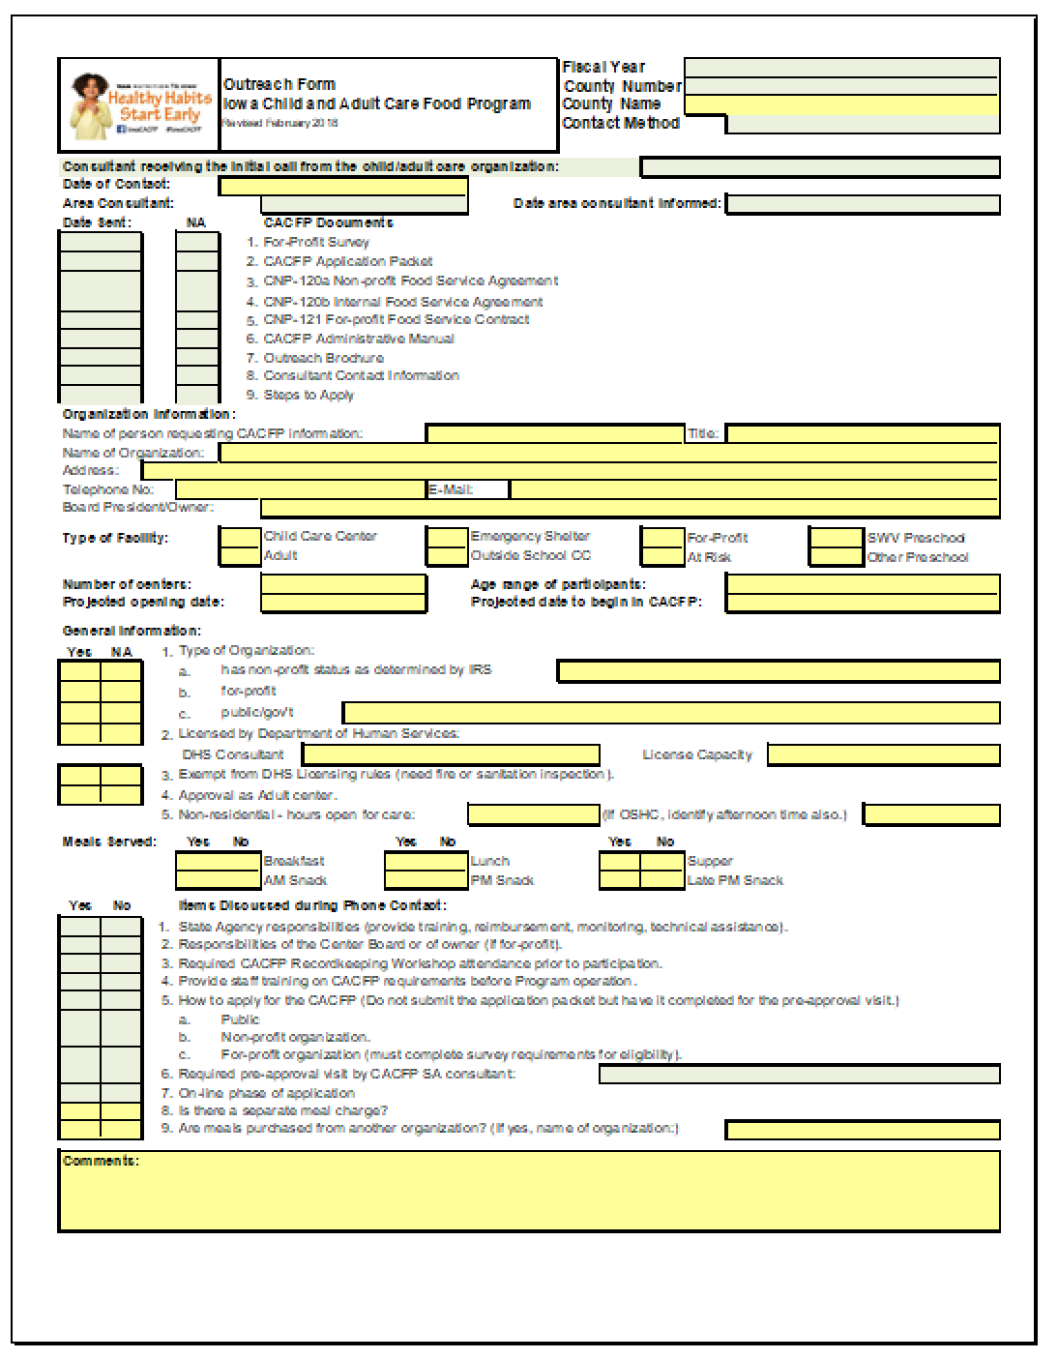
How to Apply
Contact Cheryl Tolley - cheryl.tolley@iowa.gov
Collect organization’s information
Review of steps to apply
Paper Application
Pre-Approval Visit
Online Application
Answer questions
Notes:
A center should contact us regarding their interest in participation
We complete an intake call and the Outreach form is completed
Gather center information (contact, location, licensing capacity, meals served, incorporation status)
Review the steps to apply (center’s responsibility, board/ owner responsibility, our responsibility)
Provide answers to questions
Currently talking about the Ambassador Stipend grant that connects new programs with experienced organizations.

Slide 14
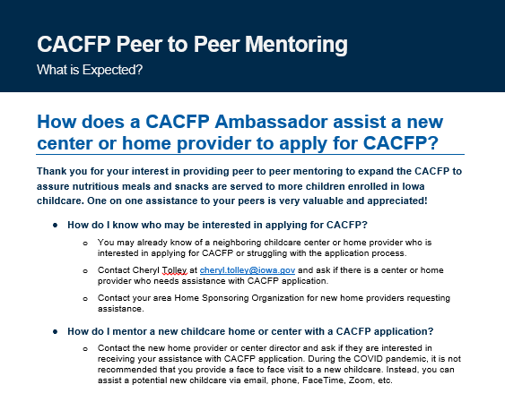
CACFP Ambassador Stipends
Payment to a current CACFP participant
Mentor a center or home provider who does not participate in CACFP
$300 for centers
Program ends June 30, 2021
CACFP Peer to Peer Mentoring Flyer
Applications on IDOE CACFP Webpage
Contact Cheryl Tolley - cheryl.tolley@iowa.gov
Notes:
The Iowa Department of Education is currently offering a funding opportunity for both centers and home providers.
A childcare center or home provider currently participating in CACFP can apply to receive an Ambassador Stipend ($300 for centers or $150 for home providers) for mentoring a center or home provider who does not participate in CACFP. Application due date is June 30, 2021 These funds are available to us through IDPH and Nemours. Our goal is to grow centers and homes who participate in the food program, and improve quality of care.
CACFP Peer to Peer Mentoring Flyer - Provides information to centers and home providers about what is expected of a CACFP Ambassador. (How do I know who may be interested; How do I mentor a new child care home or center with CACFP application; What are the steps to get started; links to the applications)
If you are a new center and would like a mentor to help you apply for CACFP, contact Cheryl Tolley who will make a connection for you.

Slide 15
Notes:
Thank you for your attention and participation today!

Slide 16
NSLP Afterschool Care Program
The Afterschool Care Program (ASCP) component of the National School Lunch Program is a federally assisted snack service that fills the afternoon hunger gap for school children
Offers cash reimbursement to help School Food Authorities (SFAs) provide a nutritional boost to children enrolled in afterschool activities
Notes:
Goals: The Afterschool Care Program (ASCP) component of the National School Lunch Program is a federally assisted snack service that fills the afternoon hunger gap for school children. The program offers cash reimbursement to help SFAs provide a nutritional boost to children enrolled in afterschool activities.

Slide 17
Eligibility for the ASCP
Must operate the National School Lunch Program
Must provide children with regularly scheduled educational or enrichment activities in a supervised environment
Notes:
In order for a site to participate, the school district must operate the National School Lunch Program. Additionally the afterschool care program must provide children with regularly scheduled educational or enrichment activities in a supervised environment. Organized athletic programs engaged in interscholastic sports do not qualify. However, afterschool programs which include supervised athletic activity may participate provided that they are “open to all” and do not limit membership for reasons other than space, security, or licensing requirements.

Slide 18
ASCP Reimbursement
Schools may claim reimbursement for one snack per child per day
Site Eligible:
50% of enrolled children are eligible for free or reduced price meals
receive reimbursement for all snacks at the free rate
Sites Located in Other Areas: must claim reimbursement by eligibility type of the child
free
reduced
paid
No more than $.15 may be charged for a reduced-price snack
Notes:
Schools may claim reimbursement for one snack per child per day. If the site is located in an area served by a school in which at least 50% of the enrolled children are eligible for free or reduced-price meals, all children are eligible to receive reimbursement for snacks at the free rate. Sites located in other areas must count snacks and claim reimbursement by eligibility type of the child (free, reduced-price and paid) and have documentation of eligibility. If there is a charge for snacks, no more than $.15 may be charged for a reduced-price snack.

Slide 19
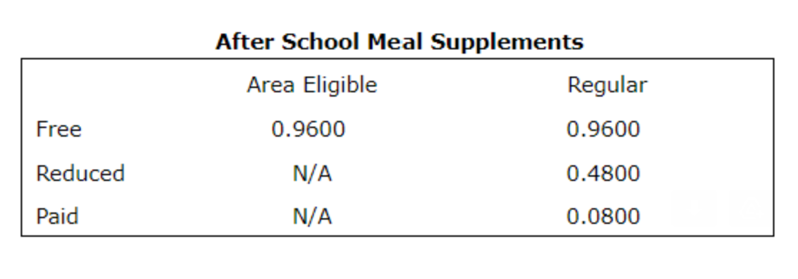
ASCP Reimbursement Rates
Notes:
This slide shows the Afterschool Care Program reimbursement rates per snack served for school year 2020-2021. Reimbursement rates are adjusted annually every July 1st.

Slide 20
Snack Types
In order to be reimbursed:
Snacks must contain at least two different components of the following four:
A serving of fluid milk
A serving of meat or meat alternate
A serving of vegetables, fruits or juice
A serving of whole grain or enriched bread and/or cereal
Notes:
In order to be reimbursed, the snacks must contain at least two different components of the following four: a serving of fluid milk; a serving of meat or meat alternate; a serving of vegetable(s), fruits(s) or juice; and/or a serving of whole grain or enriched bread and/or cereal. A reimbursable meal might consist of ¾ cup Kiwi with 1 oz of Wheat crackers, 4 oz of yogurt with ¾ cup Granola cereal or ¾ cup pineapple with ¼ cup cottage cheese.

Slide 21
Day/Year
Snacks may only be claimed when served after the school day has ended
Meal served on the following days may not be reimbursed under the NSLP
Weekends
Holidays
Vacation Periods
Notes:
Meals may only be claimed when served after the school day has ended. Meals served on weekends, holidays, or vacation periods may not be reimbursed under the Afterschool Care Program.

Slide 22
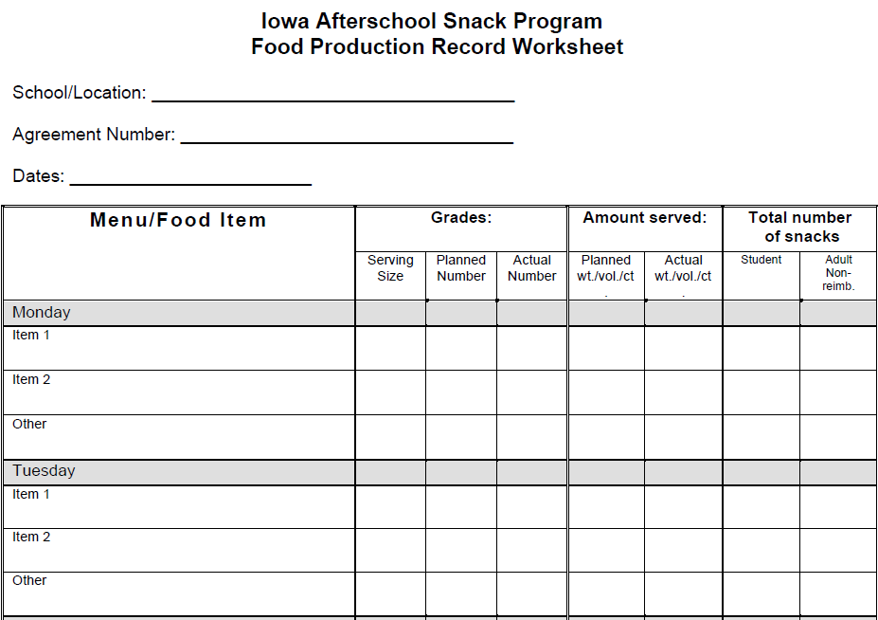
Records
The following records are required to receive reimbursement:
For sites that are not area eligible
Free and reduced price applications
Meal Counts
Documentation for each child’s attendance
Documentation of compliance with meal pattern requirements
Menus
Food Production Records
Notes:
The following records are required to receive reimbursement.
For sites that are not area eligible, free and reduced price applications for all children for whom free and reduced price snacks are claimed must be collected, determined and kept on file;
Meal counts for sites qualifying for free reimbursement for all children would be a total meal count and meal counts by type for sites that are not area eligible.
Documentation for each child's attendance; and
Documentation of compliance with meal pattern requirements. This would be done with menus and food production records.

Slide 23
Monitoring Reviews
Documentation of two monitoring reviews each year must be maintained
The first review must be done within the first four week of program operations
The review is to be unannounced
Must assess each sites compliance with counting and claiming procedures and the snack meal pattern
Notes:
Self-monitoring forms must be completed two times per school year. The School must conduct the first review unannounced during the first four weeks of snack service when the Afterschool Care Program is in operation. The review must assess each site(s) compliance with counting and claiming procedures and the snack meal pattern.

Slide 24
How to Apply
To apply the school should:
Contact Patti Harding at patti.harding@iowa.gov
will determine whether eligibility criteria are met
A Permanent Agreement must be completed
Add ASCP to the school’s application packet
Notes:
A school should contact the School Program Administrative Consultant Patti Harding regarding their interest in participation. Patti can be reached at the email address on the slide. The State agency will determine whether the eligibility criteria are met. Also, a Permanent Agreement must be completed prior to operating the Afterschool Care Program and the Afterschool Care Program must be added to the school’s application packet.

Slide 25
Summer Food Service Program
Established to ensure that children in low-income areas continue to receive nutritious meals when school is not in session
Who is eligible? Children aged 18 and under
Operates during school vacations, primarily in the summer months
May through August
May operate during emergency school closures
Dubuque Dream Center
Notes:
While learning does not end when school lets out, neither does the need for good nutrition. The Summer Food Service Program was created to ensure that children in low-income areas could continue to receive nutritious meals during long school vacations, when school is not in session.

Slide 26
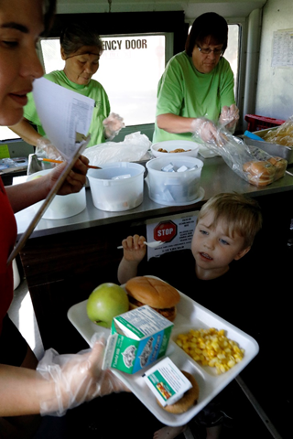
Potential Site Locations
•School
•Library
•Housing Complex
•Park/Playground
•Swimming Pool
•Splash Pad
•Church
•WIC Office/Clinic
•Community Center
•Parks & Rec Site
•Mobile Site
•Tribal Organization
•Summer Camp
•Migrant Center
•Emergency Shelter
•Trailer Park
Sioux City Comm Schools
Notes:
A site is the physical location, approved by the State agency, where you serve the SFSP meals during a supervised time period. Meal service sites may be located in a variety of settings, including schools, recreation centers, playgrounds, parks, churches, community centers, day camps, residential summer camps, housing complexes, migrant centers, and on Indian reservations.
Although there is no requirement for activities at a summer meals site, we do know that sponsors have ongoing success at sites when they can partner with child serving organizations and activities.
Organizations that provide after school programs often times offer summer enrichment activities during the summer months. These partner well with summer meals.

Slide 27
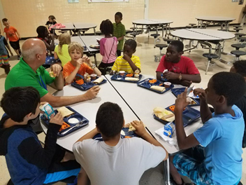
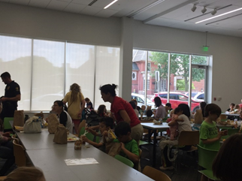
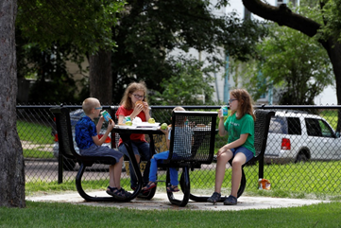
Chapel Ridge Apartments - Johnston
Boys & Girls Club - Cedar Rapids
Ames Public LIbrary
Sioux City park
Notes:
It is important to identify where the children are in your community. Partnering meals with these locations gives you the most likelihood of success with your program.
On this slide you will snapshots from a variety of sites across the state. From the Ames Public Library to the Boys & Girls Club in Cedar Rapids to the Chapel Ridge Apartments in Johnston to a park in Sioux City.
As you can see, there is no one-size fits all for a successful program. It can take on a different look in each community. You have a great opportunity to make it your own!

Slide 28
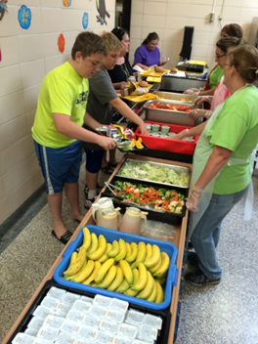
Open Sites
Open site – All children eat free.
Area eligible -
Located in a school attendance area where 50% or more of the children are eligible for free or reduced price meals OR
Located within the boundaries of a census block or tract that demonstrates 50% free & reduced price meal eligibility
Area Eligibility Waiver in place through September 30th
Alternative Sources –
Housing authority data
Migrant data
Glenwood Comm Schools
Notes:
There are 3 main types of sites.
The first type of site is an Open site. If a site is located in a needy area and meals are made available to all children in the area on a first come, first serve basis, these sites are considered to be open. Need is determined by area eligibility data which is either the free & reduced data from a school or census data.
The site must be located in a school attendance area where 50% or more of the children are eligible for free or reduced price meals. This can be established with data from October’s site enrollment reporting or any other subsequent claim month.
The Census Bureau began to annually estimate household income using the American Community Survey. The ACS is an ongoing survey that provides annual estimates, based on sampling data. The site must be located within the boundaries of a census block or tract that demonstrates 50% free & reduced price meal eligibility. This census data is updated annually in October.
In an open site, reimbursement is provided for all meals/snacks served to children at the site.

Slide 29
Enrolled Sites
Enrolled site – All children eat free
50% or more of children enrolled at the site must be eligible for free or reduced price meals.
Closed sites must establish eligibility either through:
individual income eligibility of the children attending OR
area eligibility
Area eligibility waiver in place through September 30th
Notes:
The second type of site is an Enrolled site.
These types of sites are ONLY open to an identified group of children as opposed to the community as a whole.
Closed enrolled sites must establish eligibility either through the individual income eligibility of the children attending the site or through area eligibility. To establish eligibility based on the income of the individual students, sites must collect income eligibility applications from the household or utilize eligibility data already established during the current school year.
If the site is serving children that live in the area in which the site is located, the site may be able to use area eligibility data such as the school’s free/reduced percentage or census data.
For example, if ABC Elementary is offering a summer reading program to it’s students and wishes to serve meals to those children and the school has a free/reduced percentage of 62%, this closed, enrolled program can utilize the school’s free/reduced percentage to qualify the site. However, if ABC Elementary is offering a summer reading program to children from several elementary schools in the community and not all of the elementary schools have a free/reduced percentage of 50% or greater, the site would then have to collect individual eligibility data on each child to qualify the program.
In a closed, enrolled site, reimbursement is provided for all meals/snacks served to children in the program.

Slide 30
Camp sites
Camps – offer regularly scheduled food service as part of an organized program for enrolled children
Residential or nonresidential
Do not have to establish 50%+ free/reduced eligibility
Must collect individual eligibility data
Via income eligibility applications or shared school data
Reimbursed only for meals served to children eligible for free and/or reduced price meals
Saydel Comm Schools
Notes:
The 3rd type of site is a camp. Camps can be residential or nonresidential day camps which offer regularly scheduled food service as part of an organized program for enrolled children. A camp does not need to establish income eligibility at the 50% level. These sites must collect and maintain individual income eligibility forms or data such as shared school eligibility and are reimbursed only for those enrolled children who meet the free and/or reduced price eligibility standards. In this scenario, you will need to have a different funding source to cover the cost of the paid status meals or you can charge the paid students for those meals.

Slide 31
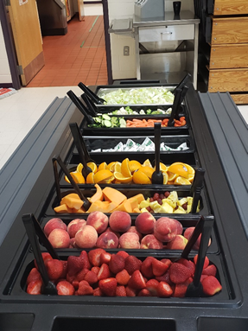
Meal Service
Open/Closed Enrolled Sites:
Can provide up to 2 meals or 1 meal & 1 snack per day
Lunch & supper cannot be combined
Camp Sites:
Can provide up to 3 meals or 2 meals and 1 snack per day.
Congregate meal service – onsite
Non-congregate waiver through September 30th
Can provide grab ‘n go meals
Sponsor chooses day(s) & time of service
Can operate Monday-Sunday
Can operate any period of time within summer break
Meal service time waiver through September 30th
Can provide multiple days worth of meals
Meskwaki Settlement School
Notes:
When participating in the SFSP as an open or closed, enrolled site, you may choose to offer up to 2 meals or 1 meal and 1 snack per day. When participating as a camp site, you may choose to offer up to 3 meals or 2 meals and 1 snack per day. You may also choose to offer just 1 meal per day. It depends on the type of service you feel is needed for your program.
The SFSP is a congregate program. With that, meals must be consumed on-site. Children may not pick up a meal bag and take it home with them. This requirement is in place to ensure that the children who need these nutritious meals are truly those who are consuming the meals provided. During the pandemic, USDA has issued a waiver to allow for the service of non-congregate meals, up through September 30th.
Sponsors get to choose the days they wish to operate and the times that meals will be served. A sponsor can choose to operate Monday through Sunday and can operate just as soon as the day after school releases for summer all the way up to the day before school resumes in the Fall.
Initial eligibility determinations for open sites guarantee you for five years of operation in the program.

Slide 32
Meal Pattern
Meals must meet USDA standards
SFSP Meal pattern requirements
Milk
Vegetables and/or fruits
Bread and bread alternates
Meat and meat alternates
Notes:
The SFSP has a meal pattern requirement, which is based on four food components – milk, vegetables and/or fruits, bread, and meat/meat alternate. If you are a school district or an organization vending from a school district, you are also allowed to utilize the NSLP meal pattern that you prepare your school meals with.

Slide 33
SFSP Reimbursement Rates - 2021
Combined Operational & Administrative Reimbursement
Notes:
Here is a snapshot of the meal reimbursement that will be provided during the summer of 2021. The administrative component of the rate is higher for sponsors of sites located in rural areas and for self-prep sponsors that prepare their own meal.
How do you obtain reimbursement for SFSP meals? Sponsors receive reimbursement on a per-meal basis for meals that meet program requirements that are served to eligible participants. To receive reimbursement, a claim must be submitted each month via the IowaCNP, our online claim system.
Your reimbursement level is driven by the participation at your site locations. With careful planning, you can cover your costs. Reimbursement is determined by the number of eligible meals served multiplied by the combined rates for food service operations and administration.

Slide 34
USDA Extends Flexibilities through Summer 2021
These memos pertain specifically to summer meals, guidance on the 2021-2022 school year is forthcoming from USDA.
Child Nutrition Waiver Update
Allow Meal Pattern Flexibilities for Summer 2021 Operations
Applies to the operation of the NSLP, SBP, and SSO
Does not apply to the SFSP - regular SFSP meal pattern requirements apply effective July 1st
Allow Non-Congregate Feeding for Summer 2021 Operations
Allow meals to be taken and eaten off-site
Allow Parents and Guardians to Pick Up Meals for Children for Summer 2021 Operations
Allow meals to be picked up without the child present
Must ensure meals are distributed only to parents or guardians of eligible children and duplicate meals are not distributed for any child
Waive Meal Service Time Restrictions for Summer 2021 Operations
Allow flexibility in service times and distribution of multiple meals at one time
Notes:
The U.S. Department of Agriculture (USDA) recently announced the nationwide extension of several Summer Food Service Program (SFSP) waivers that allow all children to continue to receive nutritious meals this summer when schools are out of session and ease the administrative burden to program operators. These flexibilities are now effective through Sept. 30, 2021. While these memos pertain specifically to summer meals, more guidance on the 2021-2022 school year is forthcoming from USDA.

Slide 35
USDA Extends Flexibilities through Summer 2021(cont)
Extend Area Eligibility Waivers for Summer 2021 Operations
Allow SFSP meals in areas that do not meet the usual free or reduced-price eligibility threshold
Allow Offer Versus Serve (OVS) Flexibilities in the SFSP for Summer 2021 Operations
Allow use of OVS with the SFSP meal pattern
Allow Area Eligibility for Closed Enrolled Sites for Summer 2021 Operations
Allow use of area eligibility data in lieu of individual student eligibility to qualify a Closed Enrolled site
Waive First Week Site Visits in the Summer Food Service Program for Summer 2021 Operations
Allow the first week site visit requirement to be waived for:
those sites that operated in the previous year
those sponsors that successfully participate in the Child and Adult Care Food Program or the National School Lunch Program

Slide 36
How to Apply
Contact Stephanie Dross - stephanie.dross@iowa.gov
Collect organization’s information
Review of steps to apply
Pre-Approval Visit
Pre-Approval Documents
Online Application
Answer questions

Slide 37
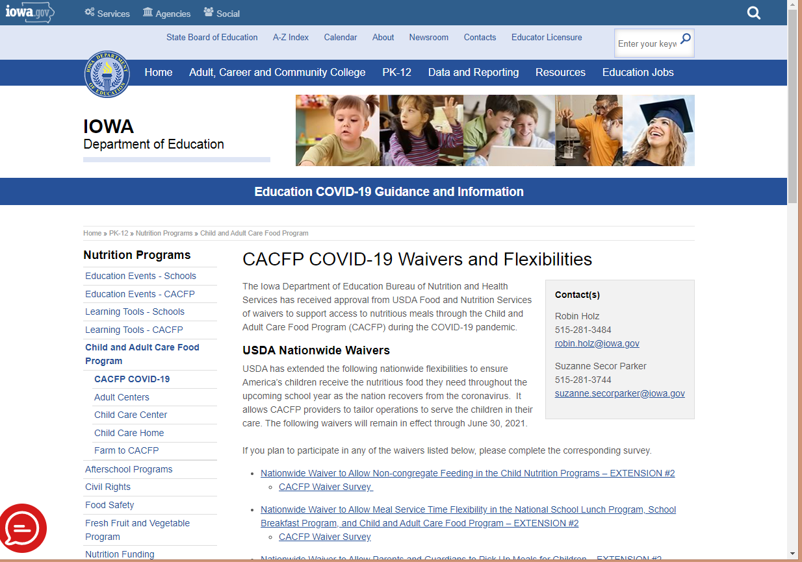
Department of Education Website
Nutrition Programs
https://educateiowa.gov/pk-12/nutrition-programs/
Afterschool Programs
CACFP & NSLP Afterschool Program Comparisons
USDA At-Risk Handbook
USDA At-Risk Fact Sheet
Promotional Flyers
CACFP
SFSP
Webcasts
Sponsor resources

Slide 38
Notes:
Thank you for your attention and participation today!

Slide 39
Contact Information
Robin Holz, CACFP Lead Consultant
robin.holz@iowa.gov
(515) 681-2305
Deb Linderblood, NSLP Consultant
deb.linderblood@iowa.gov
(515) 281-5663
Stephanie Dross, SFSP Lead Consultant
stephanie.dross@iowa.gov
(515) 281-4760

