Slide 1
Iowa Department of Education
March 2021
Update on GPRA measures and the APR
Vic Jaras

Slide 2
This information was received from the USDOE

Slide 3
Agenda
Why GPRA?
Overview of new GPRA measures
TIMELINE of the transition in the APR data collection system
Detailed view of each GPRA measure
Training
Questions

Slide 5
Overview of the New GPRA measures
Replace 14 OLD GPRA measures with measures that better reflect the work our program does.
Only 5 NEW GPRA measures that ALL focus on IMPROVEMENT rather than proficiency.
We have been working on these new measures for several years and they should provide a more accurate picture to Congress of the work we do helping at-risk children.

Slide 6
NEW GPRA MEASURES
A
)
Notes:
This is the primary piece of federal legislation related to the education of children and youth experiencing homelessness.
The Main themes of this legislation include:
Identification
School stability
School enrollment
Support for academic success
Child-centered, best interest decision making

Slide 7
NEW GPRA MEASURES
Principal reported measure from referrals
A
)
Notes:
This is the primary piece of federal legislation related to the education of children and youth experiencing homelessness.
The Main themes of this legislation include:
Identification
School stability
School enrollment
Support for academic success
Child-centered, best interest decision making

Slide 8
Make sure you talk with your district to insure that you update your data sharing agreement.
This grant does NOT violate FERPA (The Federal Education Rights and Privacy Act. The district only provides aggregate data for ALL 21st CCLC data requests
Districts sign an assurance that includes data sharing to comply with federal statutes on data reporting

Slide 11
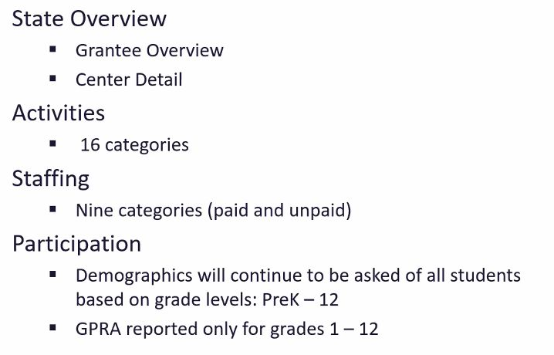
In the APR, what is NOT changing

Slide 12
What IS going to change…

Slide 13
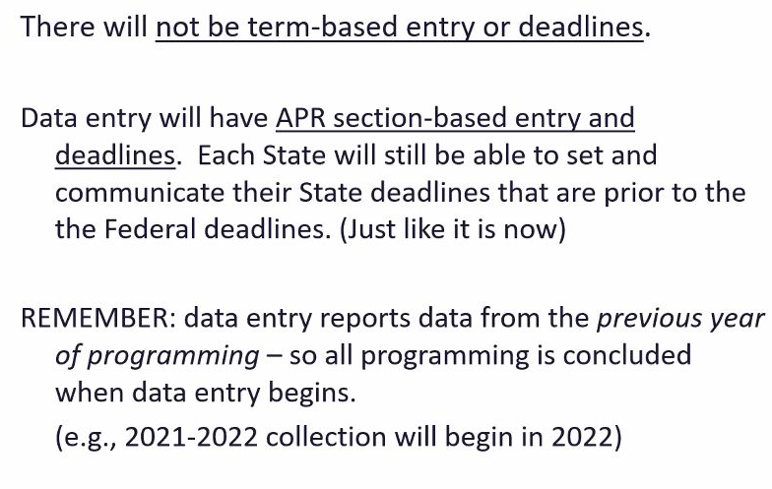
Frequency of reporting..

Slide 14
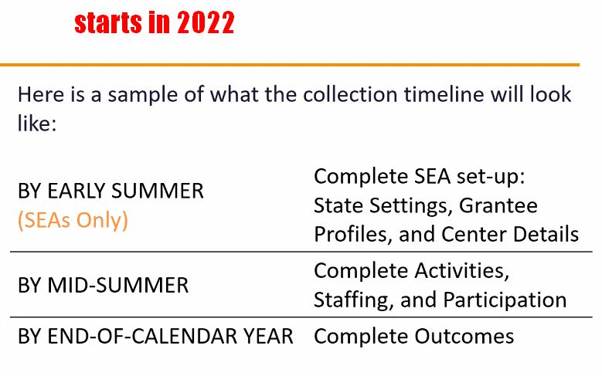
Frequency of reporting..
Only reported once.. Here
Outcomes reported in December each year

Slide 15
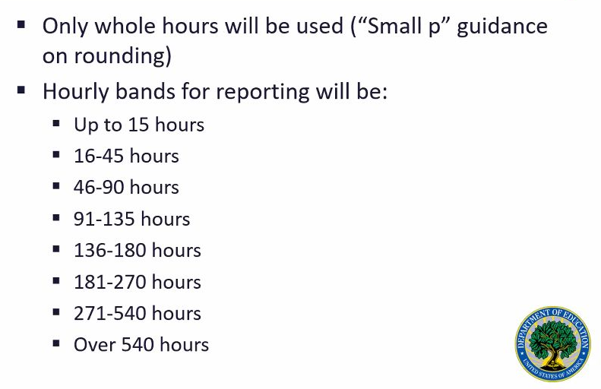
Participation will go from days to HOURS..
In Iowa, we require a minimum of 60 hours per month.
If you run a yearlong program, then you should be reporting OVER 540 hours.

Slide 16
SEAs complained about too many bands to report

Slide 17
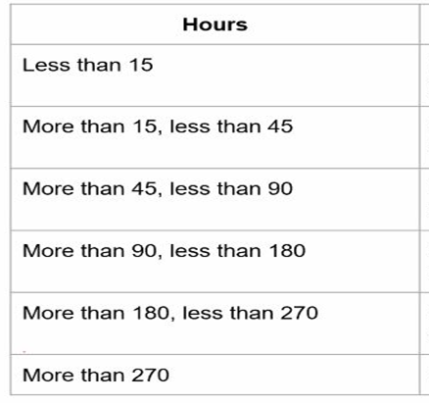
Convert hours to days
DAYS
Less than a week
More than a week
More than a month
More than two months
More than three months
More than four months

Slide 18
More Details on NEW GPRA measures…
Elementary students

Slide 19
How applied…

Slide 22
Details on the NEW GPRA
Secondary students

Slide 23
Details on the NEW GPRA
Secondary students

Slide 29
Every building principal collects this data in the Student Information System and can provide you with a report for the students in 21st CCLC

Slide 35
TRAINING

Slide 37
