Slide 1
LITERACY ENRICHMENT
Presented by
Theresa slaughter, literacy enrichment coach

Slide 2
AS YOU JOIN…
In the Chat Box tell us:
Name, Organization, Answer: Do they have a Fourth of July in England?

Slide 3
HOUSE KEEPING
Encourage participation (camera, chat box, discussions)
Add your name (this makes it more personal and easier to interact)
Utilize the chat box (to connect with others or ask questions)
Need to step away momentarily? Use the toolbar to turn off video/sound

Slide 4
LITERACY ENRICHMENT PD SERIES OBJECTIVES
-- Identify and create various ways to foster learning opportunities
-- Reinforcing literacy skills
-- Explore various approaches and/or perspectives to literacy
-- Provide a platform for Literacy discussion

Slide 5
AGENDA
4 Question Strategy
Literacy Enrichment Activities Compare/Contrast Read Alouds & Book Clubs Themed Literacy
Literacy Enrichment Evaluation

Slide 6
4 QUESTION STRATEGY
Ask yourself 4 questions: -- Is this age and/or grade appropriate?
- content -- Is this skill appropriate?
- child development, delivery of content -- Does this activity fit within the purpose?
- objectives and/or goals -- Is this activity a medium-high level of interest?

Slide 7
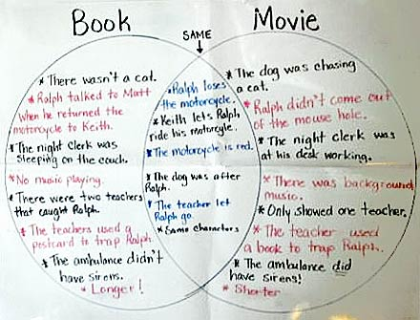
LITERACY ENRICHMENT ACTIVITY#1 COMPARE/CONTRAST
GROUP – GRADES 3+
VOCABULARY BUILDER – compare and contrast
FORMAT – book to movie, movie to movie; character to character, book to book
-- book to movie (the Lorax, Matilda, Fault in Our Stars)
-- character to character (Harry Potter, Percy Jackson, Artemis Foul)
SKILLSETS – critical thinking, communication, and relationship skills
Lesson: The Lorax

Slide 8
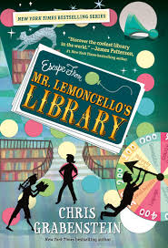
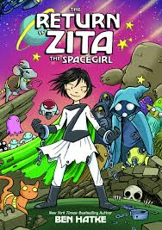
ACTIVITY #2 READ ALOUDS & BOOK CLUBS W/A TWIST
Read Alouds – instructional practice; reading and discussing a shared book -- children and chapter books -- for ALL AGES
Book Clubs – reading and discussion a shared book -- chapter book, reading is done over an extended period of time -- delivery of instruction deciphers read aloud or book club -- comprehension questions to probe for understanding of reading -- may be accompanied with mini-activities and/or projects
Lesson Planning Process
Graphic Novel – Readers Society

Slide 9
Children’s Story Book

Slide 10
LESSON PLAN PROCESS
Children Story Book
Looking at the title and the book cover, what are some questions you can ask in regards to the title/book cover? These are the Before Reading discussion questions.
What are some questions you can ask while you’re reading?* These are the During Reading discussion questions. *This section is optional.
What are some questions that can be asked after reading the story? These are the After Reading discussion questions.
Connection Activity – What are some activities that you can pull out of the story to make the “connection.” Think of at least 2-3 activities, fieldtrips, and/or community partners.
Chapter Book
Looking at the title and the book cover, what are some themes that jump out at you? - What are some questions you can ask in regards to the title/book cover? These are the Before Reading discussion questions.
Research – Utilizing the Internet, search for comprehension questions and activities for your book. - Feel free to read the book and come up with your own questions and activities.
Connection Activity – What are some activities that you can pull out of the book to make the “connection.” Think of at least 2-3 activities, fieldtrips, and/or community partners.

Slide 11
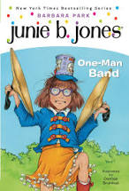
Chapter Books

Slide 12
THEMED LITERACY A collection of books; may be grouped based on subject matter or themes
FORMAT – reading, writing, discussion
BEST PRACTICE - connection activity
If you choose to do the reading:
-- several books are chosen within the group and accompanied with comprehension questions
-- lesson planning process is the same as the children’s and/or chapter book
Examples:
-- Under the Sea
-- Inventor’s Workshop
-- Sports/Xtreme Sports

