Slide 1
EVIDENCE-BASED PRACTICES for LITERACY ENRICHMENT
Presented by
Theresa Slaughter, Literacy Enrichment Coach
21 CCLC Spring Conference
April, 19 2022

Slide 2
AS YOU JOIN…
In the Chat Box tell us:
Name, Organization,
Your “go to” Spring/Summer activity.

Slide 3
HOUSE KEEPING
Encourage participation (camera, chat box, discussions)
Add your name (this makes it more personal and easier to interact)
Utilize the chat box (to connect with others or ask questions)
Need to step away momentarily? Use the toolbar to turn off video/sound

Slide 4
AGENDA
Evidence Based Practices (EBP) -- definition and benefits
Ways of Implementation -- embedded instruction, checking for understanding, group work -- activities of how this could look within programming

Slide 5
EVIDENCE-BASED PRACTICES (EBP)
What is Evidence-Based Practices? -- supported by extensive scientific research (systematic approach); bridging gap research-practice; creating a high-quality standard -- works on a large scale → improve student outcomes -- practices can be used on various “disciplines”
Benefits of Evidence-Based Practice -- priority of setting goals; increased accountability -- invested time → maximum growth and progress -- high-level of support from ALL stakeholders
Various ways to incorporate practices within afterschool programming -- Embedded Instruction -- Group Work (Cooperative Learning) -- Checking for Understanding (Comprehensive Questioning)

Slide 6
EVIDENCE-BASED PRACTICES
Embedded Instruction -- intentionally planned learning opportunities that are inserted in program routines and activities. - clear and precise ______ (focus/goals/objectives/purpose) -- incorporate learning content between and among subject areas
Offers high-quality programming and activities, creates connection and meaning, yields to higher youth engagement
Connection activities involving reading, writing, and/or discussion (guided)

Slide 7
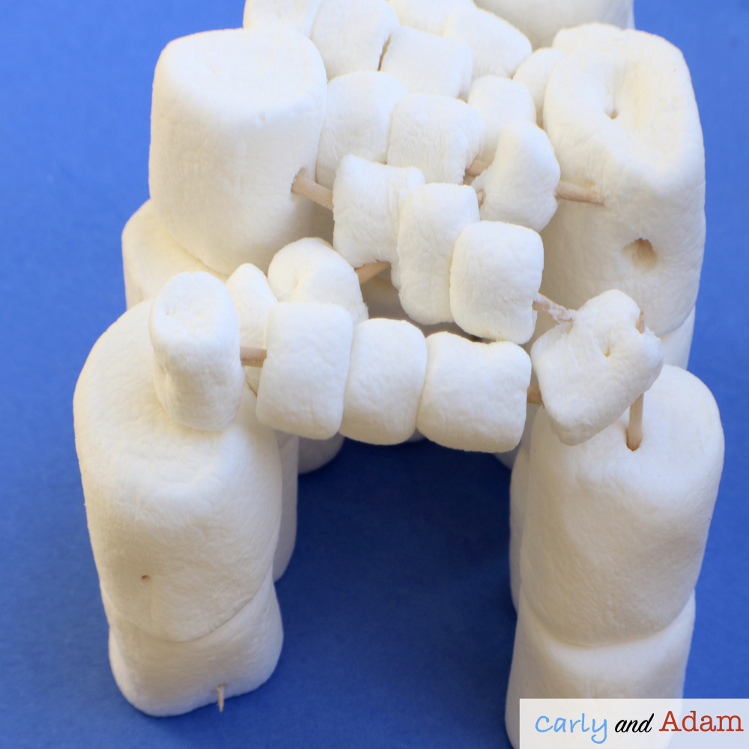
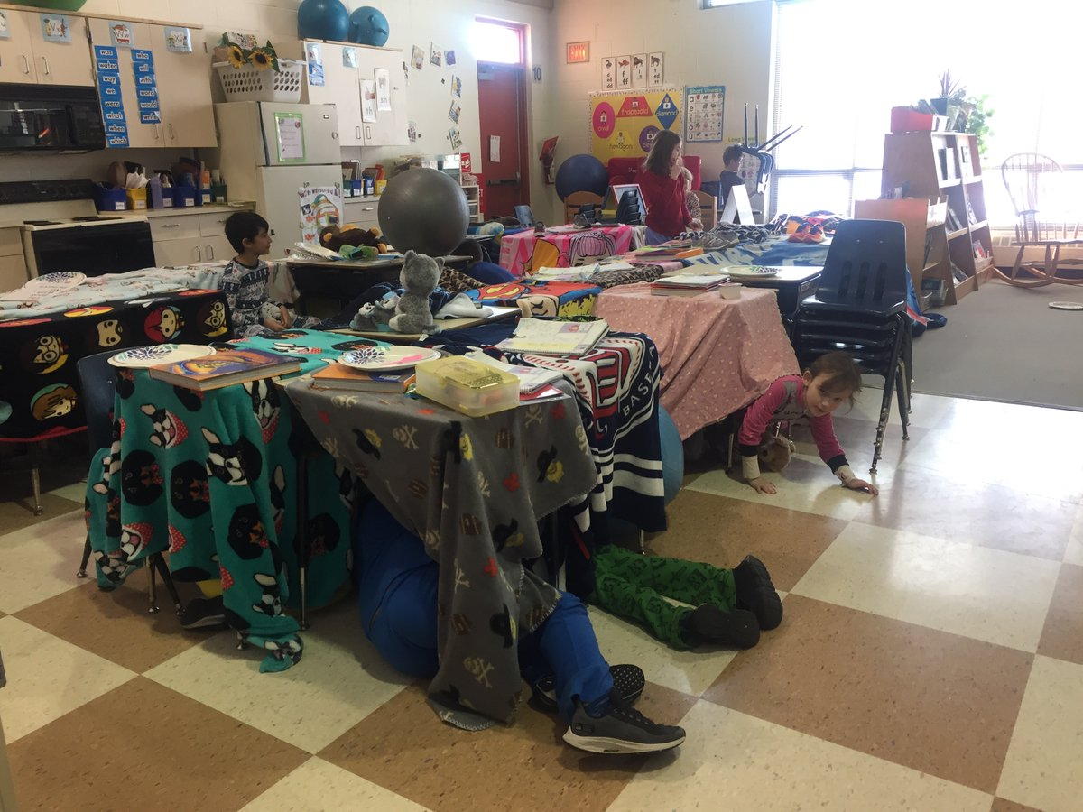
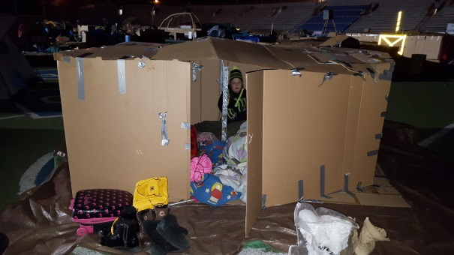
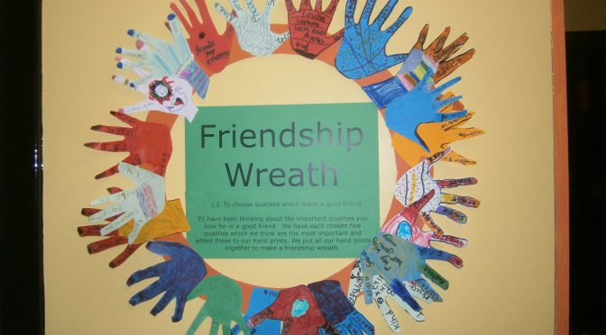
Embedded Instruction planned and intentional inserted in program routines and activities
Reading - The Little Red Fort (K-5)
STEM - Fort Challenge
Community Service Activity (5)
SEL/Reading – Friends (K-2; 3-5)
Art -- Friendship Wreath Palm – picture of self Thumb – favorite superhero (3) things that make you “unique;” (3) things you like to do; favorite (food and color); favorite (music, movie, book)

Slide 8
EVIDENCE-BASED PRACTICES
Group Work (Cooperative Learning) -- highly intentional, task oriented activities -- partners and/or small groups -- assigned roles/responsibilities
Encourages active learning, problem solving, practice of SEL competencies
Mini-projects/activities; connection activities in reading, writing, and/or discussion

Slide 9
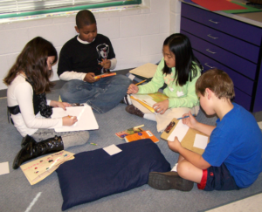
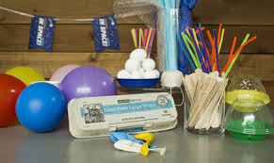
Group Work highly intentional, task oriented activities
Egg Drop - Using the materials provided, design a device to keep an egg from breaking when dropped from a high place.
Materials: variety
Assigned Roles: material getter, record/time keeper, spokesperson, etc.
Literature (Reading) Circles – reading and discussion a shared book over an extended period of time; assigned instructional roles -- For example, discussion director, recorder/time keeper, presenter, etc. -- may be accompanied with mini-activities and/or projects

Slide 10
EVIDENCE-BASED PRACTICES
Checking for Understanding (Comprehensive Questioning) -- a process allowing for review of learned knowledge and/or skills -- reflective questioning and/or reading questions
Helps us to gauge understanding…before moving on; let’s us know if we’ve met our purpose; guides instruction (“refine, improve, and strengthen”)
Discussions (guided), writing assignment, connection activities -- observational interactions

Slide 11
Pete the Cat and Cool Cat Boogie By James Dean
Read Aloud, checking for understanding -- What do you think this story is about? -- How do think Pete felt when he wasn’t able to get the dance moves? Is there a time that you ever felt that way? -- Who told Pete to just be himself? Why do you think they said that?
CONNECTION activity -- individually create your own dance move -- work w/a partner or small group, create a dance routine

Slide 12
-> What is Evidence-Based Practices? -> List and explain in your own words, 2 ways of implementation.
CHECKING FOR UNDERSTANDING

Slide 13
WORKS CITED
Aperture Education. “Evidence-based” vs “research-based:” Understanding the differences. (2022). Retrieved from https://apertureed.com/evidence-based-vs-research-based-understanding-differences/
Diery, A., Vogel, F., Knogler,M., and Seidel, T. (02 June 2020). Evidence-based practice in higher education: Teachers’ educators attitudes, challenges, and uses. https://doi.org/10.3389/feduc.2020.00062
Killian, S. (2021). Top 10 evidence-based teaching strategies for those who care about student results. University of Nebraska-Lincoln Newsroom. Retrieved from https://newsroom.unl.edu/announce/csmce/5272/29630
Special Education Resource Project. (2022). What are evidence based practices? Vanderbilt University. https://my.vanderbilt.edu/spedteacherresources/what-are-evidence-based-practices/
The IRIS Center Peabody College Vanderbilt University. (2021). What is an evidence based practice or program (EBP)? https://iris.peabody.vanderbilt.edu/module/ebp_01/cresource/q1/p01/#content

