Slide 1
STRATEGIES FOR YOUTH RECRUITMENT AND RETENTION
May 25, 2021
21CCLC Best Practice Webinar
Crystal Hall – IAA
Nikki Clausen and Elana Zalar – Council Bluffs
Megan Bogdan - YouthPort

Slide 2
LET’S HAVE SOME FUN!
Let’s see who knows their sweets! Everyone will need a piece of paper and you will need to number it 1-6. I’ll show you a screen shot of a cross-section cut of a candy bar. It’s your job to correctly identify as many as you can. We’ll review the answers in a bit. Ready to play?

Slide 3
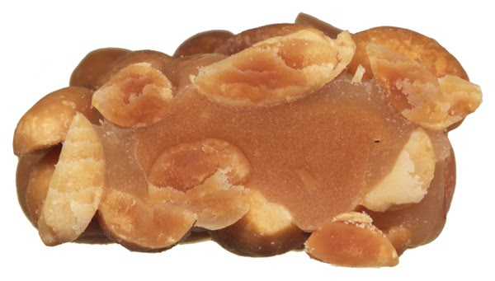
1
2
3
4
5
6

Slide 4
ANSWER TIME!
Three Musketeers
Butterfinger
Payday
Snickers
Kit Kat
Twix

Slide 5
GOALS FOR THE DAY
Identify the importance of regular youth attendance.
Review the requirements of your 21CCLC grant.
Strategies for recruitment and retention from the field.
Questions

Slide 6
YOUTH ATTENDANCE AND RECRUITMENT
Why regular attendance is important: USDOE
USDOE recommends elementary aged youth attend an OST program a minimum of 3 days per week for potential impact. The more days attended, the better.
Afterschool programs can support social, emotional, cognitive, and academic development, reduce risky behaviors, promote physical health, and provide a safe and caring environment for youth.
Attending high-quality afterschool programs and regular participation can lead to improved social and emotional competencies, including prosocial behavior, intrinsic motivation, better concentration efforts, and higher sense of self-worth.

Slide 7
ACCORDING TO THE IDOE
Local data tells us that…
IDOE states that well designed programs have high attendance expectations for enrolled youth as a best practice. 21CCLC recommends 60 contact hours per month.
Children generally improve their school day attendance due to a high-quality afterschool program.
Youth attendance is one of the four program success areas identified by 21CCLC – reading, math, behaviors and ATTENDANCE
It’s part of your Site Monitoring Agreement!

Slide 8
21CCLC RECOMMENDATIONS FOR RECRUITMENT – LANGUAGE FROM THE RFP
The 21CCLC program engages in recruitment strategies that target high poverty, at-risk and students with achievement gaps.
The 21CCLC program employs transportation strategies to enable sufficient participation
The 21CCLC program has policies to address chronically absent participants
The 21CCLC program connects to community partners to assist with recruitment
The 21CCLC program seeks input from school day personnel on how to target recruitment efforts
The 21st CCLC program communicates with parents about the importance of Participation, Attendance and Engagement

Slide 9
21CCLC GRANT REQUIREMENTS
Vic has shared that much more emphasis will be placed on attendance this upcoming year.
Response to COVID gaps seen in academics and SEL in particular.
You have set attendance goals in your grant application.
Year 1 – 70% of proposed numbers
Year 3 – 80% of proposed numbers
If you are having trouble meeting these goals – CALL VIC OR THE IAA – as a failure to meet goals could result in a reduction of your funding.
You’ll want to make sure you are tracking your total enrollment average daily attendance which is reported on your quarterly financial claims.
A reminder that non-school days (ex. weather or other closures) do not count against you.

Slide 10
21CCLC GRANT REQUIREMENTS
Attendance is reported in several documents required by the grant including the local evaluation document, the APR, your quarterly claims, etc.
Attendance is reported in the APR system (and will continue to be reported in the “new” format with data collection starting this summer). Right now attendance is reported in a “regular attendance” mindset but moving forward this will switch to hourly tracking. A training will be provided on this new model.
Summer program reminders: try to schedule over 30 days of programming so you have data to report

Slide 11
YOUTH RETENTION
Three major indicators as to why youth continue to attend a program are:
Youth interest – is it fun? Is it engaging?
Quality programming – supervision, structure, management, intentional program offerings, etc.
Strong partnerships – relationships, experiences, and “stuff.”

Slide 12
LET’S HEAR FROM THE FIELD

Slide 13
COUNCIL BLUFFS

Slide 14
BUILDING PARTNERSHIPS
A few of our partners:
Metro YMCA
Midlands Humane Society
Omaha Henry Doorly Zoo
Treynor State Bank
Future Tennis & Soccer
Omaha Children’s Museum
VEX Robotics
CB Soccer Club
Council Bluffs Library
The Hub Trampoline Park
Hitchcock Nature Center
Kaneko
Gifford Farm
SAC Museum
Our 21st CCLC programs in Council Bluffs are very fortunate to work with over 100 partners in the last 5-7 years. We take pride in building relationships with our partners and get to know them on a personal level.
By providing quality programming at our schools, through the use of partners and teachers, we are able to retain students and families stay engaged and involved throughout the school year.

Slide 15
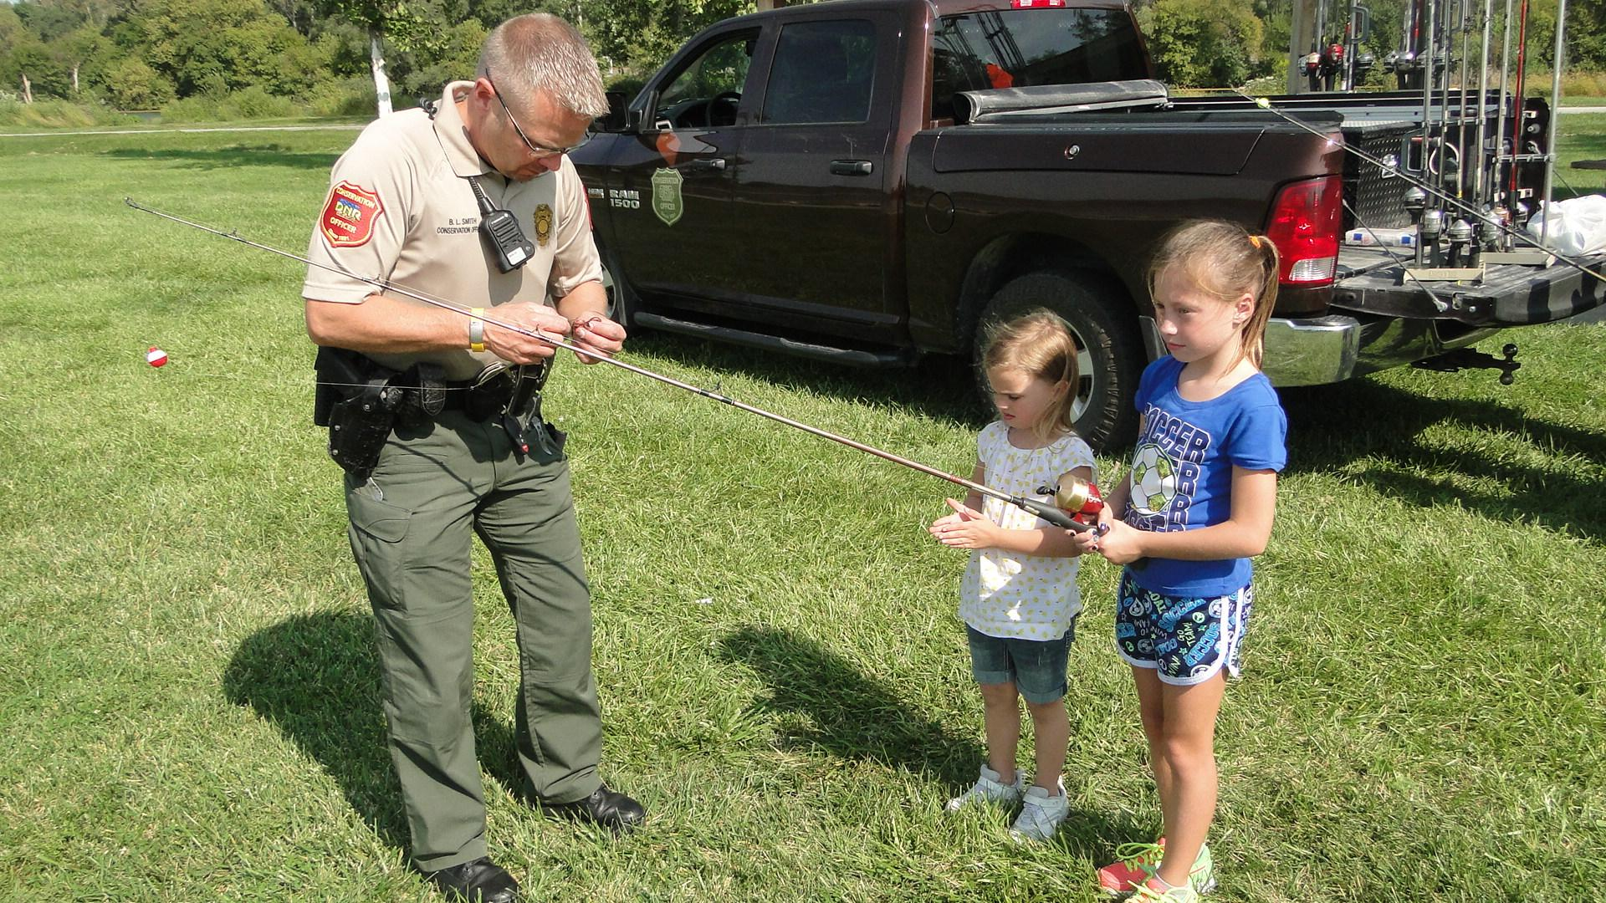
Definitions to consider:
Community partners are nonprofit organizations, public agencies, government offices, schools, and certain private business where students provide community service as an integral part of their academic courses.
Sustainable is being able to be maintained at a certain rate or level.

Slide 16
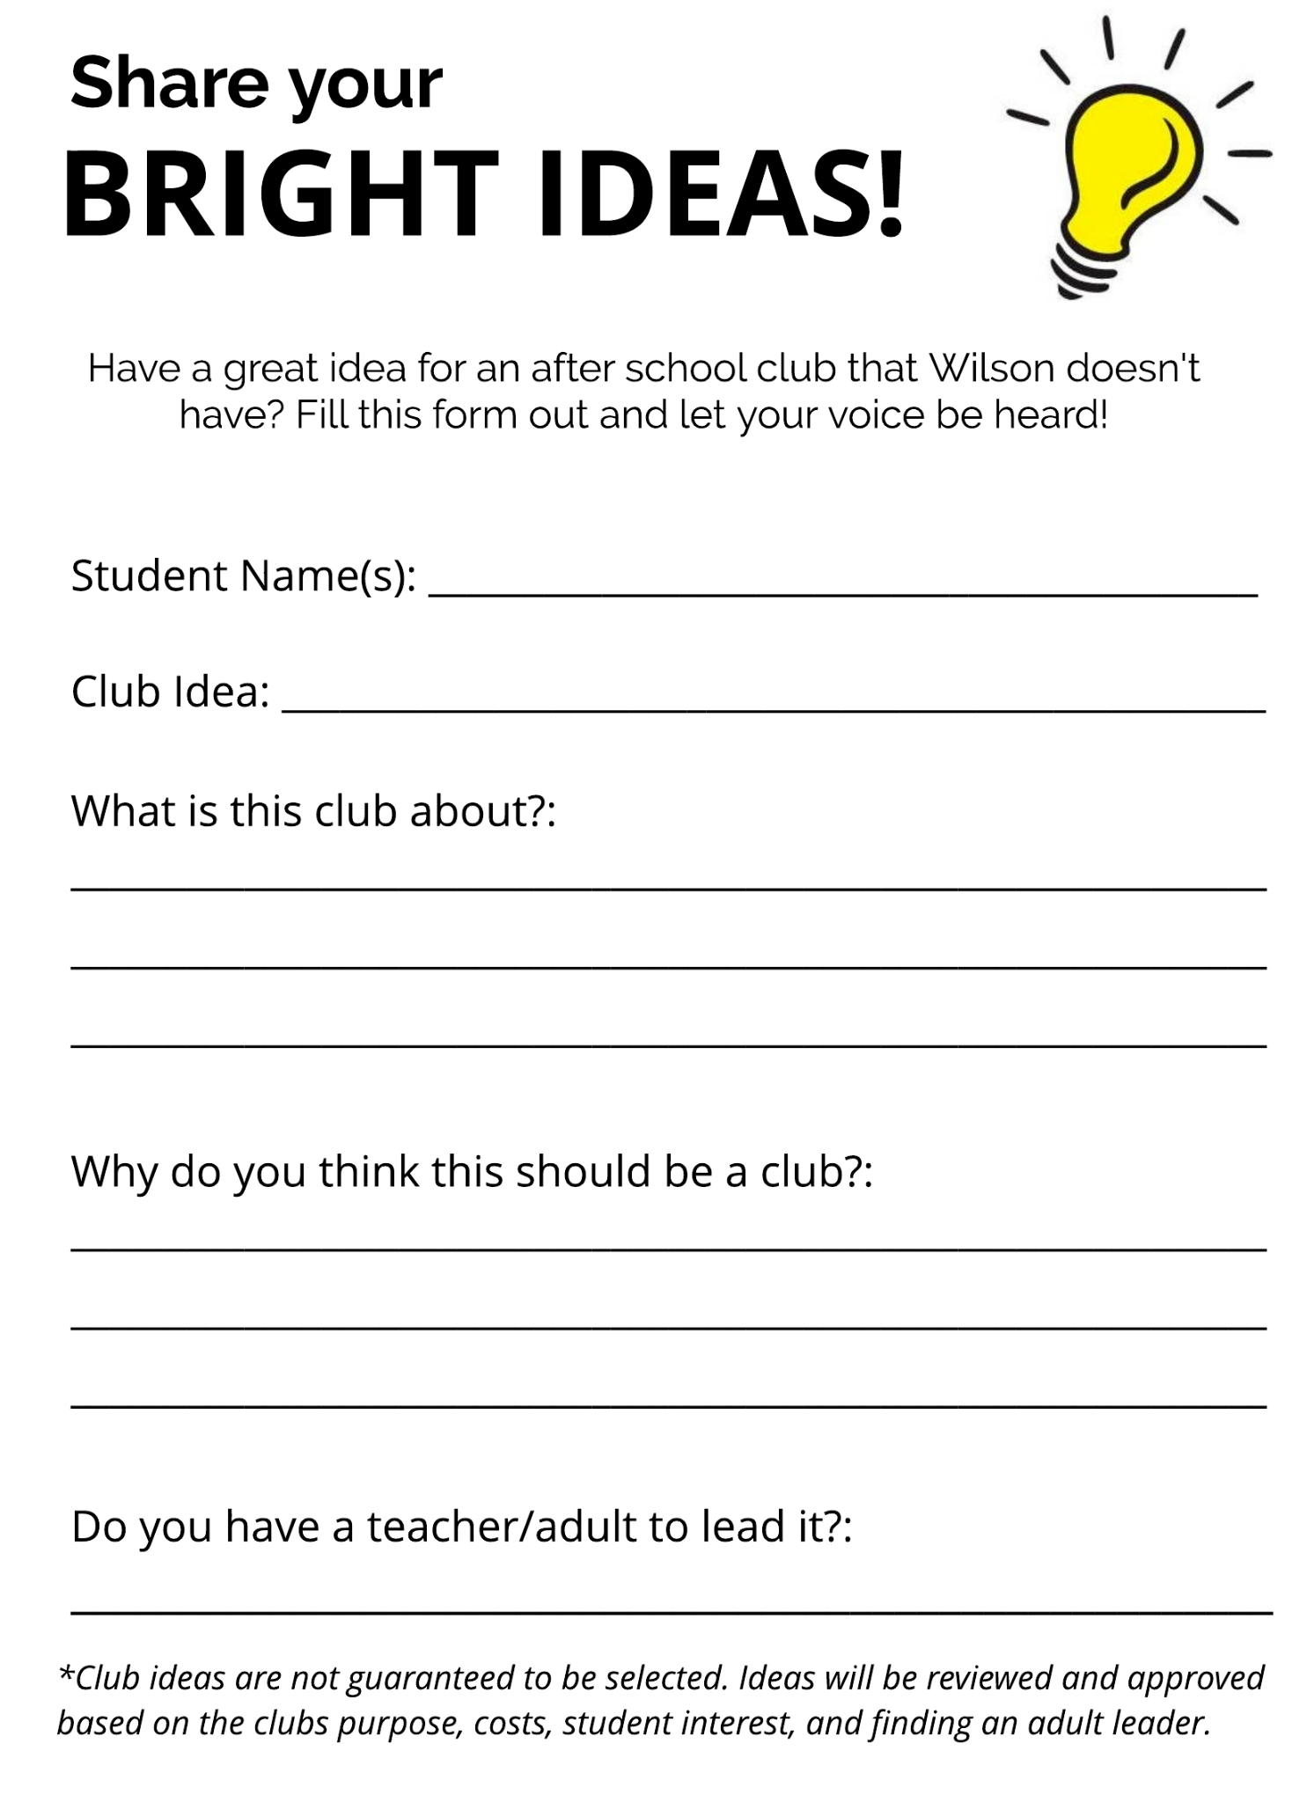
LISTENING TO STUDENT INPUT
In our middle & high school buildings, we always encourage students to give us input on what type of clubs they’d like to see. We also have an online “virtual suggestion box” where students, teachers, or parents can participate too.

Slide 17
FAMILY ENGAGEMENT
We do quarterly family engagement events at our 21st CCLC schools. Below are examples of the ones we have done pre-COVID and during COVID.
Pre-COVID Events:
Omaha Children’s Museum Night: Families could bring their entire family and enjoy the museum for 2 full hours free of charge.
Durham Museum Night: Typically held the last Tuesday in November. Families could tour the museum and also get pictures taken by the Christmas tree and also with Santa.
Fontenelle Forest Night: Families could come and enjoy a snack and hike on the trails, as well as do some hands-on activities with the staff.
During COVID Events:
This 20-21 school year we were unable to do in-person family events, until spring, therefore we scheduled some take home activities for families.
Fall 2020: Kits were assembled with fall related books and pumpkins for families to paint or carve.
Winter 2020: Families received Eileen’s Cookies decorating kits with sugar cookies, frosting and sprinkles.
Winter/Spring 2021: Families were given a kit with popcorn and candy as well as math card games to be played together at home.
Spring 2021: In May, we held an in person family event, partnering with Hitchcock Nature Center, where families came and learned about trees and received seedlings to plant at their home.
Spring Surprise: All of our 21CCLC schools were surprised with Kona Ice to enjoy on a random weekday during programs.

Slide 18
YOUTHPORT – CEDAR RAPIDS

Slide 19
Youth Recruitment -Word of Mouth -Teacher referrals -Organization referrals -Families Youth Retention -Enrichments -Dinner -Field trips -Staff

Slide 21
QUESTIONS?
chall@sppg.com
319-310-8312

