Slide 1
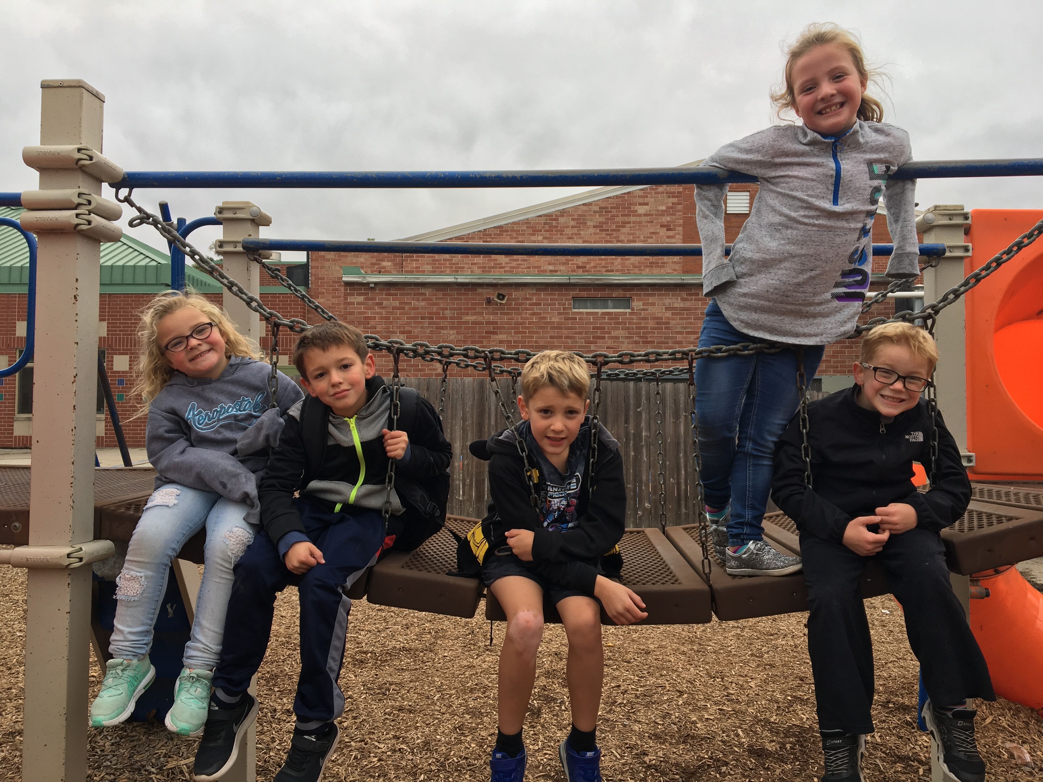

Special thanks for allowing us to spend some time together discussing how we can provide expanded learning opportunities that help kids be successful with the help of Camp Fire Heart of Iowa.

Slide 2
Connecting School with After School Programs Will Increase Student Engagement and Achievement
By forming a collaborative partnership with Camp Fire Heart of Iowa, your school can improve student engagement and motivation with “hands on” learning while closing the achievement gap and improving the scores of your students. This presentation will describe Before and Afterschool programming along with the opportunities Camp Fire Heart of Iowa can offer at NO COST TO YOUR SCHOOL!
See Camp Fire’s Before and Afterschool information at this link:
https://www.campfireiowa.org/programs/before-after-school/

Slide 3
As Principal at Holmes Junior High School in Cedar Falls, Iowa, I have been a strong advocate of After School programming since coming to Holmes in 2001. Nationally and locally, Afterschool programs play an important role in the community. As many as 15 million children have no place to go after the school day ends, and studies show the hours of 3 to 6 p.m. are prime hours for violent juvenile crime and risky behavior.
Alongside current education reforms that are being discussed, Afterschool programming offers a cost effective way to improve student achievement while providing motivation for students to get engaged. I’ve learned through experience it’s not about adding days or hours, but about motivation and engagement!

Slide 4
Camp Fire takes before - and after-school care to the next level with standard tutoring and homework help as well as enrichment activities led by our professional staff. Camp Fire staff are trained to observe and engage youth in order to support, extend, and clarify learning. Furthermore, Camp Fire’s Thrive methodology helps each child learn to thrive by allowing them to explore their personal interests, make healthy choices, develop social skills, and have fun. Make after-school an adventure with Camp Fire Heart of Iowa!
What Camp Fire Before and After School Programs Offer
AT NO COST TO YOUR SCHOOL…
Safe environment
Dedicated homework assistance
Low staff to youth ratios
Outdoor nature studies
Dedicated outdoor free-play
Quality youth development programming
Art projects
Snacks and more!

Slide 5
What does Research Say About
The Importance of Early Intervention
in a Child’s Education?
Dr. James Heckman, an economics professor at the University of Chicago and winner of a Nobel Prize in Economics has written extensively on the need to increase funding to programs that support children as the most cost effective for society. In fact, Professor Hickman has data to show that for every dollar invested in a program for child development such as Afterschool programming, the return on investment is $13!
The following graphic shows that the highest rate of economic returns comes from the earliest investments in children, providing an eye-opening understanding that society invests too much money on later development when it is often too late to provide great value. It shows the economic benefits of investing early and building skill upon skill to provide greater success to more children and greater productivity and reduce social spending for society.

Slide 6
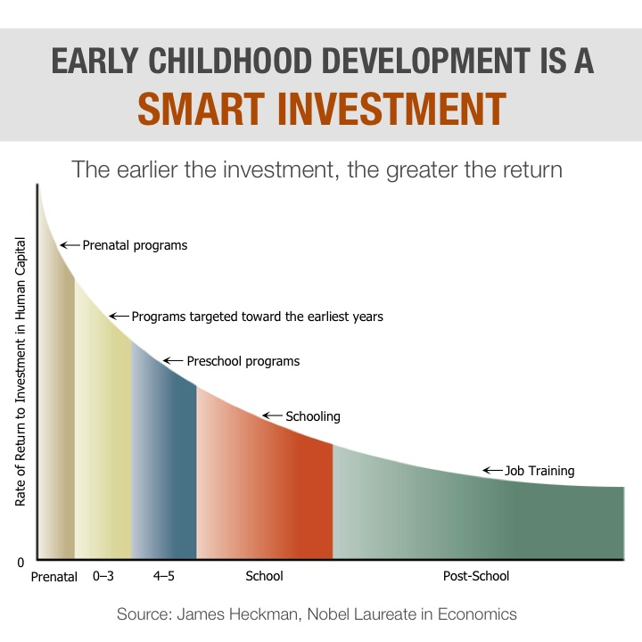

Slide 7
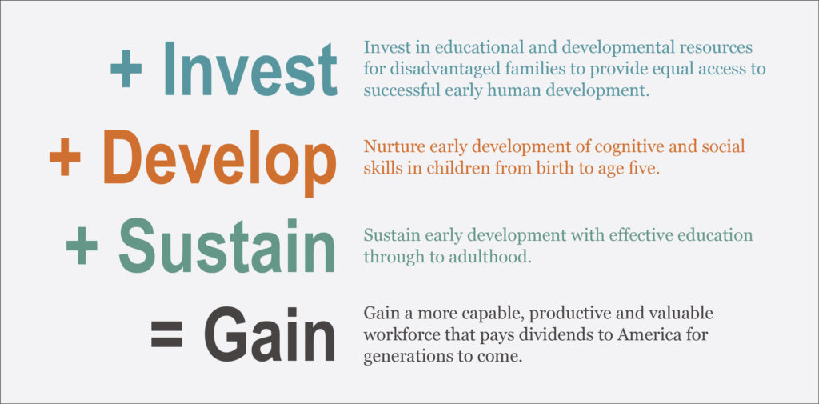
Dr. James Heckman’s Economics of Human Potential Equation

Slide 8
What Impact Has Afterschool Programming Had at Holmes Jr. High in Cedar Falls?
Students are engaged in learning and are receiving immediate intervention when not demonstrating proficiency in Essential Learning's.
Students who “get it” are drilling deeper into curricular interest areas through enrichment.
Attendance has improved and truancy is literally a non-factor.
Our data shows we rank 1st in Reading Comprehension scores, 2nd in Math scores and 2nd in Science scores with FRL proficiency when compared with schools our size in Iowa over a six year period.

Slide 9
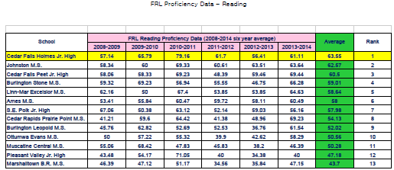

Slide 10
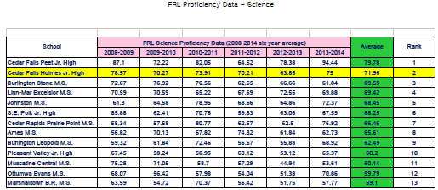

Slide 11
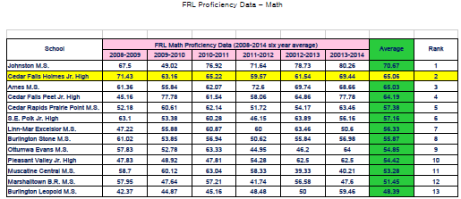

Slide 16
Student Behavior and D-F reports have improved with those students who attend Afterschool programming at Holmes Jr. High.

Slide 17
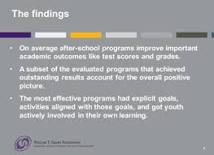

Slide 18
What Benefits can Camp Fire Heart of Iowa Bring to Your Building as Part of a Before and Afterschool Program?
We have an Administrative Staff in Place
We have a Payroll Staff in Place
We have Transportation Available
We will Recruit and Staff the Program
You just need Provide a Space for Programming!

Slide 19
We have been working hard at Camp Fire Heart of Iowa to investigate ways to promote a “culture” that supports a “community of learners” as we confront the changes we are faced with in education today.
Unfortunately, not all students experience school as a place in which they feel a sense of connection, support and safety…
We all do care about students, and want to express that care in ways that are meaningful. We want students to become connected through the people who care about them, and to feel connected by getting involved and being successful.
We invite you to collaborate with us to help make this happen by setting up a time to visit with us!
Our contact information is listed below and we look forward to hearing from you!

Slide 20
Contact Information:
David R. Welter
Recently Retired Principal – Cedar Falls, Iowa
Board Member Iowa After School Alliance
Cell: 319-404-5022
Email: david.welter14@gmail.com
Bob Reid
Executive Director – Camp Fire Heart of Iowa
5615 Hickman Road
Des Moines, Iowa 50310
Office: 515-274-1501
Email: bob@campfireiowa.org

