Slide 1
Family Engagement
9/24/2021

Slide 2
Defining Family Engagement
Family Engagement within the afterschool program setting
Definition = educational opportunities and activities for parents/caregivers and their families that will enhance the academic and social-emotional development of youth.
How do you define family engagement within your program(s)?
Lets take 5 minutes to write down & discuss the components from your own programs.
Activities
Participation
Feedback

Slide 3
Where does it start?
Family engagement starts with the first hello with the person who is dropping off or picking up a student and can set the tone for the entire year. \
Build relationships with the families
Start small and build up
Newsletters
Emails
Communication boards

Slide 4
Types of Family engagement
Family Nights – In person
Fall fest
Winter Carnival
Dinner & a Movie
Pumpkin Patch Trip
Hosting a dance
Grandparent or special family member night
Helpful hints to success
Always have food
Always have prizes
Make the event engaging
Find the right time that works for your families

Slide 5
Types of Activities
Themed Activities & Classes
Nutrition
Partnering with ISU Extension & Outreach on classes
Adult literacy
Local Libraries & Community Colleges
Parenting classes
Accessing resources- Title IX, SNAP, WIC
Law Enforcement

Slide 6
Take Home Family Engagement
Activities in a Bag
Most success
Meaningful
Families participate on their timeline
Pictures
Parents gave great feedback

Slide 7
Family nights in a bag
Topic | Curriculum Focus | Hand Out | Book | Supplies | Prize Requirements
Cooking | Math | Baking and Math Instructions | Super Good Baking for Kids (Duff Goldman) | Measuring cups, spoons and utensils, all ingredients for the cookies | Photo of children cooking to SS phone with name?
Tangrams | Math (Geometry) | Instructions | Grandfather Tang's Story (Dragonfly Books) by Ann Tompert | Classic Tangoes
Time | Math (Time) | Worksheet Instructions | A Second, a Minute, a Week with Days in It: A Book about Time (Math Is Categorical (R)) by Brian P. Cleary | Calendar | Return completed worksheet
Measurement | Math (Measurement) | Worksheet Instructions | Me and the Measure of Things by Joan Sweeney | Ruler, tape measure | Return completed worksheet
Construction | Math (Geometry) | Challenge? | Look at That Building!: A First Book of Structures (Exploring Our Community) by Scot Ritchie | Legos | Photo of children with completed challenge

Slide 8
Family Nights in a bag
Topic | Curriculum Focus | Hand Out | Book | Supplies | Prize Requirements
Cooking | Math | Baking and Math Instructions | Super Good Baking for Kids (Duff Goldman) | Measuring cups, spoons and utensils, all ingredients for the cookies | Photo of children cooking to SS phone with name?
Tangrams | Math (Geometry) | Instructions | Grandfather Tang's Story (Dragonfly Books) by Ann Tompert | Classic Tangoes
Time | Math (Time) | Worksheet Instructions | A Second, a Minute, a Week with Days in It: A Book about Time (Math Is Categorical (R)) by Brian P. Cleary | Calendar | Return completed worksheet
Measurement | Math (Measurement) | Worksheet Instructions | Me and the Measure of Things by Joan Sweeney | Ruler, tape measure | Return completed worksheet
Construction | Math (Geometry) | Challenge? | Look at That Building!: A First Book of Structures (Exploring Our Community) by Scot Ritchie | Legos | Photo of children with completed challenge

Slide 9
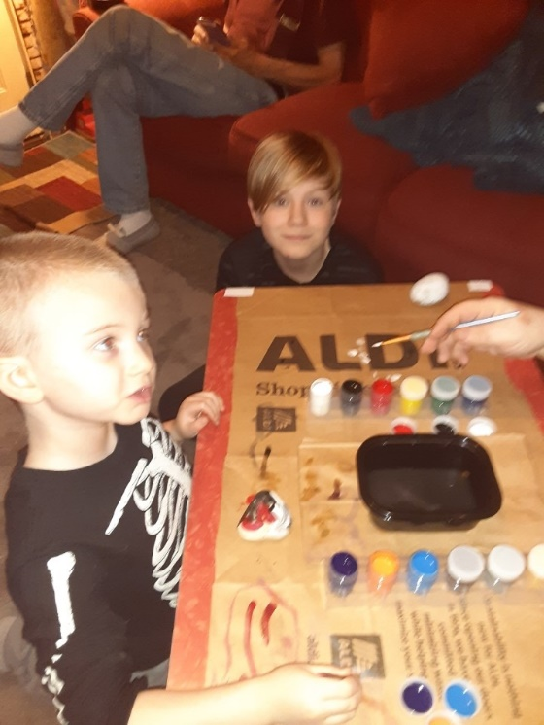
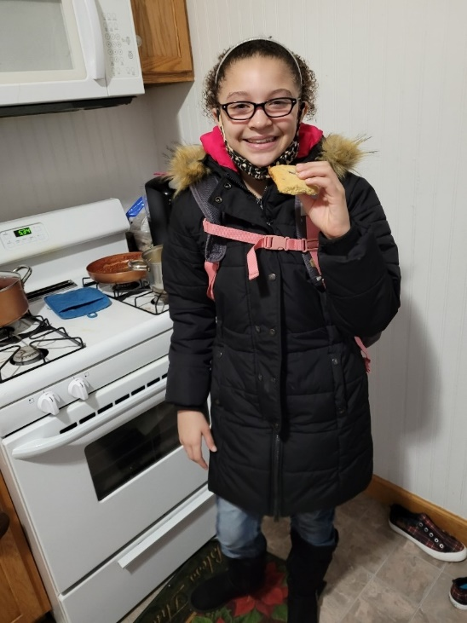
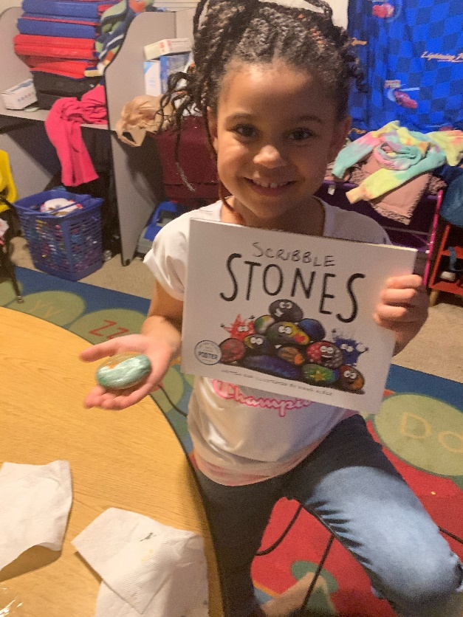
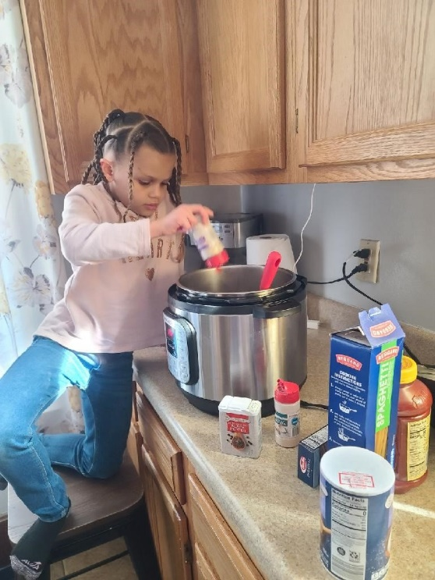
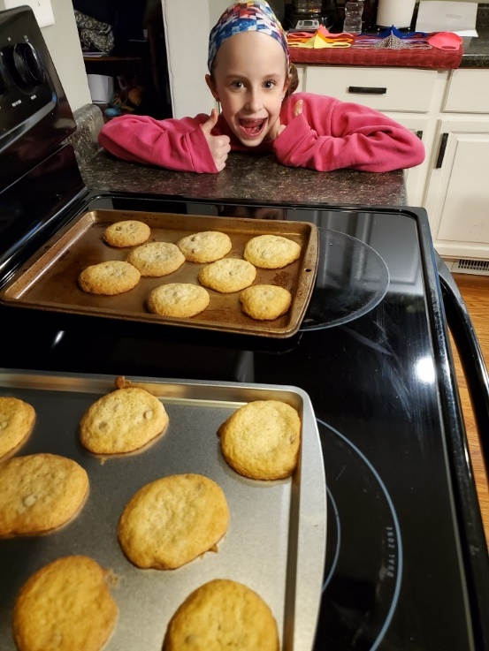

Slide 10
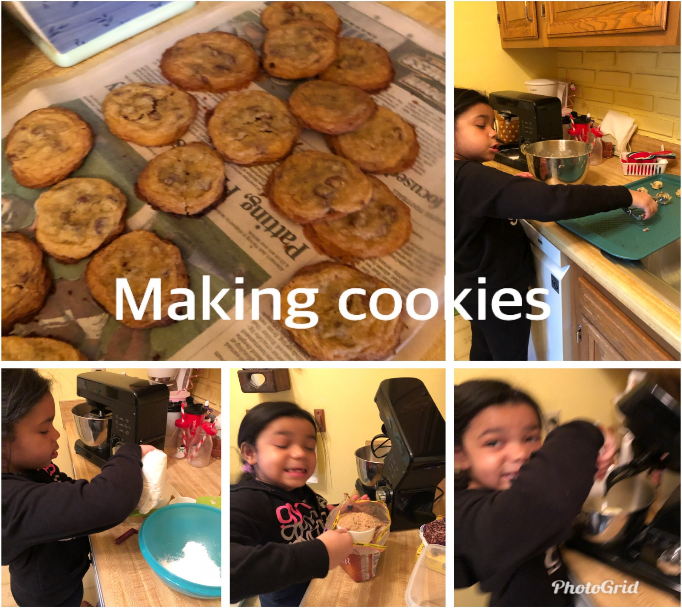

Slide 11
Challenges – table talk
Lets spend some time identifying challenges and talk about ways to overcome them:
Participation
Interest
Childcare
Time
Additional challenges ?

Slide 12
21-22 Davenport Plan
Plan at the 21st CCLC
Quarterly in person family night events- the in person events will be evaluated as each date gets close due to the COVID-19 pandemic
Monthly family night take home bags
What is your plan
Table discussion

Slide 13
Successes & failures
Each table work together for 5 minutes and discuss:
Successes
Failures
Share out

