Slide 1
LITERACY ENRICHMENT PROFESSIONAL DEVELOPMENT
Presented by
Theresa Slaughter, Literacy Enrichment Coach
October 7, 2021

Slide 2
AS YOU JOIN…
In the Chat Box tell us:
Name, Organization,
I am excited about…

Slide 3
HOUSE KEEPING
Encourage participation (camera, chat box, discussions)
Add your name (this makes it more personal and easier to interact)
Utilize the chat box (to connect with others or ask questions)
Need to step away momentarily? Use the toolbar to turn off video/sound

Slide 4
THINGS to KNOW
7 sessions – Oct-Apr on Thursday
-- session recordings
-- time to plan and implement
-- cumulative work pages
Check point (January)
In-between sessions
-- Coaching is available
Contact Information Theresa Slaughter, Literacy Enrichment Coach tslaughter.ost@gmail.com
21 CCLC/IAA Logistics Crystal Hall chall@sppg.com

Slide 5
AGENDA
-- Literacy Enrichment -- Best Practices
-- Table Discussions (4 Corners +1)
-- National Family Literacy Day
-- Literacy Activities

Slide 6
LITERACY ENRICHMENT
3rd year Literacy Enrichment implementation
The primary focus of these sessions is to build the capacity of program staff to support the learning and development of children and youth in OST programs. “The ultimate goal of literacy instruction is to build a student’s comprehension, writing skills, and overall skills in communication.” (Alber, 2014)
Main objectives:
Compliment your existing program along with fostering growth and development of staff
Develop and Reinforce youth literacy skills
Integration of Best Practices
Provide a platform for new ideas and Create opportunities to share

Slide 7
LITERACY DEFINED
The word “LITERACY” has evolved over time -- topic of discussion among researchers, practitioners, and educators
Literacy is the ability to read, write, and comprehend (speaking and listening) -- interaction with the world -- educational literacy – grasp concepts, explore subjects, communicate effectively
Literacy can be referred to the development of literate practices; therefore, allowing people to understand how meaning is made (language and text).

Slide 8
INTEGRATED BEST PRACTICES
Embedded Instruction -- planned and intentional learning opportunities that are inserted in everyday routines and activities; done in a way not to point out the obvious.
Differentiated Learning -- providing content and materials that embrace all levels of learning and styles (hands-on, discussion, writing/reading).
Content and Delivery -- being aware of content (grade/skill appropriate) -- style of delivery

Slide 9
4 corners + 1
List 3-5 things you would like to get from these PD sessions?
What are your thoughts/feelings/reflections on literacy? On integrated best practices?
What do you feel is your role in providing Literacy Enrichment?
To be successful in the area of Literacy Enrichment I and/or program need…..
(professional development, coaching, materials/supplies, etc.)
How much commitment do you feel will be required to plan, implement, and grow your literacy program? What would be some next steps in moving forward?
12 min
5-8 min

Slide 10
NATIONAL FAMILY LITERACY DAY
Passed by Congress in 1994 -- November 1
What is it? -- A day highlighting the importance of Literacy by encouraging families to read and/or do Literacy activities together. -- Most programs celebrate throughout the month providing Literacy activities that promote family participation
Examples: -- Read-athons -- Game night like Scrabble, Scattergories, Boggle, Trivial games -- sharing recipes -- Featured book(s) of the week
National Center for Family Learning (NCFL) https://www.familieslearning.org/blog/category/national-family-literacy-month

Slide 11
FEATURED BOOK(s) of the WEEK
(K-12) Who are the main characters in the story? (6-12) Why do you feel they are important to the story?
(K-12) What are 2 things that happened in the story? (6-12) What is the problem in the story?
(K-12) How does the story end? (6-12) How does the problem get resolved?

Slide 12
ACTIVITY – WRITING A STORY

Slide 13
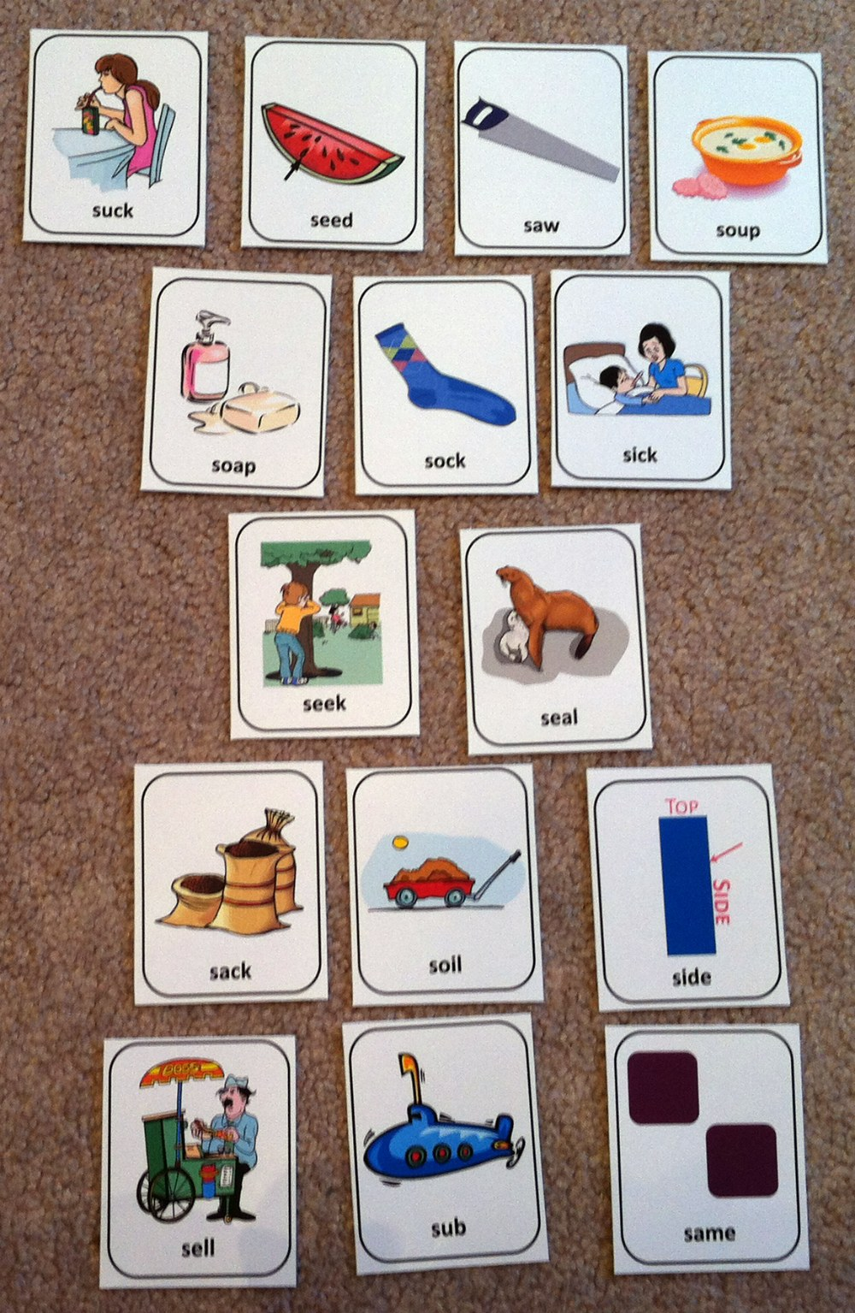
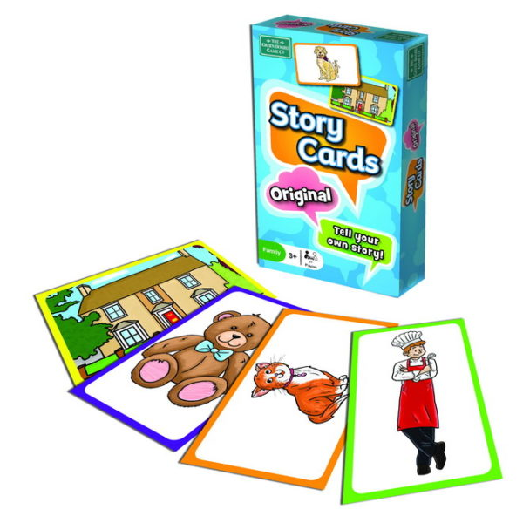
ACTIVITY – TELL A STORY
Instruct participants to pick 2 cards from the pile. Using the 2 cards, they will be telling a story. Allow a couple of minutes for participants to think of a story.
Select a starting point and that person will go first telling a story using their 2 cards. This continues around the room until everyone has a chance.
Additions - shuffle the cards then pass one out to each person in the group. Instruct kids that they will be telling a story as a group.

Slide 14
WORKS CITED
Alber, R. (January 2014). How important is teaching literacy in all content areas? Edutopia. https://www.edutopia.org/blog/literacy-instruction-across-curriculum-importance
Introduction to Literacy in English. (September 2021). Victoria (Australia) Education and Training. https://www.education.vic.gov.au/school/teachers/teachingresources/discipline/english/literacy/Pages/introduction-to-literacy-in-english.aspx
Robb, L. (n.d.). What is differentiated instruction? Scholastic. https://www.scholastic.com/teachers/articles/teaching-content/what-differentiated-instruction/
Weselby, C. (April 2021). What is differentiated instruction? Examples of how to differentiate instruction in the classroom. Resilient Educator. https://resilienteducator.com/classroom-resources/examples-of-differentiated-instruction/

